Slide 1
WELCOME!
Youth Prophecy Group
10:00am PST
#5
Contact:
youthprophecygroup@gmail.com
For notes, questions, updates, and recordings

Slide 2
November 10,2019
Meeting Five
We’re glad you’re here to share and discuss the Midnight Cry message.

Slide 3
The Fulfillment of
Daniel 11 and Pyrrhus
Lesson Five

Slide 4
Daniel 11

Slide 5
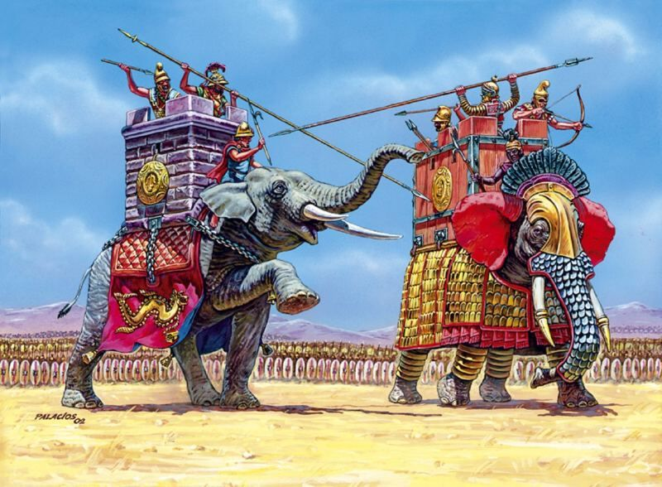
The battle of Raphia

Slide 6
11/9/2019
Midnight
1989
Midnight Cry
Sunday Law
Verse 10
Verses 11,12
Verse 15
Verse 16
Raphia
Panium

Slide 7
The Third Diadochi War

Slide 8
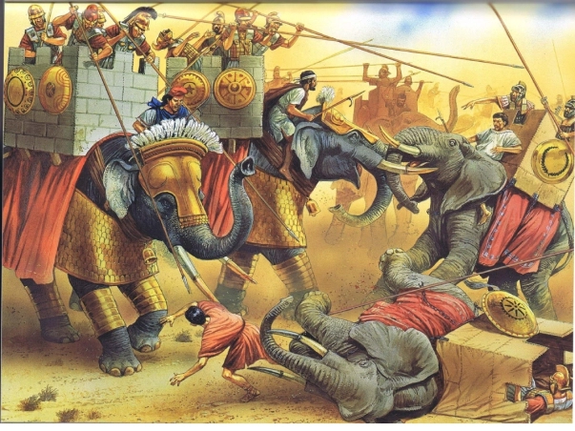
The battle of Gaza

Slide 9
11/9/2019
Midnight
1989
Midnight Cry
Sunday Law
316BC
The battle of Gabiene: Antigonus defeated Eumanes from the inside
312BC
The battle of Gaza: Ptolemy defeated Demetrius
311BC
“Peace of the Dynast”
309BC
The beginning of the Seleucid Dynasty

Slide 10
Pyrrhus in Macedonia

Slide 11
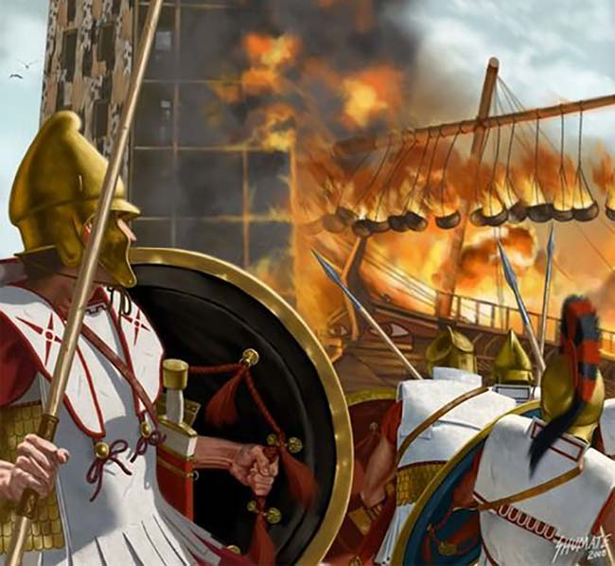
Demetrius ravages Epirus

Slide 12
11/9/2019
Midnight
1989
Midnight Cry
Sunday Law
307BC
Demetrius frees Athens from Cassander’s dictator
289BC
Demetrius invades and ravages Epirus
287BC
Pyrrhus joins the “allies” and he and Lysimachus defeat Demetrius
285BC
Lysimachus takes all from Pyrrhus except Epirus

Slide 13
The Pyrrhic War

Slide 14
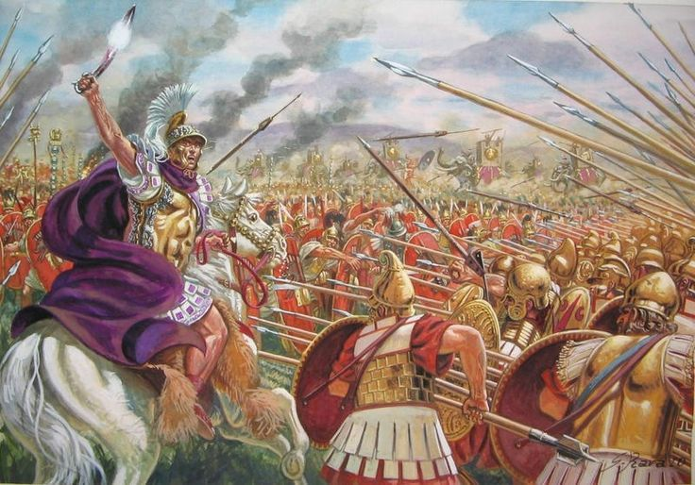
The battle of Asculum

Slide 15
11/9/2019
Midnight
1989
Midnight Cry
Sunday Law
273
285BC
Thurri appeals to Rome for help
279BC
The battle of Asculum: Pyrrhus wins the two day battle
275BC
The battle of Beneventum: Pyrrhus loses
273BC
Egypt sends ambassadors
To Rome
272BC
Pyrrhus dies, at the age of 46; Rome sends ambassadors to Egypt

Slide 17
Thank you for coming!
Contact us at:
youthprophecygroup@gmail.com
if you want notes, questions,updates or recordings.

