Slide 1
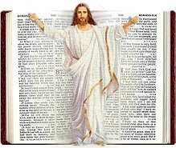
A Living Parable
Understanding Parable Teaching: The Natural and The Spiritual
https://youtu.be/TNnQNRTjmPc

Slide 2
Behind Every Word
Behind Every Word is a…?
Mind=heart=character=Himself
Is a thought.
We have come to understand that behind every form of communication there is a thought. The one communicating in however form he/she chooses is sharing their mind in the hopes that the one listening correctly understands him/her and becomes more familiar with the way he/she operates and views things from his/her perspective.
So, in understanding this point, we can see that through God communicating to us, He is allowing us entrance into His mind in order for us to know and understand Him and His ways from His perspective.
In order to understand the depths of His thoughts we use rules and parables. Parables provides us the additional information that we cannot see from the plain form of communication itself.

Slide 3
The Methodology to Understand Communication
What is the methodology that God is using to communicate to us and help us to understand Him?
William Miller’s 14 rules of Bible Interpretation
The line of progression
Line upon line/Repeat and Enlarge
And parables
Using the correct methodology and the rules properly will help us to have the right interpretation of what God is communicating to us.

Slide 4
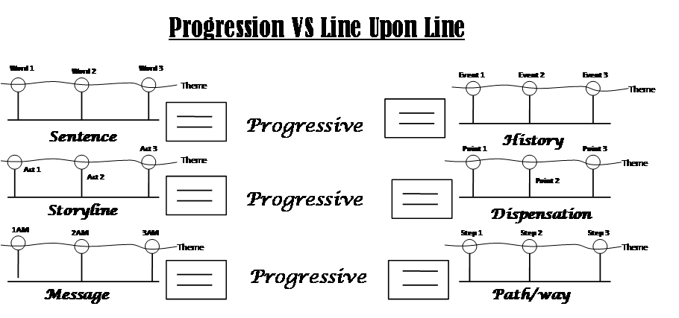
Line of Communication
What are some forms of communication?
Narratives/Books
Storylines/Movies
Words
Paragraphs
Essays/Articles
Characters/People
History
Providence
Numbers
** We can take any and every form of communication and place it on a line**

Slide 5
Wheels Within Wheels?
Every line of communication can be viewed as parable.
Note:
Point 1 is in and of itself a parable. It stands alone as its own point.
Point 1 comes before point 2. Point 1 leads to point 2. They are connected.
There couldn’t be a point 2 without point 1.
Therefore, the same applies to each period. Each period is and of itself a parable.
The entire line, from start to finish is a parable.
Parable
Parable
Parable
To the prophet the wheel within a wheel, the appearances of living creatures connected with them, all seemed intricate and unexplainable. But the hand of Infinite Wisdom is seen among the wheels, and perfect order is the result of its work. Every wheel works in perfect harmony with every other. {TM 213.3}
Wheel Within Wheels

Slide 6
Focusing In…
Chapt. 1
Chapt. 2
Chapt. 3
Chapt. 4
Book : Christ Object Lessons
¶ #1
¶ #2
¶ #3
¶ #4
Note:
Not every line can be cut. There are some subjects that can only be understood in progression.
Chapter 1: Teaching in Parables
WM rule #1: Every word needs to have its proper bearing. Bearing here means proper weight and direction. In other words, what is/are the most important word(s)? All else is viewed as noise.
Sentence #1
Sentence #2
Sentence #3
Sentence #4
Noise is irrelevant information. Though all words has it’s proper bearing and importance, not all is relevant. Depending on the study, some words bear more weight or have greater importance than others. So we need to be skilled at looking for the key words; highlighting them and thinking about all the other words as noise.
Paragraph #1
Word 1
Word 4
Word 8
Word 14
Sentence #1

Slide 7
Focusing In Cont’
Sentence #1
In Christ’s parable teaching the same principle is seen as in His own mission to the world.
Parable teaching the same as mission.
Parable: 1.) Teaching 2.) Mission
Noise
Teaching
Mission
In Christ’s
Parable
Principle
Is seen
In His own
Ellen G. White is comparing and contrasting two things: teaching and mission. Parable is connected to teaching. What does it mean when she says the same? It means that Parables is also connected to mission. Christ is doing parables at two levels.
To the world

Slide 8
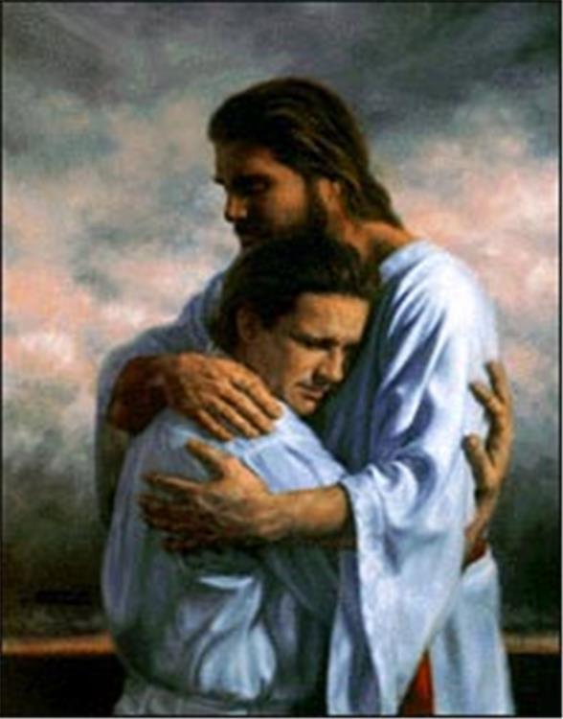
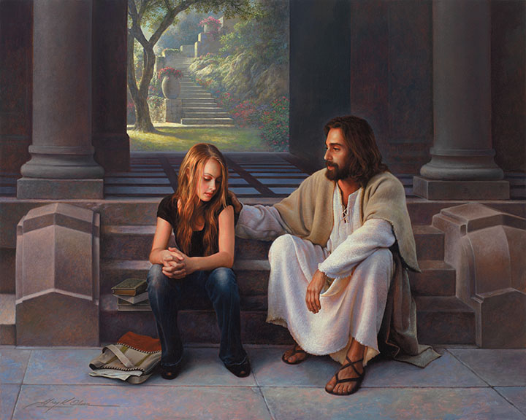
Two Important Words: Mission & Teaching
What is Christ’s mission?
To save His people.
How does He save them?
He saves them by comforting them—their pain.
Christ is the comforter. The Holy Spirit is also the comforter. How does the Holy Spirit bring us comfort?
He convicts us of sin; He teaches us to be righteous so He can prepare us for the judgment, which is the 3 step-testing process or the everlasting gospel. So we are given comfort through the gospel, which is grace if we want to say it simply.
How does Christ comfort us through the gospel?
He does this through His teachings (words) and mission (His life). His teaching is a parable and His mission is a parable.
Matthew 13:34 says, “All these things spake Jesus unto the multitude in parables; and without a parable spake He not unto them. He could not speak to them except in parables. Why?
They couldn’t understand Him otherwise.
To reiterate, Christ’s mission is the everlasting gospel.

Slide 9
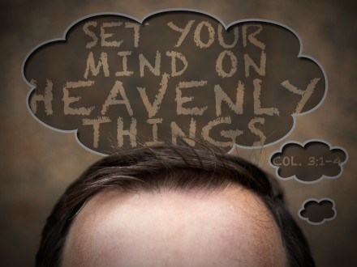
Understanding the Everlasting Gospel
Christ wants us not to live in this world. I don’t mean He wants us to move planets. For instance, here we are on earth and we think things. What does God want us to think about? earth or heaven?
Heaven
He wants us to be in heavenly places doesn’t He? Even though our bodies are here, He wants us to be heavenly minded. [So when you talk to someone, you would not talk to them as if you were on earth, but as if you were in heaven.]
Who would get irritated in heaven? None of us would. We would be scared to. We would be kind, generous, and respectful. If things were not going well in life, how do you think people would respond to those types of situations if they were in heaven? They would accept it. We don’t do that here on earth. We get irritated and upset.
[ With your mind on Heaven, it would change and influence the way you would speak and behave on Earth. Nothing on this earth would phase you or bother you. Though you’re here physically, your mind is not. It is focused on heavenly things.]
God wants us to think about heavenly places.

Slide 10
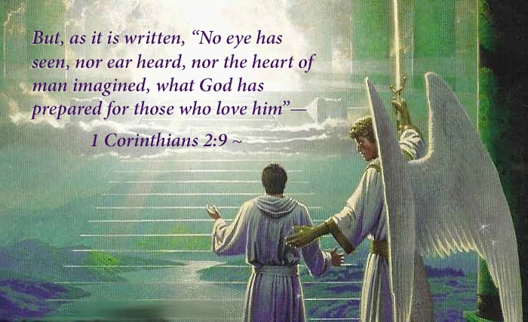
Understanding the Everlasting Gospel Cont’
Eye hath not seen. Ear hath not heard what it’s like in heaven. So how can you have thoughts about heaven when you don’t know what it’s like?
We can’t. We have no idea what heaven is like. So what God needs to do is explain heaven. How will God explain heaven to us? How will He explain something that we’ve never seen? He’s going to try to explain it to you using things that you already understand. So when God wants to teach us about heavenly places, He has to do it through the natural.
The way that He is going to teach us about the everlasting gospel and how it works, how it operates, by definition, it has to be done through parables.
If you want to learn about God, He’ll give you a lesson about a wicked judge and this woman who keeps on crying to him. What is He trying to teach us? That we should pray without ceasing. If it works for a wicked king, in contrast, how would it work for a good God?

Slide 11
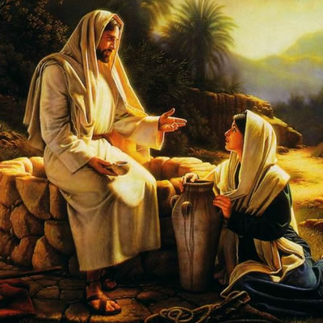
Principles Seen in His Teachings
There are some principles that are seen in His teaching. The principle that is seen in His teaching is parables—the natural and the spiritual. The same principle is seen in His mission or His life. What does that mean? It means that when you look at this man, when you experience Him, you see that His words are parables and His life is parables.
What does it mean that His life is a parable? Let me explain. Christ came down to earth 2,000 years ago and died for your sins. How do you know that happened? What factual information do you have that that really happened? What evidence do you have? It’s only the Bible you have. So you have to trust that. So there’s no good external secular evidence. No pictures, no government evidence, no birth certificate. Nothing. So, you just trust the word.
It’s only those people who were living at the time—those eye witnesses that it would have made a difference to where He died. But for all the rest of us, it would not make a difference to where He would have died.

Slide 12
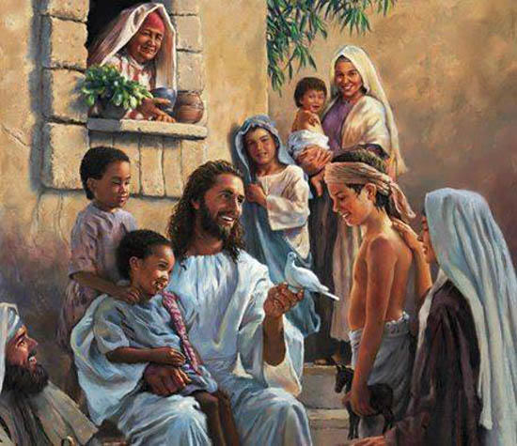
Christ: The Natural and the Spiritual
Now when Christ is in heaven, what kind of a being is He?
A spiritual being.
When Christ comes down to earth, what kind of being is He?
A natural being.
So can you see in His very life He is a parable? When He came down to earth, He wasn’t a human being like you and me. There were some differences.
When He came down to earth, He looks like us; He eats the same food; He has the same number of fingers. In fact, if you looked at Him, would you even know who He was? He wasn’t 7-foot tall or muscular. He doesn’t have a tattoo that says I’m Jesus. He doesn’t have some light glowing out of His head. You cannot tell the difference. So what’s the difference between Him and us? His heart is new. It’s glorious and beautiful! This heart is the spiritual and His body the natural. We don’t call it the spiritual and the natural. We call it the human and divine. Divinity and humanity combined.

Slide 13
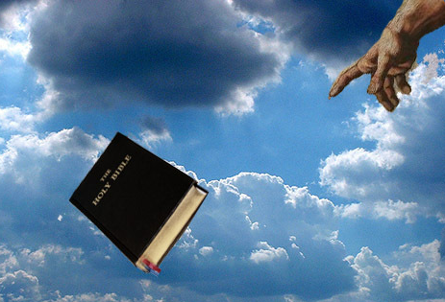
Christ: The Natural and the Spiritual Cont’
So if He wanted to explain to you about salvation—how it works—it’s not enough for Him to send a letter. He could have got this book—how to be saved book, called the Bible, thrown it out of heaven, and it land on earth to have as our instruction. We had the Bible long before we had Jesus.
The problem is that teaching is not enough. It’s not a complete revelation of how heaven looks. The sin problem is so deeply entrenched, the separation between heaven and earth is so big that sending a book from heaven is not enough. You can’t just teach about it, you have to live it. So He’s forced to come to earth. He doesn’t have a choice. He couldn’t die in heaven because we wouldn’t have much information to understand how heaven works. So he has to come to earth and not only teach in parables, but he has to be a parable.

Slide 14
Christ: The Natural and the Spiritual Cont’
When it comes to us, if I were to say, you’re a hypocrite, what would I be saying? You say one thing but you do another thing. You don’t practice what you preach. Your teaching is not in agreement with your life. This is what hypocrisy is, isn’t it?
For us to be holistic—complete—we need to sort two things out: the teaching and the life. It’s not enough to just tell people what to do, you have to show them how it’s done. This is why Christ was a parable in His words and His life. So, I want us to stop being hypocrites. Stop telling people to be good when you’re bad. Is this what that is showing? Not really. This is not a rebuke to tell you to stop teaching. I’m not saying to stop telling me to be good when you’re not good. What I want us to understand is that the very nature of the human being, if we desire to be in heavenly places, needs to follow the model that Christ had; which was the combination of humanity and divinity which by definition is a parable.
When you see His body, His tone of voice, His facial expressions; how he uses His muscles, what His hands are for, these are all parables that explain what’s on the inside—the spiritual. They explain what Heaven is like. If you want to know what Heaven is going to be like, look in the mirror, and if what you see you don’t like, you know there is a problem. This is what it means when His life is a parable.

Slide 15
The Nature of Christ
Parable
N
N
S
In the opening sentence of the opening chapter of Christ Object Lessons, Ellen G. White opens up one of the most profound truths on the nature of Christ that we need to understand. If we had approached the subject of the nature of Christ’s humanity (and therefore the nature of our humanity) through parables like Ellen White is telling us to, we wouldn’t have any arguments. We would understand what the human and divine nature of Christ was, how it works. When the Bible says it would come in the likeness of sinful flesh, we would know what that meant. Parables teach it easily. Christ came in the likeness of sinful flesh.
Outside
Outside
Outside
Inside
Inside
Inside
Human and Human
N
Human and Divine
S
Divine and Divine
S
What part of this human being is sinful? The humanity or the divinity? It’s humanity. It’s the human that’s sinful. Which is sinful the heart or body? The body is sinful. The heart as referred to as the mind is divine. is spiritual. If Christ mind was sinful, if he had a fallen nature, a sinful nature, what would this look like? Human and human. This is not a parable. So you know that the inner man of Christ must have been spiritual and divine.
Psalm 51 King James Version (KJV)
⁵ Behold, I was shapen in iniquity; and in sin did my mother conceive me.
⁶ Behold, thou desirest truth in the inward parts: and in the hidden part thou shalt make me to know wisdom.
⁷ Purge me with hyssop, and I shall be clean: wash me, and I shall be whiter than snow.

Slide 16
The Nature of Christ Cont’
Parable
N
N
S
The Bible says let this mind be in you which was also in Christ Jesus. When we were born we looked like human on the inside and human on the outside. The Bible wants to change our mind. It doesn’t want to change our bodies. He says change your mind because if our bodies change, people would come and worship us like we were gods. And that would be worship through fear or idolatry and God does not want that. So, He cannot change our bodies. That’s why we are defective and still have disease. This is because He cannot explain heaven if He made our bodies divine. Both models wont work—the human inside and out and the divine inside and out—because of the set principle of parables. God keeps these rules because He is One who lives what He thinks and practices what He teaches.
Outside
Outside
Outside
Inside
Inside
Inside
Human and Human
N
Human and Divine
S
Divine and Divine
S
The corruptible (old man in physical body) = Lower passions controlling the higher powers on earth—sinful condition.
The incorruptible (new man in physical body) = Lower passions succumbing to the higher powers on earth—sinless condition.
The overcomer (new man in glorified body) = Lower passions succumbing to the higher powers in heaven—sinless condition.
We are born human on the inside and human on the outside. In heaven, we will look like divinity on the inside and divinity on the outside. Neither of these are parables. In between them is where we should be today, human on the outside and divine on the inside. As Paul says, living epistles/books/letters is the condition we should live in today. What does it mean to be a living letter? It means a combination of the divine and the natural. On the outside we are human and on the inside we are divine—parable—this was the same condition that Jesus was in.

Slide 17
Focusing In #2…
Sentence #2
^[So]That we might become acquainted with His divine character and life, Christ took our nature and dwelt among us.
Note:
Reordered the sentence: Christ took our nature and dwelt among us [so] that we might become acquainted with His divine character and life.
In sentence two of paragraph #1 in the book Christ Object Lessons, Ellen White is going to do a repeat and enlarge. In the first sentence: Teaching; Life—all a parable.
What is another term for repeat and enlarge?
Line upon line. So, we can see that sentence 2 is building on sentence 1 by repeating the same point in different words.
Our nature become acquainted with His divine character and life
It begins with “that we”. We’re going to add a word, “so.” in front of that-- So that we might become acquainted with His divine character.

Slide 18
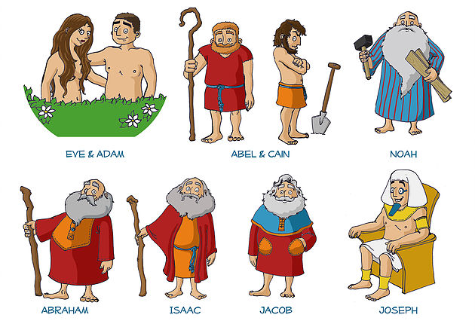
The Nature of Christ Cont’
In the first sentence, Ellen White, says Jesus is a parable whether He speaks or whether He just lives—just in being He is a parable. This is what God wants us to be today. We are also to be a parable. So we should be teaching in parables. Should we be talking to people about Jesus? Of course we should. What kind of Jesus should we be talking about? We should be talking about the parable man. The man that is hidden in shadows, in types, in allegories, or parables. You find this man everywhere in the Bible. His name might be Cyrus, Artaxerxes, Ahasueres. It could be many different people. Christ is found in many stories. It could be Boaz. [It could be you.]
When we start studying, we need to start studying In this approach. To start seeing things that are not that easy to see. This is not an easy task. Many of us are not experienced. We need to grow up and start becoming spiritually mature. That takes effort. If we’re not taxing our energies and our brain doesn’t hurt in the study of God’s word; and if we’re not confused and complexed, that should indicate that our studies are headed in the wrong direction. It’s in the direction of apostate Protestantism, which is cheap grace. The story of salvation that is not real. It’s like living in the model of human and human and thinking that you are going to understand heaven and get there. We will never do that.

Slide 19
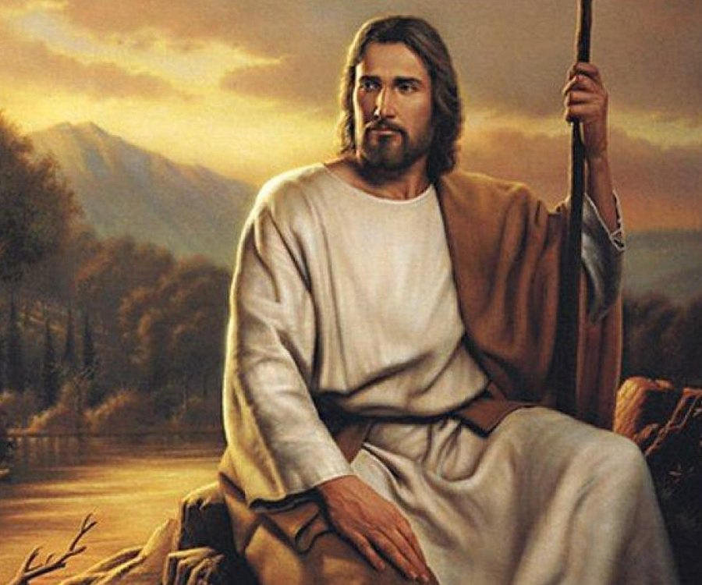
Jesus, a Parable
Is Jesus a parable in heaven today?
He is not all human nor is He all divine, but is a combination of the two. So by definition, he must be. He retained His humanity when He went to heaven. This is so because when we get to heaven, we will still have this humanity. Even though it will be glorified, it will still be human.
In the first sentence of the book Christ Object Lessons, it is going to be understood that parable is connected to both the teaching (word) and the mission (life). In other words, parable teaching is the same or equal to the parable life. The principle, which is parable, is seen in the life. Substitute the word principle for parable and you get the parable teaching is the parable life.

Slide 20
Focusing In #2… Cont’
Our nature become acquainted with His divine character and life
Noise
His divine Character and life.
Our nature
(Humanity)
His divine
(Divinity)
Christ took
Parable
us
and
dwelt among
[so] that
Acquainted means familiar. In order that we might become familiar with His divine life.
we might
What’s His divine life? His character. Divine life and character are the same.
.
Where is character? It’s not in your fingers or in your feet. Where is character? In your heart and mind
Remember: Mind=heart=character=Himself

Slide 21
Focusing In #2… Cont’
Human Body
So that we might understand what a divine mind is, what did Christ have to do? Christ took our nature and dwelt among us. If you take the words on their own, we begin to argue what nature did he take: The sinful or the sinless? Away with these arguments. They’re not good arguments. The picture tells you in order for us to understand HIs mind, what did He take? He took a human body. The nature that He refers to here is self-defining, which is rule # 5 of WM rules of Bible interpretation, which states the Bible needs to be its own expositor or own definer.
Divinity: Himself
When we start thinking about the nature of Christ, don’t guess, don’t go to some other Spirit Of Prophecy quote. Use the rules, principles, and laws; and the passage will tell you what the nature is.
Christ has to take the nature that we have on the outside. He could have never taken that nature on the inside. If Christ were the same on the inside like you and I, why would the Bible say “Let His mind be in you”? It’s because we could say it’s already there. He has nothing to offer me. [We would be left with no hope and no true salvation. ]

Slide 22
Focusing in the Rest of Paragraph #1
REST OF THE PARAGRAPH:
Divinity was revealed in humanity; the invisible glory in the visible human form. Men could learn of the unknown through the known; heavenly things were revealed through the earthly; God was made manifest in the likeness of men. So it was in Christ’s teaching: the unknown was illustrated by the known; divine truths by earthly things with which the people were most familiar.
What she does now. She is going to juxtaposition. Ellen White is talking about parables and she is structures the first paragraph using all of these rules: compare and contrast, juxtaposition, natural and spiritual, repeats and enlarges, talks about Jesus. Everything you need to know about parables is in this first paragraph.
Note:
Juxtapositioning is placing two elements, two objects, two words, two ideas, two concepts side by side for the purpose of developing comparisons and contrasts.

Slide 23
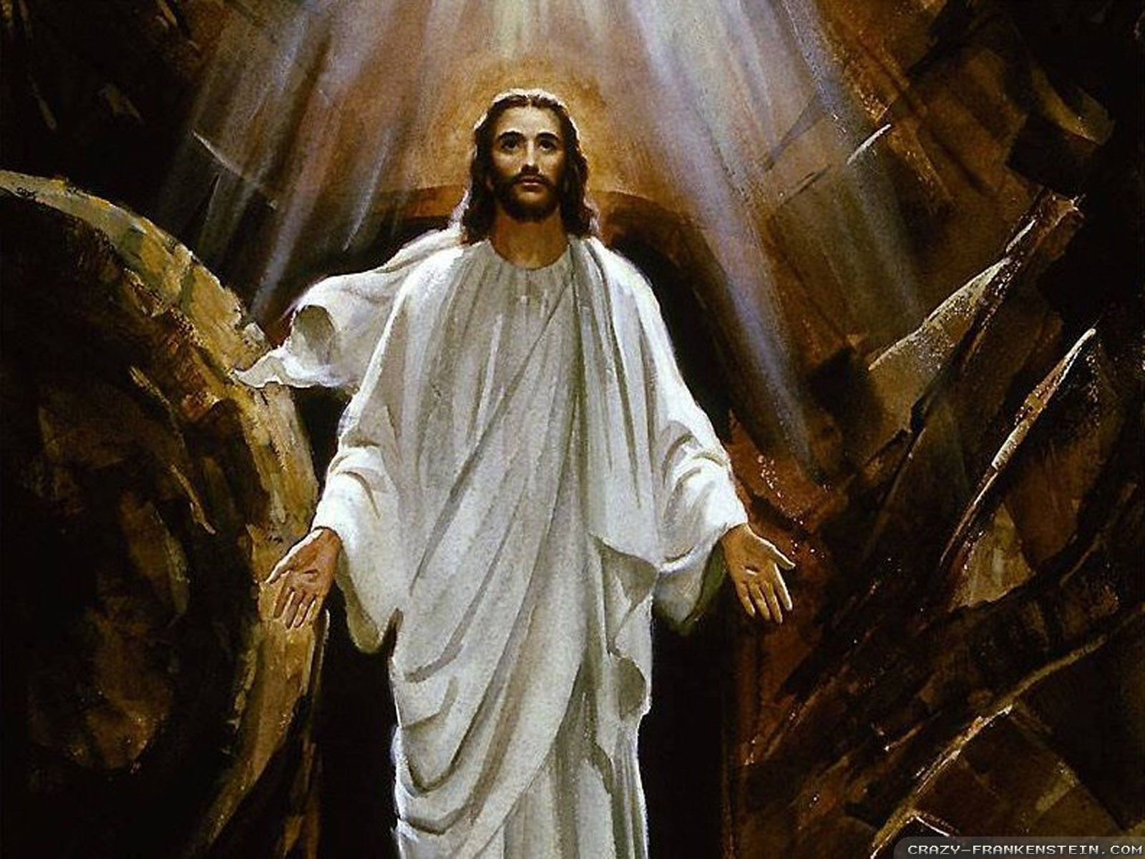
Focusing in the Rest of Paragraph #1 Cont’
So we’ve read the first paragraph. I’m just going to highlight the words—Divinity and humanity; invisible glory and the visible human form; let’s pause here and look at this one before we continue. Can you see my mind or my heart? No. The mind and heart is invisible. The condition of the invisible mind and heart is glory. The glory on the inside cannot be seen. The invisible glory is in the visible human form. The visible human form is the outside—the human body.
This is a repeat and enlarge of what the second sentence is teaching. We’re using the repeat and enlarge technique to see how she reinforces this point over and over again. We proved it in the first sentence; reinforced it in the second; and now in the third, it says straight, “divinity and humanity”.
Let’s continue, the unknown and known; heavenly things and earthly; God and man. How easy is it to explain the nature of Christ. This paragraph is not even dealing with the nature of Christ. This is an introductory paragraph on parables. And, we have done one of the most comprehensive studies on the nature of Christ.

Slide 24
Focusing in the Rest of Paragraph #1 Cont’
Side Note: It was impressed upon my mind a relation between a rib taken from Adam to create Eve and the new heart taken from Christ to create the new human.
When Ellen White says God was manifest, seen in the likeness of man, it means that God was seen in man. This human body that we have is full of sin. It’s sinful flesh. Divinity is not sinful. It is sinless. Christ was sinless in the inside. He was dwelling in a sinful body and that tension between the two produced the Messiah.
Adam and Eve
2nd Adam and 144K
If we want to experience the same, that is what God is offering us. To be His counterpart. That means to be the same. To be identical with Christ. That’s what we are supposed to be—copies of Christ. We do this by taking our human heart out—the one we were born with—and having heart surgery replace it with a divine heart. We have no power to do that work. Only Christ does. He is willing to offer us what He had. That is the gospel and it is all found through parables. A comprehensive, advance study on the nature of Christ and on the process of salvation is all unpackaged through parables. Divinity and humanity; invisible glory and the visible human form; the unknown and known; heavenly things and earthly things; God was manifested in the likeness of man. These five truths which all come together dealt with His life. In the last sentence of the first paragraph, it reads, “So it was in Christ teaching.” Christ teaching was the same as those five truths previously mentioned. Teaching referred to as the unknown and the known; divine truths by earthly things.” So she gives two for the parables. So Ellen White has gone through this repeat and enlarge seven times. When you unpack a passage, it teaches us many things.
1st surgery—Rib taken from Adam to create Eve
2nd surgery—Heart taken from Christ to create a new human—His church
Adam and Eve together are complete—one .
Christ and His church together are complete—one .
Rib signified that Eve was to stand by Adam’s side as equal, to be loved and protected by Him.
The new heart signifies revival—God give us a part of Himself. We become partakers of His mission/ character/life.

Slide 25
In Closing…
This is just an introductory passage to a big book. Can you imagine what truths are in the second paragraph; or In the third? The second chapter? It goes on and on. I want to inspire us. I want to encourage us to really study God’s word with zeal, with a desire, and with a belief that if we use the rules, He will give us in response great light. With great light, comes great happiness and joy. With great joy, we have the assurance that God is with us. And if God is with us, who can be against us?
Amen

