Slide 1
“In God We Trust”
Tess Lambert
the Alberta Prophecy School
Notes taken by Lana Segizbayeva

Slide 2
2520: Mene, Mene, Tekel, Upharsin
When we combined the line of Millerites with our line, we came to conclusion that 2014 is midway between 9/11 (April 19) and 11/9 2019 (Oct 22)
What brought us to 2019?
126 (from 1863)
151
Mene = 50,
Shekel = 1
Upharsin=25
2x Mene = 100
1 Tekel = 1 shekel
Upharsin = 25

Slide 3
National Reform Movement = M.A.G.A
“Early in 1863, the Civil War had not been going well for the North. Distressed over the terrible disaster his troops had suffered at Fredericksburg in December, General Ambrose Burnside had just stepped down as commander of the Army of the Potomac. Interpreting the Union defeats as a manifestation of divine wrath, clergymen representing 11 Protestant denominations met at Xenia, Ohio, on February 4, 1863, seeking ways to appease an angry God. This meeting led to the formation of the National Reform Association.” WEGW 120.1
They see the defeat of the Republican side as a manifestation of God’s wrath,
They seek ways to appease God’s anger and meet in Ohio and form National Reform Association
Why was God angry with the U.S. according to the NRA?
Failure of the Government to acknowledge the lordship of Jesus Christ and to enforce His moral law.
Even after the war was over and the North had won they retained this conviction that Jehovah was displeased with America.
National Reform Accociation continued to warn for at least the next 3 decades that the divine judgement threatens the U.S. (all through the 1890s our pioneers were fighting this ideology)
Democrats winning, Rep. in panick
Call by Relig. Org & Prot churches for relig. Inscription on currency due to National Crisis
They believe the nation is under the judgement of God
The phrase is decided:
In God We Trust
February, 1863, there was begun an organized movement by a religious combination, composed of the "evangelical" churches of the country, to get the government of the United States committed by direct legislation to a recognition of "the Christian religion," and a national adoption and enforcement of Sunday as "the Christian Sabbath," or Lord's day. They proposed first to accomplish their purpose by an amendment to the national Constitution, declaring this to be a "Christian nation," and "so placing all Christian laws, institutions, and usages upon an undeniable legal basis in the fundamental law of the land.“
“National Reform Movement”
1864 it becomes official & stamped
Act of Congress places it on all new coins
This is the movement fought by AT Jones and our pioneers

Slide 4
Two Streams of Information: Both see the Civil War as the Judgement of God, but different conclusions
Hiddekel:
They perceived the defeat of the Union as a manifestation of God’s anger
So they were to appease an angry God
Ulai:
Ellen White:
The U.S. is judged for slavery
God is particularly angry with who?
His anger burns against this nation especially against the religious bodies who sanction slavery – Protestant churches. Same one bringing the NRA.
They don’t realize that THEY are the reason this nation is being judged.
They think it’s all the immoral people, atheists, etc

Slide 5
Two Streams of Information: Both see the Civil War as the Judgement of God, but different conclusions
What does Lincon introduce in the Pledge of Allegiance?
“One Nattion Under God”
Battle of Gettysburg: The tide turns, Republicans start winning, and Lincoln introduces “One Nation Under God” in the pledge of allegiance

Slide 6
Two Streams of Information: Both see the Civil War as the Judgement of God, but different conclusions
What is 1861 on our reform line?
9/11 (April 19)
So what is 1863 on our line?
Midway/ midpoint of the Civil War = Midway/Midpoint between tarrying of the bridegroom and the shut door.
What is 1865 on our line?
2019
Battle of Gettysburg: The tide turns, Republicans start winning, and Lincoln introduces “One Nation Under God” in the pledge of allegiance

Slide 7
Two Streams of Information: Both see the Civil War as the Judgement of God, but different conclusions
What is 1861 on our reform line?
9/11 (April 19)
So what is 1863 on our line?
Midway/ midpoint of the Civil War = Midway/Midpoint between tarrying of the bridegroom and the shut door.
What is 1865 on our line?
2019
If we consider 151 (subtract 151 from 2019) we get 1868.
What is the issue in 1868? – 14 and 15th amendments that gave rights to freed slaves.
But what did they introduce in the 14th and 15th amendments?
Male pronouns. By so doing they made sure that women do not get the right to vote. This is the beginning of the women’s suffrage movement
“For the 1st time the constitution asserted than men not the women had the right to vote. Previously only the state laws restricted the voting rights to men”
Side note (not related to this story): 1868 1st case of impeachment of a U.S. president
A. Lincoln had died, and on whose side was this new president? – South. The president is favoring the South and seeks to restrict the freedom of slaves.
Battle of Gettysburg: The tide turns, Republicans start winning, and Lincoln introduces “One Nation Under God” in the pledge of allegiance

Slide 8
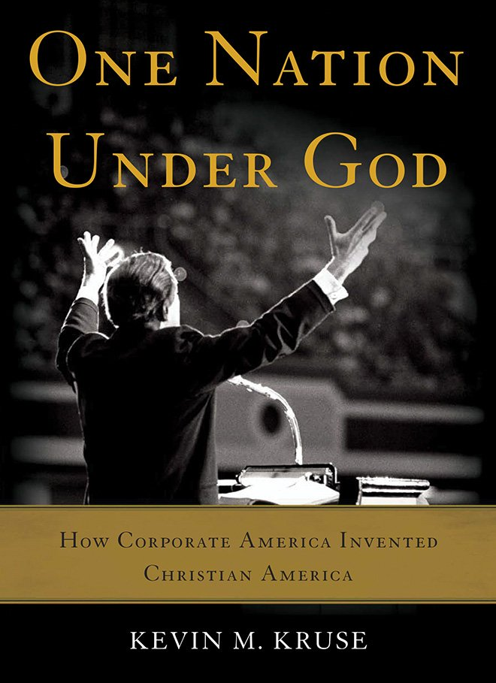
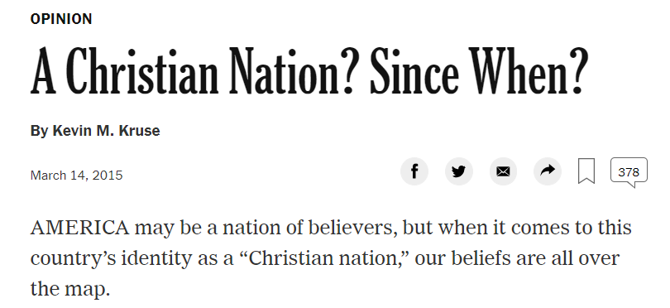
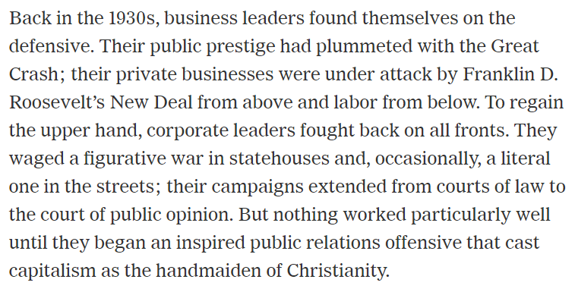
If we go back 63 years from 2019 where does it bring us? 1951. → 1951 is midpoint.
The NYT article (left) shows how the concept that the U.S. is a Christian Nation has been introduced slowly and methodically over time.
The author shows how it begins in 1930s:

Slide 9
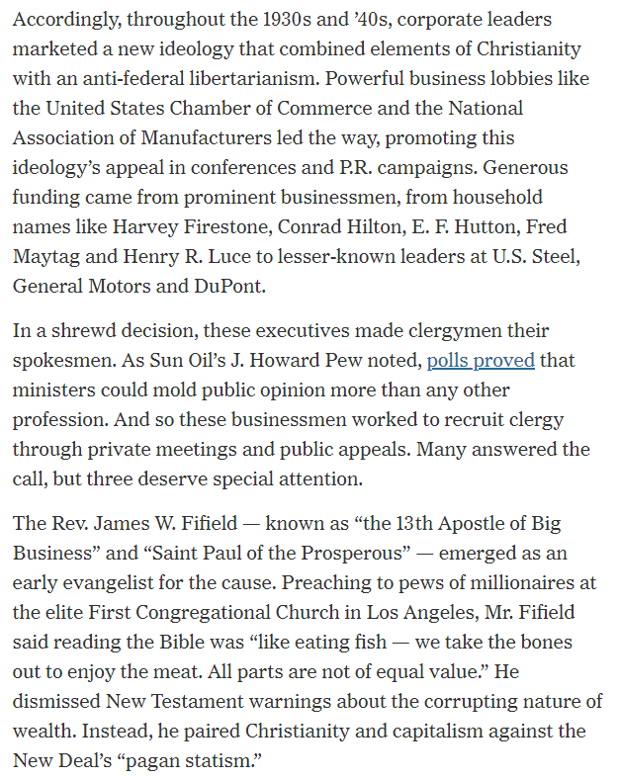
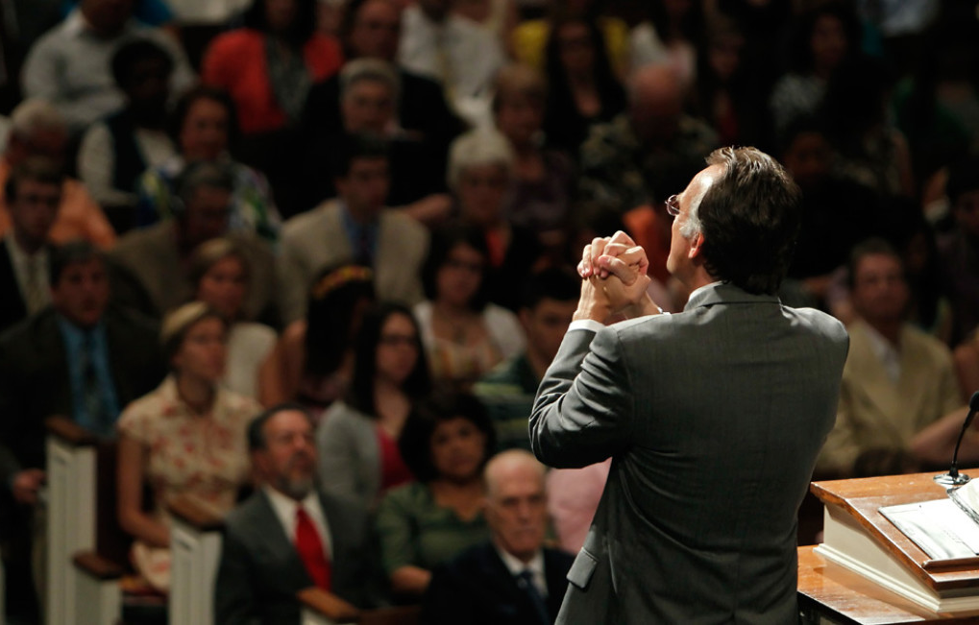
If we go back 63 years from 2019 where does it bring us? 1951. → 1951 is midpoint.

Slide 10
The business leaders of 30s employed powerful CLERGYMEN to speak on behalf of business lobbies

Slide 11
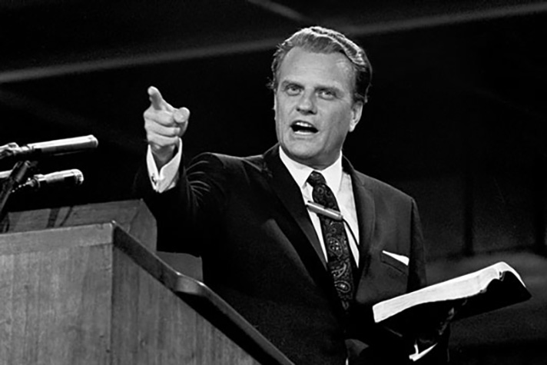
The business leaders of 30s employed powerful CLERGYMEN to speak on behalf of business lobbies

Slide 12
The business leaders of 30s employed powerful CLERGYMEN to speak on behalf of business lobbies
Coming out of the great depression and Roosevelt’s New Deal the business leaders are losing power. So they connect their version of capitalism with Christianity.
This leads up to 1950.
In 1950 – we have a National crisis.
After the Great Depression and World War II people become terrified of socialism.

Slide 13
The Fear of Socialism timeline summary
In the history of Civil War people are terrified of “all those godless wicked slaveholding southerners, and immoral people”. The victory of the Civil war reinforced their idea that God was on their side.
In the history of the beginning of the Cold War the protestant churches are blaming again on atheists, communists, socialists, and see the need to enforce the moral law. They are holding on to the same ideology that they had in Civil war period
In the history of 9/11 the protestant churches again blame on immorality, atheists and again see need to enforce moral law

Slide 14
The Fear of Socialism timeline summary
In 1948 Louis Bowman, an attorney from Illinois suggests to the National Society of the Daughters of the American Revolution that they introduced the phrase “Under God” into their pledge of allegiance.
Soon after the phrase also was adopted by the Society of the Sons and Daughters of the American Revolution
In 1951 the catholic organization Knights of Columbus incorporated the phrase into their pledge of allegiance.
Adoption of “Under God” similar to gradual acceptance of “In God We Trust” in the history of Civil War.
“Under God” in Soc Of Son&Daughters of Am. Rev
Knights of Columbus adopted “Under God”
George Dougherty delivers sermon “New Birth of Freedom” claiming that the U.S. pledge of allegiance is missing “Under God”
President Eisenhauer in audience.

Slide 15
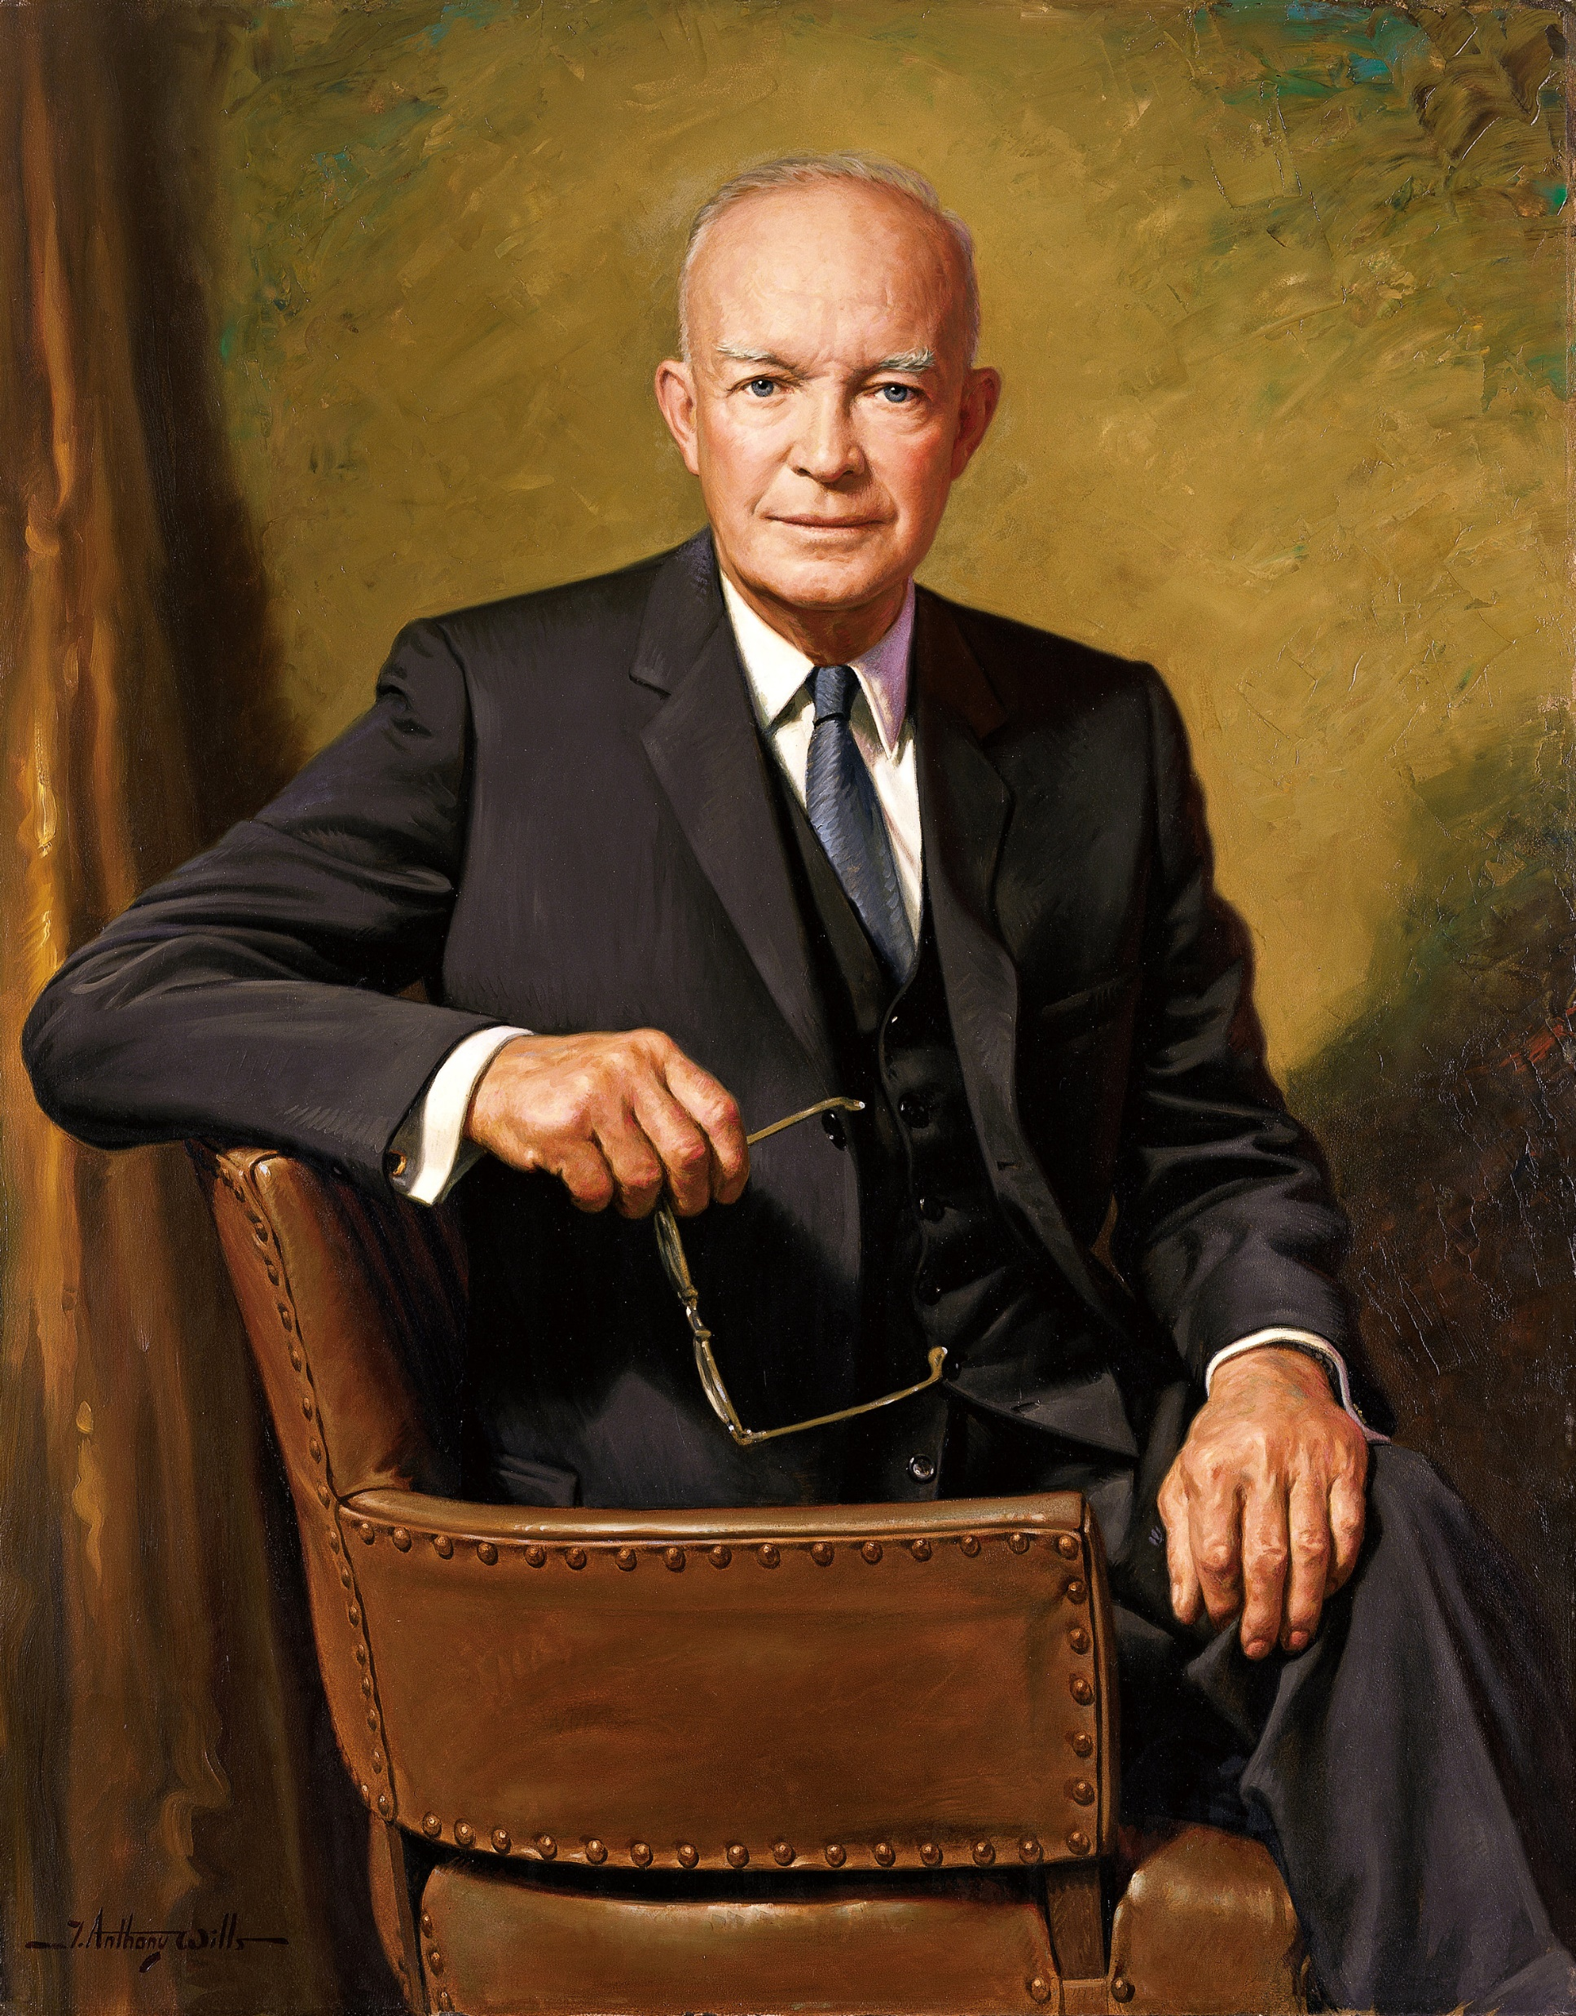
The Fear of Socialism timeline summary
The very next day in Feb of 1954 a bill was introduced into Congress. The Congress passed the necessary resolution and Eisenhauer signed the bill into law:
"From this day forward, the millions of our school children will daily proclaim in every city and town, every village and rural school house, the dedication of our nation and our people to the Almighty. To anyone who truly loves America, nothing could be more inspiring than to contemplate this rededication of our youth, on each school morning, to our country's true meaning. In this way we are reaffirming the transcendence of religious faith in America's heritage and future; in this way we shall constantly strengthen those spiritual weapons which forever will be our country's most powerful resource, in peace or in war.“
- Statement by the President Upon Signing Bill to Include the Words "Under God" in the Pledge to the Flag, June 14, 1954
“Under God” in Soc Of Son&Daughters of Am. Rev
Knights of Columbus adopted “Under God”
George Dougherty delivers sermon “New Birth of Freedom” claiming that the U.S. pledge of allegiance is missing “Under God”
President Eisenhauer in audience.

Slide 16
Christian Nation? Since when?
In the history of the Civil War there is a call to come up with a phrase to acknowledge God in the government→ “In God We Trust” formed in 1863, stamped and made official in 1865
In this history it’s a call to add “Under God” in the pledge of allegiance
The Things that seems so normal about Christianity in America are not that old. It was never meant to be that way from the start.

Slide 17
The insertion of the phrase was a pushback against the Russian atheistic communism during the Cold War.
Driven by fear of annihilation from atheistic Russia the phrase “In God We Trust” was made into official motto of the U.S.
What was the motto before the “In God We Trust”?
E Pluribus Unum – Out of Many, One
It is a beautiful motto!
Many states, - one nation.
Couldn’t we say many religions, many cultures, - one people? Black, white, female, male, Protestants, Muslim, Jewish, ect?
E Pluribus Unum is a perfect motto, but they rejected it

Slide 18
9/11 Era
On 9/11 Islam strikes, and how does the protestant America respond?
“in post-9/11 America, evangelical preachers gleefully whipped up the flames of Islamophobia, and blamed the attack on America’s decadent acceptance of feminism and homosexuality. In the aftermath of the 2008 financial crisis, a renewed call to the prosperity gospel, which held that God would deliver personal riches to those who showed their faith through tithing and confession. This doctrine was preached beneath the same roofs whose holy texts taught that Jesus once scattered the merchants and money changers from the temple in anger. And when given the option to defect or abstain from the Republican party when it nominated Donald Trump—who not only displayed none of the ethical qualifications necessary to lead the country, but was himself accused by multiple women of sexual assault—evangelicals chose to vote for Trump and hew themselves to perhaps the most immoral presidency since Woodrow Wilson’s segregationist government.”

Slide 19
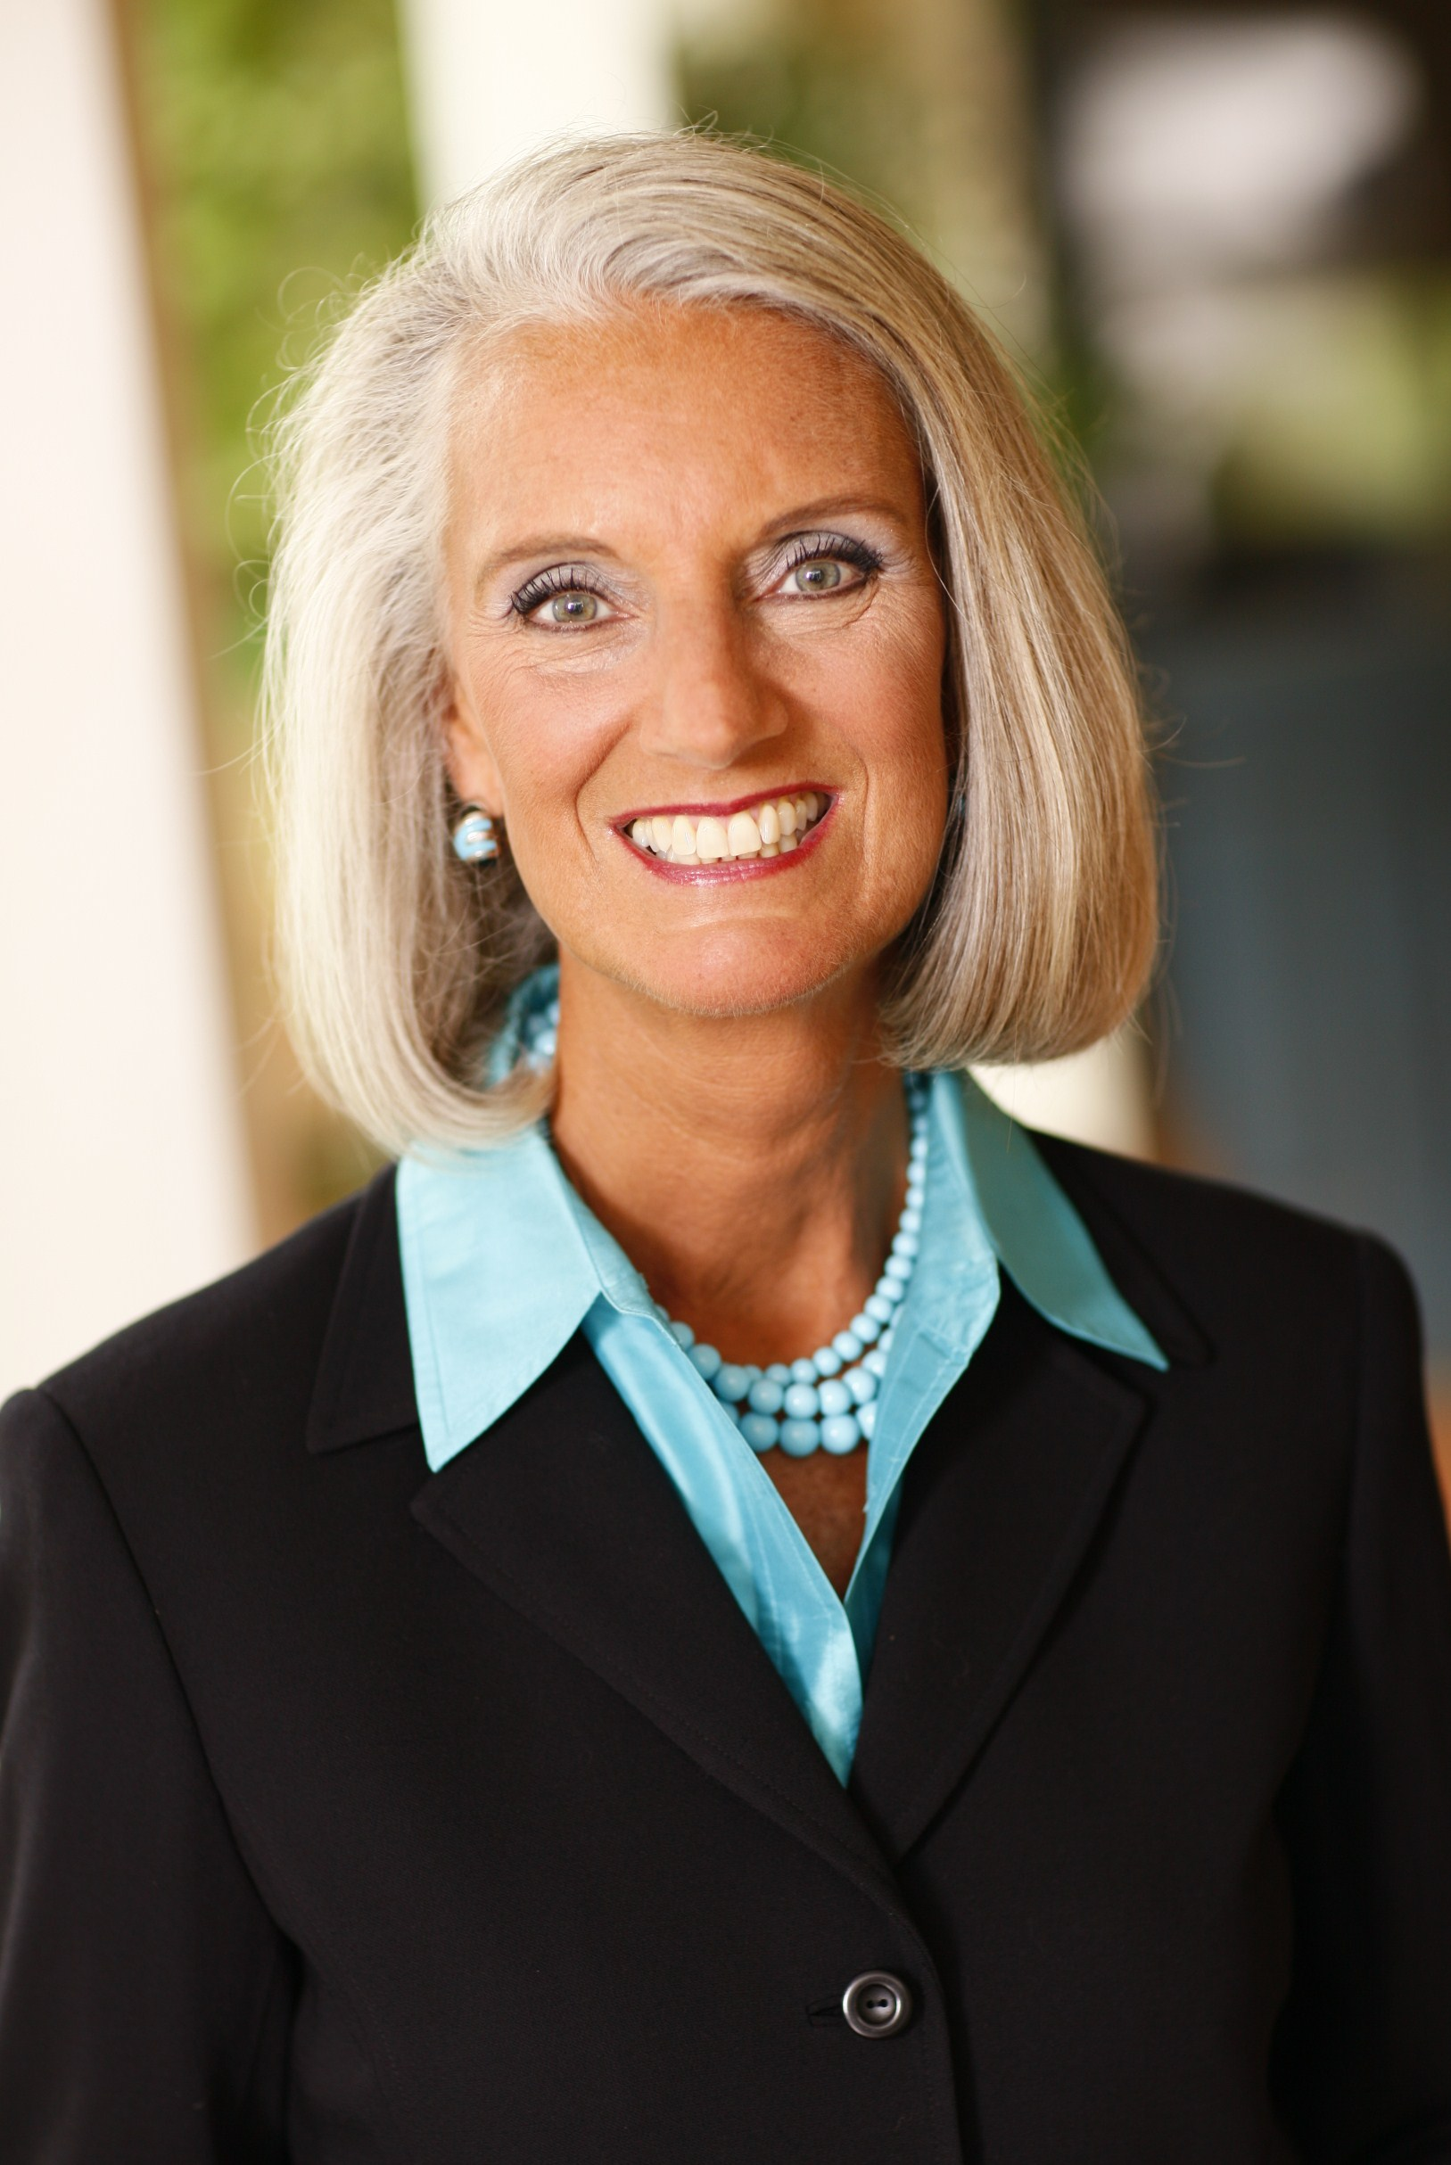
9/11 Era
Anna Graham Lotz (daughter of Billy Graham):

Slide 20
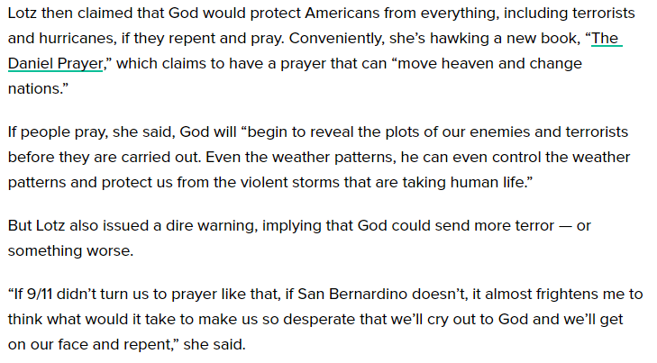
9/11 Era

Slide 21
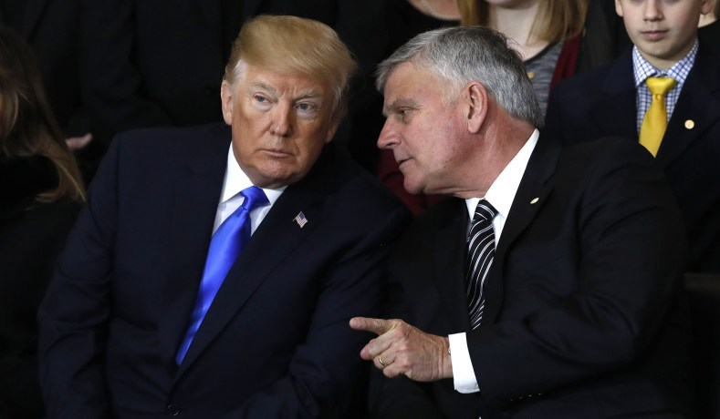
“9/11 is punishment for immorality, gays, transgenders, and for exclusion of God from politics”
Her brother Franklin Graham, founder of the charity “Samaritan’s Purse” accused Barack Obama of spreading immorality, while praising Vladimir Putin of instituting a ban on gay propaganda.
This is the problem with the religious right: their hero is Vladimir Putin. They think that he is so moral!
IF you have read the writing of A.T. Jones what right does the U.S. politics have to include God?
NO right! But this is who the protestants are blaming for 9/11

Slide 22
Two streams of information
In each of these histories protestant churches of the U.S. always blame the God’ judgement on secularization of the society, immorality, gays, lesbians, exclusion of God from political arena.
In each of these stories there are two streams of information that are influencing the people.
In each of these histories protestant America’s solution is in enforcing morality.
In the history of 9/11 they have exact same stream of information.

Slide 23
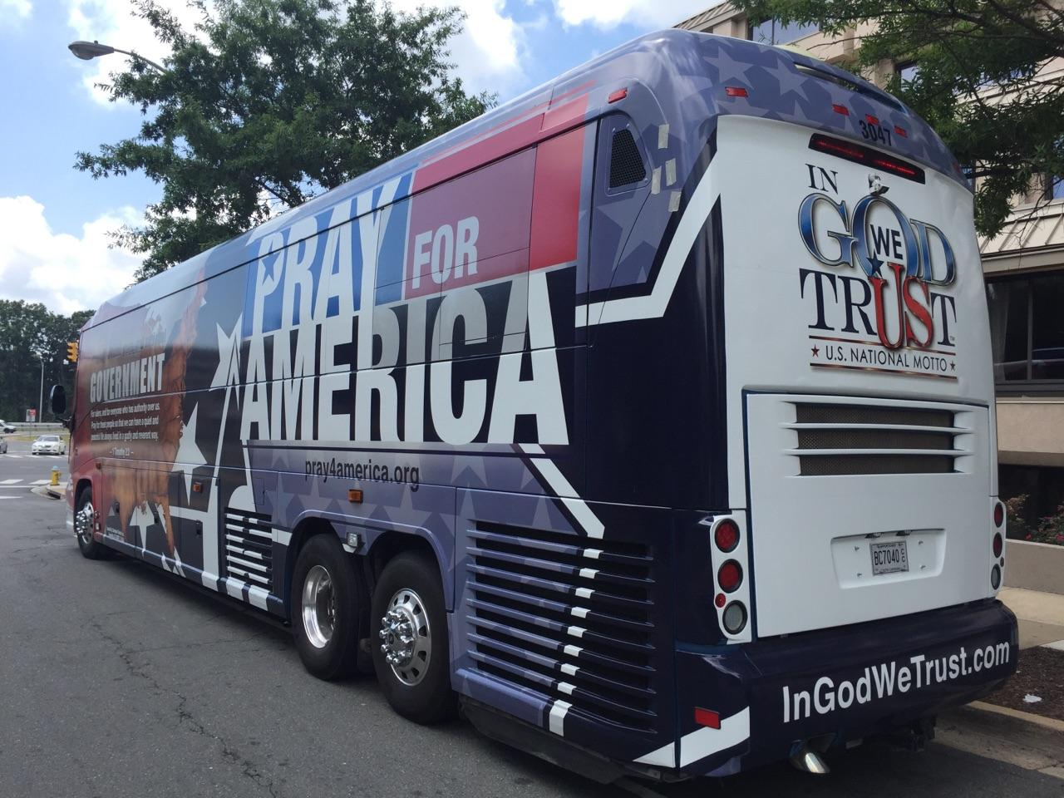
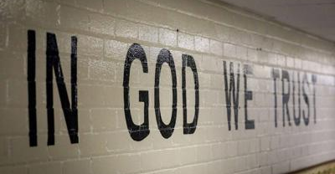
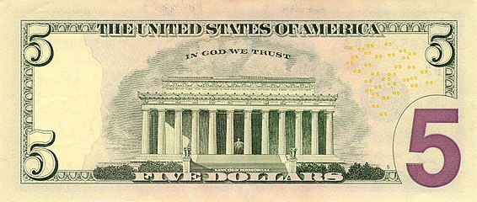
Two streams of information
This kind of ideology hasn’t stopped, and it continued through the cyclone that hit New Orleans.
In New Orleans they blamed God’s judgement on gay pride march and some in this movement taught the same thing.
Interesting that when the cyclone hits Florida, they go quiet, - suddenly it doesn’t work anymore.
In the aftermath of the hurricane Harvey evangelical leaders blamed LGBT community
How did Obama treat the phrase? – He picks E Pluribus Unum, thus asserting the separation of Church and State
In 2001 prior to 9/11 the new law issued in Mississippi requiring to place the inscription “In God We trust” in public places, on buses, walls, etc.
9/11 gave this law a powerful leverage.

Slide 24
Obama: “E Pluribus Unum”
Consider this: Prior to 2014 which side is winning?
Democrats
Is the nation on course or off course? – It is on course under Obama.
Why? Which motto did we say that Obama stated in 2010?
E Pluribus Unum. He gets attacked by the churches for this.
When reciting the pledge of allegiance did he include the phrase “Under God”?
No, he would not include “Under God” – supporting the separation of church and state.
Evangelicals see that they are losing their war under Obama.
Ship on course Ship off course

Slide 25
Other events of 2014
Steve Bannon at the conference in Vatican:
"We're at the very beginning stages of a very brutal and bloody conflict, of which, if the people in this room, the people in the church, do not bind together and really form what I feel is an aspect of the church militant, to really be able to not just stand with our beliefs, but to fight for our beliefs against this new barbarity that's starting.“
What does he mean?
We are too secular. We need to get back to our Christian roots. In his speech Bannon articulated a view of the world as a constant conflict between capitalist Jewish-Christian West and godless socialism communism, Islam etc.
Conservatism – to conserve – to protect Judeo-Christian culture and values.
Some of the important events that happened in 2014:
Steve Bannon meets cardinal Burke at Vatican
Cambridge Analytica
Republican donors start to fund his work

Slide 26
Other events of 2014
Another important movement that started in 2014 – Make America Great Again
Make America Great Again equivalent to which other movement in the history?
National Reform Movement
National = Nationalism
Reform = Make Great Again
This M.A.G.A. movement is the same movement from the history of the Civil War.
They have the same agenda: both see the U.S. as being under judgement, both want to reform it, to turn it around into something that they think it was before.
Are they right in what they think it was before?
No. They have a wrong concept of what the nation was created to be. It is nationalistic at its core.
Some of the important events that happened in 2014:
Steve Bannon meets cardinal Burke at Vatican
Cambridge Analytica
Republican donors start to fund his work

Slide 27
Congressional Prayer Caucus Foundation Leader: Church-State Separation ‘The Death Knell For Our Nation’

Slide 28
What does A.T. Jones have to say about this?
…when the Papacy was formed and the power of the empire was seized upon by the professed Christian Church, just as these people are now trying to do to “protect” the day and the things “generally considered holy,” there was again introduced the spirit of persecution and the principles which produced the Dark Ages and the fearful despotism that ruled in those ages.
So what gave rise to papacy? – desire to protect that which is holy.
And when the Reformation came, again holding before the world the true ideas of holiness and of holy things as announced by Jesus Christ, the persecutions which were inflicted upon those who chose to disregard the governmental idea of holiness and holy things, outdid by far the persecutions which pagan Rome had inflicted at the first upon those who chose to decide for themselves before God what was required of them in the matter of holiness and holy things. And our fathers who framed this new Nation, seeing the long course of oppression marked by a steady stream of blood in the attempts of government to protect things and institutions generally considered holy, decided that this Government should be cursed with any such thing, and therefore declared that “no religious test shall ever be required as qualification to any office of public trust under this Government;” and that “Congress shall make no law respecting an establishment of religion or prohibiting the free exercise thereof,” and so they rightly decided to leave holy things to themselves and to protect themselves.
In fact this is all any government, can rightly do. No government can really protect anything that is really holy. If it be indeed holy, whatever connection the government has with it will just as certainly make it unholy to the extent that this connection is recognized by anybody. If a thing be really holy, it is fully able to support its own character of holiness, and to secure respect for itself as such. If it is not really holy, then it ought not to be protected at all, for the sooner the falsehood is exposed and the unholy thing destroyed, the better for all concerned. The government can not protect a thing that is really holy, and to protect a thing that is unholy is to compel men to unholiness, to sin, and thus to make them worse than they could possibly be otherwise.
“Right is not decided by majorities, even though the majority be right.”
Yet how fast this wicked principle of majority rule in matters of religion and the conscience, is growing.
But this question “is not a question of majorities or minorities, for if the conscience of the majority is to be the standard, then there is no such thing as right of conscience at all. It is against the predominance and power of majorities that the rights of conscience are protected, and have need to be.” And those who call themselves Protestants are not the only people in the world who have a conscience.
AMS 1889 Oct 13

Slide 29
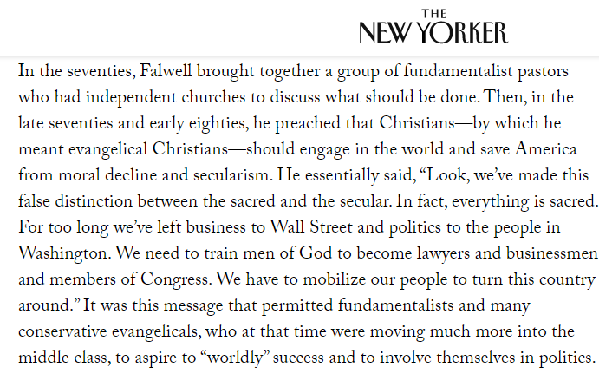
Moral Majority
1979 – Establishment of the Moral Majority
“We are in the majority.
The majority is moral.
Therefore the morals of the majority must be enforced.”
Their 1st victory – got Ronald Raegan into office
What does A.T. Jones say against the predominance and power of majorities?
Protestant and even the Christians are not the only ones that have conscience
Consider the origins of the Moral Mojority:

Slide 30
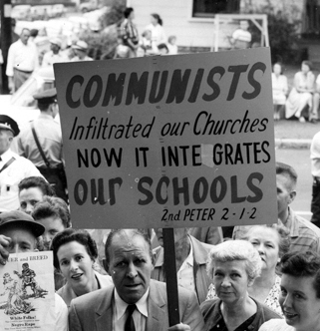
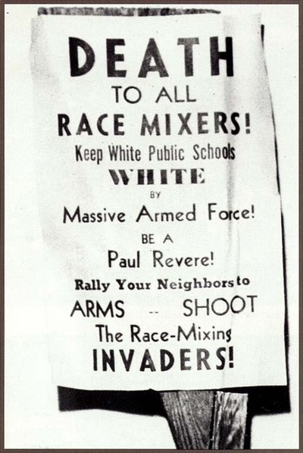
“Race Mixing is Communism”
In 1974 the IRS revoked the tax exempt status from Bob Jones University due to the institution’s discriminatory practices. They forbade interracial marriages and refused to admit “applicants engaged in interracial marriage or dating”
Prior to 1971 black people were not allowed to attend.
The University filed a countersuit that the IRS violated the First Amendment rights of the institution. The Supreme Court eventually resolved it in favor of the IRS
Christians perceived that the right to segregate was their 1st Amendment right.
This decision infuriated Falwell and he wanted to keep the tax exempt status and still allow segregation.

Slide 31
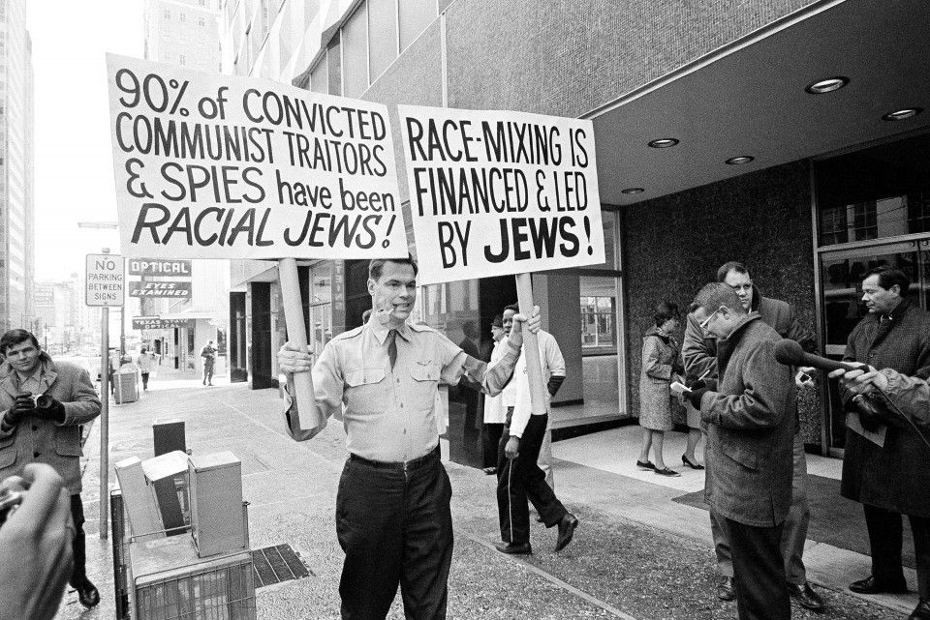
Jerry Falwell and beginning of Liberty University
What brought Falwell and other white evangelicals into a common cause in the late 1970s was this interference by the IRS.
They brought about a ruling that stripped tax-exempt status from all-white private schools formed in the south.
In reaction to Brown vs. Board of Education Supreme Court ruling to desegregate public schools Falwell had founded one of these schools in Lynchburg though he and other white evangelicals insisted that their schools were Christian economy academies, not segregation academies.

Slide 32
Motivation:
Racism
in this controversy the Religious Right found its voice and its power and it was the common cause that brought these different universities and evangelicals together
in the decades following World War II evangelicals especially white evangelicals in the north had drifted towards the Republican Party and climbed in that direction by:
Fears of Cold War
Suspicions of Catholicism
and work of Billy Graham and his friendship with Eisenhower and Nixon
Despite these issue evangelicals stayed out of politics

Slide 33
The National Reform Association (1860s) = Moral Majority (1970s) = Make America Great Again
in this controversy the Religious Right found its voice and its power and it was the common cause that brought these different universities and evangelicals together
in the decades following World War II evangelicals especially white evangelicals in the north had drifted towards the Republican Party and climbed in that direction by:
Fears of Cold War
Suspicions of Catholicism
and work of Billy Graham and his friendship with Eisenhower and Nixon
Despite these issue evangelicals stayed out of politics
“The leadership, moral philosophy, and workable vehicle are at hand just waiting to be blended and activated,” he wrote. “If the moral majority acts, results could well exceed our wildest dreams.”

Slide 34
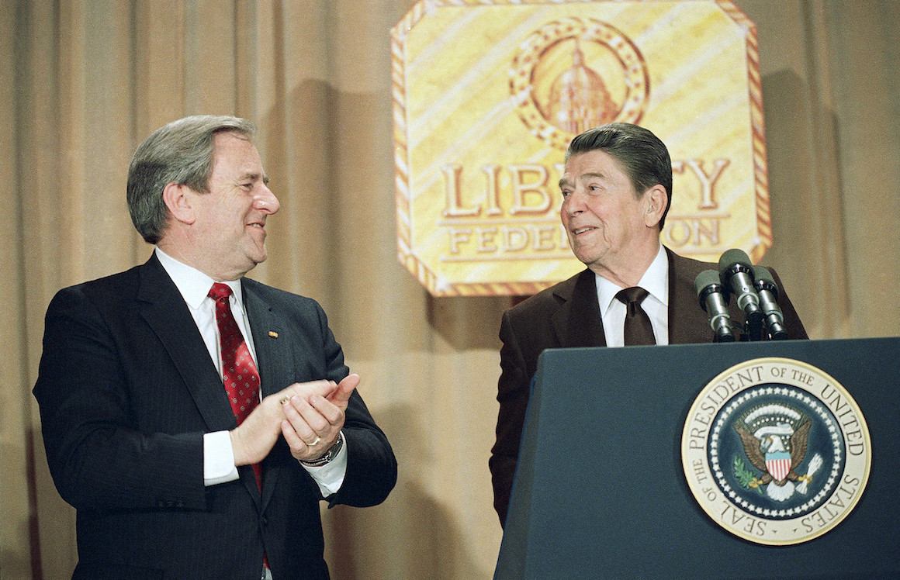
“We need to wield influence on those who govern us.
We need to wield political power.
We need to make America great again”
- Jerry Falwell 1980s

Slide 35
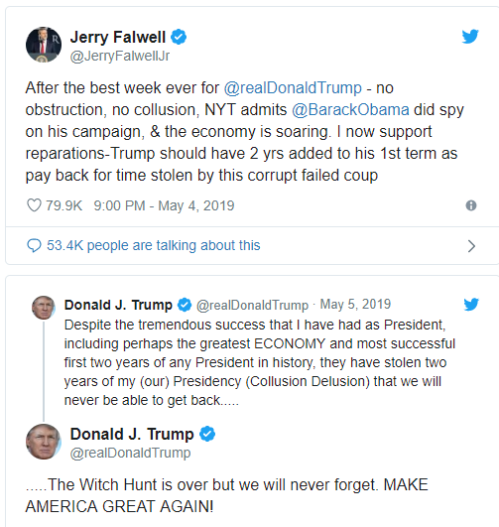
Jerry Falwell at 1989: “Our mission is accomplished”
Jimmy Carter is not a Christian, but a traitor to the country → 2/3 of the votes went to Ronald Raegan in 1980
“Our mission is accomplished. I feel that I've performed the task to which I was called in 1979”
Why?
It is Time of the End and there is no going back. They have Ronald Raegan and George Bush.
George Bush
Christian Coalition
Jerry Falwell Jr

Slide 36
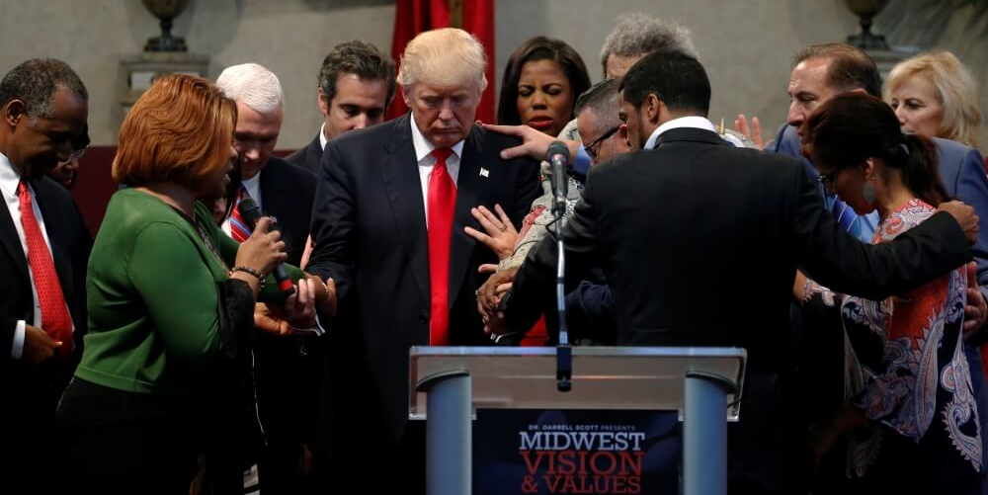
In the early morning hours of November 9, 2016, God told Frank Amedia that with Donald Trump having been elected president, Amedia and his fellow Trump-supporting “apostles” and “prophets” had a new mission. Thus was born POTUS Shield, a network of Pentecostal leaders devoted to helping Trump bring about the reign of God in America and the world.
Amedia described the divine origins of POTUS Shield during a gathering that spread over three days in March 2017 at the northeastern Ohio church he pastors. Interspersed with Pentecostal worship, liturgical dancing, speaking in tongues, shofar blowing, and Israeli flag waving, Amedia and other POTUS Shield leaders put forth their vision for a Christian America and their plans to bring it to fruition through prayer, political engagement and organizing in all 50 states. Among the many decrees made at the event was that Islam must be “completely broken down.”
The movement’s theology is grounded in a verse from the biblical book of Ephesians, in which the apostle Paul describes five kinds of leadership callings that Christ granted to people in Christianity’s founding era in order to build up the church: apostles, prophets, evangelists, pastors and teachers. NAR believes that for centuries the church had abandoned the first two. But, they believe, God has moved in our time to re-establish the ancient roles for apostles and prophets who will transform Christianity and bring about the kingdom of God on earth.
NAR is meant to be disruptive to the rest of the Christian Church. It views “denominationalism” as a sin and views established denominations and leaders as resistant to the reestablishment of the offices of prophet and apostle. Wagner, who died last year, believed that today’s apostles and prophets would bring about the most radical changes to Christianity since the Reformation in the 16th century, changes that were meant to allow the church to fulfill its true mission. A triumphant, dominion-taking church, Wagner’s disciples believe, will establish the kingdom of God on earth and set the stage for the second coming of Jesus Christ.

Slide 37
Trump’s personal pastor – Paula White
white prayed over them asking God to guide them in wisdom and protect them in the days ahead. Just days earlier White was traveling with Trump on his plane, when he brought up how Harry Truman surprised everyone by winning against Thomas Dewey in 1948 she says: “I haven’t personally seen this this coming together of the body of Christianity since when since 9/11”

Slide 38
Reasoning of the other stream is always the same throughout history
⬅In each of these histories protestants are going against the Constitution
In each they are driven by the same ideology.
And their solution remains the same - ENFORCE MORALITY
Slavery of Civil War: “It is my religious freedom to keep slaves”
Segregation: “It is my religious freedom to allow African Americans to attend the same school”
Islamophobia, Homophobia, Xenophobia: “It is my religious freedom to not have to bake a cake for a gay couple”

