Slide 1
BATTLE OF RAPHIA
BY TESS LAMBERT

Slide 2
So we were discussing the Revolutionary time period in its two parts, revolution and counter-revolution. Revolution 9/11 to 2019, really nine eleven to eleven nine. That process by which the United States establishment was overturned, and then we mark in 2020 the beginning of a counter-revolution.
What were you expecting to see on November nine? So when it comes to November nine people had various answers; one of the answers was that would be when we would see a presidential impeachment. So that's actually one of the things that Elder Jeff attacked us with after November nine was that the presidential impeachment didn't occur on the day. He would say it didn't occur at all but that suggests a very simple basic misunderstanding of what an impeachment is.

Slide 3
151
1865
2016
If we were to go back to how that study was developed it was a really neat study where you have 1865. 1865 was the changing from a president who freed the slaves to a pro-slavery president, the death of Abraham Lincoln the beginning of the presidency of Andrew Johnson. So 1865 plus one five one takes you to 2016 the end of Obama who was for equality and the beginning of Donald Trump who was against equality.

Slide 4
151
1868
2019
Impeachment
Impeachment
So you can see the one five one also in this same context explain 2016 and that process. But then you can also see three years later 1868 Andrew Johnson he has favored the South to such a degree, he has fired someone, he's misused his power as president and they try to impeach him. 1868 plus one five one takes you to 2019. So it's a neat study that explains more than 2019 and that impeachment. It takes you back to 1865 and shows you the change in these presidents.

Slide 5
But that study never linked to November nine it had no link, I don't believe that link was ever made in a presentation. So there was a misunderstanding where some people thought that impeachment should happen on November nine. But in 1868 Andrew Johnson's impeachment is not on November nine, so we have no link for that. So I would suggest that could never have been the event of November nine.

Slide 6
WW l Eastern
WW II Western
Russia USA
USA West
USA
The study that gave us November nine is the story of the revolutions. So when we think about the revolutions what's the context what's the theme. I'll take us back to the World Wars. If we were to look at World War l and World War II how many fronts do they exist on? There is an Eastern Front and a Western Front. The Eastern Front in World War III the one—which is facing our history today. Who's fighting in the Eastern Front? Russia and the United States. Who's fighting in the Western? Where's is this Western fight taking place? United States. The United States versus the West and the United States is part of the West.

Slide 7
So in many ways it's the United States versus the United States, which is what when you have a country against its own country, Civil War, so this is Civil War. So when we do the study of the revolutions are we speaking about the Eastern Front or the Western Front? The Western. The studies of the revolutions which gave us November 9 is a study of what is happening on the Western Front of World War III. November nine is a Western Front subject internal to the United States. So when we look at November nine we have to first understand it's a Western Front subject not an Eastern Front.

Slide 8
Now I want to put a spanner in that. 1989 that's a battle, it's described as a battle. 1989 is November nine for one other history that we have brought to these revolutions and we said 1989, 2019. 1989 was a battle between the United States and the Soviet Union. 2019 is a battle between the United States and Russia. November nine 1989 November 9, 2019. So we've agreed that November nine is a subject of the Western Front, Civil War the United States versus itself.

Slide 9
Then when we went back to 1989, Raphia is a battle in Daniel 11. 1989 is a battle in Daniel 11, and 1989 is November nine. So I want to suggest the way that I view this. 1989 to change your mindset for a moment you're no longer a citizen of which ever country you come from to keep it simple you're no longer a citizen of the United States because that's the context reviewing this in you're a citizen of the Soviet Union.

Slide 10
Place yourself in the mindset of a citizen of the Soviet Union in 1989. So 1989 you're a member of the Soviet Union how do you see November nine? Where is the United States November nine 1989? It's not there what happens on that day, what happens through 1989 is a revolution through the Soviet Union, its internal civil war. The United States was not there, they weren't there themselves forcing the people to break down that wall, which was happening inside by citizens of the Soviet Union. It was destroyed from the inside and where was the United States not even visible.

Slide 11
So why is it described as being a battle between the United States and the Soviet Union? So what do we know what the United States had done before 1989. Before 1989 they'd already through the Afghanistan proxy war, through Voice of America and subterfuge through working with John Paul the second, through the arms race through all of these different ways that already maneuvered to bring the Soviet Union to its own place of Civil War. They had manipulated events surrounding the Soviet Union to cause its own people to rise up against it.

Slide 12
So what you're seeing in 1989 is an internal Civil War, its Soviet Union vs. Soviet Union that's what you see but you know that the United States played a role in bringing that about. So when we see Western Civil War inside the United States who brought that about partly, who works through disinformation campaigns, Russia. So on that day do you see them, it just looks like an internal Civil War pure Western Front. But you know by the prior history that it has been influenced by Russia, by the king of the South.

Slide 13
So for the people that said before they expected to see Russia on the day you wouldn't see Russia on the day but you are correct that Russia has had involvement in that. Trump became president with the help of Vladimir Putin that changed in overthrowing the American establishment happened through Russian assistance to Vladimir Putin, through Russian disinformation campaigns, through the work of GRU and the Internet Research Agency.

Slide 14
So on one hand from one perspective this is the Western Front of World War III. We're observing the world through these revolutions the progressive steps of the Western Front of World War III just from another perspective but the same thing. But it's also equally correct to say that that Civil War is the result of influence by the King of the South. Therefore that internal Civil War is a battle between North and South just as the internal civil unrest in 1989 was a battle of Daniel 11:40 between North and South.

Slide 15
Can you see how history is complex, you need these different perspectives to approach the subject. If you just look at it from one perspective then the application will be too narrow. You can say it's the Western Front and be correct, you can say it's a battle between North and South which looks like Eastern Front and you would be correct. Its understanding that there are these two fronts looking at both of them and that both combined. I think what I was trying to describe in Brazil last year and did it badly is that our lines they have a component of being three-dimensional. Whiteboards are wonderful, there's still a limit. Our message actually if we really conceptualize even just this one thing it's not a two-dimensional subject it’s more of a three D model than a two D and we're working off the Lines and whiteboards that only give us two-dimensional images and that's part of the battle we have to work through.

Slide 16
When it comes to November 9 last year is it Western Front yes, is it Eastern Front yes, but in a different way. This isn't something visible like the United States and the Soviet Union fighting over Cuba, fighting over a different country, fighting over Afghanistan. It's something that occurs internal to the Soviet Union itself; it is an internal Civil War. So there's those two components, there's a fight for the spheres of influence that relates to other countries outside the Soviet Union but under their influence countries like Afghanistan and Cuba. November 9 relates to what's happening inside the Soviet Union, but because of the influence America has already exerted to cause civil unrest inside the Soviet Union it is a battle between North and South it is Eastern Front as well.

Slide 17
So I just want to give us that understanding of November 9, I don't have an explanation of November 9, I don't have that to give you I'll justify that by saying that on the lines we don't, the disciples don't understand the cross for some time. That is our key reform line more than any other, success of ancient Israel, success of modern Israel even when Christ ascends why are they so disappointed when Christ ascends, it's their increase of knowledge after the cross. Why are they disappointed; if Christ goes back to heaven how is he going to lead them against the Romans. They're so disappointed at the Ascension because they still don't understand what happened at the cross.

Slide 18
It's a characteristic of that dispensation, what we need to do is understand what we're supposed to see when we do understand. It will not relate to the impeachment it will not relate to anything visible with Russia over external spheres of influence, it’s internal to the United States. It's the end point of an overturning of an establishment. I know that that's complex it's like having a few different points as I said three-dimensional different perspectives that we need to be able to pick up look at put back down, its Eastern Front and it's Western Front its internal Civil War influenced by the enemy.

Slide 19
So I want us to briefly look at what else happened in 2019. We should have expected multiple things in 2019. First of all there is strength of radical Islamic terrorist groups. You'll notice I don't say the restraint of Islam. I think we need to move beyond that terminology, it was a restraint of radical terrorist Islamic group Isis, the death of Baghdadi, and the conquering of the Islamic state all of its territory the restraint was fulfilled. We would expect to see a impeachment of the US president neither of them connected to November 9, we saw that occur. So we have the restraint of radical Islamic terrorist group. So we a restraint put upon Isis including the losing all of the last remnants of their territory.

Slide 20
We have the impeachment that we would expect to see, we also have a fight over spheres of influence between the United States and Russia external to what's happening inside the United States. This fight over the spheres of influence was not connected to November 9.
So what I want to do for a short amount of time is something I want to do perhaps more thoroughly at another point. This is something that I'd like to do more thoroughly in the coming weeks. But we have a fabric to learn on this subject.

Slide 21
When it comes to Raphia, Raphia was a fight over what country, what territory in its literal history? It was the fight over Coele-Syria. So you have these two generals North and South, Babylon and Egypt fighting over that territory of Syria that they both wanted to control that external sphere of influence. So when it comes to Raphia I want to suggest Raphia as a name is more than November 9. Raffia is a fight external to the civil unrest, external to the Revolution. The spheres of influence that is what Raphia is about.

Slide 22
We are going to Google Maps just so we can see a world map. I'd like to do this more thoroughly at another point in time. I just want to lead us through a little bit of history why these spheres of influence are so important. You remember that last year what FFA’s position on Raphia was? The issue that they have with Raphia is that they cannot look outside of the United States. Because FFA, the whole world view is so encased in this nationalism, its pro nationalistic they cannot look and see the importance of events in other countries.

Slide 23
This has hindered them being able to see the external events of Raphia. Raphia was a fight over Coele Syria, it was external to Babylon, its external to Egypt. It’s a fight over who controls the staging region of the world. In 2019 there are multiple strategic areas; this is outside of November 9. Raphia was not the day, Raphia was the year and I want us to see the importance of these spheres of influence.

Slide 24
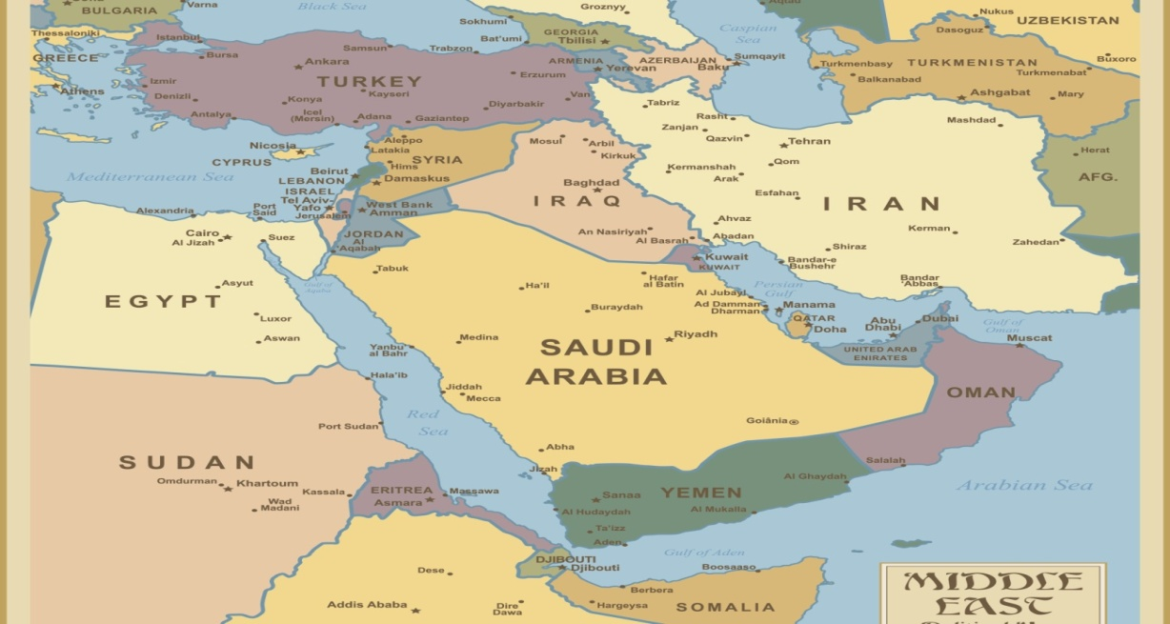
We have discussed before this territory of Syria. I’ll Just review quickly why this is a place of such strategic importance. If you look down you have Saudi Arabia and you have Iran. Saudi Arabia and Iran are mortal enemies. Iran is Shia and Saudi Arabia is Sunni. It's not just a religious divide, it has become a political issue because whoever is right in that ideology as it relates to Islam, whichever country or government is right about Islam, that country then has the authority to rule these two areas, Mecca and Medina.

Slide 25
These are the two holiest sites in the Muslim religion. So if Iran is correct Iran says this government of Saudi Arabia does not have the religious right to control Mecca and Medina. So this is about legitimacy as a world power as a government. This is the church state Union that began to come together much more forcefully in 1979. So these are mortal enemies and these two fight over spheres of influence.

Slide 26
So Russia supports Iran, the United States supports Saudi Arabia and in here you have another country supported by the United States Qatar a US ally. So Qatar has access to oil from the Persian Gulf, they wanted to build a pipeline it would have had to go through Iraq through Syria and then into Europe. So for this little country down here an ally to the United States to build a pipeline from the Persian Gulf into Europe it would have to go through Iraq and Syria.

Slide 27
Iraq is okay with that they are quite controlled by the United States by this stage. You don't want to go down through this territory of Lebanon and Israel there's too much unrest you need to go through Syria and then through Turkey. Turkey is a US ally when it wants to be, it’s acting like a rebel without a cause at the moment but it wouldn't be a major problem. The problem is Syria because who is Syria allied to, Iran and Russia. So when Qatar wants to build this pipeline through here Syria blocks it. This is in the history of 2009 to 2011.

Slide 28
Iran also has access to the Persian Gulf it wants to build a pipeline that will go through Iraq and Syria under the Mediterranean Sea and come out in Europe. Iran has no problem, Syria has no problem because Iran is supported by Russia Syria is supported by Russia they have the same strategic interests.

Slide 29
.
So Iran wanted to build this pipeline, Syria said that's fine go ahead that was around 2010. One year later you have Arab Spring the Syrian civil war begins. So that is why Syria is such a strategically important location, it was a gateway to all of this territory; it was also the crossroads between Egypt and Babylon because this was desert.

Slide 30
But it's it remains a place of strategic importance today if you want to have access from this area rich in natural resources into Europe who wants to use and buy those natural resources the route goes through Syria. So whoever controls Syria controls who gets to send natural resources to Europe which is a major amount of resources.

Slide 31
So this is why this was a sphere of influence of power over Syria. I want us to come back out of the subject of Syria and just have us briefly look at a couple of others, we'll come down here to Yemen. So what do we know about Yemen.

Slide 32
I'm going to read a little from the Center for Strategic and International Studies. This fellow I don't agree with his perspective he writes from a very nationalistic American perspective. But he explains why Yemen is so important. Yemen is a growing reminder of just how important the strategic US partnership with Saudi Arabia really is. This area of Yemen developed into civil war and it has been controlled by outside proxies from early in, particularly Saudi Arabia and Iran. Saudi Arabia and Iran support different sides in this Yemen's Civil War.

Slide 33
So these two powerful middle-eastern countries are wrestling it out over who can control Yemen, and I hope we can start to see why this area is of such strategic importance. Particularly through the early days of this war while America didn't become directly involved what they did is American planes would take off from their bases up here from where they were bombing in Syria.

Slide 34
They would take off from their bases in Iraq and would fly down into Saudi Arabian airspace. They would meet in mid-air with a Saudi Arabian fighter jets and they would refuel those fighter jets and then those fighter jets would fly down and conduct a bombing in Yemen on behalf of Saudi Arabia.

Slide 35
So that's just one example where the United States was supporting Saudi Arabia in that proxy war over Yemen. The human life lost the casualties due to that Saudi Arabian bombing was so horrific that Obama because this happened in the Obama administration, Obama was warned if you keep supporting Saudi Arabia in this proxy war the UN will be forced to charge the United States with war crimes. The human casualties were horrific and if anyone from Europe wants to know why there's refugees flooding up from Yemen this is one example. At one stage it was the greatest humanitarian crisis in the world millions on the break on the brink of starvation.

Slide 36
So Obama had to start to pull back there but he still supported Saudi Arabia, of course Russia supporting Iran and Yemen. In quoting this fellow he puts Yemen in a broader strategic context, the crisis in Yemen is only part of the US Saudi strategic equation. So this all relates to this alliance between Saudi Arabia and the United States. At the same time Yemen is of major strategic importance to the United States as is the broader stability of Saudi Arabia and all of the Arab Gulf states.

Slide 37
Down here you have the Strait of Hormuz this is hugely strategic you would know it even in the early months of this year when Iran was attacking tankers that went through there. It's something that they practiced in 1997 as well. It's been a practice of this that when they want to push for more of global influence, when they want to punish another country they start covertly attacking the oil tankers that are forced to travel out of the Persian Gulf and around this point.

Slide 38
So Iran controlling this choke point can cause a great deal of problems for the United States and for US allies. Yemen does not match the strategic importance of that Gulf but it is of great strategic importance to the stability of Saudi Arabia and to the Arabian Peninsula. Yemen also became the base of Al Qaeda in the Arabian Peninsula.

Slide 39
Then he goes on to describe the strategic importance of this right here it's called the Strait of Bab-El-Mnadeb it's a traffic point between the Horn of Africa and the Middle East. It is a strategic link between the Mediterranean Sea up here and the Indian Ocean.

Slide 40
The Strait is located between Yemen and this Horn of Africa, it connects the Red Sea with the Gulf of Aden and the Arabian Sea. Most exports from the Persian Gulf they transit the Suez Canal, they have to pass through here. So if you wanted to come around here and through and up to Europe you're going to have to go through this choke point as well.

Slide 41
It's 18 miles wide at its narrowest point limiting tanker traffic to two two-mile wide channels for inbound and outbound shipment. So a two-mile wide channel for inbound and a two mile wide channel for outbound. Closure of that area would keep tankers from the Persian Gulf from being able to go through the Suez Canal, or sumed pipeline having to divert them all around through the southern tip of Africa. Any hostile air or sea presence in Yemen could threaten the entire traffic through the Suez Canal.

Slide 42
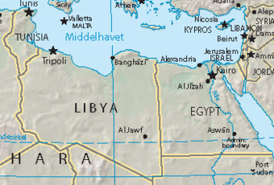
So when you have these proxy wars Syria is strategically important Yemen is strategically important. Moving on to another one, Libya is a major issue a major concern. Who first messed up Libya? This was Obama and Clinton they overthrew Gaddafi.

Slide 43
Since 2011 and the overthrow of Gaddafi it has just been a brutal civil war thousands of people suffering and dying. You have a refugee crisis and also this civil war in Libya. Quickly the west and Russia took different sides in this civil war. The UN supported with the US agreement the government that they set up in Libya but Moscow supported the rebel commander Khalifa Haftar.

Slide 44
So you have Russia supporting this rebel commander Haftar, the UN and the United States supporting this Tripoli government and they're fighting over this country here Tripoli is up here.

Slide 45
So Haftar with the support of Russia controls the vast majority of the country but the government controlled the capital and this territory up here which was of particular strategic importance. So over the last years this has been another fight over spheres of influence.

Slide 46
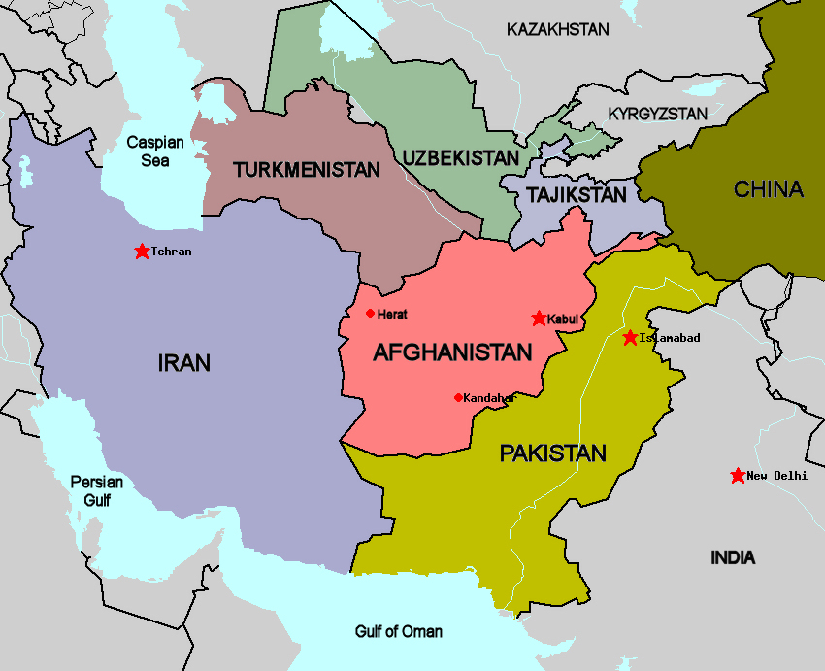
Why does Russia want their guy in charge of Libya, why do they want Libya? If they get Libya what else do they get? What was the issue over Afghanistan 79 to 89? This looked different in the history of the Cold War. The Soviet Union came down through much of this territory.

Slide 47
So Afghanistan was of strategic importance particularly because it was called the soft underbelly of the Soviet Union. You don't want an enemy government having influence over your soft underbelly. So what’s Libya directly under? If Vladimir Putin has Haftar succeed in Libya to take over the whole country he has the soft underbelly of actually the whole NATO alliance. He already has air bases situated in Libya, he has troops on the ground there, he sent in his own covet soldiers, his own drones his own tankers and bombs, he's already set up Russian air bases inside Libya in preparation.

Slide 48
The strategic importance of that location beyond the influence of any wealth or economic deals is again its location. It divides East and West Africa at this top junction and Vladimir Putin is also forging tires within Africa particularly Sudan. But Libya is of such strategic importance because of its coastline of the Mediterranean and it's directly under the NATO alliance.

Slide 49
What was the issue after world war II? Stalin said we just fought an enemy that forced his way all the way to our door step, we need to have consumed spheres of influence between Germany and the Soviet Union so that we have a buffer zone like an air bag. If anyone tries to hurt us we have these air bags and not on our doorstep everyone wants an air bag. The issue with Afghanistan it's the issue with Libya. If Ukraine wants to side with NATO what's Russia's complaint? You're going to bring NATO to the very border of Russia. So what's he going to do, he's trying to do the same thing bring his influence as close as he can to NATO as well.

Slide 50
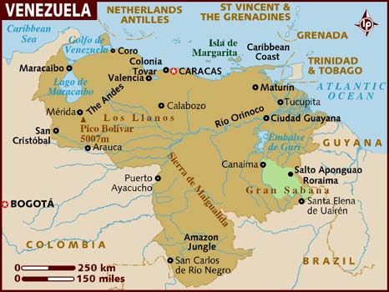
Let’s touch on one more and then we will move on. Venezuela has been clearly been a fight for spheres of influence between the United States and Russia. It's partly economic; the economic advantage that Russia has over Venezuela, the deals have made with President Madero that greatly favored Russia.

Slide 51
The millions that they have loaned for that country that they won't get repaid unless Madero stays in power, that's all part of it. But one Russian politician said; If the US wants to come to Ukraine and have a sphere of influence right on our doorstep we're going to do the same thing to them because Venezuela is on top of South America.

Slide 52
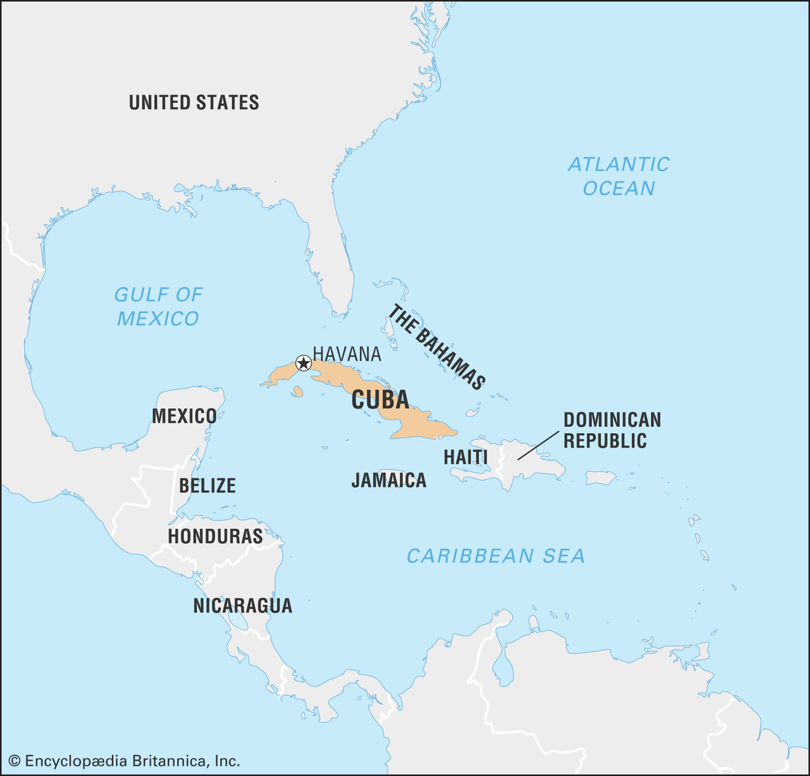
In the Cold War what was the country that stressed the United States the moist? Cuba, the Cuban Missile Crisis. Why was that such a concern, soft underbelly. Cuba became a major point of tension in the Cold War. That was the one point where we really could have had a hot and nuclear war.

Slide 53
It was because the United States did not want the Soviet Union having a sphere of influence not far from its borders. And for the same reasons it's a strategic sphere of influence

Slide 54
Last year I won't go into the details for time, when did Venezuela first erupt in protests, 2014. So much of these spheres of influence you can see particularly escalated in 2014. If it's not 2014 its 2011, Syria for example; Syria 2011 it starts the civil war, 2014 America becomes involved in that region. So you have 2011 as important but 2014 particularly is when these fields of influences blew up. 2014 protests in Venezuela, the man who led those protests is imprisoned and another protégé of his takes his place, Juan Guaidó this is the opposition leader in Venezuela. He took the place of the fellow who was leading the protests in 2014.

Slide 55
In 2019 that blows open again and Russia starts sending aid to Madero. On March 23 the same day Isis collapses Russian troops arrive in Venezuela the same day a tanker arrives as well with particular chemicals that Madero could not get because of American sanctions. He needed certain goods to continue. US sanctions blocked him receiving those needed goods so Russia sent through Rosneft, filled a tanker I think they might have filled it in South Africa and arrived in Venezuela propping up the economy as well.

Slide 56
In 2014 Russian troops start getting observed in Sudan as well as in Libya, they now have Russian troops on the ground as well, as their financial support. We won't go into all that happen in 2019 in these countries it was done in Australia as I said earlier December 2019 it was also heard on in Kenya / December in January of 2019. But all of this relates to the battle of Raphia which was a fight between North and South spheres of influence separate to themselves. That was Eastern Front, Raphia was not an internal civil war.

Slide 57
That is just a few of the spheres of influence. You could also speak about last year's efforts by Putin to influence many countries throughout Africa with his first Russian African summit. We could speak about Ukraine his efforts in Ukraine last year but last year Vladimir Putin had major victories through all of the spheres of influence that we have mentioned and others. It fulfilled the battle of Raphia. What I wanted us to see is that these things were fulfilled everything else that we expected to see fulfilled in 2019 we have this video except November 9 itself.

Slide 58
We expected the Battle of Raphia I'm suggesting that was fulfilled. We were expecting an impeachment that was fulfilled we were expecting the restraint of radical Islam that was fulfilled. What we don't understand is November 9 but we know what we're looking for it’s an internal civil war. You do not see the King of the South visible at that way mark. Someone has asked the question the Battle of Panium in its own history was also over Coele Syria, will it occur in the year 2021 and not at a date? I'm saying yes you can already see the build-up to that.

Slide 59
In Libya in the last few months how is Haftar doing? Badly, the end of last year he had made major advancements he was winning by the time you come to the last few months he has had to pull right back, and they also suggested that Vladimir Putin has already started needing to remove troops out of Libya. Yemen is struggling; Venezuela Madero is struggling more than ever before. Syria there are new sanctions, Assad is a internal loyalty even within his own family is crumbling. You can already see Vladimir Putin beginning to lose his grip on these spheres of influence.

Slide 60
So yes we should be watching these external events but there are other reasons that we should be watching these external events, and the reason for that is empathy. If I was to be actively protesting right now I honestly don't know what I would protest for I would have to stand in front of our Parliament. I don't know how big that board would need to be. Go and look at what's happening in these countries, look up Obama’s Predator drone program. What he did in Pakistan in Libya in Yemen in Syria with these drone strikes.

Slide 61
An article was put up on maybe a broadcast last night Australian time. It spoke about these US military strikes through Syria. What they were able to investigate and reveal was that the civilian death toll, the innocent civilians killed by mistakes made in these strikes whether by aircraft or drone was 31 times higher than the official number. What this article does is it takes you through the stories of the people that lived in these countries. The survivors continue to live in the wreckage of these countries, and read what has been done not just by the United States and by Russia but by their own dictatorship, by Assad, by the influence of Saudi Arabia and Iran.

Slide 62
Any attempt to make this earthly Kingdom better I think we would see as a hopeless cause that it is. It's like someone described to me a hose, a hose with a leak. You want you put to put your thumb over that leak and three more burst open it's horrific to read about these innocent lives. Part of the reason that FFA could not understand the battle of the spheres and understand these spheres of influence is because the FFA world view is Libya who, Libya where, who cares about what's happening in Yemen, who even knows where to find Yemen on a map. It's that nationalistic world view that places an importance of the lives and citizens of one country over the lives and citizens of another country that causes their blindness to see the external events correctly.

Slide 63
They calculated that last year the United States caught killed more innocent civilians in Pakistan than the Taliban. The United States is supposed to be there to free them from the Taliban but they are killing more innocent people. So are they there for the Taliban or not? If you go back and you read their stories it hurts but when you do that when you understand the degree of pain you'll understand why this movement and the setting up of another Kingdom is the only hope that this world has.

Slide 64
I know it hurts part of the reason that we're hurting is because people have finally seen the need to be vaccinated. We should not need to be vaccinated against the pain that we feel ourselves. I know what it feels like to live in a sexist movement that belongs to a sexist church in a sexist country in a sexist society that has practiced sexism for 6,000 years justified by the Word of God and called it a positive good. I know what it's like, I know what it's like to feel abuse from that, I don't need vaccinations for my own pain. When you need a vaccination it's because there is something separate to your own experience, separate to what you feel in your own gender in the own color of your skin in your own country and nationalism.

Slide 65
To look outside and see the pain of somebody else we need to be able to do that broadly. I will have more confidence in the direction people are taking in this movement when I see them push the stories of the innocent lives lost in Pakistan and Syria and Libya and Yemen and Venezuela. Because of both internal dictatorships eternal problems we can we speak about India what that Hindu nationalistic government is doing to the Muslim population. What did they just do in Kashmir? What did Israel just do in the West Bank? This is the vaccination the pain that is outside of the things that we feel ourselves, it is universal, and it is global in its context now.

Slide 66
And when we can see and feel that to the degree that we should the value of the of a life in Syria when his entire body is smashed up, when he just lost his wife and his daughter and his son, normal people because an American drone said there's an Isis compound nearby this house looks good enough. Watching them rebuild their bodies and their lives without their family members we should have that degree of vaccination when we truly see that it hurts but we will not be tempted to remove ourselves from this movement because we will recognize the only hope that these innocent people have in countries where this movement doesn't even have a single representing priests will be that we set them up at Kingdom they can join.

Slide 67
They don't have that hope in their own countries, we're setting up a kingdom for their sakes not for our own sakes; a kingdom where a woman in Yemen a man in Syria a family in Pakistan can find a home where they can find proper treatment where people do not have the freedom to hurt each other that's the kingdom that we're setting up. It comes with restrictions of freedom because if there was no restrictions people would abuse their power that's the kingdom we need to focus on. In the next presentation we'll discuss more of that kingdom.

Slide 68
If you kneel with me we will close in prayer dear father in heaven we know at the cross what kills Christ what hurt his heart more than anything else was bearing the sin of the whole world we'll look at our experience now Lord in a parable sense where to do that where to look at the sin of the whole world and it hurts it breaks our hearts it's universal global we see the suffering and the pain Lord may we see the hope that is in this movement that is in the setting up not just of a church but a kingdom not just a church but what will also be a state a place that people can live with freedom that they won't fear Obama's Predator drones over their heads in the sky where they can't even see them that they won't live in such fear

Slide 69
that there will be no Isis fainting women who faint at the sight of anything that reminds them of what they enjoyed where genital mutilation in South Sudan where women believe to death that that will no longer be practiced because you have rules may we be will abide in a country that does not practice freedom to her freedom to abuse we don't understand sin as you do whatever restrictions you desire to place on us to bring us to this kingdom may we accept because you are wise you see all we do not so if you tell us to do something that we don't want to do that we feel violates our freedom may we trust our eyes your eyes and not our own that's what it means to let go of every earthly support and trust you as you are

Slide 70
revealed in parable teaching Lord we are in a crisis in this movement this vaccination process hurts it hurts to bear the sin of the whole world and it's nothing compared to what Christ personally had placed upon him but we are required to have our eyes open and see it I pray that every head bowed those Lord who did not stay and finish watching those who have left those who will no longer watch oh Lord I pray that they might be saved that they might join with us in that Kingdom now we do everything in our power to convince them of the right way I pray this in Jesus name Amen

