Slide 1
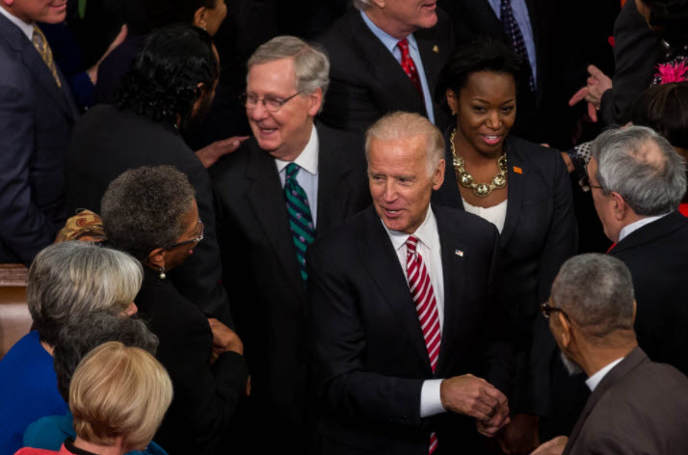
Biden, Compromise and the MC
Elder Tess Lambert
September 21, 2020
Preparing to assume the presidency in a divided country, Joe Biden confronts the ultimate test of his principal theory of governance: that compromise is good and modest progress is still progress.
Islands of the Sea September Camp Meeting #3

Slide 2
Biden, Compromise and the MC
compromises
1818 to 1821
1833
1850
There’s a number of US elections
✓1840. P. William Henry Harrison (dies)/VP. John Tyler
☒1844 P. Henry Clay/VP. Theodore F
✓1848 P. Zachary Taylor (dies)/VP. Millard Fillmore
1860 P. Lincoln/VP Hannibal Hamlin
Where we finished last was in 1850 with the 1850 Compromise. The 1850 Compromise is linked directly to 1844. 1844 is directly linked to 1840. In 1840 the Whig party compromises, the president dies, and the vice president becomes president. He's a slavery sympathizing expansionist. He brings that idea of annexing Texas to the forefront. The Democrat party run with that in 1844. They win and annex Texas, Oregon and California. In 1850 what they're struggling with is what to do with slavery in these new territories. And that disagreement in 1850 becomes dangerous.
α Modern
1798
1840
SL
1850
COP
1861
1863
2014
2019
TT
July 21,
1844
Oct. 22,
1844
1850
1798
1840
Failure
TT
✓
18
20
33
✓
✓
✓
✓
1850
1861
✓
⬆
2nd Adv
Henry Clay first political speech
Compromise
Tariff, Whig party formed
TT
Missouri
Compromise
Nov.9,2019
✓

Slide 3
Biden, Compromise and the MC
compromises
1818 to 1821
1833
1850
There’s a number of US elections
✓1840. P. William Henry Harrison (dies)/VP. John Tyler
☒1844 P. Henry Clay/VP. Theodore F
✓1848 P. Zachary Taylor (dies)/VP. Millard Fillmore
1860 P. Lincoln/VP Hannibal Hamlin
The Whig party won the last election with Zachary Taylor and Millard Fillmore. The Missouri Compromise was all about new territory and what to do with slavery in those territories. The issue in 1850 was quite similar.
α Modern
1798
1840
SL
1850
COP
1861
1863
2014
2019
TT
July 21,
1844
Oct. 22,
1844
1850
1798
1840
Failure
TT
✓
18
20
33
✓
✓
✓
✓
1850
1861
✓
⬆
2nd Adv
Henry Clay first political speech
Compromise
Tariff, Whig party formed
TT
Missouri
Compromise
Nov.9,2019
✓

Slide 4
Biden, Compromise and the MC
compromises
1818 to 1821
1833
1850
There’s a number of US elections
✓1840. P. William Henry Harrison (dies)/VP. John Tyler
☒1844 P. Henry Clay/VP. Theodore F
✓1848 P. Zachary Taylor (dies)/VP. Millard Fillmore
1860 P. Lincoln/VP Hannibal Hamlin
A quote from digital history, a paraphrase: Henry Clay is old and sick, especially elderly for their time period when you didn't live as long. He's rushing to visit a friend. This friend is Daniel Webster, the brother of the man who wrote the Webster's dictionary. They were close allies. Clay is terrified of what is about to happen to the Union, so he visits Webster and introduces him to a compromise that he has developed. Then he brings that proposal that they’ve both agreed upon to the Senate. He asked them to put away what divides them in the place of national patriotism. So put away slavery and those things that divide you and in the name of national patriotism accept to compromise. This is not that well received.
α Modern
1798
1840
SL
1850
COP
1861
1863
2014
2019
TT
July 21,
1844
Oct. 22,
1844
1850
1798
1840
Failure
TT
✓
18
20
33
✓
✓
✓
✓
1850
1861
✓
⬆
2nd Adv
Henry Clay first political speech
Compromise
Tariff, Whig party formed
TT
Missouri
Compromise
Nov.9,2019
✓

Slide 5
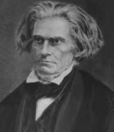
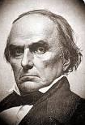
Biden, Compromise and the MC
compromises
1818 to 1821
1833
1850
There’s a number of US elections
✓1840. P. William Henry Harrison (dies)/VP. John Tyler
☒1844 P. Henry Clay/VP. Theodore F
✓1848 P. Zachary Taylor (dies)/VP. Millard Fillmore
1860 P. Lincoln/VP Hannibal Hamlin
α Modern
1798
1840
SL
1850
COP
1861
1863
John C. Calhoun
2014
2019
TT
John C. Calhoun threatens southern secession, Clay has the full support of Daniel Webster but there are some in the North who are anti-slavery and reject a compromise on slavery.
July 21,
1844
Oct. 22,
1844
1850
1798
1840
Failure
TT
✓
18
20
33
✓
✓
✓
✓
1850
1861
✓
⬆
2nd Adv
Henry Clay first political speech
Compromise
Tariff, Whig party formed
TT
Missouri
Compromise
Nov.9,2019
✓
Daniel Webster

Slide 6
Biden, Compromise and the MC
compromises
1818 to 1821
1833
1850
There’s a number of US elections
✓1840. P. William Henry Harrison (dies)/VP. John Tyler
☒1844 P. Henry Clay/VP. Theodore F
✓1848 P. Zachary Taylor (dies)/VP. Millard Fillmore
1860 P. Lincoln/VP Hannibal Hamlin
We should be familiar by now with John C. Calhoun, but we want to remember another name. We want to consider William H. Seward of New York. He called Webster and with him Clay and their compromise, but specifically Daniel Webster for defending that compromise a traitor to the cause of freedom. The southerners feel comfort that they see the North will compromise but there are some in the North who see that compromise and hate it. The president, Zachary Taylor says we need to admit all of this new territory and then consider slavery afterwards. This would have given a massive benefit to the North. It would have given a 10-vote majority in the Senate. They could have overruled any southern claims. William H. Seward gives a speech in the Senate, he denounces that compromise, he says there's a higher law than the Constitution, a law that demanded an end to slavery.
α Modern
1798
1840
SL
1850
COP
1861
1863
2014
2019
TT
July 21,
1844
Oct. 22,
1844
1850
1798
1840
Failure
TT
✓
18
20
33
✓
✓
✓
✓
1850
1861
✓
⬆
2nd Adv
Henry Clay first political speech
Compromise
Tariff, Whig party formed
TT
Missouri
Compromise
Nov.9,2019
✓

Slide 7
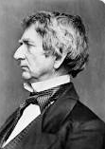
Biden, Compromise and the MC
compromises
1818 to 1821
1833
1850
There’s a number of US elections
✓1840. P. William Henry Harrison (dies)/VP. John Tyler
☒1844 P. Henry Clay/VP. Theodore F
✓1848 P. Zachary Taylor (dies)/VP. Millard Fillmore
1860 P. Lincoln/VP Hannibal Hamlin
William H. Seward
α Modern
William H. Seward was one of the foremost critics of the Compromise of 1850 and he was severely criticized for that speech. During his speech, Daniel Webster decided that he needed to take care of other duties, Clay was restless, and within 20 minutes the previously packed galleries had almost entirely emptied. He was attacked as being a reckless enemy of the Constitution. Subverting that great document to some type of nebulous higher law. But those northern anti-slavery Whigs did defend him. But because the president won't endorse it, the compromise appeared to be dead. Disappointed and exhausted Henry Clay left Washington. Then with an unexpected suddenness the outlook abruptly changed.
1798
1840
SL
1850
COP
1861
1863
2014
2019
TT
July 21,
1844
Oct. 22,
1844
1850
1798
1840
Failure
TT
✓
18
20
33
✓
✓
✓
✓
1850
1861
✓
⬆
2nd Adv
Henry Clay first political speech
Compromise
Tariff, Whig party formed
TT
Missouri
Compromise
Nov.9,2019
✓

Slide 8
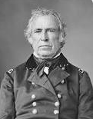
Biden, Compromise and the MC
compromises
1818 to 1821
1833
1850
There’s a number of US elections
✓1840. P. William Henry Harrison (dies)/VP. John Tyler
☒1844 P. Henry Clay/VP. Theodore F
✓1848 P. Zachary Taylor (dies)/VP. Millard Fillmore
1860 P. Lincoln/VP Hannibal Hamlin
Zachary Taylor
α Modern
July 1850 President Taylor died. Fillmore was an ardent supporter of compromise and he passed it.
New Mexico and Utah could decide slavery for themselves. California was allowed to be a free state. The slave trade was abolished in the district of Columbia. In a separate issue Texas was paid off. What caused abolitionists the most heartache was that fugitive slave clause to please the South.
1798
1840
SL
1850
COP
1861
1863
2014
2019
TT
July 21,
1844
Oct. 22,
1844
1850
1798
1840
Failure
TT
✓
18
20
33
✓
✓
✓
✓
1850
1861
✓
⬆
2nd Adv
Henry Clay first political speech
Compromise
Tariff, Whig party formed
TT
Missouri
Compromise
Nov.9,2019
✓

Slide 9
Biden, Compromise and the MC
compromises
1818 to 1821
1833
1850
There’s a number of US elections
✓1840. P. William Henry Harrison (dies)/VP. John Tyler
☒1844 P. Henry Clay/VP. Theodore F
✓1848 P. Zachary Taylor (dies)/VP. Millard Fillmore
1860 P. Lincoln/VP Hannibal Hamlin
Many in the North believed that this issue had been resolved peacefully. One northerner wrote there is rejoicing over the land. But one southern editor wrote it is the calm of preparation and not peace. Two years later Henry Clay dies, that Kentucky politician whom Lincoln called his beautiful idea of a statesman. Abraham Lincoln gave his eulogy. He says there are many people who don't like what Henry Clay did but there is little or no disagreement amongst intelligent and patriotic Americans in support of the Missouri question 1818 to 1821, nullification that was the 1833 tariff compromise, and the now recent compromise measures.
α Modern
1798
1840
SL
1850
COP
1861
1863
2014
2019
TT
July 21,
1844
Oct. 22,
1844
1850
1798
1840
Failure
TT
✓
18
20
33
✓
✓
✓
✓
1850
1861
✓
⬆
2nd Adv
Henry Clay first political speech
Compromise
Tariff, Whig party formed
TT
Missouri
Compromise
Nov.9,2019
✓

Slide 10
Biden, Compromise and the MC
compromises
1818 to 1821
1833
1850
There’s a number of US elections
✓1840. P. William Henry Harrison (dies)/VP. John Tyler
☒1844 P. Henry Clay/VP. Theodore F
✓1848 P. Zachary Taylor (dies)/VP. Millard Fillmore
1860 P. Lincoln/VP Hannibal Hamlin
In 1852 what are the recent compromise measures? So, Abraham Lincoln list these three and says every patriotic intelligent American would support them. He then speaks favorably about Clay's position on slavery because Lincoln and Clay's positions were quite identical. And he says, first of all he knows that Clay was a slave owner part of his life, he wanted the end of slavery, but like every wise man he saw that to eradicate it would produce a greater evil even to the cause of human liberty itself. Their fear was if they freed those slaves, those slaves would rise up and take away liberty from the white people. So, clay opposed both extremes of opinion. We've already seen that one of those extremes was abolition. An extreme position for that time even in the North.
α Modern
1798
1840
SL
1850
COP
1861
1863
2014
2019
TT
July 21,
1844
Oct. 22,
1844
1850
1798
1840
Failure
TT
✓
18
20
33
✓
✓
✓
✓
1850
1861
✓
⬆
2nd Adv
Henry Clay first political speech
Compromise
Tariff, Whig party formed
TT
Missouri
Compromise
Nov.9,2019
✓

Slide 11
Biden, Compromise and the MC
compromises
1818 to 1821
1833
1850
There’s a number of US elections
✓1840. P. William Henry Harrison (dies)/VP. John Tyler
☒1844 P. Henry Clay/VP. Theodore F
✓1848 P. Zachary Taylor (dies)/VP. Millard Fillmore
1860 P. Lincoln/VP Hannibal Hamlin
Ellen White says in Testimonies 1 264.2: that fugitive slave law was calculated to crush out of man every noble generous feeling of sympathy. It was in direct opposition to the teaching of Christ, a higher law like William H Seward said. God’s scourge is now upon the North because they have so long submitted to the advances of the slave power. They've sanctioned the extension of slavery, it extended every time they compromised and allowed for another slave state. They did that in the name of upholding the Constitution and the liberty and freedom of the states.
α Modern
1798
1840
SL
1850
COP
1861
1863
2014
2019
TT
July 21,
1844
Oct. 22,
1844
1850
1798
1840
Failure
TT
✓
18
20
33
✓
✓
✓
✓
1850
1861
✓
⬆
2nd Adv
Henry Clay first political speech
Compromise
Tariff, Whig party formed
TT
Missouri
Compromise
Nov.9,2019
✓

Slide 12
Biden, Compromise and the MC
compromises
1818 to 1821
1833
1850
There’s a number of US elections
✓1840. P. William Henry Harrison (dies)/VP. John Tyler
☒1844 P. Henry Clay/VP. Theodore F
✓1848 P. Zachary Taylor (dies)/VP. Millard Fillmore
1860 P. Lincoln/VP Hannibal Hamlin
After 1850 the South has more and more victories in the Supreme Court and in Congress. The Missouri Compromise which limits slavery is abolished. There is the Kansas Nebraska Act and there's also the Dred Scott decision of the Supreme Court all of which favor the South. We won't go into them for time.
In the North the states are largely refusing to abide by the 1850 slave clause, violating the Constitution and the law.
α Modern
1798
1840
SL
1850
COP
1861
1863
2014
2019
TT
July 21,
1844
Oct. 22,
1844
1850
1798
1840
Failure
TT
✓
18
20
33
✓
✓
✓
✓
1850
1861
✓
⬆
2nd Adv
Henry Clay first political speech
Compromise
Tariff, Whig party formed
TT
Missouri
Compromise
Nov.9,2019
✓

Slide 13
Biden, Compromise and the MC
compromises
1818 to 1821
1833
1850
There’s a number of US elections
✓1840. P. William Henry Harrison (dies)/VP. John Tyler
☒1844 P. Henry Clay/VP. Theodore F
✓1848 P. Zachary Taylor (dies)/VP. Millard Fillmore
1860 P. Lincoln/VP Hannibal Hamlin
So, we come to the 1860 election and society is polarized, tension is high. The Democrat party is divided which splits their vote. So now the Whig party collapsed in the 1850s because of people like Seward who were so opposed to these compromises, the party collapses and now you have the rise of the Republican party.
α Modern
1798
1840
SL
1850
COP
1861
1863
2014
2019
TT
July 21,
1844
Oct. 22,
1844
1850
1798
1840
Failure
TT
✓
18
20
33
✓
✓
✓
✓
1850
1861
✓
⬆
2nd Adv
Henry Clay first political speech
Compromise
Tariff, Whig party formed
TT
Missouri
Compromise
Nov.9,2019
✓

Slide 14
Biden, Compromise and the MC
compromises
1818 to 1821
1833
1850
There’s a number of US elections
✓1840. P. William Henry Harrison (dies)/VP. John Tyler
☒1844 P. Henry Clay/VP. Theodore F
✓1848 P. Zachary Taylor (dies)/VP. Millard Fillmore
1860 P. Lincoln/VP Hannibal Hamlin
Now in 1860 they have to pick a presidential candidate. We're reading from a book by the Charles River editors, called The Missouri Compromise and the Compromise of 1850, “as they came together to decide their candidate, William H Seward was the front runner”, this same Seward who fought against the 1850 Compromise. Now what are they afraid of? We need to win this election, if we have a radical, they will lose votes in the Midwest. So, while Seward is the front runner at the beginning, so many people are afraid of his radical view of abolition, he falls down the list of favorites until they choose Lincoln. Abraham Lincoln was a compromise. You only have to go back and see how the two men stood in 1850.
α Modern
1798
1840
SL
1850
COP
1861
1863
2014
2019
TT
July 21,
1844
Oct. 22,
1844
1850
1798
1840
Failure
TT
✓
18
20
33
✓
✓
✓
✓
1850
1861
✓
⬆
2nd Adv
Henry Clay first political speech
Compromise
Tariff, Whig party formed
TT
Missouri
Compromise
Nov.9,2019
✓

Slide 15
Biden, Compromise and the MC
compromises
1818 to 1821
1833
1850
There’s a number of US elections
✓1840. P. William Henry Harrison (dies)/VP. John Tyler
☒1844 P. Henry Clay/VP. Theodore F
✓1848 P. Zachary Taylor (dies)/VP. Millard Fillmore
1860 P. Lincoln/VP Hannibal Hamlin
A little history of William H Seward, he risked his entire political career on the conviction that all men should be free. He made sure that fugitive slaves were guaranteed to trial by jury. In 1846 he defended a free black man who'd murdered four members of a white family because he believe this black man was insane and wouldn't get a fair trial by a white judge. During that trial he gives some quite profound statements, profound for them. He's talking to the jury and asks them whether or not they've lifted their souls above the bondage of prejudice. The color of the prisoner's skin and the form of his features are not impressed upon the spiritual immortal mind which works beneath them.
α Modern
1798
1840
SL
1850
COP
1861
1863
2014
2019
TT
July 21,
1844
Oct. 22,
1844
1850
1798
1840
Failure
TT
✓
18
20
33
✓
✓
✓
✓
1850
1861
✓
⬆
2nd Adv
Henry Clay first political speech
Compromise
Tariff, Whig party formed
TT
Missouri
Compromise
Nov.9,2019
✓

Slide 16
Biden, Compromise and the MC
compromises
1818 to 1821
1833
1850
There’s a number of US elections
✓1840. P. William Henry Harrison (dies)/VP. John Tyler
☒1844 P. Henry Clay/VP. Theodore F
✓1848 P. Zachary Taylor (dies)/VP. Millard Fillmore
1860 P. Lincoln/VP Hannibal Hamlin
He's your brother and mine in form and color accepted by his Father and your Father and my Father and bears a quality with us the proudest inheritance that we have, the image of our Maker. Hold him to be a man. His court case was unsuccessful.
His house was a stop along the underground railroad. In 1855 he wrote to a friend, "the underground railroad works wonderfully, two passengers came here last night". It was he and his son that carried the emancipation proclamation to the White House to be signed. He was the one that should have been their president, but they want the votes of the people, so Abraham Lincoln was the Compromise.
α Modern
1798
1840
SL
1850
COP
1861
1863
2014
2019
TT
July 21,
1844
Oct. 22,
1844
1850
1798
1840
Failure
TT
✓
18
20
33
✓
✓
✓
✓
1850
1861
✓
⬆
2nd Adv
Henry Clay first political speech
Compromise
Tariff, Whig party formed
TT
Missouri
Compromise
Nov.9,2019
✓

Slide 17
Biden, Compromise and the MC
compromises
1818 to 1821
1833
1850
There’s a number of US elections
✓1840. P. William Henry Harrison (dies)/VP. John Tyler
☒1844 P. Henry Clay/VP. Theodore F
✓1848 P. Zachary Taylor (dies)/VP. Millard Fillmore
✓1860 P. Lincoln/VP Hannibal Hamlin
The same year 1858 that Seward gave a speech against slavery, Abraham Lincoln was doing his famous debates against Douglas to win a seat on the Senate. We read these quotes in Portugal. He says someone asked him whether or not he believed in perfect equality between the black people and the white people. Lincoln says I am not nor ever have been in favor of bringing in any way the social and political equality of the races. I am not and never have been in favor of giving them the ability to vote or sit on a jury, nor to hold political office, nor to inter marry. Because of their physical differences I believe that we will ever forbid them to live together on terms of social and political equality. And in so much that we do live together there must be superior and inferior. As much as any man I'm in favor of the white race being Superior. I have no purpose directly or indirectly to interfere with the institution of slavery in the states where it exists. I have no lawful right to do so and no inclination to do so.
He says quite a lot. And yet still the South considered him too radical because like in 1844 he spoke two different things to two different groups of people. He was a compromiser himself and a compromised candidate. When he is elected the South secedes from the Union. That's the 1860 election. The Republicans won it but they compromised.

Slide 18
Biden, Compromise and the MC
compromises
1818 to 1821
1833
1850
There’s a number of US elections
✓1840. P. William Henry Harrison (dies)/VP. John Tyler
☒1844 P. Henry Clay/VP. Theodore F
✓1848 P. Zachary Taylor (dies)/VP. Millard Fillmore
✓1860 P. Lincoln/VP Hannibal Hamlin
We may be all familiar with Andrew Johnson and reconstruction. 1865 Abraham Lincoln has been reelected, they've won the Civil War, they were going to win it from 1863 it was clear. But they don't want the South to feel too bad so they're going to pick a southerner vice president who supports slavery. They haven't learned from 1840 when their president died. Or 1848 when their president died. And when Lincoln dies in 1865 who was president? And who gets to reconstruct the United states? Even when they're winning the war they still feel the need to compromise because how much do they really believe in equality?
α Modern
1798
1840
SL
1850
COP
1861
1863
2014
2019
TT
July 21,
1844
Oct. 22,
1844
1850
1798
1840
Failure
TT
✓
18
20
33
✓
✓
✓
✓
1850
1861
✓
⬆
2nd Adv
Henry Clay first political speech
Compromise
Tariff, Whig party formed
TT
Missouri
Compromise
Nov.9,2019
✓

Slide 19
Biden, Compromise and the MC
compromises
1818 to 1821
1833
1850
There’s a number of US elections
✓1840. P. William Henry Harrison (dies)/VP. John Tyler
☒1844 P. Henry Clay/VP. Theodore F
✓1848 P. Zachary Taylor (dies)/VP. Millard Fillmore
✓1860 P. Lincoln/VP Hannibal Hamlin
So, the Civil War is fought in 1861. Trump supporters would say that Civil War was about maybe state rights, it was all about slavery for the South. Why was Lincoln fighting that war? A gentleman wrote to him in mid-1862, the influential editor of the New York Tribune. It was an open letter that he published to Lincoln and he told Lincoln you're compromising; Congress had already passed provisions to allow emancipation.
α Modern
1798
1840
SL
1850
COP
1861
1863
2014
2019
TT
July 21,
1844
Oct. 22,
1844
1850
1798
1840
Failure
TT
✓
18
20
33
✓
✓
✓
✓
1850
1861
✓
⬆
2nd Adv
Henry Clay first political speech
Compromise
Tariff, Whig party formed
TT
Missouri
Compromise
Nov.9,2019
✓

Slide 20
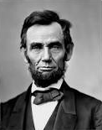
Biden, Compromise and the MC
So, you have the North and the South but there are border states that are part of the Union in the North that have sided with the North but are themselves slave states. So, in 1862 Lincoln is still compromising to make sure that these slave border states stay with the North. This is what he's being accused of. Lincoln responds to this open letter and he says I've never intended to leave anyone in doubt about the course I am pursuing. I'm fighting this war to save the Union and I will do that the shortest way possible under the Constitution. My first object is to save the Union and not either save or destroy slavery. If I could save the Union without freeing a single slave, I will do it. And if I could save it by freeing all the slaves I would do it. If I could save it by freeing some and leaving others alone, I would also do that. What I do about slavery and the black race I do because I believe it helps to save the Union. What I don't do, I don't do because I do not believe it will help to save the Union.
North
(slave)
Border States
South
So is it entirely accurate to say that the Civil War was fought over slavery? Not by Lincoln.

Slide 21
Biden, Compromise and the MC
We're going to paraphrase a few Ellen White quotes. If you look in Testimonies volume one 363 and the 250s, she speaks a lot about slavery. She's in this early history, in the early 1860s. She says many were blinded and grossly deceived in the last election. They placed in authority men who would wink at evil, men who would witness a flood of woe and misery unmoved, whose principles are corrupt, who are southern sympathizers and would preserve slavery as it is. She never names people but when you think that these are being written at the same time period as Abraham Lincoln's comments, however much she's impeded by sexism she knows all about Seward, all that Lincoln said in his 1858 debates, and we should read these quotes understanding that context. Many were blinded and grossly deceived when they placed Lincoln. Page 254.1, thousands have been induced to enlist with the understanding that this war was to exterminate slavery but now that they're stuck in the war, they're seeing they were deceived, that object of the north was not to abolish slavery. Lincoln had said that and she's describing that as a deception upon thousands who joined the northern army. They left their homes and sacrificed their lives to exterminate slavery and at that point in time they see no good results from the war except to preserve the Union and they are dissatisfied.
North
(slave)
Border States
South

Slide 22
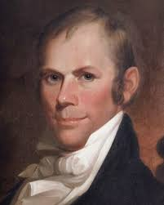
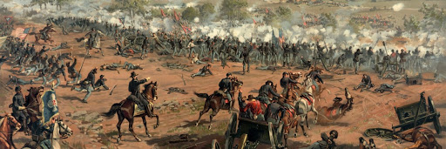
Biden, Compromise and the MC
Does she care about the preservation of the union? That war should have been fought to exterminate slavery and it was not. It was fought to hold together the country. She says it looks to her like an impossibility for slavery to be done away. All that abuse and cruelty exercised towards the slave is chargeable to all who have upheld the slave system whether they are southern or northern. Her position is opposed to that of Lincoln vehemently. She says God alone can wrench the slave from the hand of his oppressor.
We're not trying to make direct applications of people to people in this study. But if we can get a sense of the compromise that had occurred from 1798 through the Civil War so when Ellen White says God is judging the North we understand why. It's because of the men like Clay and Webster and Lincoln. When there are protests in America right now and they're tearing down statues, these aren't the statues heavily targeted. Because these are the good men, these were on the side that you would cheer for and vote for.
Henry
Clay
Daniel Webster
Abraham
Lincoln

Slide 23
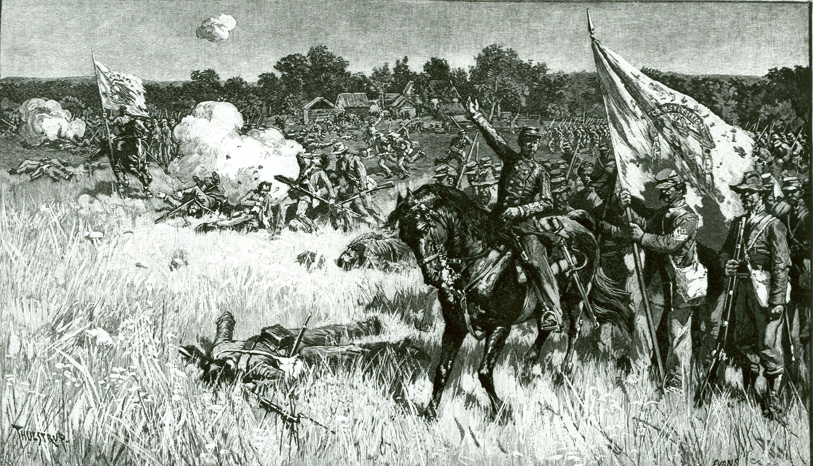
Biden, Compromise and the MC
We haven't discussed the Democrat party much at all, the John C Calhoun's, the sin of the South, that should be clear to everyone. What we want to get is a feel for the compromise of the North. It's the history of the Civil War, it's their time of trouble and she says only God can free the slaves.
How is he going to do that? In the middle of the first year of war she says that she sees a battle scene, it's shown to her. She sees the southern and the northern army's charge. The northern army starts to win, there is desperate fighting. But just as that northern side seems to be winning, she sees angels come down and start to help the South. They extend the length of that battle by giving help to the South. God was deliberately extending the Civil War. He wasn't going to let the South win, but he wasn't going to let the North win too quickly. Why would that be? This was mid-1861. A whole year later in August 1862, Lincoln is saying that if he could win that war and still permit slavery, he would do it. So, if God wants the end of slavery what does he have to do? He has to make that war hurt.

Slide 24
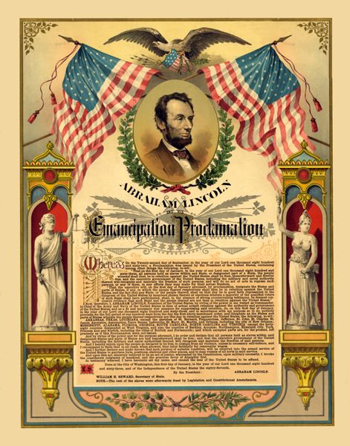
Biden, Compromise and the MC
Late 1862 Lincoln has drafted the Emancipation Proclamation. From 61 to mid 63 neither side was winning. The North couldn't get the upper hand over the South. Lincoln is saying if I can bring the union together and still permit slavery, I will do it. So, God essentially says I'm not going to let you bring the union together until you get rid of slavery. He's a Pharaoh at war with God and he's going to hurt until he does what he's told.
January 1863, he passes the Emancipation Proclamation. Mid 1863 at the Battle of Gettysburg the North begins to win. Yet even then the Emancipation Proclamation was a compromise. He freed all the slaves in the South but none of the slaves in the border states. So, about half a million slaves were still kept in bondage till the end of the Civil War.
North
(slave)
Border States
South

Slide 25
Biden, Compromise and the MC
compromises
1818 to 1821
1833
1850
There’s a number of US elections
✓1840. P. William Henry Harrison (dies)/VP. John Tyler
☒1844 P. Henry Clay/VP. Theodore F
✓1848 P. Zachary Taylor (dies)/VP. Millard Fillmore
✓1860 P. Lincoln/VP Hannibal Hamlin
Why are we looking at this history? We're looking at it because it has direct prophetic application to today. We're tracing the history of the good men. We began to do that in Portugal in April. We're not looking at the Bannons, the Donald Trumps, the Mitch McConnells, the Jeff Sessions. We're looking at nice centrist Democrats.
There's three specific compromises that the Whig party made. We haven't listed 1865 because it's outside of our reform line, 1864. But where they particularly compromised was at every election and the compromise sounds reasonable. If you want to end slavery, shouldn't you do it in a way that upholds the Constitution and the rule of law as it's written? Shouldn't you do that in a way that holds the United States together? Shouldn't you do that with a candidate who you know will get enough votes? The issue of slavery back then was complex. It had major implications for the financial system, for the medical system, for schools, it required complex answers and it wasn't simple. So, you wanted a nice centrist who'd win enough votes to become president, make some small token changes, but nothing revolutionary that would risk splitting the country.

Slide 26
Biden, Compromise and the MC
compromises
1818 to 1821
1833
1850
There’s a number of US elections
✓1840. P. William Henry Harrison (dies)/VP. John Tyler
☒1844 P. Henry Clay/VP. Theodore F
✓1848 P. Zachary Taylor (dies)/VP. Millard Fillmore
✓1860 P. Lincoln/VP Hannibal Hamlin
So, we come to the 2020 election. The Democrats have a very diverse pool to choose from. What is the major reasonable debate? Do you really think Elizabeth Warren can defeat Donald Trump? We just won't win. Or a young man in a homosexual relationship, or a black woman. So, they're going to compromise, they're going to create a cult of personality around Joe Biden that paints him as some type of benevolent uncle, he's always fought for equality but can compromise and hold together the United States as it becomes more and more polarized. We don't believe that Joe Biden is Henry Clay. Clay is a symbol of a whole group of people, of a centrist wing in a political party. But to uphold law, because it's really embarrassing to get called a dictator, because compromise sounds nice, because you want to win the election, you'll go with a white male candidate. Create a cult of personality around him and ignore his past history, with bussing, putting people on buses. Look up what he did in the criminal justice reform sector, the war on drugs, Anita Hill, how he's admired for his ability to compromise with Republicans and make friends.
And across his decades in the Senate, Mr. Biden tended to find his way to the center of the fray — civil rights debates, judicial hearings, the crime bill, the Iraq war — priding himself on a reputation as the lawmaker most likely to befriend Ted Kennedy and Strom Thurmond in the same lifetime.

Slide 27
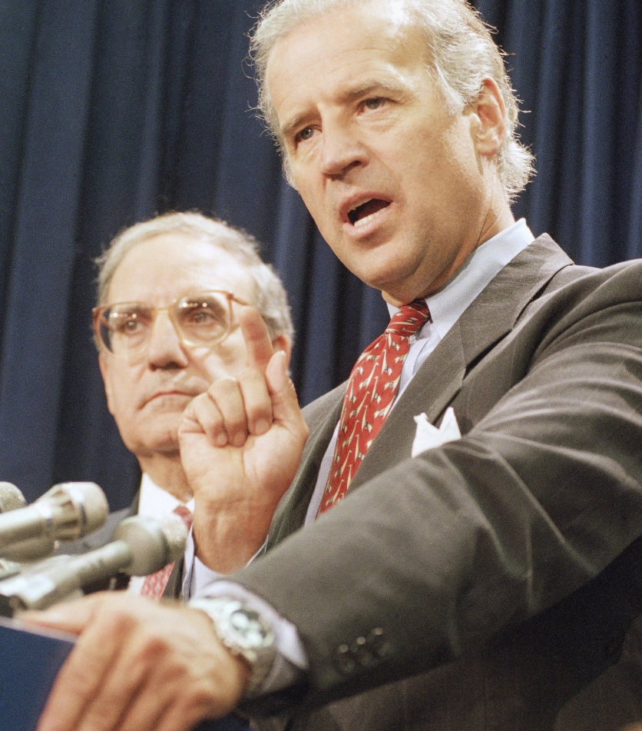
‘Lock the S.O.B.s Up’: Joe Biden and the Era of Mass Incarceration
He now plays down his role overhauling crime laws with segregationist senators in the ’80s and ’90s. That portrayal today is at odds with his actions and rhetoric back then.
‘Lock the S.O.B.s Up’: Joe Biden and the Era of Mass Incarceration - The New York Times (nytimes.com)
WASHINGTON — In September 1994, as President Bill Clinton signed the new Violent Crime Control and Law Enforcement Act in an elaborately choreographed ceremony on the south lawn of the White House, Joseph R. Biden Jr. sat directly behind the president’s lectern, flashing his trademark grin.
For Mr. Clinton, the law was an immediate follow-through on his campaign promise to focus more federal attention on crime prevention. But for Mr. Biden, the moment was the culmination of his decades-long effort to more closely marry the Democratic Party and law enforcement, and to transform the country’s criminal justice system in the process. He had won.
“The truth is,” Mr. Biden had boasted a year earlier in a speech on the Senate floor, “every major crime bill since 1976 that’s come out of this Congress, every minor crime bill, has had the name of the Democratic senator from the State of Delaware: Joe Biden.”

Slide 28
Biden, Compromise and the MC
What we’re becoming confused in as a movement is where we position ourselves regarding these external events. Last year it was easy for everyone except for those that left. So, I guess it wasn't so easy. The message was clear, on this side of November 9 from 2016 to 2019, from the increase of knowledge to the test we're meant to see Donald Trump, see him for all that he is and all that he stands for. It's not one man, he's a symbol. The overthrow of the government began at 9/11. The Republicans began to win in 2014. He's a symbol of something much bigger than himself. So, for all of those socially conservative people, they felt they were being pushed left. That was enough we're in the left. But we're making some points in how we prophetically view Alexandria Ocasio-Cortez and Michael Moore, which certainly wasn't centrist. But now that we're on the other side of November 9, from the test to the increase of knowledge, Concord, many people are confused, and we can see why. It’s not that they're doing bad things or they're bad people. But we're in a new testing time, a new dispensation and as false liberalism has been addressed inside the movement, many people start to say okay, that makes sense we are centrists because of what Elder Tess said about false freedom. We want to challenge that understanding, that we are not centrists.
Nov. 9
2019
IoK
2014
2016
Gethsemane
Wilderness
Trump externally

Slide 29
Biden, Compromise and the MC
There are two misunderstandings in this movement. One is the idea that we are centrist and that is a good thing, we shouldn't be extreme. The second is the idea that we are centrists and those supporting false freedom are saying they are the AOCs, the Michael Moores, the protesters, the defenders of freedom. Neither misunderstanding is correct. Politically externally we should be seeing the correct arguments of the protesters. One of the key ideas behind the protests, one of the main things that they want, is to destroy this false cult of personality around these so-called good people revered by statues in the United States.
We have not been controlled or guided by watching them, we have not learned from their protests. We were doing that, beginning that work a month before the death of George Floyd on April 18th in Portugal. This study would have come to the point that it is without them.
Nov. 9
2019
IoK
2014
2016
Gethsemane
Wilderness
Trump externally

Slide 30
Biden, Compromise and the MC
Equality is a complex argument, it requires major restructuring in education, in healthcare, and in law enforcement, positions held to by Warren, by Sanders, by those considered extremists. Someone asked Biden if he would defund the police because does a local police force really need a tank. When asked if he would defund the police he said absolutely not because he's not an extremist, he's a centrist that can win the election. It's all part of dealing with the inequality and racism from the beginning of America.
The message has guided us to see what is right and what is wrong. The news sources are important and helpful, but the lines themselves place us and it's not as a centrist, but who would be considered political extremists even in liberal America, even in the Democrat party.
Nov. 9
2019
IoK
2014
2016
Gethsemane
Wilderness
Trump externally

Slide 31
Biden, Compromise and the MC
So, it wasn’t the point in the studies to make an application of who will win the election. The movement does not know who will win the election. We haven't been prophetically shown that but regardless of that we have to know where we stand. Many people are asking questions about voting and we're not saying whether or not people should vote but one of the reasons people so desperately want to vote is because they feel hope and Biden that they should not feel. A Calhoun presidency would have been horrific as would a Trump second term. But just like World War III we should expect this crisis, the Sunday law issues to be more subtle. We should have seen that develop when we said those horns aren't broken because America never stops pretending. We can see that in their history.
Nov. 9
2019
IoK
2014
2016
Gethsemane
Wilderness
Trump externally

Slide 32
Biden, Compromise and the MC
The last dispensation, in the latter rain and the testing issues associated with it, we had to see Trump externally, and then internally FFA versus the midnight cry of radical equality. From 2019 Elder Tess and others felt no desire to read any more books about how bad Trump is, to share a multitude of articles about how bad he is, of the wickedness of the Republican party. There has been no impulse to do that. You may have noticed the media broadcast sharing less and less of him because we should all already know it. It's not that we have changed, or we shouldn’t still follow what is occurring but the test in this dispensation is more subtle, it's not the fight between good and evil that we simply saw in the last dispensation. It's the fight between evil and so-called compromised good.
Nov. 9
2019
IoK
2014
2016
Gethsemane
Wilderness
Trump externally
FFA internally

Slide 33
Biden, Compromise and the MC
What we have in this dispensation is Biden. We'll just make it Republican and Democrat. What were meant to see is Democrat compromise. Why did they compromise? The idea is if we don't compromise, we won't win over the people. What's the internal of that? Because we have faced a shaking and rebellion in both dispensations.
And the argument of the internal is the following:
If we are these extremists, how will we ever win over Levites and Nethinims? How will we be successful as a movement? We have to compromise. Compromise on our vows, compromise on our reforms which is all compromise on equality. That argument appears differently in different countries.
Nov. 9
2019
IoK
2014
2016
Gethsemane
Wilderness
Republican
FFA vs. MC
Democrat compromise

Slide 34
Biden, Compromise and the MC
In portions of Africa, it has presented itself in the following way:
If we really believe in freedom, we will not force equality on the people. We will see cultural beauty in the dowry system. We will give freedom to practice equality to whatever extent and whatever way they choose, because God doesn’t force, and God doesn't kill. They're encouraged to go back and read the history of the Civil War . God took Abraham Lincoln by the throat and said you will abolish slavery and he was willing to allow death in that process. As they've made their argument for freedom, the idea is how will you ever have success in South Sudan or in many of those countries if you have a message against Lobola? Teach equality but don't practice it, you won't get the votes of the people.
Nov. 9
2019
IoK
2014
2016
Gethsemane
Wilderness
Republican
FFA vs. MC
Democrat compromise

Slide 35
Biden, Compromise and the MC
The movement doesn't have the right to remove teachers or leaders, an attack on organization. Go back to Testimonies volume one in the 350’s when she's referring to a brother and she names him who had pro-slavery sympathizers and came under church discipline. These arguments by people who claim to be for freedom, who claim to be holding up equality are presenting to their people a compromised version. In that process they are destroying them. And we watch the dead and the dying spiritually on every side. If people could see the carnage, they would not have any problem with those leaders being named. But we either don't believe the sin of the North or we can't see it. In the Western world compromise exhibits differently.
Nov. 9
2019
IoK
2014
2016
Gethsemane
Wilderness
Republican
FFA vs. MC
Democrat compromise

Slide 36
Biden, Compromise and the MC
The problem in the history of Gethsemane 2016 to 2019 is that FFA has a feeling of what is right and wrong, and the message goes against what they feel is right or wrong. The same has occurred now. Many people have a feeling that there's nothing wrong with jewelry, with makeup, that those reform vows infringe their freedom.
This is something that the external world has known for many years. In history the Chinese used to bind the feet of their women, mothers would do that to their daughters because it seemed to make them more desirable. In parts of Africa, they'll take a rusty knife and cut up a woman between her legs, it makes her more desirable. In South Korea they cover themselves in toxic chemicals to bleach their skin because it makes them more desirable. In other parts of Africa, the women wear rings around their necks to make it appear longer up to 25 pounds. Or they practice scarification, they create deep cuts across the body that scar because it's considered desirable.
Nov. 9
2019
IoK
2014
2016
Gethsemane
Wilderness
Republican
FFA vs. MC
Democrat compromise

Slide 37
Biden, Compromise and the MC
And for 6,000 years women have been taught that your value depends on how desirable you are. And this push for jewelry and everything associated with that kind of lifestyle, it's not that those women are somehow immoral and evil, it’s that their damaged by 6,000 years of sexism. And as a movement we will not compromise and say that that is okay. Our position on jewelry does not make us centrists. The people that cannot see the inequality in those practices are suffering the same thing FFA did. It goes against their deep feeling about what is right or wrong. But we are not conservatives looking at a woman in a short skirt and judging her. We won't defend anyone thinking that way. What we see is the damage of sexism. And our position on the reform vows puts us on the extreme end of equality not in the center. Mothers hold their daughter down while they perform genital mutilation because women struggle with equality. Women in the movement defend Lobola in their own slave trade because they fail to see the sin.
Nov. 9
2019
IoK
2014
2016
Gethsemane
Wilderness
Republican
FFA vs. MC
Democrat compromise

Slide 38
Biden, Compromise and the MC
It's been 6,000 years but do we in this movement have the right to compromise what God is requiring us to learn through the message? Organization is a specifically severe test in this dispensation. For 30 years there were women leaders in this movement, there was a female leader in Australia and in other parts of the world. For one of 31 years they have had support from the leadership. One of 31 years. So, is it any wonder now that people start to attack organization? Is it any wonder that us extremists are wishing to uphold it strictly when you have a woman leader in North America? A woman leader in Oceania. It's as much a test here as it is there. No change was made to the organization of Oceana or Australia last year. There was only a verbal repetition of what had already been put in place but it's not just on the Continental level. We have a woman leader in South Sudan facing persecution and abuse. We have a woman leader in Argentina, a woman leader in the German world. Beneath them we have female Bible workers through Africa now sitting on boards. The attacks occurring in this dispensation in Africa, in the West, in the name of absolute freedom, against the vows, against practiced organization and practiced equality, and nothing more than the internal application of the external compromise. It's false freedom versus the Midnight Cry and we have the history of the Millerites to teach us that.
Nov. 9
2019
IoK
2014
2016
Gethsemane
Wilderness
Republican
FFA vs. MC
Democrat compromise

Slide 39
Biden, Compromise and the MC
So, whoever wins it does not change the course of the United States. If they were so supportive of Kamala Harris why isn't she their presidential candidate? They've balanced that presidential ticket just as the Whig party did, just as the Republican party did to win people. We should go back and look at his record, we should see the inequality of today for what it is. The extent of it and the historical causes of it to give legitimacy to so-called extremist positions like defund the police. If you want to vote at least see that you would be voting for a compromise, a compromised candidate
Nov. 9
2019
IoK
2014
2016
Gethsemane
Wilderness
Republican
FFA vs. MC
Democrat compromise

Slide 40
Biden, Compromise and the MC
We weren't wishing to make application about who wins. What we need to see is why Ellen White's, maybe not her harshest words, but her most extensive condemnation is preserved for the North. If we can see the external danger and see the compromise, we'll understand the internal shaking. As much as it is against what we might feel is the natural order of things, to bring those feelings in line with the Midnight Cry and not the other way around, to recognize organization and not just encourage, not just uplift, but respect the leadership of the women in charge. In reference to the local leaders, be they Continental, be they on your boards, be they your Bible workers because we've only begun this work and we’ll only have its greatest success if we do it together.
Nov. 9
2019
IoK
2014
2016
Gethsemane
Wilderness
Republican
FFA vs. MC
Democrat compromise

Slide 41
Biden Knows Washington Has Changed. He’s Less Sure He Has To. - The New York Times (nytimes.com)

