Slide 1
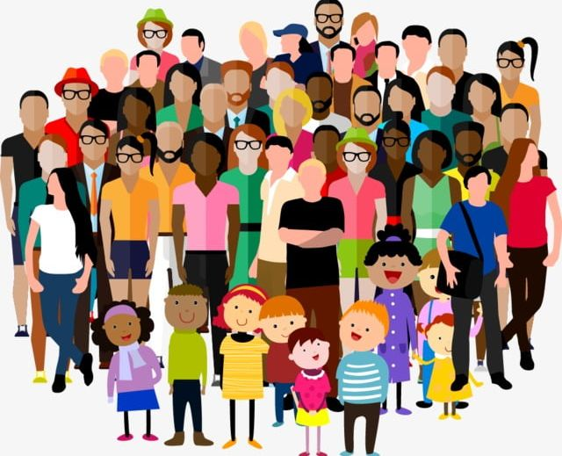
Freedom In America Part 6
Citizens in Communities
Part 1: Unit Overview
https://www.docsoffreedom.org/units/citizens-in-communities
Side Notes:

