Slide 1
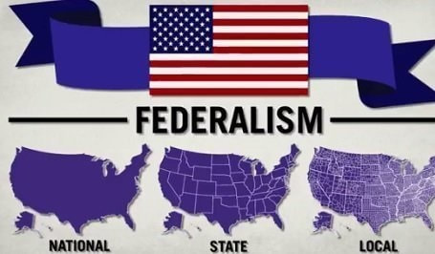
Freedom In America Part 6
Citizens in Communities
Part 2: Federalism
https://www.docsoffreedom.org/readings/federalism
Side Notes:

