Slide 1
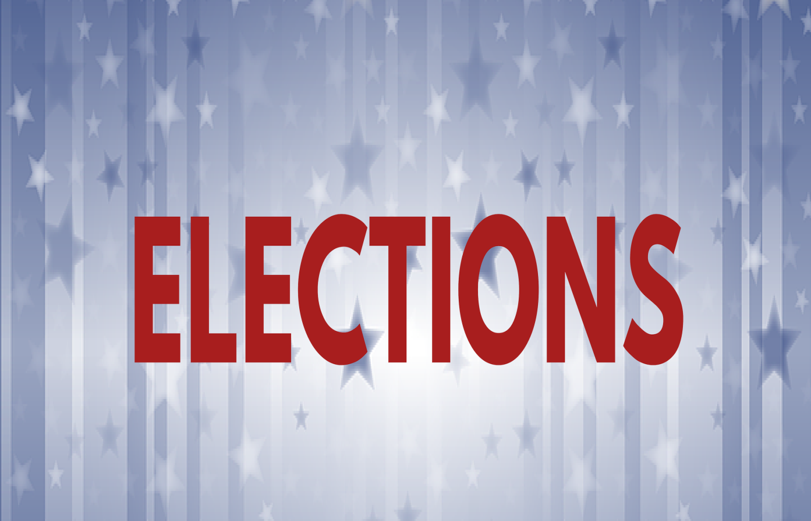
Freedom In America Part 6
Citizens in Communities
Part 3: Elections
https://www.docsoffreedom.org/readings/elections
Side Notes:

