Slide 1
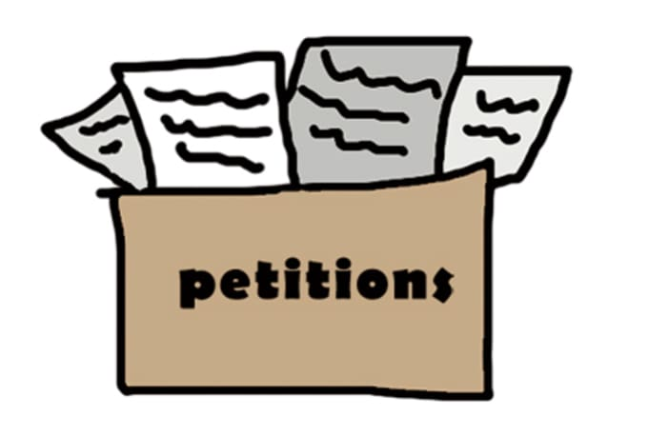
Freedom In America Part 6
Citizens in Communities
Part 6: Civil Discourse and Petitioning
https://www.docsoffreedom.org/readings/civil-discourse-and-petitioning
Side Notes:

