Slide 1
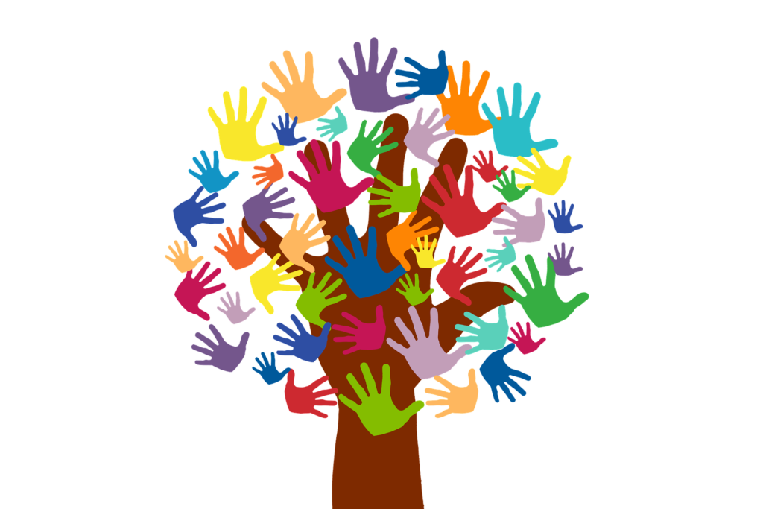
Freedom In America Part 6
Citizens in Communities
Part 7: Voluntarism and Public Servants
https://www.docsoffreedom.org/readings/voluntarism-and-public-servants
Side Notes:

