Slide 1
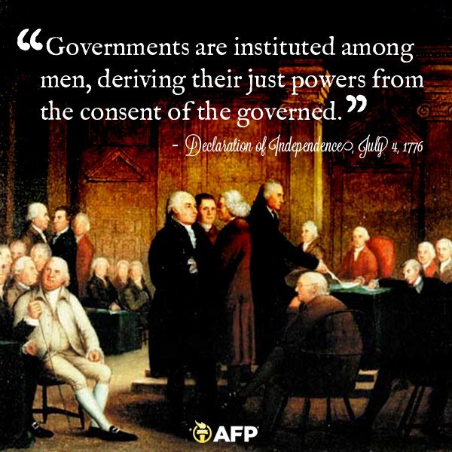
Freedom In America Part 2
The Foundations of American Government
Part 6: Popular Sovereignty and the Consent of the Governed
https://www.docsoffreedom.org/readings/popular-sovereignty-and-the-consent-of-the-governed
Side Notes:

