Slide 1
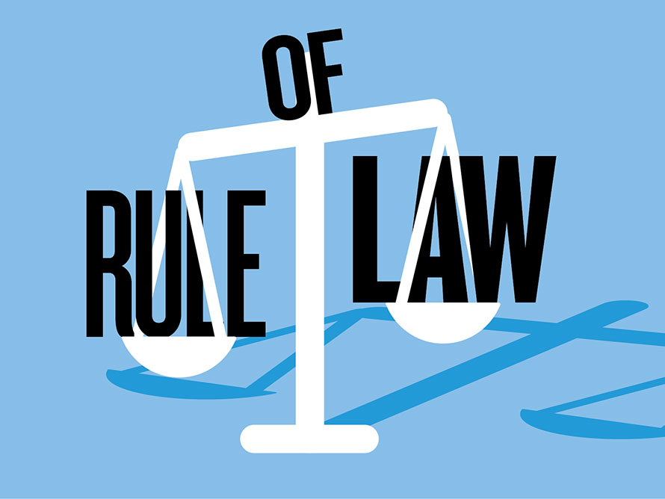
Freedom In America Part 2
The Foundations of American Government
Part 7: Rule of Law
https://www.docsoffreedom.org/readings/rule-of-law
Side Notes:
The rule of law is defined in the Oxford English Dictionary as: "The authority and influence of law in society, especially when viewed as a constraint on individual and institutional behavior; (hence) the principle whereby all members of a society (including those in government) are considered equally subject to publicly disclosed legal codes and processes."^{[2]} The phrase "the rule of law" refers to a political situation, not to any specific legal rule.
Wikipedia Source

