Slide 1
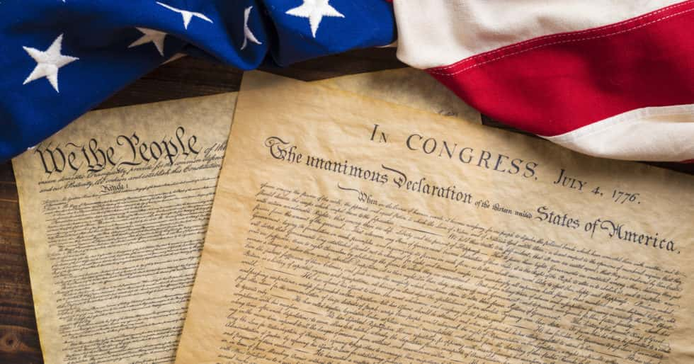
Freedom In America Part 2
The Foundations of American Government
Part 2: The Declaration of Independence
https://www.docsoffreedom.org/readings/the-declaration-of-independence
Side Notes:
The Continental Congress was initially a convention of delegates from a number of British American colonies at the height of the American Revolution, who spoke and acted collectively for the people of the Thirteen Colonies that ultimately became the United States of America.
Social Compact or Social Contract: (Philosophy) (in the theories of Locke, Hobbes, Rousseau, and others) an agreement, entered into by individuals, that results in the formation of the state or of organized society, the prime motive being the desire for protection, which entails the surrender of some or all personal liberties

