Slide 1
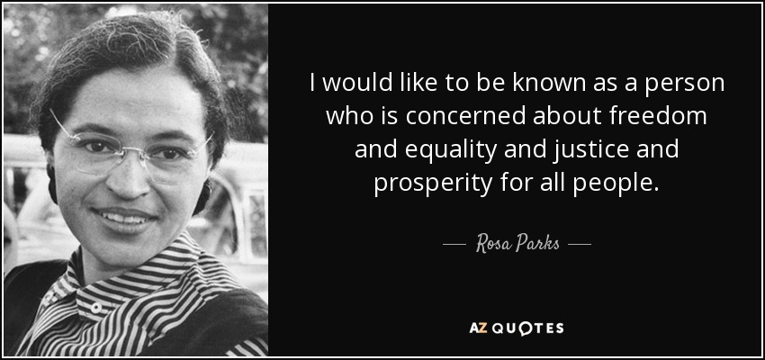
Freedom In America Part 2
The Foundations of American Government
Part 3: Justice For All
https://www.docsoffreedom.org/readings/justice-for-all
Side Notes:

