Slide 1
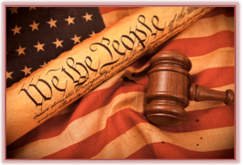
Freedom In America Part 2
The Foundations of American Government
Part 4: The Constitution
https://www.docsoffreedom.org/readings/the-constitution
Side Notes:
The Olive Branch Petition was a final attempt by the colonists to avoid going to war with Britain during the American Revolution. It was a document in which the colonists pledged their loyalty to the crown and asserted their rights as British citizens. The Olive Branch Petition was adopted by Congress on July 5, 1775.
Wikipedia Source

