Slide 1
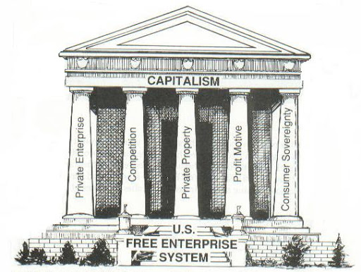
Freedom In America Part 7
Free Enterprise
Part 1: Unit Overview
https://www.docsoffreedom.org/units/free-enterprise
Side Notes:

