Slide 1
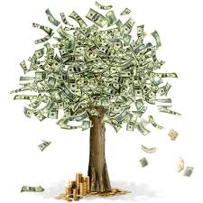
Freedom In America Part 7
Free Enterprise
Part 2: Making Economic Decisions
https://www.docsoffreedom.org/readings/making-economic-decisions
Side Notes:

