Slide 1
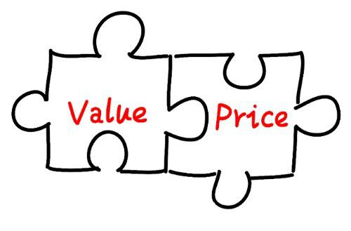
Freedom In America Part 7
Free Enterprise
Part 3: Prices and Value
https://www.docsoffreedom.org/readings/prices-and-value
Side Notes:

