Slide 1
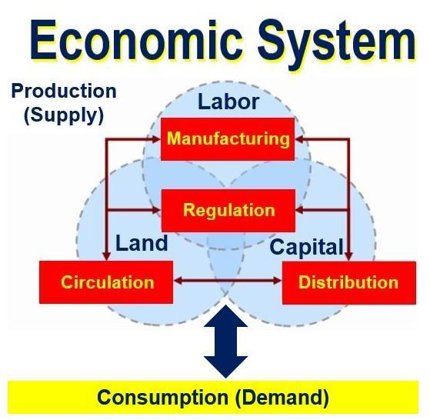
Freedom In America Part 7
Free Enterprise
Part 4: How Economic Systems Work
https://www.docsoffreedom.org/readings/how-economic-systems-work
Side Notes:

