Slide 1
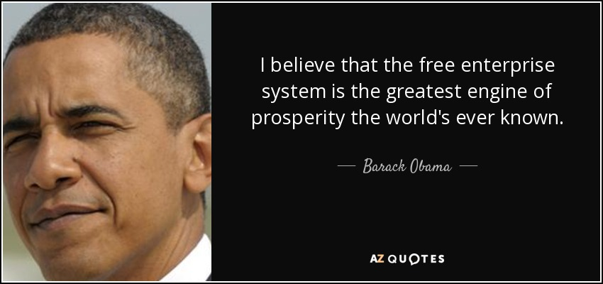
Freedom In America Part 7
Free Enterprise
Part 5: Free Enterprise and Prosperity
https://www.docsoffreedom.org/readings/free-enterprise-and-prosperity
Side Notes:

