Slide 1
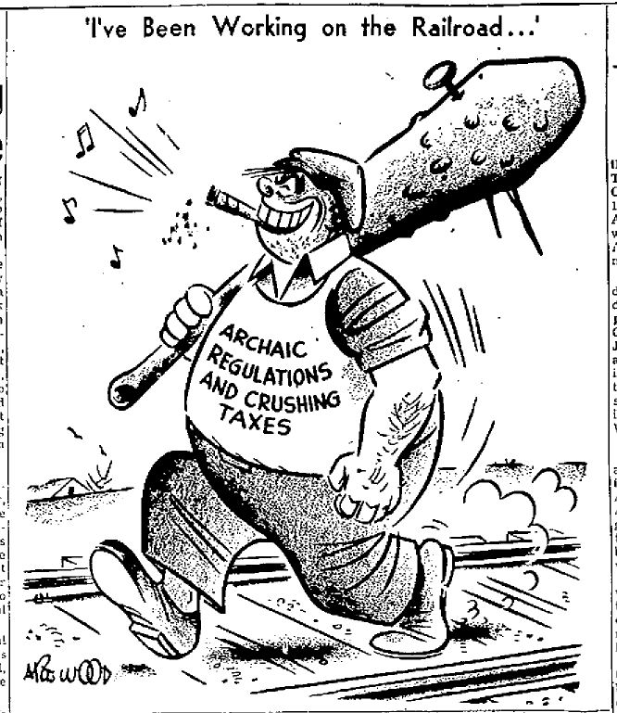
Freedom In America Part 7
Free Enterprise
Part 7: Taxes and Regulations
https://www.docsoffreedom.org/readings/taxes-and-regulation
Side Notes:

