Slide 1
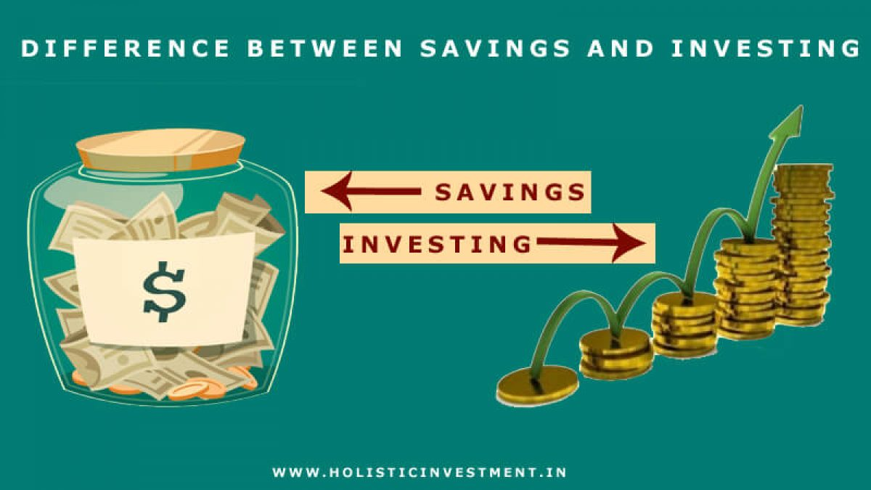
Freedom In America Part 7
Free Enterprise
Part 8: Saving and Investing
https://www.docsoffreedom.org/readings/saving-and-investing
Side Notes:

