Slide 1
Camp Meeting Guadeloupe
Acts 27 – 1 of 15
Tess Lambert
April 2019

Slide 2
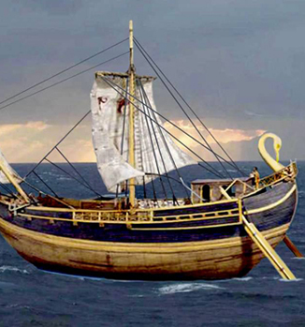
We’ll begin this study by laying some foundational work. Its hard for us to go into and understand or teach, some of the things we want to address and going back to the beginning and reminding us where we started. So I want to go back to Acts 27. And just briefly lay out it's structure. This wont be comprehensive, this was done in France at the end of last year The study has developed since then, so there are a couple of other points I want to highlight, which may be new to us. But besides that, we still need to understand these lines or at there basic structure to form some of our later arguments or conclusions. We are also encouraged to be familiar to the studies late last year.
In elder Parminder's classes, he's spending some time discussing methodology, and that methodology is really the foundation for these studies. If we want to be safe, we should also know how we come to the conclusions that we come to, to really establish us in these things. And to also protect us from mistakes or errors. So we can understand the methodology that undergirds.
We'll begin in Acts 27, we won’t go into every detail and prove every point but rather refer back to last years studies, but we’ll just lay out those lines, to remind us. Because all the way through this study, nearly everything we discuss can be placed or backed over this chapter, and everything is interconnected.
So turning to Acts 27, we see that it's Paul's 4thmissionary journey. And immediately we should notice the number 4. It's his journey as a prisoner from Caesarea to Rome. And in Acts 27 and 28, particularity focusing on Acts 27, it is going to give us the story of 2 ships. We want to look at those 2 ships, and their journey as a parable. And to use the methodology that Parminder is teaching, regarding parable teaching. So we'll look into the meaning of the names. And were going to plot Paul’s journey on a reform line.
Acts 27, the story of the 2 ships. We'll start with the first ship. This is the ship of Adramyttium.

Slide 3
What does Adramyttium mean? Abide in Death. So it means to abide in the condition of being dead. So if you were to abide, what does that imply? If I went somewhere, I went into a house, and then I abided in that house, it means you’re already there.
Noah Websters dictionary we want to note the 3rddefinition, it says to continue in the same state permanently. To be firm and unmovable.
So this ship of Adramyttium, when Paul begins his journey it's in a dead state before, and then something comes or happens, and it chooses to abide in that same dead condition. It's not changing so the ship abides in death. It's already in death, it's going to maintain that same condition. We mark the beginning of its journey at Caesarea. And what does Caesarea mean? It means to be cut out. So this point in time, you can notice that this ship abides in the same condition, you can also mark a cutting out, or a separation.
As we would note at the time of the end (TOE), it would refer us back to the story of Daniel 2 and the cutting out of the that stone from the mountain.
Adramyttium
“Abide in death”
TOE
“cut out”
Caesarea

Slide 4
Adramyttium
“Abide in death”
TOE
“cut out”
1A
Caesarea
If we went to Acts 24:24-25, This is what Paul is experiencing in Caesarea as a prisoner, he's not going to remain idle, but has a message to give.
Acts 24:24 And after certain days, when Felix came with his wife Drusilla, which was a Jewess, he sent for Paul, and heard him concerning the faith in Christ.
24:25 And as he reasoned of righteousness, temperance, and judgment to come, Felix trembled, and answered, Go thy way for this time; when I have a convenient season, I will call for thee.
So at this point Paul gives a message and what message is that? This the first AM. How many parts does the first AM have? 3. The 3 angels message is encapsulated in the first. What reaction does Felix have to this? EGW says in AA that he is reminded of his guilt, he saw himself as cruel, and immoral, and never had the truth been brought so into his heart. And his soul was filled with terror, all the secrets of his crimes were opened before God, as he saw that he was going to be judged. And this caused terror, fear, and EGW says he trembled with dread. So the reaction of the first Angels Message, is one of fear. He saw that he was going to be judged. EGW said that when he rejected this message, he never received another call from God. So this message was life and death.

Slide 5
Adramyttium
“Abide in death”
TOE
“cut out”
1A
Caesarea
Felix/Festus= USA
Reagan/Bush
Acts 24: 27 But after two years Porcius Festus came into Felix' room: and Felix, willing to show the Jews a pleasure, left Paul bound.
Felix transitions to Festus. Felix is a state power, he’s government, he receives the warning of judgment at the TOE. And we see a transition in this state power, from one lead to another. It's at this point in time, where we often mark a transition in leadership. The one at our TOE in 1989, we would say Reagan and George Bush. So what does Felix represent? = USA. State power now being warned of judgment.
But Paul gives the message to another person in the next chapter.
Acts 25:13 And after certain days king Agrippa and Bernice came unto Caesarea to salute Festus.
So Agrippa and Bernice visit Festus and hear of Paul, and Agrippa says he wants to hear Paul. Agrippa is a Jewish king, and he is connected to the Jewish system, particularly to that of the Sanctuary, at the temple. He is part of a triumvirate, 3 men, who choose the high priest, they make decisions for the temple and the Jewish nation. He’s a Jew himself, a Jewish king.
In verse 22, we find Agrippa saying unto Festus, that he want to hear the message of Paul and in the beginning of Ch 26, Paul begins to speak to Agrippa. And what message does he give him in Ch 26? He lays open prophecy, he showed how Jesus was prophesied in the Old Testament scriptures.

Slide 6
Adramyttium
“Abide in death”
TOE
“cut out”
1A
Caesarea
Felix/Festus= USA
Reagan/Bush
We want to note a couple of things that Paul says to Agrippa that he could not say to Felix or to Festus. He says to Agrippa, “ Acts 26:3 “I know you are an expert, in all the customs and questions which are among the Jews” Agrippa is well acquainted with that system, he’s part of it. And then he says:
26:26 For the king knoweth of these things, before whom also I speak freely: for I am persuaded that none of these things are hidden from him; for this thing was not done in a corner.
26:27 King Agrippa, believest thou the prophets? I know that thou believest.
You will find interesting that the core message to Felix you can tie Ch 24:24, and the point to Agrippa 26:26, Paul says to Festus, pointing to Agrippa, that Agrippa knows what I'm talking about. Festus has accused Paul of madness, and Paul says in his defense I'm speaking freely to Agrippa because all I’m doing is telling him what he already knows. Because these things might have been hidden from you, but they were not hidden from Agrippa because Agrippa already had the prophecies. Not only did he have them, he believed them and the life of Christ had not been hidden from him because he already knew and believed in the OT scriptures.

Slide 7
So the message is given to 2 people. Felix and Agrippa. We want to note Agrippa’s history, his fathers, In the life of Paul, pg 255, EGW is speaking of Agrippa in response to Paul's message. Again it's one of fear, but it’s not only his own sins he is reminded of, he’s reminded of 4 generations - his great grand father, his great uncle, his father and himself, 4 generations and it is not only his own sins he is reminded of, but he is reminded of 4 generations that killed the prophets and ignored the prophecies. His great grandfather Herod killed the children of Bethlehem, it was Herod that spoke to the wise men, and had the babies and children killed. His great uncle, he calls him Antipas, but this is the Herod that killed John the Baptist. And then he is reminded of his father Agrippa who killed the apostle James, and he saw these as judgments of God. The judgments of God that fell on his fathers because they disregarded the prophets. He was reminded of all of this and then his own sins, but she says he put all these thoughts aside, and while he said he was almost convicted, he refused to surrender his pride. We find that his experience is that of Belshazzar, when Daniel says “thou has known all this”, and Paul could not say “though knewest all this, to Felix or Festus. That’s a condemnation reserved for Agrippa. Because he knew what was happening, and Agrippa represents the Adventist church structure.
So we come to the TOE and we are marking two different institutions. A warning, a judgment is given them, and what do they choose? They choose to abide in their present condition. Neither Felix nor Agrippa will swerve from the path that they are on. We'll then quickly just note the course of this ship.
Adramyttium
“Abide in death”
TOE
“cut out”
1A
Ceasarea
4th
Felix/Festus= USA
(Reagan/Bush)
Agrippa SDA

Slide 8
Adramyttium
“Abide in death”
TOE
“cut out”
1A
Ceasarea
911
Sidon
Cypress
4th
Felix/Festus= USA
(Reagan/Bush)
Agrippa SDA
4th
4th
refreshing
Next it takes us to Sidon. Sidon in the Bible, is mentioned in connection to two other powers. Here are a few references, Isaiah 23:2, Jer 25:22, Joel 3:4, and Ezk 28-29 both chapters. We will find that it is mentioned in context with the 3 fold union, and if we went through those verses, we did that last year, we found Sidon is a representative of the false prophet of the USA. So Sidon at this point, marks the USA at 9/11. And we see in the verses that this is were Paul was in Acts 27
27:3 And the next [day] we touched at Sidon. And Julius courteously entreated Paul, and gave [him] liberty to go unto his friends to refresh himself.
So EGW says that this was as an oasis, for him in his journey. And we will note in verse 3 it calls it a refreshing. And what concept does refreshing give us? That of rain and at 9/11, we would mark the beginning of rain. This period between 1989 and 9/11 is the plowing. Then we have early rain marked at 9/11, a refreshing.
The next stop for the ship, is under Cypress. Please note 2 things, we marked the 4thgeneration at Caesarea (TOE) we got that from the story of Agrippa, he represents the 4thgeneration. We come to Sidon, it this is Noah’s great grand son, the 4thgeneration. When we come to Cypress, (Kittem) and Kittem is Noah's great grand son, 4thgeneration. We have 3 times on this reform line from Caesarea to Sidon to Cypress, it's marking the 4thgeneration.

Slide 9
We find in the book of Acts, there's two false prophets connected with Cypress. One is Simon Magus, and the other is Barjesus also known as Elymas. So at this point we mark a false prophet, externally. There is an external false prophet, as well as an internal false prophet. Elymas or Barjesus was separate to the early Christian movement in the book of Acts. He never claimed to be part of them, he's external in that movement, Simon Magnus is internal. A baptized member of the new Christian church. Ellen White puts him in connection to Ananias and Saphira, Demus and Judas Iscariot. She says that all of these people show that false brethren will be found in Gods church, to the end of time. So we can mark at Cypress, an external and an internal false prophet.
We considered the meaning of the name Cypress, and it's connected to the concept of purity. To be fair or be pure, and to be fair means to be clear. Like a clear blue sky or clear water, it doesn't have any impurities, so it's this concept of purity and completeness. If we were to go to Early Writings, EGW talks about the living testimony. And what does the living testimony mean? She is talking about Millerite history and the company that left the fallen churches. And she says these people had the living testimony. So if you have a living testimony, you have a testimony that your living from the inside out. It's purity, a clean life. To have no spot within you. So we connect the concept of Cypress, which means to be unpolluted the concept of the living testimony, meaning unpolluted. And what EGW talks about the living testimony she is describing the condition of the Millerite's at the MC. And we connected the MC to the experience of Cypress.
Adramyttium
“Abide in death”
TOE
“cut out”
1A
Ceasarea
911
Sidon
MC
Cypress
4th
Felix/Festus= USA
(Reagan/Bush)
Agrippa SDA
4th
4th
refreshing
False prophet
Int: Simon Magus
Ext: Elymas

Slide 10
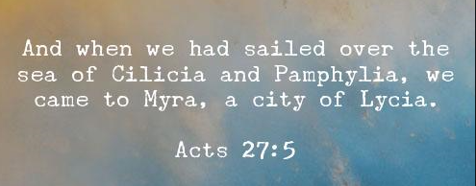
Adramyttium
“Abide in death”
TOE
“cut out”
Panium/
MC
Cypress
SL
1A
Ceasarea
911
Sidon
Overturn
A nation made up of every tribe
Cilicia
Pamphylia
4th
Felix/Festus= USA
(Reagan/Bush)
Agrippa SDA
4th
4th
USA
UN
refreshing
False prophet
Int: Simon Magus
Ext: Elymas
Next we see the Sea of Cilicia and Pamphylia.
Acts 27:5 And when we had sailed over the sea of Cilicia and Pamphylia, we came to Myra, [a city] of Lycia.
So after sailing under Cypress, they sail over the sea of Cilicia and Pamphylia.
And what does Cilicia and Pamphylia, mean? Cilicia means to “over turn”, and Pamphylia means “A nation made up of every tribe”. And when do we mark this experience? What’s the nation that’s falling after the M/C or Panium? This is the USA. After the M/C we mark the fall of which head of Bible prophecy? The fall of the 6thhead and the rise of the 7th. EGW says, God has given plenty of evidence that He can establish kingdoms and over turn kingdoms. And after the M/C which we’ll rephrase as Panium, we mark the fall of one head, and the rise of another. The fall of the USA and the rise of the 7th head, the UN.

Slide 11
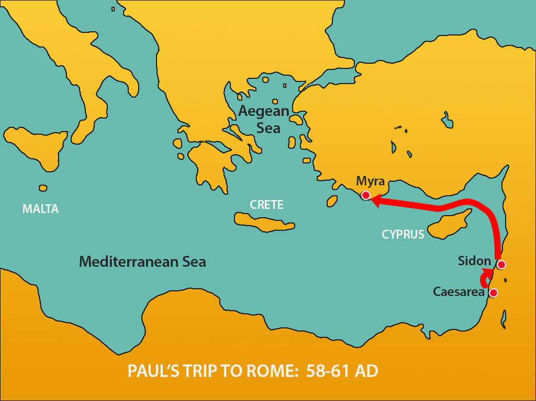
We’re tying the journey of this ship to two men. At the very beginning at Caesarea, they give us the theme, what this ship represents, they are the ones that chose to abide in death. They are symbolized the by the ship of Adramyttium. We mark them in Caesarea, choosing to abide in that condition. We traced them over Sidon, over Cypress where there is contrary winds, to where they begin to fall and are overturned, as we see another nation rise up. You can already see the transition in the heads, externally it's simple. We already teach the fall of the USA is completely fallen by S/L. And the rise of the UN. But this ship doesn't just represent the USA, It also represents the institutions of Adventism. There’s another quote; PM 170.2 and we’ll paraphrase it. Here she says, the Lord will purify His church, God is going to turn and over turn the institutions called by His name, this will be a refining process but it won't be put off for long. He's going to cleanse His temple. So not only do we see an external over turning, we see an internal over turning, in the institutions of Adventism. Externally it's the institutions of the USA, internally it's the institutions of the Adventism, ending at the S/L, which is symbolized in Acts 27:5 by Myra a city of Lycia.
Adramyttium
“Abide in death”
TOE
“cut out”
Panium/
MC
Cypress
Myra
Lycia
SL
1A
Ceasarea
911
Sidon
Overturn
A nation made up of every tribe
Cilicia
Pamphylia
4th
Felix/Festus= USA
(Reagan/Bush)
Agrippa SDA
4th
4th
USA
UN
refreshing
False prophet
Int: Simon Magus
Ext: Elymas

Slide 12
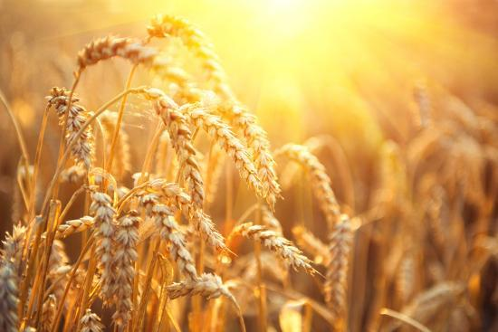
The word Myra comes from the word Myrrh. To go back into the Old Testament, we will find our meaning of the word Myrrh. The Greek word in Acts 27, just takes you back to the Hebrew. So we have to go to the OT to define Myrrh. And the concept we see from that, is “Bitterness” It means to distill in drops, it's “Extracting”, it has those two concepts. An extraction and also bitterness.
So we mark Myra as a representative of bitterness. And Lycia you can trace to a couple of different meanings, its name gives us two concepts. One is an idea of a Wolf. It may not seam like these two meanings are related, but they are. One is the concept of a wolf, as in cruel – cruelty and destruction, greed. The words used in its definition are the same words that EGW uses to attribute to Felix. Some of them don't translate well. But they are essentially the same words that EGW attributes to Felix. Which is the same concept of being a wolf. It also comes down to color.
In Thayers, we find the meaning of light. And it's this idea of being white. But it's not any type of white, it's light. It's really bright. So the concept is not just a white but a bright white. It’s a brilliant glowing white and what they tie it to is the color of ripened grain. So when the people left the city of Lycia, they looked over their harvest and they would identify the color in the same language; and it's believed this is where the word came from, from the idea of their ripened harvest. They weren't just white they were more golden like ripened grain. Brilliant and Golden.
Adramyttium
“Abide in death”
TOE
“cut out”
Panium/
MC
Cypress
Myra
Lycia
SL
Bitterness
Extracting
bright white
harvest
1A
Ceasarea
911
Sidon
Overturn
A nation made up of every tribe
Cilicia
Pamphylia
4th
Felix/Festus= USA
(Reagan/Bush)
Agrippa SDA
4th
4th
USA
UN
refreshing
False prophet
Int: Simon Magus
Ext: Elymas

Slide 13
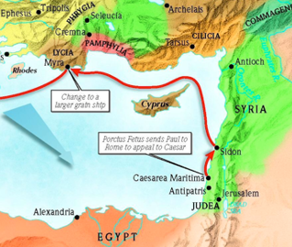
Adramyttium
“Abide in death”
TOE
“cut out”
2 FP
Bitterness
Extracting
bright white
harvest
Panium/
MC
Cypress
Myra
Lycia
SL
1A
Ceasarea
911
Sidon
Overturn
A nation made up of every tribe
Cilicia
Pamphylia
Argos
4th
Felix/Festus= USA
(Reagan/Bush)
Agrippa SDA
4th
4th
USA
UN
refreshing
This is where Paul gets off the ship, it’s journey ends. If we were to consider this reform line if it wasn't about this ship, but a group of people we would continue the story past S/L. What way mark would we mark after S/L? We mark the L/C. Why is there a Loud cry? Who are they crying to? To the World. What is the time period of the world? It's their harvest. You’re calling them out of the world, into God’s church or people. So after S/L, what is it for the world? It's their harvest time.
We need to note, if we followed the studies of Pyrrhus, a city is marked at S/L, known as (Argos) the same way mark. And what does Argos mean? It means to be white, but there is a reason why the city is named after whiteness. Beneath the city of Argos, was the Argolic plain, and when they looked out their windows at harvest time, they saw the color of the their ripened grain. And Argos is named after that color, it's this golden glow, that seams to shimmer white. So Argos gives us the exact same concept as Lycia and both are placed at the same way mark S/L. This is the journey of the first ship, Ardamyttium.

Slide 14
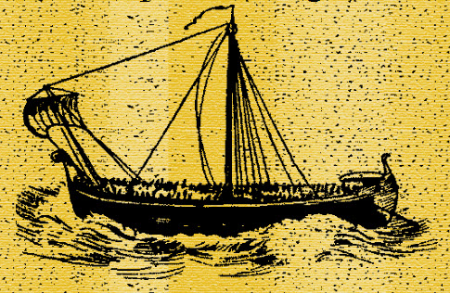
Alexandria
“protector or
defender of the people”
Myra
Lycia
Bitterness
harvest
We are going to quickly review, our second ship. Highlighting the points we want to draw from later in the study. This is the ship of Alexandria - Alexandria, coming from the word Alexander, means to be a protector or defender of the people. Where does Paul get on the ship? The same place where he gets off the first ship, Ardamyttium. Ardamyttium goes from Caesarea to Myra and Lycia. Paul begins the journey at Caesarea, he ends at Myra, he gets off the ship, that journey ends. And then he boards a second ship, the ship of Alexandria. We can bring in our same definitions of harvest and of bitterness.

Slide 15
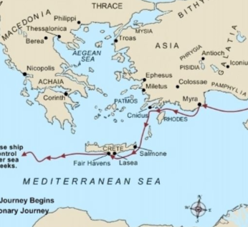
We’re going to skip some history and go back Acts 27 and place a few way marks, and then we are going to fill in the gaps.
Acts 27:13 And when the south wind blew softly, supposing that they had obtained [their] purpose, loosing [thence], they sailed close by Crete.
27:14 But not long after there arose against it a tempestuous wind, called Euroclydon.
Adramyttium
“Abide in death”
TOE
“cut out”
2 FP
Bitterness
Extracting
bright white
harvest
Panium/
MC
Cypress
Myra
Lycia
SL
1A
Ceasarea
911
Sidon
Overturn
A nation made up of every tribe
Cilicia
Pamphylia
Argos
4th
Felix/Festus= USA
(Reagan/Bush)
Agrippa SDA
4th
4th
USA
UN
We’re skipping part of the journey, we’re going to go back to and explain those points. We go to verses 13-14, it takes us to a period in history where we identify the blowing of the south wind. EGW tells us, they should have been warned by that south wind, because soon after the south wind blows Euroclydon is coming. The meaning is from Euros (East) and clydon (A little Cyclonic seasonal storm). It's representative of an east wind. And where do we mark east wind, where do we place that? 9/11.
refreshing
Alexandria
“protector or
defender of the people”
East wind
9/11
Euroclydon
Myra
Lycia
Bitterness
harvest

Slide 16
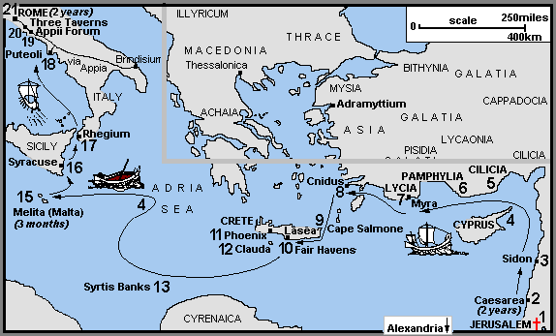
So what we can see, just at the beginning with out going to all the other way marks that the story of Acts 27 and the two ships is not giving us sequence. It's not one ship, showing you history, and the other ship continuing that history. Instead it is a different concept. It's showing us a repeat and enlarge. It's repeating the same history but not just repeating it, it's enlarging upon it. It's going to take the same history, as we saw in the first ship. Then expand and add information and show us it from a different perspective. We've marked 9/11 we would connect that with Sidon.
Adramyttium
“Abide in death”
TOE
“cut out”
2 FP
Bitterness
Extracting
bright white
harvest
Panium/
MC
Cypress
Myra
Lycia
SL
1A
Ceasarea
911
Sidon
Overturn
A nation made up of every tribe
Cilicia
Pamphylia
Argos
4th
Felix/Festus= USA
(Reagan/Bush)
Agrippa SDA
4th
4th
USA
UN
refreshing
Alexandria
“protector or
defender of the people”
East wind
9/11
Euroclydon
Myra
Lycia
Bitterness
harvest

Slide 17
We are going to fill in our gaps. We step back to just prior to Euroclydon, where were they in verse 8?
27:8 And, hardly passing it, came unto a place which is called The fair havens; nigh whereunto was the city [of] Lasea.
Lasea means wise. We could mark the wise at Lasea. They stayed at this port for some time, they were going to stay here, then they make the decision to begin the journey. So it marks another beginning. They sailed before, they arrived at Lasea, they spent time there, they planned to stay. But then they decide that it’s not a good enough port, and those that undertake this voyage at a bad time of year to get some where more favorable. We mark the wise in the story of the 10 virgins beginning in 1989. Again it's the TOE.
Adramyttium
“Abide in death”
TOE
“cut out”
2 FP
Bitterness
Extracting
bright white
harvest
Panium/
MC
Cypress
Myra
Lycia
SL
1A
Ceasarea
911
Sidon
Overturn
A nation made up of every tribe
Cilicia
Pamphylia
Argos
4th
Felix/Festus= USA
(Reagan/Bush)
Agrippa SDA
4th
4th
USA
UN
refreshing
Alexandria
“protector or
defender of the people”
TOE
1989
Lasea
East wind
9/11
Euroclydon
Myra
Lycia
Bitterness
harvest
wise

Slide 18
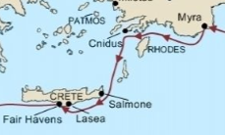
So where would we mark the bitter experience before our TOE? …because we skipped some history. We've gone from verse five, to verse eight.
27:5 And when we had sailed over the sea of Cilicia and Pamphylia, we came to Myra, [a city] of Lycia.
27:6 And there the centurion found a ship of Alexandria sailing into Italy; and he put us therein.
27:7 And when we had sailed slowly many days, and scarce were come over against Cnidus, the wind not suffering us, we sailed under Crete, over against Salmone;
And in verse 8 they come to Lasea. We've marked it from Myra where Paul boards the ship, we next mark Cnidus. We note that the wind there is unfavorable. We mark Cnides, and this is where its helpful to use your Bible maps. It’s much easier to track that voyage. But they leave port, they sail on this journey, everything is going to plan, until they come here at Cnides.
Adramyttium
“Abide in death”
TOE
“cut out”
2 FP
Bitterness
Extracting
bright white
harvest
Panium/
MC
Cypress
Myra
Lycia
SL
1A
Ceasarea
911
Sidon
Overturn
A nation made up of every tribe
Cilicia
Pamphylia
Argos
4th
Felix/Festus= USA
(Reagan/Bush)
Agrippa SDA
4th
4th
USA
UN
refreshing
Alexandria
“protector or
defender of the people”
TOE
1989
Lasea
East wind
9/11
Euroclydon
Myra
Lycia
Cnides
Bitterness
harvest
wise

Slide 19
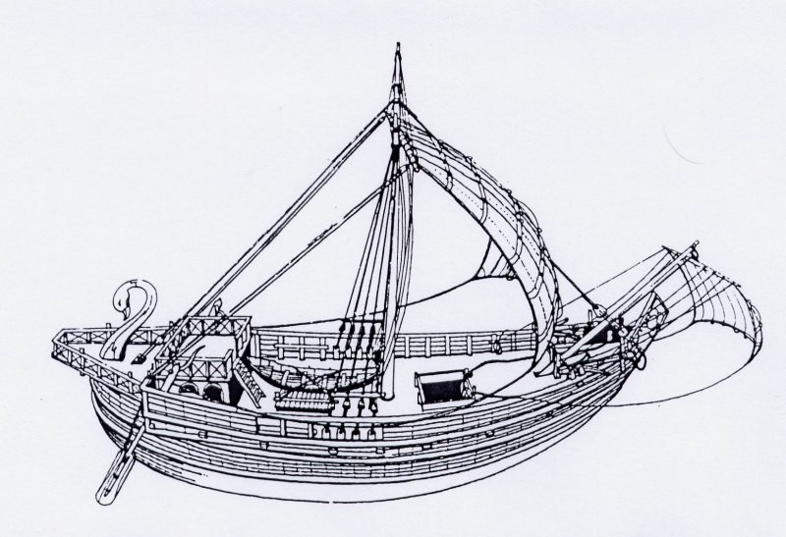
Adramyttium
“Abide in death”
TOE
“cut out”
2 FP
Bitterness
Extracting
bright white
harvest
Panium/
MC
Cypress
Myra
Lycia
SL
So what does the ship do? There’s unfavorable winds, external circumstances are not to their favor. They’re going on their course until here, and looking at your Bible maps they make a sharp turn, and go off their planned course and go south. So if we were to track this journey, from Myra, Myra is harvest, and it is a bitter experience. Where do we mark harvest before 1989 connected to bitterness? We would need to go back to Millerite history. That bitter experience of Oct 22, 1844. Also marking the harvest period for the Milleritres. If we mark it 1844, we are marking it for Myra. But this is a ship from Alexandria in the Roman empire and was where they sourced their grain, the bread belt. The most fertile part of the Roman Empire of that time, was along the Nile River. Where with its flooding, it left it with very fertile ground for them to grow their grain and they utilized that area, there they grew the grain to feed the Roman empire. So along the Nile River, they grew their grain and they transported it to Alexandria and placed in huge grain silos, it was loaded onto ships and transported across the Roman Empire. So if it's a ship of Alexandria, what is it carrying? Grain or wheat. And you can see that through out the chapter when they talk about throwing the wheat over board they were throwing off their cargo which was the wheat. You can mark the wise in 1989, and back here at the beginning of the ship at Alexandria you can mark the wheat.
1A
Ceasarea
911
Sidon
Overturn
A nation made up of every tribe
Cilicia
Pamphylia
Argos
4th
Felix/Festus= USA
(Reagan/Bush)
Agrippa SDA
4th
4th
USA
UN
refreshing
Alexandria
“protector or
defender of the people”
East wind
9/11
Euroclydon
10/22/1844
Myra
Lycia
TOE
1989
Lasea
Alexandria
Cnides
wheat
Bitterness
harvest
wise

Slide 20
So what we can see in this story, is again the story of a ship… We need to note this important point: This is the story of a ship and Adramyttium is the story of a ship. We can bring in different concepts. We can see Paul at the TOE, giving the first AM. And we can bring symbology into that. We say who Paul was. We can see him after Cypress, in the history between Cypress and the S/L where EGW says now he is the captain of the ship, he's the boss. So we can create different symbology, but if we can take him back to 1798, or we have to place him in 1844, or he will have to have a different meaning. We can see harvest after S/L so we can talk about people, groups of people. We can bring in the Levites. We brought in the history of the Nethanims when we talked about harvest. So there are other layers.
Adramyttium
“Abide in death”
TOE
“cut out”
2 FP
Bitterness
Extracting
bright white
harvest
Panium/
MC
Cypress
Myra
Lycia
SL
1A
Ceasarea
911
Sidon
Overturn
A nation made up of every tribe
Cilicia
Pamphylia
Argos
4th
Felix/Festus= USA
(Reagan/Bush)
Agrippa SDA
4th
4th
USA
UN
refreshing
Alexandria
“protector or
defender of the people”
East wind
9/11
Euroclydon
TOE
1989
Lasea
Myra
Lycia
Cnides
Alexandria
wheat
Bitterness
harvest
wise

Slide 21
Adramyttium
“Abide in death”
TOE
“cut out”
2 FP
Bitterness
Extracting
bright white
harvest
Panium/
MC
Cypress
Myra
Lycia
SL
But the primary story of Acts 27 is the story of 2 ships. The story of Alexandria is going to tell us the story of the good ship. We can draw lessons from those on the ship. But it’s primarily the story of the ship itself. We learned that from Adramyttium. This is Felix and Festus and Agrippa. They are people in that history, they’re not people in the Alexandria history, so much as they are for the institutions. The first ship is the story of an institution and structures as much as we can draw other lessons. Alexandria is the story of institutions also, even though we see other lessons. This is the primary thing of this chapter.
1A
Ceasarea
911
Sidon
Overturn
A nation made up of every tribe
Cilicia
Pamphylia
Argos
4th
Felix/Festus= USA
(Reagan/Bush)
Agrippa SDA
4th
4th
USA
UN
refreshing
Alexandria
“protector or
defender of the people”
East wind
9/11
Euroclydon
TOE
1989
Lasea
Myra
Lycia
1863
Cnides
Alexandria
Wheat
Bitterness
harvest
wise

Slide 22
So the ship of Adramyttium, is that positive or negative? Negative. It's a ship that abode in death.
The ship of Alexandria was a ship that was a protector or defender of the people. Is that positive or negative? Positive.
What institutions are protecting or defending the people in 1798? The USA. What else rises up in 1798? Adventism. So what is the theme of our second ship? The USA and SDA: 2 institutions. And the exact same theme as our fist ship but from a different perspective, one is negative and one is positive. Alexandria is positive it protects and defends the people, which was the role of the USA coming out of 1798. It was supposed to be a place of refuge for those who wanted religious liberty, also the story of God’s church, Adventism. So they have the same theme, they’re both telling a story of these institutions. Even though Alexandria is a good ship it sailed from 1798 to 1844, it's on course, there is external circumstances and it goes off course. When do these institutions go off course? 1863. And what history is 1863? The mid point in a civil war. The American Civil War with external circumstances. Later in our study we are going to come back to this concept to talk about the Civil war and what was happening in the United States and within Adventism.
Adramyttium
“Abide in death”
TOE
“cut out”
2 FP
Bitterness
Extracting
bright white
harvest
Panium/
MC
Cypress
Myra
Lycia
SL
1A
Ceasarea
911
Sidon
Overturn
A nation made up of every tribe
Cilicia
Pamphylia
Argos
4th
Felix/Festus= USA
(Reagan/Bush)
Agrippa SDA
4th
4th
USA
UN
refreshing
Alexandria
“protector or
defender of the people”
East wind
9/11
Euroclydon
TOE
1989
Lasea
Myra
Lycia
1863
Cnides
Alexandria
‘61
‘65
Wheat
USA
Adventism
Bitterness
harvest
wise

Slide 23
Adramyttium
“Abide in death”
TOE
“cut out”
2 FP
Bitterness
Extracting
bright white
harvest
Panium/
MC
Cypress
Myra
Lycia
SL
1A
Ceasarea
911
Sidon
Overturn
A nation made up of every tribe
Cilicia
Pamphylia
Argos
What we need to see is the ship goes off course in this history, not just internally with the rejection of the 2520, but the USA also goes off course. And through this history these institutions are inseparable. We can mark their connection at every way mark. EGW says that the USA the Lamb like beast rose out of the earth in what year? 1798. Alexandria is the Lamb like beast in 1798 it is rising up.
We also know that this is the time of the end, and the beginning of Adventism, and an increase of knowledge. We come to 1844, there is a bitter experience. We mark it internally, we know the experience of the Millerites. But what happens to the USA to the lamb like beast? It lost one of its horns in 1844. So we can bring both of these institutions to this way mark, and both go off course in 1863.
4th
Felix/Festus= USA
(Reagan/Bush)
Agrippa SDA
4th
4th
USA
UN
refreshing
Alexandria
“protector or
defender of the people”
TOE
1989
Lasea
East wind
9/11
Euroclydon
Myra
Lycia
1798/ TOE
Alexandria
1863
Cnides
‘61
‘65
Wheat
USA
Adventism
Bitterness
harvest
wise

Slide 24
Adramyttium
“Abide in death”
TOE
“cut out”
2 FP
And for 1863 to Lasea they are all sailing under Crete, which means fleshy of the flesh. We can also place Salmoni but we won’t review those names today. They bring us to 1989 Lasea, then we mark the east wind. From the east wind the ship is damaged. From this east wind forward its barely floating, its in a damaged condition. Even though its a good ship we can see its a more complicated story, it's a good ship that’s battling other circumstances and chooses to go off course, it’s damaged. We’re going to see it barley makes it way through this history until as we will read it faces ship wreck.
A Review. In Acts 27 there are two ships. The Ship of Adramyttium abides in death. And it’s representative of two institutions. The USA and SDA. And we traced them from the TOE - 1989, through 9/11, Panium to where they end at the S/L. We marked their overturning between Panium to the S/L. We then considered the second ship, a good ship, Alexandria. There’s much history of that ship before the east wind. We identified it took us back to 1798, the story of those same two institutions. But it’s going to give us more information and from a different perspective.
Bitterness
Extracting
bright white
harvest
Panium/
MC
Cypress
Myra
Lycia
SL
1A
Ceasarea
911
Sidon
Overturn
A nation made up of every tribe
Cilicia
Pamphylia
Argos
4th
Felix/Festus= USA
(Reagan/Bush)
Agrippa SDA
4th
4th
USA
UN
refreshing
Alexandria
“protector or
defender of the people”
TOE
1989
Lasea
East wind
9/11
Euroclydon
Myra
Lycia
1798/ TOE
Alexandria
1863
Cnides
‘61
‘65
Wheat
USA
Adventism
Bitterness
harvest
wise

Slide 25
In 1798 they are the protectors and defenders of the people, they sailed from 1798 to 1844, and in 1863 they went off course. Internally and externally. Then they sailed from 1863 to 1989; which we know is a 126. They set sail after 1989 because there is a south wind that is favorable to the ship. What happens after 1989, after the south wind— there’s favorable circumstances for the ship, the king of the South is falling from 1989 to 1991. The USA is the world’s only super power. As a favorable south wind, that EGW said that it should have been a warning because the east wind was coming. And at 9/11 the ship is hit by a cyclone, severely damaged, and it barely makes its way through to ship wreck.
In our next study we’re going to consider the rest of that journey and pull out a couple of more points. Then we will move from Acts 27 to where it takes us in history, and that history is primarily to teach us about these winds, particularly the south wind.
Adramyttium
“Abide in death”
TOE
“cut out”
2 FP
Bitterness
Extracting
bright white
harvest
Panium/
MC
Cypress
Myra
Lycia
SL
1A
Ceasarea
911
Sidon
Overturn
A nation made up of every tribe
Cilicia
Pamphylia
Argos
4th
Felix/Festus= USA
(Reagan/Bush)
Agrippa SDA
4th
4th
USA
UN
refreshing
Alexandria
“protector or
defender of the people”
126
East wind
9/11
Euroclydon
Myra
Lycia
TOE
1989
Lasea
1863
Cnides
Alexandria
‘61
‘65
‘91
S
Wheat
USA
Adventism
Bitterness
harvest
wise

