Slide 1
Camp Meeting Guadeloupe
Repetition and Application of History
6 of 15
Tess Lambert
April 2019

Slide 2
We saw in the history of Pyrrhus that it occurs in 2 parts. In both parts he is trying to establish an empire. First is the history in Macedonia against Demetrius. Then there is his history in Italy against Rome. We traced his history. Then we considered the king and we realized that Pyrrhus was a representative of Vladimir Putin. Using the succession of kings in the nation of Epirus; and the leaders of Russia back to the beginning of the Soviet Union, and the falling of Czar Nicolas we are able to understand that it’s also the history of Stalin. So we tied Pyrrhus with Putin, but also saw that Putin was first typified by Stalin, and we can see that Stalin covered the history of WW2.
We went back to 1929, where Stalin is finally ready to think outside of his own country. It also marks the rise of Hitler.
There is civil war in Spain as it develops into a proxy war between fascism and communism, between Stalin and Hitler. We see that it ends on the 1st of April 1939. It ends in favor of fascism when general Franco takes power. So you can see that these countries are already enemies. The opposite side of two ideologies, communism, fascism.
4th Diadochi War
Macedonia Italy
10
-307
-303
-301
Ipsus
291
289-288
287
285
282
280
317
Macedonia divided
Cold war
Cassander
Athens
Demetrius
Frees
Athens
Alliance
Demetrius
Pyrrhus
S, C, L 3 allies
Vs
Antigonu
Demetrius
→ Pyrrhus
Pyrrhus invades Thessaly
Demetrius invades Epirus
Demetrius
W by Py,
E by Lys.
Subterfuge
Sanctions
Thurri allies with Rome
Taren. Attacks Thurri
Pyr.
Arrives in
Taren.
1929
April 1, 1939
Aug. 23,
1939
Sept 1
1939
Aug
1940
June 22
1941
1945
1989-91
2014
Europe divided
Cold war
Proxy
Great
depression
Spanish Civil War
Molotov Ribbentrop Pact
Non Aggression
Spheres of Influence
Trade—payment
Br., Fr., Pld
Vs
Germany
é
USSR
Operation
Barbsrosa
Germ
USA USSR
West East
Subterfuge
sanctions
Russia, Putin attacks Ukraine

Slide 3
4th Diadochi War
Macedonia Italy
But they surprised the world a few months later when they go into an alliance. When the western world, particularly Britain and France heard about this alliance, everyone knew that this was for the purpose of WW2, and they already started evacuating their cities such as London, and preparing for war because this Pact heralded war.
That war began on the 1st of September, 8 days later, when Hitler invaded Poland, WW2 began. As this Pact stipulated eastern Europe was divided between Hitler and Stalin. We see that their relationship was strained because of this division, and also because of a disagreement over trade and Hitler’s payment for the services of the Soviet Union. This will become important where we make up application.
10
-307
-303
-301
Ipsus
291
289-288
287
285
282
280
317
Macedonia divided
Cold war
Cassander
Athens
Demetrius
Frees
Athens
Alliance
Demetrius
Pyrrhus
S, C, L 3 allies
Vs
Antigonu
Demetrius
→ Pyrrhus
Pyrrhus invades Thessaly
Demetrius invades Epirus
Demetrius
W by Py,
E by Lys.
Subterfuge
Sanctions
Thurri allies with Rome
Taren. Attacks Thurri
Pyr.
Arrives in
Taren.
1929
April 1, 1939
Aug. 23,
1939
Sept 1
1939
Aug
1940
June 22
1941
1945
1989-91
2014
Europe divided
Cold war
Proxy
Great
depression
Spanish Civil War
Molotov Ribbentrop Pact
Non Aggression
Spheres of Influence
Trade—payment
Br., Fr., Pld
Vs
Germany
é
USSR
Operation
Barbsrosa
Germ
USA USSR
West East
Subterfuge
sanctions
Russia, Putin attacks Ukraine

Slide 4
They sorted out their differences, their alliance became strong again, but it was temporary. Hitler decided that he was ready for war on the east and he attacked his ally on the 22nd of June 1941. The largest invasion known in history, Operation Barbarossa. This drove Stalin into an alliance with the allies, which he’d originally backed Hitler against in Sept 1939.
In 1945, Germany is defeated, Hitler is defeated, it’s divided into East and West by the United States and the Soviet Union. This sparked the cold war between those two powers that lasts until 1989-91. This is “Sanctions” and “Subterfuge”. And we could say that’s the end of that history.
4th Diadochi War
Macedonia Italy
10
-307
-303
-301
Ipsus
291
289-288
287
285
282
280
317
Macedonia divided
A few years ago, we would have taken this cold war, we would have talked about Reagan and John Paul II, the United States and the Papacy, and an alliance, and we would have said that this was successful, that the King of the South was defeated, Daniel 11:40 is fulfilled, and that the King of the South is removed from prophetic history. Now we know that this isn’t true, that this (1989-91) was just marking the end of one story. But there is an omega history. We see that in Italy.
Cold war
Cassander
Athens
Demetrius
Frees
Athens
Alliance
Demetrius
Pyrrhus
S, C, L 3 allies
Vs
Antigonu
Demetrius
→ Pyrrhus
Pyrrhus invades Thessaly
Demetrius invades Epirus
Demetrius
W by Py,
E by Lys.
Subterfuge
Sanctions
Thurri allies with Rome
Taren. Attacks Thurri
Pyr.
Arrives in
Taren.
1929
April 1, 1939
Aug. 23,
1939
Sept 1
1939
Aug
1940
June 22
1941
1945
1989-91
2014
Europe divided
Cold war
Proxy
Great
depression
Spanish Civil War
Molotov Ribbentrop Pact
Non Aggression
Spheres of Influence
Trade—payment
Br., Fr., Pld
Vs
Germany
é
USSR
Operation
Barbsrosa
Germ
USA USSR
West East
Subterfuge
sanctions
Russia, Putin attacks Ukraine

Slide 5
4th Diadochi War
Macedonia Italy
So what happened in this history between Regan and John Paul II? We are going to go over it again later in our studies. Was that successful? Was John Paul II successful in what he wanted to accomplish? I’m going to say no. It was failure. What John Paul II wanted was to defeat the Soviet Union and free Eastern Europe, particularly Poland from the control of the King of the South. He was able to do that, go that far. But what he really wanted was for those Eastern European Countries to choose the Papacy at least as their moral leadership; and he wanted a Catholic revival across Eastern Europe. In that endeavor he failed, and he knew that practically from the fall of the Soviet Union. He became very quickly aware that he’d failed in that endeavor.
10
-307
-303
-301
Ipsus
291
289-288
287
285
282
280
317
Macedonia divided
Cold war
Cassander
Athens
Demetrius
Frees
Athens
Alliance
Demetrius
Pyrrhus
S, C, L 3 allies
Vs
Antigonu
Demetrius
→ Pyrrhus
Pyrrhus invades Thessaly
Demetrius invades Epirus
Demetrius
W by Py,
E by Lys.
Subterfuge
Sanctions
Thurri allies with Rome
Taren. Attacks Thurri
Pyr.
Arrives in
Taren.
1929
April 1, 1939
Aug. 23,
1939
Sept 1
1939
Aug
1940
June 22
1941
1945
1989-91
2014
Europe divided
Cold war
Proxy
Great
depression
Spanish Civil War
Molotov Ribbentrop Pact
Non Aggression
Spheres of Influence
Trade—payment
Br., Fr., Pld
Vs
Germany
é
USSR
Operation
Barbsrosa
Germ
USA USSR
West East
Subterfuge
sanctions
Russia, Putin attacks Ukraine

Slide 6
We don’t often talk about John Paul II after 1991, that he was an angry Pope, because he saw this as failure. Eastern Europe did not want another dictatorship and they would not look to the Papacy or their priests as their leaders; whether it was birth control, which was for him a big issue, and all these different issues Eastern Europe chose the United States, their liberal economy and way of living after years of oppression. They were not going to choose a moral authority that was as oppressive as the papacy, even though they were Catholics themselves. John Paul II was a conservative Catholic. What he wanted for Eastern Europe was not accomplished. So this was partly successful, partly failure. The Papacy did not come out of 1989-91 with what they wanted to come out with. The King of the South was able to return. We began to trace that.
What we want to do is take Pyrrhus’s history in Italy and look at what it can teach us. We talked about 1991. There is one particular country that twice turns to the West. First at the same date as the end of the cold war; that was Ukraine. They chose the west over Communism.
4th Diadochi War
Macedonia Italy
10
-307
-303
-301
Ipsus
291
289-288
287
285
282
280
317
Macedonia divided
Cold war
Cassander
Athens
Demetrius
Frees
Athens
Alliance
Demetrius
Pyrrhus
S, C, L 3 allies
Vs
Antigonu
Demetrius
→ Pyrrhus
Pyrrhus invades Thessaly
Demetrius invades Epirus
Demetrius
W by Py,
E by Lys.
Subterfuge
Sanctions
Thurri allies with Rome
Taren. Attacks Thurri
Pyr.
Arrives in
Taren.
1929
April 1, 1939
Aug. 23,
1939
Sept 1
1939
Aug
1940
June 22
1941
1945
1989-91
2014
Europe divided
Cold war
Proxy
Great
depression
Spanish Civil War
Molotov Ribbentrop Pact
Non Aggression
Spheres of Influence
Trade—payment
Br., Fr., Pld
Vs
Germany
é
USSR
Operation
Barbsrosa
Germ
USA USSR
West East
Subterfuge
sanctions
Russia, Putin attacks Ukraine

Slide 7
4th Diadochi War
Macedonia Italy
But we come to the history of 2014 and there is an issue inside Ukraine. That issue is that there are 2 separate factions. What do those 2 factions want? One faction wants to ally with the west, with the United States. And another faction wants to stay allied to the traditional master or boss, Russia.
Previous to 2014, a leader comes to power, Viktor Yanukovych. He wins the election, Viktor Yanukovych, promising Ukraine that he is going to ally them to the west, and he’s open to the idea that many people want that of joining the NATO alliance. Yanukovych is promising to bring Ukraine into another alliance with the West.
10
-307
-303
-301
Ipsus
291
289-288
287
285
282
280
317
Macedonia divided
Cold war
Cassander
Athens
Demetrius
Frees
Athens
Alliance
Demetrius
Pyrrhus
S, C, L 3 allies
Vs
Antigonu
Demetrius
→ Pyrrhus
Pyrrhus invades Thessaly
Demetrius invades Epirus
Demetrius
W by Py,
E by Lys.
Subterfuge
Sanctions
Thurri allies with Rome
Taren. Attacks Thurri
Pyr.
Arrives in
Taren.
1929
April 1, 1939
Aug. 23,
1939
Sept 1
1939
Aug
1940
June 22
1941
1945
1989-91
2014
Europe divided
Cold war
Proxy
Great
depression
Spanish Civil War
Molotov Ribbentrop Pact
Non Aggression
Spheres of Influence
Trade—payment
Br., Fr., Pld
Vs
Germany
é
USSR
Operation
Barbsrosa
Germ
USA USSR
West East
Subterfuge
sanctions
Russia, Putin attacks Ukraine
ViktorYanukovych

Slide 8
Macedonia Italy
Pyrrhic War
-287
-285
-282
-280
-280
Heraclea
-279
Asculum
-275
Beneventum
-272
Dictator
D. Temple
Sicily
-273
Cold war
winter
treaty
Demetrius
W. Py,
E. Lys.
Subterfuge
Sanctions
Thurri allies with Rome
Tar. Attacks Thurri
Pyrrhus
Arrives in
Tarentum
Rome ý
attacks Pyrrhus þ
Pyrrhus þattacks Rome ý
Rome þattacks Pyrrhus ý
Egypt →
Rome
Rome→ Egypt
Maximum flood
Pyrrhus killed
Argos
Tarentum falls
1945
1989-91
2014
2016
Cold war
Germ
USA USSR
West East
Subterfuge
sanctions
Russia, Putin attacks Ukraine
Putin
Preparation Russia
ViktorYanukovych
But in 2013, Yanukovych drops the act, because that was a pretense, he made it very clear that he was going to draw Ukraine back into an alliance with Russia, rejecting the West.
2013, that sparked protests known as Euromaidan. Yanukovych was removed from power. Where did he flee? He fled into Russia and he lived there protected by the Russian Government ever since.
In 2014 he is removed from power and the majority of the people in Ukraine choose to ally with the West, and they place a government in power that’s allies to the West, because remember, there are 2 factions. The side that wants to ally with the West, particularly with NATO and the United States wins. They remove Yanukovych. What was Russia’s response? They attacked Ukraine. That situation is still on going. Just like Thurri, Ukraine is now permanently dependent on the West.

Slide 9
Euromaidan (/ˌjʊərəˌmaɪˈdɑːn, ˌjʊəroʊ-/;^{[74][75]} Ukrainian: Євромайдан, Yevromaidan,
literally 'Euro[pean] Square'^{[nb 6]}) was a wave of demonstrations and civil unrest in Ukraine,
which began on the night of 21 November 2013 with public protests in Maidan Nezalezhnosti
(Independence Square) in Kiev. The protests were sparked by the Ukrainian government’s
decision to suspend the signing of an association agreement with the European Union,
instead choosing closer ties to Russia and the Eurasian Economic Union. The scope of the
protests soon widened, with calls for the resignation of President Viktor Yanukovych and his government.^{[79]} The protests were fueled by the perception of "widespread government corruption", "abuse of power", and "violation of human rights in Ukraine".^{[80]} Transparency International named President Yanukovych as the top example of corruption in the world.^{[81]} The situation escalated after the violent dispersal of protesters on 30 November, leading to many more protesters joining.^{[5]} The protests led to the 2014 Ukrainian revolution.
During the Euromaidan, there were protests and clashes with police throughout Ukraine, especially at the Maidan (central square) in Kiev, which was occupied and barricaded by protesters, along with some administrative buildings,^{[82]} including Kiev City State Administration. On 8 December the crowd toppled a Lenin statue nearby. Protests and clashes increased in January, after the Ukrainian parliament passed a group of anti-protest laws. Protesters occupied government buildings in many regions of Ukraine. The protests climaxed in mid-February. Riot police advanced towards Maidan and clashed with protesters but did not fully occupy it. Police and activists fired live and rubber ammunition at multiple locations in Kiev. There was fierce fighting in Kiev on 18–20 February, (see List of people killed during Euromaidan). As a result of these events, the Agreement on settlement of political crisis in Ukraine was signed on 21 February 2014 by the President of Ukraine Viktor Yanukovych and the leaders of the parliamentary opposition (Vitaly Klitschko, Arseny Yatsenyuk, Oleh Tyahnybok) under the mediation of the European Union and the Russian Federation. The signing was witnessed by the Foreign Ministers of Germany and Poland, Frank-Walter Steinmeier, Radosław Sikorski, respectively, and the Director of the Continental Europe Department of the French Foreign Ministry, Eric Fournier.^{[83]} Vladimir Lukin, representing Russia, refused to sign the agreement.
Shortly after the agreement was signed, Yanukovych and other high government officials fled the country.^{[84]} Protesters gained control of the presidential administration and Yanukovych's private estate. Afterwards, the parliament removed Yanukovych from office, replaced the government with Oleksandr Turchynov, and ordered that former Prime Minister Yulia Tymoshenko be released from prison.^{[85]} Events in Kiev were soon followed by the Crimean crisis and pro-Russian unrest in Eastern Ukraine. Despite the ousting of Yanukovych,^{[86]} the installation of a new government, and the adoption of the Ukraine–European Union Association Agreement's political provisions, the protests have sustained pressure on the government to reject Russian influence in Ukraine. https://en.wikipedia.org/wiki/Euromaidan

Slide 10
Macedonia Italy
Pyrrhic War
-287
-285
-282
-280
-280
Heraclea
-279
Asculum
-275
Beneventum
-272
Dictator
D. Temple
Sicily
-273
Cold war
winter
treaty
Demetrius
W. Py,
E. Lys.
Subterfuge
Sanctions
Thurri allies with Rome
Tar. Attacks Thurri
Pyrrhus
Arrives in
Tarentum
Rome ý
attacks Pyrrhus þ
Pyrrhus þattacks Rome ý
Rome þattacks Pyrrhus ý
Egypt →
Rome
Rome→ Egypt
Maximum flood
Pyrrhus killed
Argos
Tarentum falls
1945
1989-91
2014
2016
Cold war
Germ
USA USSR
West East
Subterfuge
sanctions
Russia, Putin attacks Ukraine
Putin
Preparation Russia
ViktorYanukovych
Then we come to 280 BC, we see the King of the South making war preparation of his own country. We need to consider Putin’s activity in this history, the preparations that he’s been making. You could spread it out over a larger period of time, but his activity is particularly marked in 2016, and as we made application also of the alpha history, and we talk about what war looks like in our time, we are going to continue to expand and add more layers in what’s happening, particularly from 2014 forward.

Slide 11
Macedonia Italy
Pyrrhic War
-287
-285
-282
-280
-280
Heraclea
-279
Asculum
-275
Beneventum
-272
Dictator
D. Temple
Sicily
-273
Cold war
winter
treaty
Demetrius
W. Py,
E. Lys.
Subterfuge
Sanctions
Thurri allies with Rome
Tar. Attacks Thurri
Pyrrhus
Arrives in
Tarentum
Rome ý
attacks Pyrrhus þ
Pyrrhus þattacks Rome ý
Rome þattacks Pyrrhus ý
Egypt →
Rome
Rome→ Egypt
Maximum flood
Pyrrhus killed
Argos
Tarentum falls
1945
1989-91
2014
2016
Cold war
Germ
USA USSR
West East
Subterfuge
sanctions
Russia, Putin attacks Ukraine
Putin
Preparation Russia
ViktorYanukovych
In 2016, without proving it yet, I’m saying that Putin is establishing control in his own country expecting war. Part of that preparation in 2016, is setting up his own national guard, a portion separate to the Russian army, that answers only and directly to the President.
If we went back to the history of 1989-’91, how did the King of the South first fall? How is it defeated? We can talk about Regan and Bush, but when we go to 1989 we pick a date, we talk about the fall of the Berlin wall in November 9. Where was the United States on November 9? It wasn’t there; or 1991, it wasn’t there.

Slide 12
Macedonia Italy
You go through those couple of year’s histories, and without knowing the build up to that history, you would have a difficult time blaming the United States, because who brought down Gorbachev? Not the United States, but his own people. His own people rose up and brought him down, just like Czar Nicolas. That is the purpose of a cold war. What you are doing is undermining, destroying your enemy from the inside and it’s brought down in revolution. We need to consider the beginning of our reform line, our time of the end. What did that look like? And where was the King of the North in 1989 or 1991? Not there! Because what happened to the King of the South was destruction from the inside and Vladimir Putin lived through that history. So he sees as a threat, not just the United States, but his own people.
Pyrrhic War
-287
-285
-282
-280
-280
Heraclea
-279
Asculum
-275
Beneventum
-272
Dictator
D. Temple
Sicily
-273
Cold war
winter
treaty
Demetrius
W. Py,
E. Lys.
Subterfuge
Sanctions
Thurri allies with Rome
Tar. Attacks Thurri
Pyrrhus
Arrives in
Tarentum
Rome ý
attacks Pyrrhus þ
Pyrrhus þattacks Rome ý
Rome þattacks Pyrrhus ý
Egypt →
Rome
Rome→ Egypt
Maximum flood
Pyrrhus killed
Argos
Tarentum falls
1945
1989-91
2014
2016
Nov 9, 2019 Raphia
Panium
Dictator
D. Temple
Cold war
Germ
USA USSR
West East
Subterfuge
sanctions
Russia, Putin attacks Ukraine
Putin
Preparation Russia
ViktorYanukovych
In 2016 he establishes a national guard, a portion like an army, separate to the army of about 400,000 troops, the strongest troops, that do not answer to any of his generals, no one in the army. They come directly under his leadership, and the only reason you would need that kind of force is to protect yourself from your own people. So if there is ever a coup attempted, or a revolution, as the United States tends to do and is doing in Venezuela, they try to turn the army against the government. That’s what they are trying to do in Venezuela. They can turn the army against the government, and the people against the government, they can overthrow the government. That’s how the United States has acted in multiple countries. What Putin has done is put up a defense for that. He has set up a 400,000 strong army that does not answer to anyone but him and his loyalists.

Slide 13
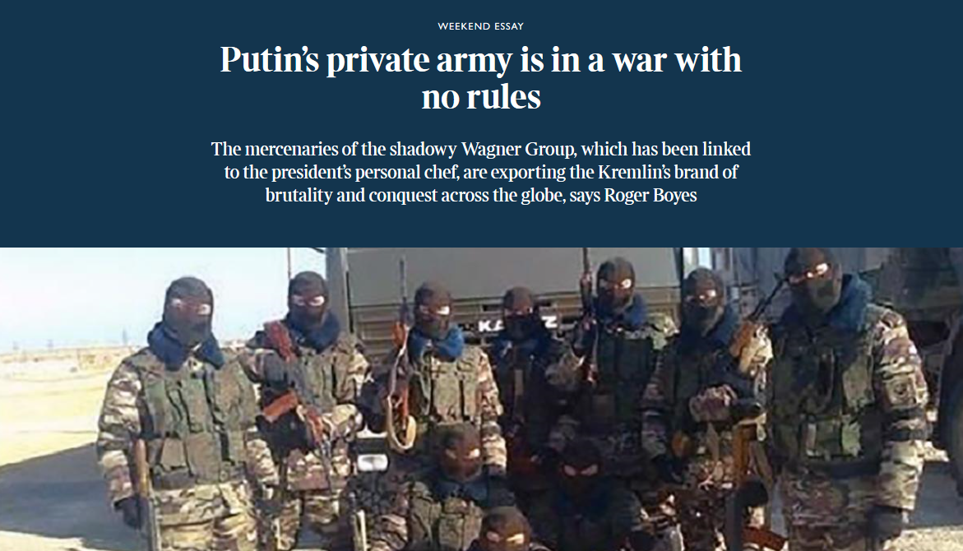
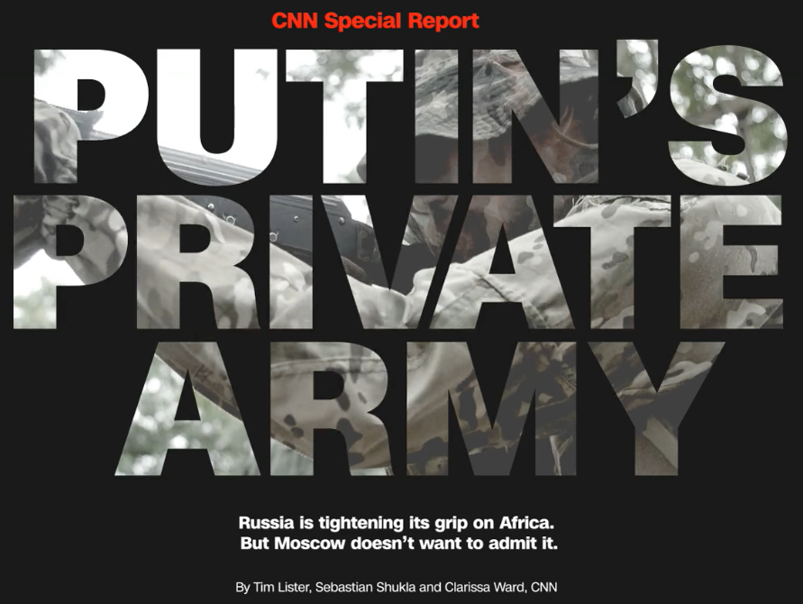
https://www.thetimes.co.uk/article/putin-s-private-army-is-fighting-a-war-with-no-rules-c092vzhcd
Free trial to read or requires subscription
https://edition.cnn.com/interactive/2019/08/africa/putins-private-army-car-intl/

Slide 14
Macedonia Italy
Pyrrhic War
So when we go to 2016, we see preparation. Then we come into the history of 3 battles, Heraclea, Asculum, Beneventum. We already understand Asculum and Beneventum, we can call them familiar names, Raphia and Panium. We have a date for Raphia (Nov. 9, 2019). We have already understood that in-between Raphia and Panium, you can identify dictatorship being set up, and the desecration of a temple. We have that from other lines of history.
-287
-285
-282
-280
-280
Heraclea
-279
Asculum
-275
Beneventum
-272
Dictator
D. Temple
Sicily
-273
Cold war
winter
treaty
Demetrius
W. Py,
E. Lys.
Subterfuge
Sanctions
Thurri allies with Rome
Tar. Attacks Thurri
Pyrrhus
Arrives in
Tarentum
Rome ý
attacks Pyrrhus þ
Pyrrhus þattacks Rome ý
Rome þattacks Pyrrhus ý
Egypt →
Rome
Rome→ Egypt
Maximum flood
Pyrrhus killed
Argos
Tarentum falls
1945
1989-91
2014
2016
Nov 9, 2019 Raphia
Panium
Dictator
D. Temple
Cold war
Germ
USA USSR
West East
Subterfuge
sanctions
Russia, Putin attacks Ukraine
Putin
Preparation Russia
ViktorYanukovych

Slide 15
Macedonia Italy
Pyrrhic War
We come to Panium. In this history, it’s the King of the North against the King of the South, and in this battle the King of the North wins. The first victory for the King of the North.
Soon after that, I’m suggesting from the history of Acts 27, and the line of Pyrrhus, we’re going to see a rising up of Rome (273BC), and we are going to come back and consider this again in a later study. If this is Panium, we’ve already identified 272BC as the Sunday Law, the overwhelming flood, the harvest of the world, and the final and complete defeat of the King of the South. He is defeated at Panium, but that is a process. It is finally accomplished at the Sunday Law.
-287
-285
-282
-280
-280
Heraclea
-279
Asculum
-275
Beneventum
-272
Dictator
D. Temple
Sicily
-273
Cold war
winter
treaty
Demetrius
W. Py,
E. Lys.
Subterfuge
Sanctions
Thurri allies with Rome
Tar. Attacks Thurri
Pyrrhus
Arrives in
Tarentum
Rome ý
attacks Pyrrhus þ
Pyrrhus þattacks Rome ý
Rome þattacks Pyrrhus ý
Egypt →
Rome
Rome→ Egypt
Maximum flood
Pyrrhus killed
Argos
Tarentum falls
1945
1989-91
2014
2016
2018
Nov 9, 2019 Raphia
Panium
Dictator
D. Temple
Sicily
-273
SL
Cold war
Germ
USA USSR
West East
Subterfuge
sanctions
Russia, Putin attacks Ukraine
Putin
Preparation Russia
KN ýattacks
KS þ
KS þattacks
KN ý
KN þattacks
KSý
Egypt →
Rome
Rome→ Egypt
Maximum flood
Pyrrhus killed
Argos
Tarentum falls
ViktorYanukovych

Slide 16
We are left with one battle that is new to our understanding. We bring this to our internal waymarks. We say it’s at 2018. This is the battle of Heraclea. In this history, it’s the King of the North that’s going to come against the King of the South. It’s a victory for the King of the South.
Raphia, the King of the South, coming against the King of the North. Who is it a victory for? The King of the South. So we are marking and tracing our battles in history. 2018, 2019, & Panium. At Panium, the King of the South is defeated, then he begins to fall progressively until he is finished at Sunday Law. This is the application that we can form from the history of Italy. Pyrrhus’ omega history.
What we then need to consider, if we are able to draw it up, is that first alpha history; what that can teach us. It is not going to be so possible to do that in these studies, but if you can keep that in your mind, we’re going to bring some of those concepts out and consider it. We can already begin to see how it would overlap.
Macedonia Italy
Pyrrhic War
-287
-285
-282
-280
-280
Heraclea
-279
Asculum
-275
Beneventum
-272
Dictator
D. Temple
Sicily
-273
Cold war
winter
treaty
Demetrius
W. Py,
E. Lys.
Subterfuge
Sanctions
Thurri allies with Rome
Tar. Attacks Thurri
Pyrrhus
Arrives in
Tarentum
Rome ý
attacks Pyrrhus þ
Pyrrhus þattacks Rome ý
Rome þattacks Pyrrhus ý
Egypt →
Rome
Rome→ Egypt
Maximum flood
Pyrrhus killed
Argos
Tarentum falls
1945
1989-91
2014
2016
2018
Nov 9, 2019 Raphia
Panium
Dictator
D. Temple
Sicily
-273
SL
Cold war
Germ
USA USSR
West East
Subterfuge
sanctions
Russia, Putin attacks Ukraine
Putin
Preparation Russia
KN ýattacks
KS þ
KS þattacks
KN ý
KN þattacks
KSý
Egypt →
Rome
Rome→ Egypt
Maximum flood
Pyrrhus killed
Argos
Tarentum falls
ViktorYanukovych

Slide 17
10 years
Ipsus
301
291
289-288
287
285
317
307
303
Cold War
If we would overlay our lines, we would bring in Pyrrhus in Macedonia. What is the first thing that we are going to notice? There is a 10 year history, a period of ten, leading up to the TOE. Do we have that on our reform line? We marked 10 years leading up to 1989, and what do we call that? What history is that? The history of a proxy war between the King of the North and the King of the South. And this is Afghanistan. This brings us to 1989.
Then when we bring in our history, we went from 1989 – 2014 marking Ukraine. If we were to take it back into this history, we marked this as the TOE; the period of 10, leading to the end of a proxy war. That is the 1st waymark. What should we next see?
Athens
Macedonia
Cassander places
dictator in Athens
Demetrius frees
Athens
Pyrrhus & Demetrius
In alliance
Antigonus defeated by 3 allies
Pyrrhus
Invades
Thessaly
Demetrius
Invades Epirus
Pyrrhus
Invades
Macedonia
Pyrrhus
Loses all but Epirus
Sanctions
subterfuge
280
Heraclea
280
Asculum
279
Beneventum
275
273
272
Ω
285
282
Pyrrhus raids temple
Sicily
Italy
Thurri appeals to Rome
Tarentum attacks Thurri
Pyrrhus arrives in Tarentum
Elephants
Pyrrhus
R
Elephants
Pyrrhus
R
Elephants
Pyrrhus
ý
Egypt ªRome
Rome ªEgypt
Tar. Falls
Py. dies
10 years
Apr 1
1939
Aug 23
1939
Sept 1
1939
Aug
1940
June 22
1941
East/west
1945
1929
1989-1991
Cold War
WW2
Spanish Civil War
Europe divided
Holocaust
Lateran Treaty
Moltov-Ribbontrop pact
alliance
Pol, Fr, B
Vs
USSR
Germany
Suspends trade
Operation
Barbarossa
USSR joins allies
USSR loses all but Russia
Sanctions
subterfuge
10 years
1
1989
2014
Ω
1979
Proxy war
Afghanistan
USSR loses all but Russia
Sanctions
subterfuge

Slide 18
10 years
Ipsus
301
291
289-288
287
285
317
307
303
Cold War
2014, an alliance between the King of the North and the King of the South. We already hear talk of the alliance, some type of agreement relationship between Putin and Trump. And if you follow United States news sources, it’s been a major subject for about the last 2 - 3 years. It’s been a major talking point, and an investigation. And the work into that is still on going, but it has been difficult to prove. I would suggest, based on prophecy, we don’t have to wonder what is going on between Putin and Trump, why their behavior is so strange. Based upon the alpha history, before we come to war like Raphia or Panium, there is first an alliance. We can mark that in 2014.
After 2014, we come to 2016. This is where we want to go back and consider our lines. In the history of Pyrrhus in Macedonia, the end of a proxy war (307BC), the alliance (303BC), where is the alliance utilized? In the battle of Ipsus. You have the first battle.
Athens
Macedonia
Cassander places
dictator in Athens
Demetrius frees
Athens
Pyrrhus & Demetrius
In alliance
Antigonus defeated by 3 allies
Pyrrhus
Invades
Thessaly
Demetrius
Invades Epirus
Pyrrhus
Invades
Macedonia
Pyrrhus
Loses all but Epirus
Sanctions
subterfuge
280
Heraclea
280
Asculum
279
Beneventum
275
273
272
Ω
285
282
Pyrrhus raids temple
Sicily
Italy
Thurri appeals to Rome
Tarentum attacks Thurri
Pyrrhus arrives in Tarentum
Elephants
Pyrrhus
R
Elephants
Pyrrhus
R
Elephants
Pyrrhus
ý
Egypt ªRome
Rome ªEgypt
Tar. Falls
Py. dies
10 years
Apr 1
1939
Aug 23
1939
Sept 1
1939
Aug
1940
June 22
1941
East/west
1945
1929
1989-1991
Cold War
WW2
Spanish Civil War
Europe divided
Holocaust
Lateran Treaty
Moltov-Ribbontrop pact
alliance
Pol, Fr, B
Vs
USSR
Germany
Suspends trade
Operation
Barbarossa
USSR joins allies
USSR loses all but Russia
Sanctions
subterfuge
10 years
1
1989
2014
2016
Ω
1979
Proxy war
Afghanistan
USSR loses all but Russia
Sanctions
subterfuge
KN & KS
alliance
3 allies
Vs KN
→KS

Slide 19
10 years
Ipsus
301
291
289-288
287
285
317
307
303
Cold War
2016, this is where the alliance was utilized and you have the first battle. In our next study, we want to breakdown this battle in the context of the US election and see how that battle was won and what it can teach us. Again in our alpha history, we can see a division of spheres of influence. We are going to talk more about that as well, leading to 2018, this is the battle of Heraclea. We’ll discuss that as well. Then we come to 2019, Asculum, or Raphia, and then the battle of Beneventum where the King of the South is defeated. So what we learned from this history when we overlay is this story of an alliance, and the first battle where that alliance is utilized (2016). We call that Ipsus or we could call it the invasion of Poland.
Macedonia
Athens
Cassander places
dictator in Athens
Demetrius frees
Athens
Pyrrhus & Demetrius
In alliance
Antigonus defeated by 3 allies
Pyrrhus
Invades
Thessaly
Demetrius
Invades Epirus
Pyrrhus
Invades
Macedonia
Pyrrhus
Loses all but Epirus
Sanctions
subterfuge
280
Heraclea
280
Asculum
279
Beneventum
275
273
272
Ω
285
282
Pyrrhus raids temple
Sicily
Italy
Thurri appeals to Rome
Tarentum attacks Thurri
Pyrrhus arrives in Tarentum
Elephants
Pyrrhus
R
Elephants
Pyrrhus
R
Elephants
Pyrrhus
ý
Egypt ªRome
Rome ªEgypt
Tar. Falls
Py. dies
10 years
Apr 1
1939
Aug 23
1939
Sept 1
1939
Aug
1940
June 22
1941
East/west
1945
1929
1989-1991
Cold War
WW2
Spanish Civil War
Europe divided
Holocaust
Lateran Treaty
Moltov-Ribbontrop pact
alliance
Pol, Fr, B
Vs
USSR
Germany
Suspends trade
Operation
Barbarossa
USSR joins allies
USSR loses all but Russia
Sanctions
subterfuge
10 years
1
1989
2014
Ipsus
2016
Heraclea
2018
11/9/19
Raphia
Panium
2021
Ω
1979
Proxy war
Afghanistan
USSR loses all but Russia
Sanctions
subterfuge
KN & KS
alliance
3 allies
Vs KN
→KS

Slide 20
10 years
Ipsus
301
291
289-288
287
285
I want us to note one particular difference between an alpha and an omega history. In the history of WW2, who is the King of the North? If we were to draw up our battles, we would talk about Pyrrhus invading Thessaly, Demetrius invaded Epirus, and then you have Lysimachus and Pyrrhus come against Demetrius, you could call it the invasion of Macedonia. We come to the history of Italy, they’re given 3 names, Heraclea, Asculum, Beneventum.
Then we come into the history of WW2. We can talk about Aug. 1940, this is the first battle or breakdown, this is where they would slide in when we would overlay our lines. We would talk about operation Barbarossa in 1941, and then we would talk about 1945. These are the descriptions of those battles. Our second and third we would more traditionally call Raphia and Panium just because that is where they were first seen in history. This is Pyrrhus’ history, an alpha, and this is an omega, and this is Pyrrhus.
317
307
303
Cold War
Macedonia
Athens
Cassander places
dictator in Athens
Demetrius frees
Athens
Pyrrhus & Demetrius
In alliance
Antigonus defeated by 3 allies
Pyrrhus
Invades
Thessaly
Demetrius
Invades Epirus
Pyrrhus
Invades
Macedonia
Pyrrhus
Loses all but Epirus
Sanctions
subterfuge
280
Heraclea
280
Asculum
279
Beneventum
275
273
272
Ω
285
282
Pyrrhus raids temple
Sicily
Italy
Thurri appeals to Rome
Tarentum attacks Thurri
Pyrrhus arrives in Tarentum
Elephants
Pyrrhus
R
Elephants
Pyrrhus
R
Elephants
Pyrrhus
ý
Egypt ªRome
Rome ªEgypt
Tar. Falls
Py. dies
10 years
Apr 1
1939
Aug 23
1939
Sept 1
1939
Aug
1940
June 22
1941
East/west
1945
1929
1989-1991
Cold War
WW2
Spanish Civil War
Europe divided
Holocaust
Lateran Treaty
Moltov-Ribbontrop pact
alliance
Pol, Fr, B
Vs
USSR
Germany
Suspends trade
Operation
Barbarossa
USSR joins allies
USSR loses all but Russia
Sanctions
subterfuge
10 years
1
1989
2014
Ipsus
2016
Heraclea
2018
11/9/19
Raphia
Panium
2021
Ω
1979
Proxy war
Afghanistan
USSR loses all but Russia
Sanctions
subterfuge
KN & KS
alliance
3 allies
Vs KN
→KS

Slide 21
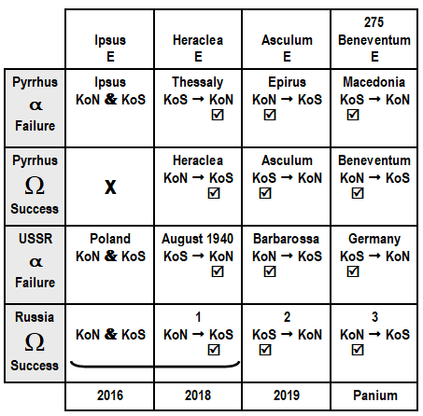
Alpha: We come down into our history, 2018, 2019 or Raphia, and Panium. So when it comes to Pyrrhus in Macedonia, his alpha history, Pyrrhus invaded Thessaly, who initiated that conflict? The King of the North, or the King of the South? The King of the South initiated that conflict, and who won? The King of the North.
Demetrius invades Epirus, who initiates that? The King of the North comes against the King of the South. Who wins? The King of the North.
Pyrrhus invades Macedonia, who initiates that? The King of the South comes against the King of the North, and who wins? The King of the South.
We have 2 victories for the King of the North, then a victory for the King of the South. That is the alpha History.
Omega: Heraclea, Asculum, Beneventum. Who initiated the battle of Heraclea? The King of the North. The King of the North came against the King of the South. Who won? The King of the South.
Asculum, the King of the South initiated it, & came against the King of the North. Who won? The King of the South.
Beneventum. It was Rome that marched down south. Rome initiated it. But who won it? Rome.
So in an alpha history, you have the two victories for the King of the North, and then a victory for the King of the South.
Then in an omega, you have two victories for the King of the South, and then a victory for the King of the North.

Slide 22
Alpha: Come to WW2, August of 1940, who initiated that? This was the King of the South. The Soviet Union, cut off their trade with Germany. We haven’t described what the outcome of that was. Without going into that history, we are saying that it was a victory for the King of the North, because out of their negotiations in that time period, it was Germany that ended up much better off.
In ‘Operation Barbarossa’, who comes against who? The King of the North comes against the King of the South. And this was at least at its inception, victory for Germany. Stalin was taken by surprise, Hitler was able to take a vast majority of the country before Stalin even realized what was going on.
But the tide turns, and at the end of the final invasion, it’s the King of the South that invades Germany. It’s a victory for the King of the South in 1945.

Slide 23
So our omega histories, and our alpha histories are subtly different. We have to not trace just the similarities, but all the differences. The differences can also teach us. They can teach us because we’re using the methodology of compare and contrast. We have shown how they compare. They teach us of a 10 year history, of a proxy war and an alliance. But we can also learn from their contrast, because their contrast also form a pattern. What we can see, is that in an alpha history, the King of the South and the King of the North are switched, not only in who wins each battle, but who initiates each conflict. The alpha history, for both Pyrrhus and the King of the South in our history, the Soviet Union and Russia, the alpha histories match. The alpha of Pyrrhus and the alpha of the Soviet Union; victory for the King of the North, victory for the King of the North, victory for the King of the South; initiated by the King of the South, initiated by the King of the North, initiated by the King of the South. It’s a direct pattern.

Slide 24
We take the omega histories, we come to 2018, we see conflict initiated by the King of the North, won by the King of the South. We are going to discuss what that looked like.
We come to Raphia, we already know that the King of the South comes to the King of the North, it’s victory for Russia.
We come to Panium, it’s the King of the North now, coming against the King of the South that is victorious (King of the North).
This is how we contrast using parables. We are learning about an alliance, and another battle. But also, there is a difference, and this become important when we start talking about the true and the counterfeit.
1945, is the battle of Panium, and what is 1945 for the King of the North? It’s failure. So if we thought about the counterfeit, talking about the King of the North, the Papacy, in this history of an alpha, does it end in a failure or success? Failure (WW2 – alpha history), failure (Pyrrhus – alpha History). An Alpha history is always a history of failure, because if it was a history of success, there is no need for an omega. If in 1945 Hitler would have won, there would be no need for the Papacy to have an alliance with the United States.
So while an alpha history is one of failure, an omega history is one of success. We need to make sure that we accept that because the implications are serious when start considering how we apply Millerite history, when we start applying dates like 1844, we talk about Snow, we talk about 1886, and 1888, and we make application. We need to understand parables, because we are so used to comparing we don’t follow how we use parables, we forget there’s contrast, and we try to bring everything into our history.

Slide 25
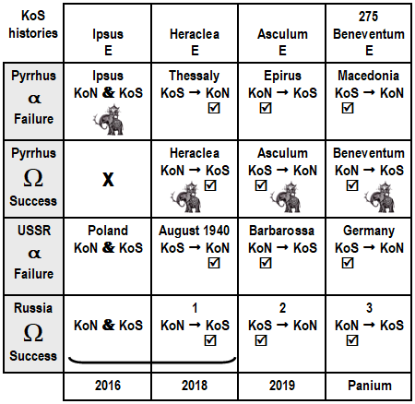
If we did that with the counterfeit, because we need to remember that the Papacy supported Hitler in WW2. They went into an alliance with Hitler. So if the Papacy supported Hitler, that ended in failure. In the omega history, does the papacy make a mistake in choosing the United States? Is Panium failure to the United States and the Papacy? No, it’s a complete and total success. We are going to go back over those lines and discuss them in more detail.
So we are able to take this first history of alpha, and it can also teach us about the omega, and those differences form a pattern where we can learn from them as well.
There is one other subject to discuss before we close and that is discussing the story of these battles, because as we can see, we have lined up 3 battles and it’s most easily and simply stated as Heraclea, Asculum, and Beneventum. Three neat names. So when we discussed Heraclea, Asculum, Beneventum, we see that it’s 2018, 2019, Panium, but when we bring in our lines, there is this previous battle, the battle of Ipsus.

Slide 26
So now we are not just discussing three, now we are discussing four. What we can do, just to simplify, take the names of our battles, and one of the things we will do probably starting the next time, is look at these battles in application, because we don’t have two, Raphia, Panium, we don’t have three, Heraclea, Asculum, Beneventum, we actually have four because the story begins with Ipsus, where the first battle you have the King of the North and the King of the South in an alliance. We have Ipsus, Heraclea, Asculum, Beneventum.
What mode of warfare decided the battle of Ipsus? Elephants. What mode of warfare decided the battle of Heraclea? Elephants. Asculum? Elephants. Beneventum? Elephants.
In 2016, is the battle of Ipsus. So we have 2016. Heraclea, 2018. Asculum, 2019. Beneventum, Panium. What we already have built into our message is four battles, two of which are already passed. And these two have the same mode of warfare as we find in Raphia and Panium. So if we want to know what Raphia looks like, and what Panium looks like, we already have two witnesses. With the witness of 2 or 3 everything is established.
Ipsus
Heraclea
Asculum
Beneventum
Alliance
2016
2018
2019
Panium

Slide 27
So understanding 2016, and 2018, teaches us what we need to know about 2019. So we need to go into the battle of Ipsus, find out how that was fought and what that looks like.
We need to go into 2018, and see the relationship between Trump and Putin break apart and then rebuild, understand what that looks like, and what they’re fighting over. And then also project that on 2019, because we need to know what we are expecting to see. As Elder Parminder has said, we misapply history and come looking for a hot war because we haven’t understood parables, followed on by the advancing light on methodology that has been advancing now for quite some years. We need to understand parable teaching. It’s the foundation of all the histories that Elder Tess has taught, and without the methodology behind it, it would fall apart because we are seeing these battles as parables.

Slide 28
So we will discuss Ipsus, and Heraclea. We also want to bring in the concept of WW2. In the history of WW2, it’s not talking about battles, it’s talking about invasions.
So now it says 2016 is Poland.
2019 is Operation Barbarossa.
What do they teach us?
WW2 brings in another element. What it begins to show us is that the position of the King of the North, his location caused him to fight the battle or war on two fronts. It’s not all a story of United States against Russia.
Now we see it’s two fronts, it begins with the west. WW2 begins with the western front that began in 2016. So when you follow the news, and we really need to be, because it becomes important, if you follow the news, you would see the condition inside the United States. More and more division, more and more it is becoming clearer and clearer that it is in the condition of a civil war. Because what Donald Trump is doing, he is fighting a war, but not against Russia. WW2 has already begun in application. We’re well into it, but he’s fighting the west, his allies, NATO, the democrats, his own institutions. This is war on the Western Front.
2019 began war on the Eastern Front. We also need to consider that the war on the Eastern Front looked a lot like the war on the Western Front. Other than some change in the view point in WW2, the fronts look the same. It’s the same mode of warfare.
Operation Barbarosa
Poland
Alliance
2016
2018
2019
Panium
Western
Eastern

Slide 29
4th Diadochi War
Macedonia Italy
10
-307
-303
-301
Ipsus
291
289-288
287
285
282
317
Macedonia divided
Cold war
Cassander
Athens
Demetrius
Frees
Athens
Alliance
Demetrius
Pyrrhus
S, C, L 3 allies
Vs
Antigonu
Demetrius
→ Pyrrhus
Pyrrhus invades Thessaly
Demetrius invades Epirus
Demetrius
W by Py,
E by Lys.
Subterfuge
Sanctions
Thurri allies with Rome
Tar. Attacks Thurri
Pyrrhus defeated general of
Demetrius
The last lesson about what this war looks like, I would suggest that it’s built into the story of Pyrrhus and Demetrius. That gives us another thing to consider about what this war looks like. When in this history, did Pyrrhus and Demetrius ever fight? They never fought a single battle. Using politics, they were able to weaken each other, defeat each other, and that without fighting a single battle. When Pyrrhus invaded Thessaly, they never fought. When Demetrius invaded Epirus, they never fought. At their final meeting, there was no battle. So we said that this is a story of the King of the North and the King of the South. I would suggest that it is another witness that it looks different than how we would have expected it in the past. They never openly come against each other on a field.
It’s worth noting, something that we need to look into, that when Demetrius invaded Epirus, Pyrrhus did defeat a general of Demetrius in hand to hand combat. Pyrrhus met a separate army led by a general of Demetrius and they decided instead of their armies fighting, they would save their armies and fight in a hand to hand combat on the field watched by their armies, Pyrrhus met the general of Demetrius, and Pyrrhus won. He struck him it’s believed, across the neck and across the thigh. He was about to kill him before the men of this general stepped in and saved his life and removed him from that battle.

Slide 30
So there is a victory here for the King of the South. We bring that down, and where that fits is over this waymark Asculum. It is a hand to hand combat, not directly with Demetrius but with one of his generals. This is the only battle that’s fought in this history and it’s not with Demetrius directly but with an ally.
What we will begin to do the next time, is to start looking at these battles. We want to look at Ipsus, break it down, and see what it teaches us about the 2016 election.
Then we want to come to Heraclea, and talk about what happened in 2018. They can give us some understanding of what this war looks like. Another thing we want to do is look at this alliance, what we can learn from 2014.
Ipsus
Heraclea
Asculum
Beneventum
Alliance
2016
2018
2019
Panium

