Slide 1
Camp Meeting Guadeloupe
Heraclea
10 of 15
Tess Lambert
April 2019

Slide 2
E
Ipsus
2016
E
Heraclea
2018
E
Asculum
2019
E
Beneventum
2021
Pyrrhus
2014
Alliance
Raphia
Panium
Western
front
Aug 1940
WW2
invasion of
Poland
eastern front
Operation Barbarosa
We’re going to start with a review of Pyrrhus where we see the four battles: Ipsus, Heraclea, Asculum and Beneventum. We want to refresh our memories of the history of Pyrrhus and WW2 and the two fronts of WW2.
So first of we laid out our four battles and we described this common theme, that in each battle you're going to find the same mode of warfare: Elephants. They are not just a component of those battles, they are the deciding factor.

Slide 3
E
Ipsus
2016
E
Heraclea
2018
E
Asculum
2019
E
Beneventum
2021
Pyrrhus
2014
Alliance
Raphia
Panium
Western
front
Aug 1940
WW2
invasion of
Poland
eastern front
Operation Barbarosa
In our previous studies we looked at 2014 and 2016. 2016 is the battle of Ipsus, and the invasion of Poland. We considered it from both the history of WW2 and Pyrrhus. In fact we looked at this way mark 2016 from 3 perspectives. The history of Pyrrhus, the history of Seleucus and Ptolemy, and the history of WW2. So we went through 3 different histories to break down the 2016 election. And they are all telling the same story, adding the different details into that picture. All three begin with an alliance whether it’s Demetrius and Pyrrhus, or Seleucus and Ptolemy, or Hitler and Stalin. They all tell the story of alliance.

Slide 4
Antigonus =
“like” “ancestor”
Alexander the Great
3 branches of government
Executive
Judicial
Legislative
Antigonus
Clinton) Demetrius
(Trump KN)
Pyrrhus KS ↑
vs
3 allies
Cassander
Lysimachus
Seleucus
Beginning with Pyrrhus and Demetrius, which was one of the main histories we discussed, we saw Antigonus and Demetrius fighting a common enemy - Seleucus ,Cassander and Lysimachus, the three allies. Then we see Antigonus’s name means ‘to be like’ or ‘compared to the ancestor’ and going into this battle with one eye, he'd already suffered the loss of one, and if we understood that Antigonus is like that ancestor, that ancestor in the history in Daniel is Alexander the great who established that empire, and built up Greece.

Slide 5
Antigonus =
“like” “ancestor”
Alexander the Great
3 branches of government
Executive
Judicial
Legislative
-323
-301
   
Antigonus
Clinton) Demetrius
(Trump KN)
Pyrrhus KS ↑
vs
3 allies
Cassander
Lysimachus
Seleucus
Death of
Alexander
cause

Death of
Antigonus
effect
Demeter
Greek Goddess of Corn and Harvest
So we can connect Alexander and Antigonus which is exactly what Daniel does in verse four, skipping four Diadochi wars. We saw that Clinton and Trump are represented by Antigonus and Demetrius. One represents the empire builder and those who founded the constitution, and one represents Demeter "harvest" and is going to bring the USA to a harvest time period. They are not fighting each other, but for control for the common enemy - Seleucus and Cassander and Lysimachus or the three branches of the American government: executive, judicial, and legislative branch. Antigonus goes into this battle with one eye.
ý
1844
Ipsus
2016

Slide 6
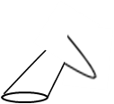
ý
=
1844
Ipsus
2016
Antigonus =
“like” “ancestor”
Alexander the Great
3 branches of government
Executive
Judicial
Legislative
The lamb like beast went into this battle with one horn and you see that republican horn broken. If you go to WW2 again you have three allies - Poland France and Britain. We see Poland was taken at once, and there is a long war with the other two allies, France and Britain. So we see the executive branch was taken at once in the 2016 election. The Executive branch is the presidency, which Trump took in the election of 2016 and now if you follow the politics inside the USA, there is an ongoing war with the other *two branches, the Judicial and the Legislative because Trump wants to control the all three branches. That was one perspective we can also see it from another.
*Feb. 2020: Trump controls Judicial branch
Antigonus
Clinton) Demetrius
(Trump KN)
Pyrrhus KS ↑
vs
3 allies
Cassander
Lysimachus
Seleucus
Hitler begins WW2
3 allies
Poland
France
Britain
Hitler
Stalin ↑
vs

Slide 7
-323
-301
   
Death of
Alexander
cause

Death of
Antigonus
effect
Daniel takes the death of Alexander, skips four Diadochi wars, which he sees as noise and goes from the cause Alexander’s death, to the effect the breaking of one horn, the rising up of the four generals. This takes us from -323 to Ipsus. Cause and affect.

Slide 8
-323
-301
   
We are doing the same thing in this perspective of Raphia. Because when we are to talk about Raphia as a battle between the King of the North and the King of the South, Ptolemy and Seleucus and for a few years we've made Raphia the COP and placed it as a way mark, we want to know why they are fighting. Why are they fighting at Raphia? And if we do use the same model that Daniel gives us, we can go to the beginning of the wars, find a cause and see Raphia is the effect. Instead of skipping four Diadochi wars, now we are passing over four Syrian wars. We are identifying them as noise and Ipsus is the cause, Raphia is the effect. Ipsus is 2016 and Ptolemy and Seleucus, are allies.
Death of
Alexander
cause

Death of
Antigonus
effect
6 Syrian Wars
Daniel 11:5-15
Ipsus
2016
Raphia
2019
Panium
1
2
3
4
5
6
cause
effect

Slide 9
You have the same dynamic in this second perspective with Seleucus against Antigonus.
Seleucus is the KoN, and Antigonus is the same person, standing in place of Alexander the Great. So you have Clinton against Trump, who has already since 2014 been identified as the KoN. Then you have the KoS, Ptolemy giving his support to Trump.
2nd Perspective
Ipsus/2016
400-500 war elephants
Seleucus KN
(Trump)
Ptolemy KS ↑
(Putin)
vs
Antigonus
-323
-301
   
Death of
Alexander
cause

Death of
Antigonus
effect
Cause
effect
George
Washington
Obama
Trump
establishment

Slide 10
A reminder, in this history what city was Ptolemy attacking in this time period? Sidon. And in Acts 27, what did Sidon represent? The USA. So we can even in that history see that Ptolemy is not idle, he was doing a work. And this conflict at Ipsus between Antigonus and the allies spark a disagreement between Seleucus and Ptolemy, over Coele-Syria. So the concept we need to consider in this history of the Syrian wars, there are six of them. Does Seleucus want Egypt? Is that what he was trying to get? No. Seleucus was not trying to take Egypt. And Ptolemy was not trying to take Babylon. What both kings wanted was Coele-Syria, it’s this portion in the middle that came under either one of their spheres of influence and this is a recurring theme.
So a few years ago we would have gone to Dan 11:40 and would have seen that the KoS was defeated by the KoN, but it only went to the neck. Because the country itself was not taken. And we would have said that meant the KoS was not properly defeated. But I just want us to note, at what point in the Syrian wars the 4th ends at Raphia, and 5th ends at Panium, and at either Raphia or Panium do either party take the country of their enemy? Even at Panium, the KoN does not take Egypt. Seleucus never took Egypt. So if we use the concept of up to the neck and we are consistent with that we don't find any evidence that Seleucus ever took Egypt, that that country is not taken. Because that’s not what they are fighting over. What they are fighting over is Coele-Syria. That’s what both sides wanted, these spheres of influence.

Slide 11
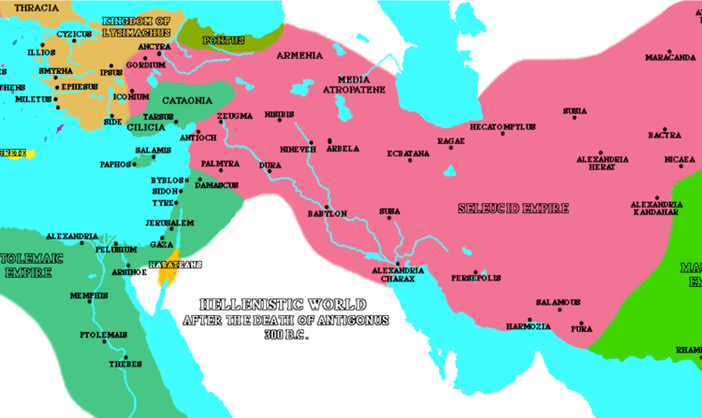

Slide 12
proxy war
prox·y war
noun
noun: proxy war; plural noun: proxy wars
a war instigated by a major power which does not itself become involved.
"the end of the Cold War brought an end to many of the proxy wars through which the two sides struggled to exert their influence"
When we come to WW2, the conflict in 1940 was over spheres of influence. When we come to the cold war, what are the KoN and the KoS fighting over? Spheres of influence. Eastern Europe.
We want to talk a little about spheres of influence before we start to discussing our second battle of Heraclea. So before we discuss Heraclea, we want to go through the civil war in Syria and to consider one thing. What’s happening right now is fairly well known, that Syria is in a civil war that has become a proxy war between the USA and Russia. We understand that Afghanistan was a ten year proxy war from 1979 to 1989. And we see now with Syria.
Christ
vs
Satan
Different ideology
God prepares Able
Satan prepares Cain
Great Controversy
Formed church
Formed church
=
babylon
AFGHANISTAN
USA
vs
SU
Russia has pipelines into Europe. Others do not—and ships are used/needed—and are much more costly.
2009 Qatar/US want to build pipelines
Rebels
Gov. Afg.
40 years later Afg still getting destroyed
Except US supporting Afg. Gov.
Russia supporting rebels
It isn’t over because political players propping up their side
Sending more arms and money — 100,000s have died

Slide 13
So in 2009, Qatar has supplies or access to natural gas. And Russia supplies about 1/4 of Europe’s natural gas and uses this for political leverage. So when Russia has conflict with Europe, it has a tendency to use the gas to manipulate them. Particularly when we consider Ukraine in Georgia, where they had conflict with Ukraine they waited until December which is winter in Eastern Europe. And they turned off the gas supply leaving many people in Ukraine without the ability to heat their homes. So they tend to use this export for political leverage. Which is why USA politicians have known for a long time that they need to bypass Russia. It will decrease Russia's political power, so that other countries do not depend on their resources and Obama spoke publicly about that in 2014. He said they needed to find another way to get natural gas into Europe that bypassed Russia.
IN 2009, Qatar comes up with a plan. Russia has pipelines into Europe whereas other nations have to put it on tankers and send it in. That’s much more costly and less effective, so what they need is pipelines. So Qatar comes up with this plan that they are going to take their supplies of natural gas and build a pipeline. This pipeline will go through Saudi Arabia, through Syria, through Turkey, and into Europe.

Slide 14
By supplying Europe with natural gas from the Persian Gulf, they are going to be able to bypass much of that Russian market. But what’s their problem? What is the issue with this picture? The problem is whether it’s obvious or not much of the world now is divided into two spheres of influence, the exact same way it was divided in the cold war. Except now it's not as neat, now its spread out over the globe. And if you were to talk about the USA and Russia, there’s a problem. Who is Qatar allied to? Who's sphere of influence does Qatar come under? USA. They have one of the largest American military bases, the largest base in the Middle east. Qatar is an ally of the USA. When they want to bypass Russia in the gas market they need to build a pipeline. Saudi Arabia is an ally of the USA, though they pretend to play both sides. Turkey is an ally, there’s no problem with Turkey and Saudi Arabia. But there is a problem with Syria. So when Qatar puts forward this proposal and asks permission of these countries to build this gas pipeline, Saudi Arabia and Turkey agree, and what does Syria say? No. They won’t permit it. Because they have a boss in Moscow, who does not want a USA ally supplying natural gas into Europe. And Syria’s president Assad, rejects this proposal.
The Qatar-Turkey pipeline was a proposal to build a natural gas pipeline from the Iranian–Qatari South Pars/North Dome Gas-Condensate field towards Turkey, where it could connect with the Nabucco pipeline to supply European customers as well as Turkey. One route to Turkey was via Saudi Arabia, Jordan, and Syria,^{[1][2]} and another was through Saudi Arabia, Kuwait and Iraq.^{[3][4]} Syria's rationale for rejecting the Qatar proposal was said to be "to protect the interests of [its] Russian ally, which is Europe's top supplier of natural gas.

Slide 15
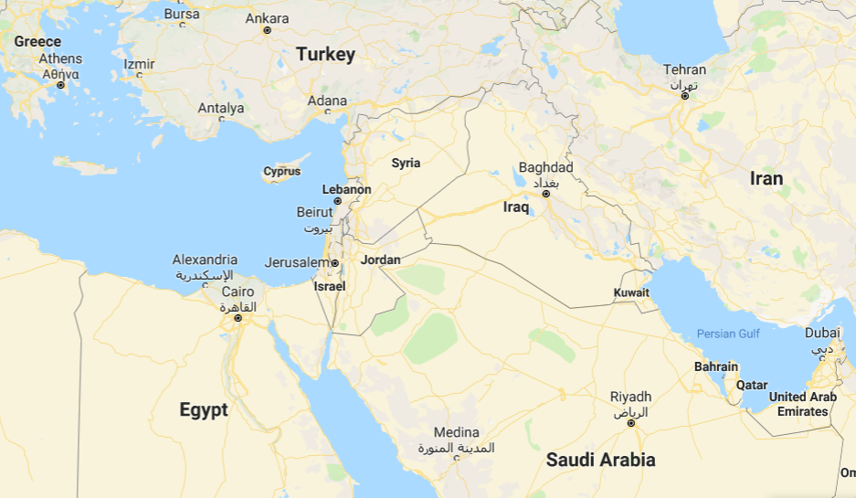
2011 (yes)
Syria has Russia’s only Navy base with direct access to Mediterranean.
Qatar has largest US Navel base in area.
For Qatar allied with USA to supply nat gas to Europe, it would have to go through Syria allied with Russia.
Syria knows he’s trying to bypass his ally 2009—they say no
2011 Iran makes plan: pipelines to go through Syria—they say yes.
But whole region is engulfed in civil war
(Russia)
2009 (no)
(USA)

Slide 16
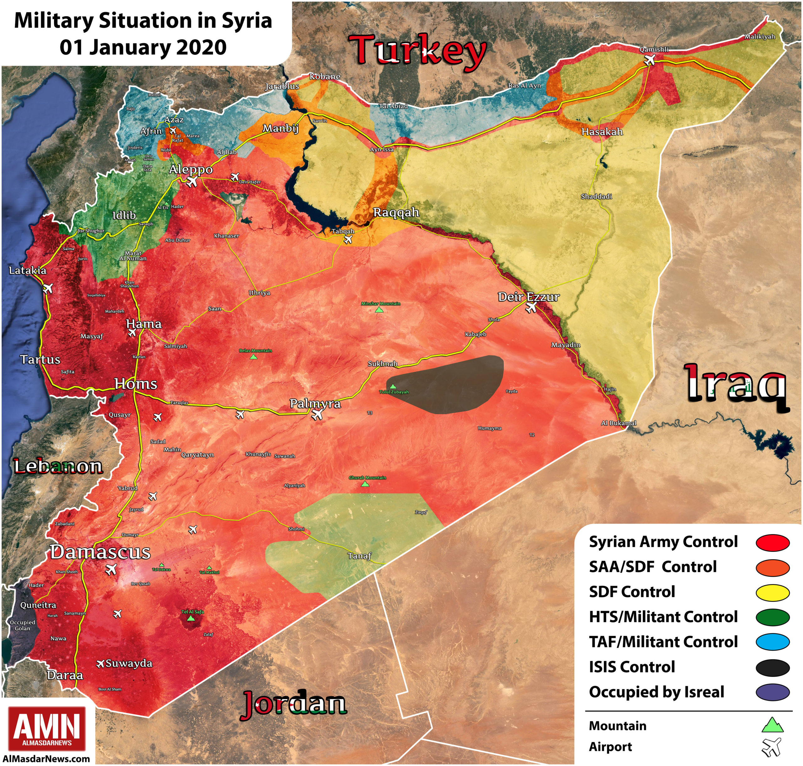

Slide 17
The Iran–Iraq–Syria pipeline (called the Friendship Pipeline by the governments involved and the Islamic gas pipeline by some Western sources) is a proposed natural gas pipeline running from the Iranian South Pars/North Dome Gas-Condensate field towards Europe via Iran, Iraq, Syria and Lebanon to supply European customers as well as Iraq, Syria and Lebanon. The pipeline was planned to be 5,600(3,500) long and have a diameter of 142 centimetres (56in). A previous proposal, known as the Persian Pipeline, had seen a route from Iran's South Pars to Europe via Turkey; it was apparently abandoned after the Swiss energy company Elektrizitätsgesellschaft Laufenburg halted its contract with Iran in October 2010 in the face of pressure over U.S. sanctions against Iran.[
Iraq signed an agreement with Iran in June 2013 to receive natural gas to fuel Iraqi power plants in Baghdad and Diyala. The contract covers 1.4 Bcf/d (billion cubic feet per day) over 10 years. Iran's plans to export 176 MMscf/d of gas to Iraq by 2015.
In July 2011 Iran, Iraq and Syria said they planned to sign a contract potentially worth around $6bn to construct a pipeline running from South Pars towards Europe, via these countries and Lebanon and then under the Mediterranean to a European country, with a refinery and related infrastructure in Damascus. In November 2012 the United States dismissed reports that construction had begun on the pipeline, saying that this had been claimed repeatedly and that "it never seems to materialize." A framework agreement was to be signed in early 2013, with costs now estimated at $10bn; construction plans were delayed by the Syrian Civil War.^{[11]} In December 2012 the Oxford Institute for Energy Studies said that the project "remains doubtful. It is not clear how such a project will be financed given that both Iran and Syria are subject to strict financial sanctions." In July 2015, Iranian Gas Engineering and Development Company (IGEDC) and Pasargad Energy Development Company signed a BOT (build-operate-transfer) contract under which the project owner will provide 25% of finance and National Development Fund of Iran the rest for the construction of IGAT-6.
The pipeline would be a competitor to the Nabucco pipeline from Azerbaijan to Europe.^{[1]} It is also an alternative to the Qatar–Turkey pipeline which had been proposed by Qatar to run from Qatar to Europe via Saudi Arabia, Jordan, Syria and Turkey.^{[14]} Syria's rationale for rejecting the Qatar proposal was said to be "to protect the interests of [its] Russian ally, which is Europe's top supplier of natural gas."^{[14]}
Jump forward to 2011, There’s another country with access to the Persian Gulf and the gas market. And who is that? Iran. They come forward with a proposal to take their natural gas through the Persian Gulf, and they are going to build the pipeline. Through their country of Iran through Iraq, through Syria, under the Meditation Sea, come out in Eastern Europe, I believe in Greece. So this is Iran's proposal. And to build that pipeline which they proposed in early 2011, they need access to Iraq and Syria. Iraq says yes, what does Syria say? Yes, why? Where does Iran fit in our spheres of influence? They are allies with Russia. Iran comes under Russia's sphere of influence and they are going to follow their boss. Russia knows it can control them. Russia also knows that Iran does not have the quantity of natural gas that Qatar has. So Assad, Syria says yes to Iran, and no to Qatar. Because he knows where he fits on the spheres of influence map. Russia doesn't mind if Iran supplies Europe with natural gas because Iran is an enemy of the USA.

Slide 18
KS
vs
KN
They have to keep their allies - Turkey was U.S ally (Nato)
ISIS wants to defeat all of them
Sometimes fight K. rebels and Syria supplies them
Sometimes fight Syria/Assad and Saudi Arabia supports ISIS
They play one side off the other side
Russia supplies natural gas to Europe, Ukraine. Ukraine makes political decisions Russia doesn’t like. Russia turns off the tap of natural gas to control.
Russia
Iran
Venezuela
Assad
(Syria)
USA
Qatar
Ukraine
Afghanistan
Syrian Civil War
ISIS
This is how politics are playing out. And it's become a world wide issue that these countries are divided between Russia and the USA. Where does Venezuela fit in on this map? Under Russia. So right now Russia has troops within Venezuela propping up their government.
What about Ukraine? They’ve been fought over but they are with the USA. What about Afghanistan? It's now a proxy war again. Now the government is on the side of the USA and as of recent history, Russia has began to stir up the rebels. We could go through most of the conflicts that have been developing over the recent times and see that the global struggle or fight that is going on is over the spheres of influence. And this comes back to the story of Ptolemy and Seleucus. What did these sides actually want? Because Seleucus didn't need to take Egypt, he wanted Coele-Syria, he wanted spheres of influence. The same applied for Ptolemy, he was content with Seleucus having Babylon, so long as he didn't have the middle east region, which was of strategic importance. So when we come to the fall of the Soviet Union, when it’s defeated is when it looses its spheres of influence just like in the Syrian wars, this is what they are fighting over.

Slide 20
What we want to consider is what they are fighting over, and lets remind our selves of the history of 1989 to 91. What the King of the South lost was spheres of influence. And as he progressively lost his spheres of influence the US rose up as the world’s only super power. Which means that when we come to the history of Raphia and Panium, what history is going to be repeated? The KoS loses his spheres of influence and at that stage the US becomes the world’s only super power. It's a repeat of history. But instead of it all being over eastern Europe, and even when we think of that it wasn't so simple, no fighting over Cuba, and Afghanistan that was the conflict between the Soviet Union and the USA. It became a battle for South America, not just eastern Europe. But we are finding our selves, it’s crept up on us largely without notice that Russia has regained its political power, and the world is divided again into two spheres of influence. That became the most clear in 2011. Soon after Syria accepted Iran's proposal, it becomes engulfed in a civil war that was not a coincidence. And that civil war has not been going on for 8 years because the rebels are so strong. It’s because Russia and the USA keep propping up opposing sides.

Slide 21
So we have discussed 2016, this is Ipsus, that conflict over the American election where Demetrius and Pyrrhus—Trump and Putin are on the same side. This is the invasion of Poland war on the western front.
Aug 1940, this where they have a break down in their alliance. So the pact that Hitler and Stalin had signed, the Molotov Ribbentrop Pact had three parts. The pact itself has two parts, there’s a third part, another agreement. This is review, we discussed this when we went through WW2.
1. The first part was a non aggression where they agree to not attack each other, Stalin agrees to allow Hitler to fight the west with out attacking him while he is weak
2. The second part was a dividing up Europe into spheres of influence.
3. The third part is the issue of trade, this is how the Soviet Union supported Hitler’s war.
So the Soviet Union is going to support Hitler, supply him with materials and Hitler has to pay. The way Hitler was to pay, was with German technology. He was to share his knowledge with Stalin, as they built stronger battle ships, new weapons, new planes. So it wasn't just money, he was to pay in sharing in this technology, this is the commercial aspect of their alliance. So non aggression and Spheres of influence but it will also have the commercial element and without Stalin’s support, Hitler would never have been able to maintain a war.
E
Ipsus
2016
E
Heraclea
2018
E
Asculum
2019
E
Beneventum
2021
Pyrrhus
2014
Alliance
Raphia
Panium
Western
front
Aug 1940
WW2
invasion of
Poland
eastern front
Operation Barbarosa

Slide 22
E
Ipsus
2016
E
Heraclea
2018
E
Asculum
2019
E
Beneventum
2021
Pyrrhus
2014
Alliance
Sept 1939
Western
front
Raphia
Panium
Aug 1940
WW2
invasion of
Poland
eastern front
Operation Barbarosa
So soon after all this was agreed too, in Sept 1939, Hitler begins war on the Western Front, the invasion of Poland. Then between Sept 1939 and Aug 1940, they continued to trade and divide up Eastern Europe. But their relationship began to come under strain until Aug 1940 when it completely broke off for one month. The Soviet Union stopped sending any deliveries to Germany, they wouldn't fund the war effort. And there were two problems: the elements of the pact that Germany was breaking, Germany was not paying their bills to the Soviet Union for that trade. And they also started arguing about the division of Eastern Europe. They began to divide up the Balkans, and they realize they couldn’t agree on how that should be done. Particularly when it came to Hungary, Romania, and Bulgaria. So they are fighting over spheres of influence and over the commercial aspects of their pact.

Slide 23
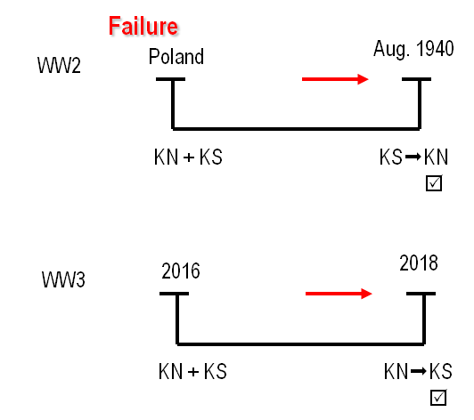
We need to remember that this is a history of failure, and that means when they come to Aug of 1940, who is the aggressor? In the history of failure it was the KoS who initiated the break down with the KoN. And as they met in secret and sorted out their differences it was Germany that came out the winner. So in the history of failure the KoS that initiates the conflict, and the KoN that wins it. So if we are going to see a history of success based on the lines we drew up, we have to see the KoN initiate the conflict with the KoS. And the KoS has to win. This is what Pyrrhus and WW2 teach us to expect and through our other lines we have identified it as 2018, the Battle of Heraclea or Aug of 1940.

Slide 24
For the remainder of our time we’re going to trace the relationship between Donald Trump and Vladimir Putin. From the 2016 election until the end of 2018. We’re going to find for the majority of that time the alliance remains strong.
This may seem like an insignificant event, but it was the preparation for what came after. Donald Trump signs a new executive order on May 11, 2017. It's the executive order, 13800. And it’s titled Strengthening the Cyber Security of Networks and Infrastructure. This is only a few months after the 2016 election, Donald Trump became an inaugurated president in 2017, and by May that year he's already beginning to take steps to protect American cyber security. Why would he do that? He has just gone through the 2016 election, and he knows how he won that, it was with the help of Vladimir Putin. One of the ways Putin helped him was by attacking America’s cyber network. And in 2016, the agency that Putin set up to do this work is the IRA: Internet Research Agency. This is a branch of the Russian Military that sounds innocent, but it’s what Putin uses to interfere world wide with the cyber networks in various different countries. And it's particularly the IRA that he used in 2016. May of 2017, Trump begins to strengthen America;s cyber security. He needs to make sure that what ever Putin did to interfere in the 2016 election to help get Trump elected doesn't continue to give Putin power over the USA now that he is president. This is just the beginning of that work as we will see.
Heraclea
May 11, 2017 ª Exec Order 13800

Slide 25
We are going to skip over a year, and come to July 2018, a summer in Helsinki, a meeting. The first official meeting between Trump and Putin, and how well did that meeting go? This should just be review, and going through this history ourselves makes it easier to see. Trump’s language just prior to this meeting, he's attacking all of his allies and you could see he is waging war on the west. He attacks NATO, he attacks Canada, he attacks the European Union. But when he comes to Helsinki and meets with Putin, he only has praise and adoration. There’s a well known Republican senator, (was) John McCain. He said this meeting was a tragic mistake, and that there has never been an American president who has abased himself before a dictator to this level. So you can imagine in July 2018, it was clear to all who followed that meeting and the press conference that followed it, that there was a relationship between these two men, and there was some kind of an alliance. So we know in this history the relationship is strong.
Heraclea
May 11, 2017 ª Exec Order 13800
July 2018 ª Helsinki meeting ª Trump & Putin

Slide 26
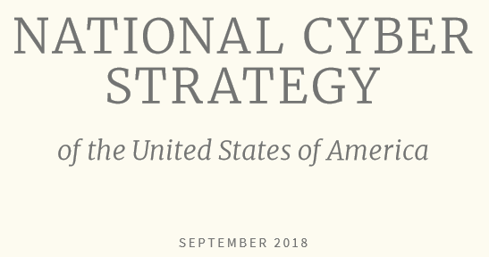
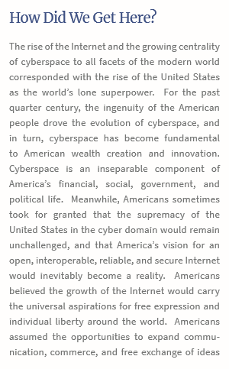
Heraclea
May 11, 2017 ª Exec Order 13800
July 2018 ª Helsinki meeting ª Trump & Putin
Sept 21 ª National Cyber Strategy
We’ll jump a couple of months to Sept 21, 2018. And what Trump did in 2017, with this executive order, he now begins to complete that work with the National Cyber Security Strategy. This is a new strategy to protect American cyber networks. The last time America had a new cyber security strategy was 15 years ago in 2003. And when he introduces NCS, Trump wrote the first pages for that strategy where he makes that comment that we have been discussing, it’s in this new NCS, where he says the rise of the internet, corresponds with the USA as the world’s only super power. And as he is strengthening his cyber security, he's reminding them the history of the USA from 1989 to 91. And he is saying we were dominant then, and that corresponds with our interaction with the internet as it rose up.

Slide 27
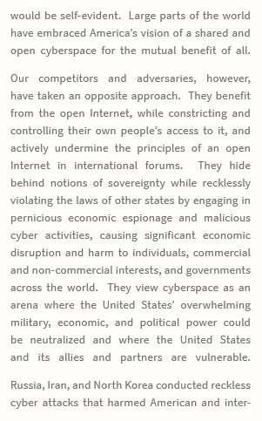
And then he identifies why he is bringing in a NCS, he says the USA is being challenged, it’s being undermined and attacked by four particular enemies. And even in peace time, remember in our history there is no clear division between war and peace, Russia told us that, and now in peace time America is finding itself under attack from four primary enemies. What’s the first enemy Trump names? Russia, his ally. In July 2018, he's saying Putin never even interfered with the election, and now in September he's telling Putin two painful things. The first thing he is reminding Putin of the fall of the Soviet Union, and that would have hurt, and the second Trump is saying in this report that he recognizes what Russia has been doing, and he is going to put an end to it. And he lists Russia, China, Iran and North Korea.
The first he lists is Russia, and then he describes how this NCS is there to protect him against Russia’s behavior. But it wasn't just an act of protection.

Slide 28
John Bolton, the National Security Adviser for Trump (was), he advises Trump on National Security and he gave more details about what this strategy was designed to do. Sept 20, when this strategy was beginning to be revealed, he makes an interesting statement. He says what this strategy is designed to do is to allow the USA to no longer just act defensively, but now they can act offensively, so now they wont just protect themselves from foreign attacks, now they can actually engage in attacks. This proposal wasn't just defense, now it was also offense, because Obama had been much more careful how the USA used the internet offensively.
Heraclea
May 11, 2017 ª Exec Order 13800
July 2018 ª Helsinki meeting ª Trump & Putin
Sept 21 ª National Cyber Strategy offensively

Slide 29
Oct 28, when we talk about the M/C, the internal message comes out in the SOTP in Arkansas, that was in Sept and Oct and that’s when we were seeing an escalation. It corresponds with our external way marks. John Bolton goes to Russia, and he meets with Putin and Putin on camera, on youtube you can watch this discussion, Putin looks at John Bolton and he reminds him of this meeting in Helsinki. Putin tells John Bolton, I met President Trump in July this year and our relationship was strong. It was a good meeting and then Putin says this is why I am surprised to see the USA take steps that are not substantiated by anything, and I would call unfriendly. They are not friendly steps. He says we are not responding to you're unfriendly steps but you keep taking them. So John Bolton and Putin meet and this part of they're meeting is all filmed. Russia's Putin meets US National Security Advisor John Bolton.
https://youtu.be/JDWEK9WVRk0
Heraclea
May 11, 2017 ª Exec Order 13800
July 2018 ª Helsinki meeting ª Trump & Putin
Sept 21 ª National Cyber Strategy offensively
Oct 28 ª ‘not friendly’ (Putin)

Slide 30
So already by October who's coming against who? Who's initiating conflict? Trump.
We’re heading towards the time period of early November which was the American midterm elections. Oct 31, a few days after this meeting, John Bolton gives us a clue about what is happening. He gives a speech and he says that the USA right now is currently undertaking offensive cyber operations, he's using this strategy and the USA is now acting offensively to protect the midterm elections. Nov 6th was the mid term elections.
Heraclea
May 11, 2017 ª Exec Order 13800
July 2018 ª Helsinki meeting ª Trump & Putin
Sept 21 ª National Cyber Strategy offensively
Oct 28 ª ‘not friendly’ (Putin)
Oct 31 ª taking offensive action ‘right now’
Nov 6 ª mid-term elections

Slide 31
In late 2018 was the 100 year anniversary of the end of WW1. To commemorate the end of WW1, many of the world leaders met in France, and both Trump and Putin were to be there, and they had a meeting scheduled on the side lines. Trump cancelled that meeting, he wasn't willing to meet with Vladimir Putin. And about a week later on Nov 16, Trump completes this work of setting up this Cyber security plan, and he creates a Cyber security agency within the department of Homeland security. CISA = Cyber Security Infrastructure Security Agency. And this is the culmination of what he has been trying to do.
Heraclea
May 11, 2017 ª Exec Order 13800
July 2018 ª Helsinki meeting ª Trump & Putin
Sept 21 ª National Cyber Strategy offensively
Oct 28 ª ‘not friendly’ (Putin)
Oct 31 ª taking offensive action ‘right now’
Nov 6 ª mid-term elections
Nov 9-11 ª meeting cancelled

Slide 32
Soon after this, Nov 25, there’s a conflict where? Russia and Ukraine. Ukrainian ships sailed into Russian water where they aren't allowed to go without permission. Ukrainian ships always sailed through that water and the permission given was more of a formality and it had never been an issue before. But Russia uses their failure to ask permission as an excuse. They fired and seized those naval vessels, they took those ships and all those crew members, some of whom were injured, and this was such an escalation of tension between Russia and Ukraine, that Ukraine started to prepare for a hot war, and they declared martial law and postponed their election. So beginning Nov 25, on this one date, there is major conflict between Russia and Ukraine.
Heraclea
May 11, 2017 ª Exec Order 13800
July 2018 ª Helsinki meeting ª Trump & Putin
Sept 21 ª National Cyber Strategy offensively
Oct 28 ª ‘not friendly’ (Putin)
Oct 31 ª taking offensive action ‘right now’
Nov 6 ª mid-term elections
Nov 9-11 ª meeting cancelled
Nov 25 ª Ukraine and Russia

Slide 33
Heraclea
Early December there was to be a G20 meeting in Buenos Aires, this was to be another meeting between Trump and Putin. On Nov 29 Donald Trump cancels this meeting. He cancels it by Twitter on his way to the G20. And the reason he gives for cancelling it is because of Russia’s behavior against Ukraine, because Russia has not released the ships and the sailors, he will not meet with Vladimir Putin. He would be willing to meet with him again once Putin releases those ships and makes peace with Ukraine. This took Russia completely by surprise. By the time you get to Nov 29, you can say this relationship is broken apart.
May 11, 2017 ª Exec Order 13800
July 2018 ª Helsinki meeting ª Trump & Putin
Sept 21 ª National Cyber Strategy offensively
Oct 28 ª ‘not friendly’ (Putin)
Oct 31 ª taking offensive action ‘right now’
Nov 6 ª mid-term elections
Nov 9-11 ª meeting cancelled
Nov 25 ª Ukraine and Russia
Nov 29 ª Trump cancelled meeting

Slide 34
Dec 19 is one of those days where everything seems to happen at once. Trump made a number of announcements. First he is removing all the troops from Syria. We just discussed Syria, Trump is removing all of his troops, no longer has any quarrel with Assad because ISIS has been defeated. So he is giving up Syria, he announces that he is removing half of all of the troops from Afghanistan. And what is Syria and Afghanistan? Proxy wars between Russia and the USA. And he is surrendering them. And another announcement he's removing sanctions on a Russian Oligarch, Oleg Deripaska. Why were there sanctions on Oleg Deripaska? We briefly discussed the Oligarchs and how they work for Vladimir Putin. There were sanctions on Oleg Deripaska because Putin used him to interfere in the 2016 elections. So we could go into the history particularly relating to that election and trace the role of Oleg Deripaska. If you trace what Russia wants, the financial element that they were trying for in the 2016 election, it’s for the removal of sanctions. There’s a meeting in Trump Tower, it was over sanctions. There’s interaction between Trump’s campaign team and members of the Russian government, they are related to sanctions. Any thing you see Putin trying to get in that history, even the language he used in July in Helsinki, what Putin wants is the removal of sanctions. So you have the break down of the relationship between Russia and the USA leading to Dec 19, when Trump completely capitulates and it relates to two elements. One is commercial, the other is spheres of influence, repeating the history of WW2.
Heraclea
May 11, 2017 ª Exec Order 13800
July 2018 ª Helsinki meeting ª Trump & Putin
Sept 21 ª National Cyber Strategy offensively
Oct 28 ª ‘not friendly’ (Putin)
Oct 31 ª taking offensive action ‘right now’
Nov 6 ª mid-term elections
Nov 9-11 ª meeting cancelled
Nov 25 ª Ukraine and Russia
Nov 29 ª Trump cancelled meeting
Dec 19 ª Trump announces troops withdrawing
Syria
Afghanistan
ª Jim Mattis resigns
ª Remove sanctions: Oleg Deripaska
Molotov-Ribbentrop Pact
.non aggression
.spheres of influence*
.trade/commerce*

Slide 35
Heraclea
Early this year we found out some more details, we filled in some of our gaps. John Bolton said the USA was undertaking an offensive operation to protect the midterm elections. Now we know what that was. And in this history, Nov 6, surrounding the midterm election, the USA launched a cyber attack against the IRA. And they completely shut down that Russian agency for the time period surrounding the midterm elections. So these were not empty words. They really did launch a cyber attack against Russia, and then in the history of WW2 they have issues over trade and spheres of influence. They met in secret, sorted out their differences, and their relationship was stronger than before.
May 11, 2017 ª Exec Order 13800
July 2018 ª Helsinki meeting ª Trump & Putin
Sept 21 ª National Cyber Strategy offensively
Oct 28 ª ‘not friendly’ (Putin)
Oct 31 ª taking offensive action ‘right now’
Nov 6 ª mid-term elections
Nov 9-11 ª meeting cancelled
Nov 25 ª Ukraine and Russia
Nov 29 ª Trump cancelled meeting
Dec 19 ª Trump announces troops withdrawing
Syria
Afghanistan
ª Jim Mattis resigns
ª Remove sanctions: Oleg Deripaska

Slide 36
Earlier this year we uncovered information that they did meet in Buenos Aires around the time of the G20, but it was kept secret. It was not reported, no notes were kept, no one was allowed to listen in. So when we consider the history of WW2, we see war on the west and war on the east. Between these two fronts, there’s a break down in their allegiance relating to the spheres of influence and their commercial agreements. Germany wasn't paying.
When we come into our history, we see a progressive breakdown in their allegiance, Trump has not successfully removed sanctions, which at least members of his campaign team has promised Russia that he would do. They still are arguing over spheres of influence and the final element of that is Ukraine, Nov 25. There’s a cyber attack, they meet in secret, what ever was said, this is the result: Trump gave up Syria and Afghanistan, and began to remove sanctions.
Heraclea
May 11, 2017 ª Exec Order 13800
July 2018 ª Helsinki meeting ª Trump & Putin
Sept 21 ª National Cyber Strategy offensively
Oct 28 ª ‘not friendly’ (Putin)
Oct 31 ª taking offensive action ‘right now’
Nov 6 ª mid-term elections
Nov 9-11 ª meeting cancelled
Nov 25 ª Ukraine and Russia
Nov 29 ª Trump cancelled meeting
Dec 19 ª Trump announces troops withdrawing
Syria
Afghanistan
ª Jim Mattis resigns
ª Remove sanctions: Oleg Deripaska
It’s official: Congress has handcuffed Donald Trump on Russia.
On Wednesday morning, President Trump grudgingly signed a bill into law that imposes new sanctions on Russia and sharply limits his ability to lift them. Since the bill sailed through Congress with a veto-proof majority, his only options were to sign it or to veto it and then endure the humiliation of seeing Congress — controlled by his own party — override him with ease, as lawmakers in both parties pledged to do.
When he signed the bill, he issued a statement calling the law “significantly flawed” and claiming that it contains “unconstitutional provisions” in its restrictions on presidential authority.
https://www.vox.com/policy-and-politics/2017/7/28/16055630/congress-trump-russia-sanctions-veto

Slide 37
And a reminder, when we consider dates, when did Donald Trump win the 2016 election? Nov 9, 2016. But there’s two actual elections. Nov. 9 is the election of the people. But the way the USA election system is set up, it's not enough. There is another election called the Electoral College. That election was Dec 19, 2016. So with the Battle of Ipsus itself, you have two votes, two dates: Nov 9, and Dec 19.
Nov 9
Dec 19
2016
people
Electoral

Slide 38
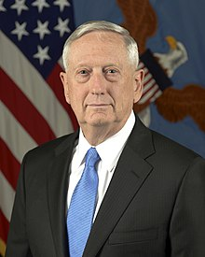
When we come to our history, we see Heraclea on Dec 19, 2018 and you should already be aware Asculum is Nov 9, 2019. So Dec 19 fits into our pattern, and that was not designed before.
One other detail, through out the history from 2016 to the end of 2018, Donald Trump is being restrained by his generals. Powerful influential generals who become part of his government and prevent him from making decisions like these, one by one those generals either quit or are being fired, until only one remains. The last of all the generals, who was willing to stand up against Trump in this was Jim Mattis. When he saw what Trump had done with Syria and Afghanistan without consulting him, he resigned and wrote a letter to condemn Trump for this. The news reports from this day, the news stations we should be listening too, recognized that the last general that had restrained Trump had just been removed from his position. He resigned and then just for effect Trump fired him.
Dec 19, of 1941 is when Adolf Hitler took control of his army from that of his generals. He decided that he would dictate the movements of his army, and compose the strategy, he released himself from the restraint of his general's, Dec 19, 1941. Donald Trump did the same thing, Dec 19, 2018.
Nov 9
Dec 19
2016
people
Electoral
Ipsus
Heraclea
Asculum
Nov 9
Dec 19
Dec 19
Nov 9
2016
2019

Slide 39
So this is the history of the breakdown and the rebuilding of that alliance and it centers around the time period of our internal Midnight Cry. We can see that it was the King of the North that initiated that conflict and the KoS that came out winning. On Dec 20, Vladimir Putin holds a four hour news conference and praises Donald Trump. He says that Donald Trump made all the right decisions and it is such a shame that his country is not supporting him, and he blames the democrats, all of these other parties of the USA. He launches into this defense of Donald Trump. So you can see Dec 19, and definitely Dec 20, that their alliance is strong. This is the story of the Battle of Heraclea, KoN and KoS.
Heraclea
May 11, 2017 ª Exec Order 13800
July 2018 ª Helsinki meeting ª Trump & Putin
Sept 21 ª National Cyber Strategy offensively
Oct 28 ª ‘not friendly’ (Putin)
Oct 31 ª taking offensive action ‘right now’
Nov 6 ª mid-term elections
Nov 9-11 ª meeting cancelled
Nov 25 ª Ukraine and Russia
Nov 29 ª Trump cancelled meeting
Dec 19 ª Trump announces troops withdrawing
Syria
Afghanistan
ª Jim Mattis resigns
ª Remove sanctions: Oleg Deripaska
Dec 20 ª Putin praises Trump in four hour press conference

Slide 40
You can build Fox News into this story, there is another layer, relating to Dec 19, the Mexican wall, and church and state.
On December 19th we need to look at, it has as much significance for us even though it's not connected to the KS. What happened in the weeks leading up to December 19th-- a new budget had been drawn up where Donald Trump wanted five billion dollars for his border wall. The Democrats were not going to allow that. They offered him about 1.6 billion, so there's a fight over the border wall leading up to December 19th. In early December Donald Trump says he will be proud to shut down the government unless they give him money for the border wall. Early on the day of December 19th, he indicates that he will not shut down the government, but he'll continue to fund the government to operate even if they do not give him money for his border wall. We need to consider what happened when he said that, particularly from Fox News. These are people who helped get him into power, they communicate between him and his base which for the majority of it is Christian conservative America. They very rarely are criticizing him, it's mostly praise. But the night of December 19th they begin to criticize him in fact they launched an attack. They say through their TV screens that this is a decision that Obama would have made, that is presidency would be a failure, that he's completely betrayed those who voted for him in 2016, that they wouldn't vote for him again. And there is this real attack launched from Fox News. One thing we need to be aware of is the power that news network has and the interaction happening between them and Donald Trump. There's this growing belief inside America that Trump is a prophetic character. Fox News themselves held a poll. The poll was related to Donald Trump's election and whether or not God placed him in power. They found that one in four Americans believed that the majority of Evangelical Christians in America, something like 67% believe that he's been raised up by God to do work in the country to bring them back to Christianity. These are people that watch Fox News, it's the base that they begin to set up intentionally from 1996 when Fox News began, that they would be a new station for American conservative Protestants, that was their business plan, not a result.

Slide 41
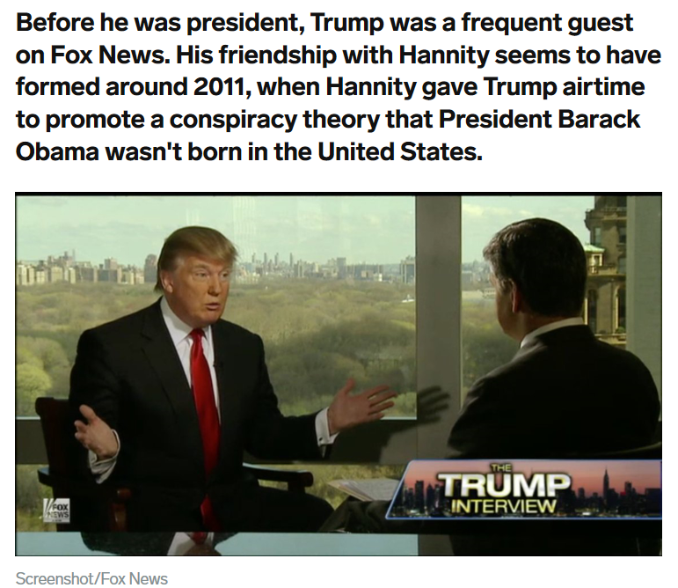
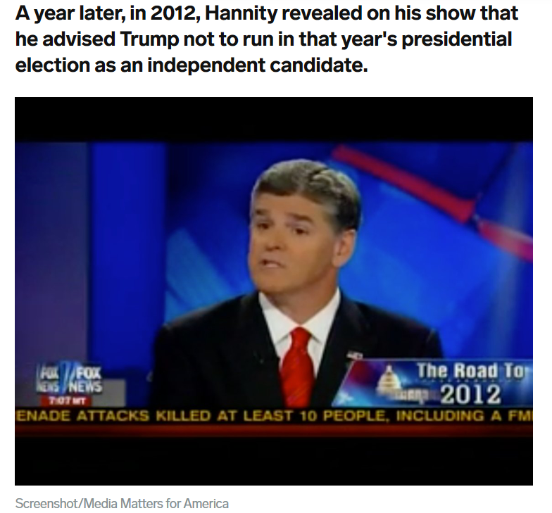
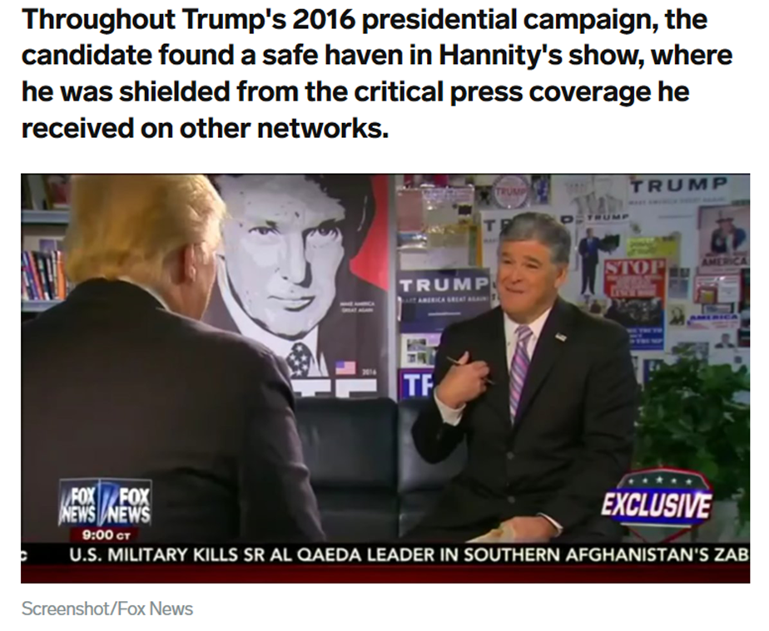
Fox star Sean Hannity is one of Donald Trump's fiercest defenders — here's how he and the president became close
https://www.businessinsider.com/sean-hannity-donald-trump-relationship-2018-4
Fox News opinion host Sean Hannity was revealed on Monday to be one of the clients of Michael Cohen, the attorney for President Donald Trump, several news outlets reported.
Monday's revelation wasn't the first time Trump and Hannity have been linked. The pair have been close for years, well before Trump announced his candidacy for the presidency. In fact, Trump and Hannity have benefited from each others' platforms immensely — Hannity lent unwavering support to Trump when other news outlets were critical of him, while Trump's frequent appearances on Hannity's show boosted Hannity to some of the highest ratings in cable news.
Look inside the relationship of Trump and Hannity to see how what they first bonded over and how close they remain today:

