Slide 1
Camp Meeting Guadeloupe
Acts 27 – 2 of 15
Tess Lambert
April 2019

Slide 2
Adramyttium
“Abide in death”
TOE
“cut out”
2 FP
First we’re going to do a quick review on what we went through last week. We're looking at Acts 27 and much of what we're going to cover in future studies is built upon this chapter. We saw that it's the story of two ships, and instead of one history after another, those two ships are a repeat and enlarge. The same subject matter but from two different perspectives. One is positive Alexandria, and one is negative, Adramyttium. Adramyttium means I shall abide in death. It begins at Caesarea which means to be cut out or severed. We find that here Paul gives the first Angels message, it has the components of all three encapsulated into one message and the response is fear for both Felix and Agrippa. Both of them show power, they're both powers but over different institutions. Felix is purely state and Agrippa is church. Felix is Roman but Agrippa is a Jew according to Ellen White. His control is over the temple, the role of the high priest and its services. So we have Felix who transitions to Festus at Caesarea. So at this waymark there's a transition between two kings: Felix to Festus, Reagan to Bush which becomes a pattern that we observe in the time of the end in various histories. That pure state power is the United States. Then we see Agrippa which is church and the 4th generation in a family history that has killed the prophets. He represents Adventism. To repeat one of the conclusions we came to, we can see these are institutions, they're people but what they represent is not a person so much as the institutions. It's separate and distinct from people, we're dealing with the structures of the United States and Adventism.
Bitterness
Extracting
bright white
harvest
Panium/
MC
Cypress
Myra
Lycia
SL
1A
Ceasarea
911
Sidon
Overturn
A nation made up of every tribe
Cilicia
Pamphylia
Argos
4th
Felix/Festus= USA
(Reagan/Bush)
Agrippa SDA
4th
4th
USA
UN
refreshing
Alexandria
“protector or
defender of the people”
126
East wind
9/11
Euroclydon
Myra
Lycia
TOE
1989
Lasea
1863
Cnides
Alexandria
‘61
‘65
‘91
S
Wheat
USA
Adventism
Bitterness
harvest
wise
X
When we deal with the structures it's separate from people, the same way when we look at the ark, it's separate and distinct from Noah, his family and the animals, it is its own structure. Then we're tracing the history of this structure or these two interconnected structures of the United States in the Adventist Church. We've started them in 1989, the time of the end.

Slide 3
Next we came to 9/11, Sidon, which we saw represents the false prophet. Then we mark at 9/11 the fourth generation and Sidon, with Sidon being the great grandson of Noah. Then we came to Cypress which comes from the word Kittem, and Kittem was the fourth generation, a great grandson of Noah. Sidon and Kittem were cousins. We mark Cypress as Panium or the midnight cry. We went to Millerite history to see that at the midnight cry Ellen White talks of the living testimony. At this point there's an overturning that begins in both of our institutions. The United States is easy to see, at Panium we see the fall of the 6th head and the rise of the 7th. Because we know when we come to Sunday law the sixth head ends and the seventh begins, but what we can see is the fall of the sixth head is a process. It doesn't happen in a day. That falling or overturning begins at Panium. If we have time we'll discuss how and why this happens and what it looks like when we say that the United States is overturned.
Adramyttium
“Abide in death”
TOE
“cut out”
2 FP
Bitterness
Extracting
bright white
harvest
Panium/
MC
Cypress
Myra
Lycia
SL
1A
Ceasarea
911
Sidon
Overturn
A nation made up of every tribe
Cilicia
Pamphylia
Argos
4th
Felix/Festus= USA
(Reagan/Bush)
Agrippa SDA
4th
4th
USA
UN
refreshing
Alexandria
“protector or
defender of the people”
126
East wind
9/11
Euroclydon
Myra
Lycia
TOE
1989
Lasea
1863
Cnides
Alexandria
‘61
‘65
‘91
S
Wheat
USA
Adventism
Bitterness
harvest
wise
X

Slide 4
Who enforces the Sunday law? United States. So does the United States have more power after it's overturned or less? We need to consider what this means and what it looks like. It's not enough just to mark something, more and more we're going into prophecy and also starting to discuss what that looks like in our history.
It’s overturned, we see the fall of the United States and the rise of the UN and it’s finished at Sunday law. So if this line represents the Adventist Church and the United States it can't take you past Sunday law, this is where the ship ends because this is the end of those institutions as we would identify them. We discussed the external, the United States overturned. We want to discuss what happens to Adventism in this history and if we have time we'll do that.

Slide 5
That's the first ship and now we'll go to the second. Paul gets on this ship at the same place that he got off the first ship, at Myra and Lycia. We brought down the same meanings of those words which was bitterness and harvest. We saw that this bitter experience can also describe the experience of the Millerites. On October 22, 1844 when they had eaten the little book and it was sweet in the mouth and bitter in the belly and they applied that verse to their experience. We can also mark the harvest. But this isn't where the ship began, the ship began at Alexandria where it's loaded with wheat and set sail heading to Rome because it's going to bring all of that grain that was grown along the Nile Delta to feed the Roman Empire. This is going to the city of Rome and we can note the time of year, it's autumn and they're coming into winter. Which is why they need this food.
Adramyttium
“Abide in death”
TOE
“cut out”
2 FP
Bitterness
Extracting
bright white
harvest
Panium/
MC
Cypress
Myra
Lycia
SL
1A
Ceasarea
911
Sidon
Overturn
A nation made up of every tribe
Cilicia
Pamphylia
Argos
4th
Felix/Festus= USA
(Reagan/Bush)
Agrippa SDA
4th
4th
USA
UN
refreshing
Alexandria
“protector or
defender of the people”
126
East wind
9/11
Euroclydon
Myra
Lycia
TOE
1989
Lasea
1863
Cnides
Alexandria
‘61
‘65
‘91
S
Wheat
USA
Adventism
Bitterness
harvest
wise
X

Slide 6
We saw that Alexandria means the protector or the defender of the people. What rose up in 1798 that was to protect or defend the people? Two institutions, the United States and Adventism, both for God's people. The United States was the glorious land and it’s supposed to be a place of protection where they've been given religious liberty. We can remember that this is the end of the 1260 years and they’re given a place where they can exercise religious liberty. And when they're given that place to exercise religious liberty the book of Daniel is unsealed, there's an increase of knowledge, and that is taken up by William Miller. We trace the journey of this ship from Alexandria to Myra coming from where the wheat is loaded onto the ship to where we can mark the bitter experience, they sail past that date and they come to Cnides and the ship goes off course. Adventism went off course in 1863. They rejected the prophetic message.
We want to consider in future studies what the United States did in 1863 because if we look at these two institutions, I think Elder Parminder will introduce the phrase of comparing and contrasting, and these two institutions need to be treated the same way because they're going on the same journey. So Adventism lost its way in 1863.
Adramyttium
“Abide in death”
TOE
“cut out”
2 FP
Bitterness
Extracting
bright white
harvest
Panium/
MC
Cypress
Myra
Lycia
SL
1A
Ceasarea
911
Sidon
Overturn
A nation made up of every tribe
Cilicia
Pamphylia
Argos
4th
Felix/Festus= USA
(Reagan/Bush)
Agrippa SDA
4th
4th
USA
UN
refreshing
Alexandria
“protector or
defender of the people”
126
East wind
9/11
Euroclydon
Myra
Lycia
TOE
1989
Lasea
1863
Cnides
Alexandria
‘61
‘65
‘91
S
Wheat
USA
Adventism
Bitterness
harvest
wise
X

Slide 7
As we look at this voyage from the story of what this ship represents, it never gets back on course. It's off course all through this history. So when we look at Adventist history, we know that 1863 is the beginning and by the time we get into our history, many people don't know of the prophetic message. Many people have never heard of the 2520. Many people in Australia don't even know what the 2300 days is let alone the 2520. There are pastors who never heard of a close of probation. So we come into our history and there's a lot of ignorance which makes us consider another subject we're going to come back and tie into this line.
Do we have clarity today on what the United States was meant to look like? Or are we in the same amount of ignorance regarding the United States, are they in ignorance about their own country as much as the Adventist Church is about their prophetic message? 1863 to 1989 is a 126. They're sailing under Crete which means fleshy. They come to Lasea which means wise and we're going to repeat the parable of the ten virgins. The south wind is blowing and we understand the activity of the King of the South from 1989 to 9/11. We're going to study the history of the king of the south, particularly 1989 to 91. Then they come against Euroclydon, an east wind, and this is where the ship takes a beating.
Adramyttium
“Abide in death”
TOE
“cut out”
2 FP
Bitterness
Extracting
bright white
harvest
Panium/
MC
Cypress
Myra
Lycia
SL
1A
Ceasarea
911
Sidon
Overturn
A nation made up of every tribe
Cilicia
Pamphylia
Argos
4th
Felix/Festus= USA
(Reagan/Bush)
Agrippa SDA
4th
4th
USA
UN
refreshing
Alexandria
“protector or
defender of the people”
126
East wind
9/11
Euroclydon
Myra
Lycia
TOE
1989
Lasea
1863
Cnides
Alexandria
‘61
‘65
‘91
S
Wheat
USA
Adventism
Bitterness
harvest
Crete
Salmone
wise
X

Slide 8
Upon leaving Sidon, the ship encountered contrary winds; and being driven from a direct course, its progress was very slow. At Myra, in the province of Lycia, the centurion found a large Alexandrian ship, bound for the coast of Italy, and to this he immediately transferred his prisoners. But the winds were still contrary, and the ship's progress slow and difficult. Says Luke, "When we had sailed slowly many days, and scarce were come over against Cnidus, the wind not suffering us, we sailed under Crete, over against Salmone; and, hardly passing it, came unto a place which is called the Fair Havens." {LP 263.2}
At Fair Havens they were compelled to remain for some time, waiting for favoring winds. During this time the Jewish season of navigation ended. Gentiles considered it safe to travel until a later date; but there was no hope of completing the voyage. The only question now to be decided was, whether to stay where they were or attempt to reach a more favorable place to spend the winter. {LP 263.3}
The matter was earnestly discussed, and was finally referred by the centurion to Paul, who had won the respect of both sailors and soldiers. The apostle unhesitatingly advised that they remain where they were. Said he, "Sirs, I perceive that this voyage will be with hurt and much damage, not only of the lading and ship, but also of our lives." But the owner of the ship, who was on board, and the majority of passengers and crew, were unwilling to accept this counsel. They urged that the harbor of Fair Havens was but imperfectly protected from the wintry winds, and that the neighboring town, being so small, would afford little occupation for three hundred sailors and passengers during a stay of several months. Port Phenice, but thirty-four miles distant, had a well-sheltered harbor, and was in all other respects a far more desirable place in which to winter. {LP 264.1}
The centurion decided to follow the judgment of the majority. Accordingly, "when the south wind blew softly," they set sail from Fair Havens, with the flattering prospect that a few hours would bring them to the desired harbor. All were now rejoicing that they had not followed the advice of Paul: but their hopes were destined to be speedily disappointed. They had not proceeded far, when a tempestuous wind, such as in that latitude often succeeds the blowing of the south wind, burst upon them with merciless fury. From the first moment that the wind struck the vessel, its condition was hopeless. So sudden was the blow, that the sailors had not a moment in which to prepare, and they could only leave the ship to the mercy of the tempest. {LP 264.2}

Slide 9
So we'll go back to Acts 27 and reread verses 13 + 14
27:13 And when the south wind blew softly, supposing that they had obtained [their] purpose, loosing [thence], they sailed close by Crete.
27:14 But not long after there arose against it a tempestuous wind, called Euroclydon.
We’ll skip some history and go to Acts 27:27
27:27 But when the fourteenth night was come, as we were driven up and down in Adria, about midnight the shipmen deemed that they drew near to some country;
Verse 13 and 14 gives us the history of 911 and the east wind. What they did while they still had opportunity, was undergird the ship.
27:17 Which when they had taken up, they used helps, undergirding the ship; and, fearing lest they should fall into the quicksands, struck sail, and so were driven.
Adramyttium
“Abide in death”
TOE
“cut out”
2 FP
Bitterness
Extracting
bright white
harvest
Panium/
MC
Cypress
Myra
Lycia
SL
1A
Ceasarea
911
Sidon
Overturn
A nation made up of every tribe
Cilicia
Pamphylia
Argos
4th
Felix/Festus= USA
(Reagan/Bush)
Agrippa SDA
4th
4th
USA
UN
refreshing
Alexandria
“protector or
defender of the people”
126
East wind
9/11
Euroclydon
Myra
Lycia
TOE
1989
Lasea
1863
Cnides
Alexandria
‘61
‘65
‘91
S
Wheat
USA
Adventism
Bitterness
harvest
Crete
Salmone
wise
un·der·gird
verb
secure or fasten from the underside, especially by a rope or chain passed underneath.
X

Slide 10
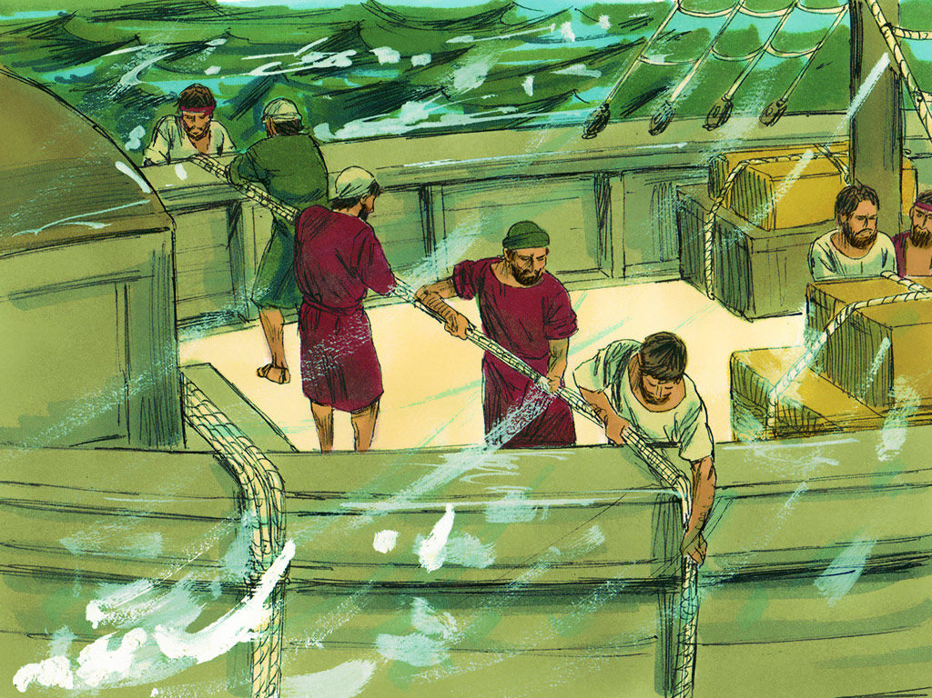
un·der·gird
verb
secure or fasten from the underside, especially by a rope or chain passed underneath.

Slide 11
What we do in this history, when you're hit by a storm is you would do this to the ship, because the storm is pulling those boards apart and water is flooding through the boards at the ship. The ship is being strained so much, water is leaking through the sides. What they're going to do is there going to take ropes and they will have two teams of men. They will go probably to the back of the ship and throw the rope over the back of the ship and then one team on either side, taking the opposite ends of the rope we're going to round the rope underneath the ship and then pull it tight. So one team would stand on one side and one the other side and they're going to meet in the middle. Like a tug of war they will come together tightening that rope around the ship and pulling the boards back together again. They're not going to do that once, they're going to do it over and over and over again until this ship is held together by ropes or line upon line upon line. That's the only thing keeping this ship floating. Because Ellen White says it’s still leaking water but it would have never stayed afloat without being held together by these ropes. They bring those boards back together just enough to stop the flow of water. But it's not more than what they can pump out.
Adramyttium
“Abide in death”
TOE
“cut out”
2 FP
Bitterness
Extracting
bright white
harvest
Panium/
MC
Cypress
Myra
Lycia
SL
1A
Ceasarea
911
Sidon
Overturn
A nation made up of every tribe
Cilicia
Pamphylia
Argos
4th
Felix/Festus= USA
(Reagan/Bush)
Agrippa SDA
4th
4th
USA
UN
refreshing
Alexandria
“protector or
defender of the people”
126
East wind
9/11
Euroclydon
Myra
Lycia
TOE
1989
Lasea
1863
Cnides
Alexandria
‘61
‘65
‘91
S
Wheat
USA
Adventism
Bitterness
harvest
Crete
Salmone
wise
un·der·gird
verb
secure or fasten from the underside, especially by a rope or chain passed underneath.
X

Slide 12
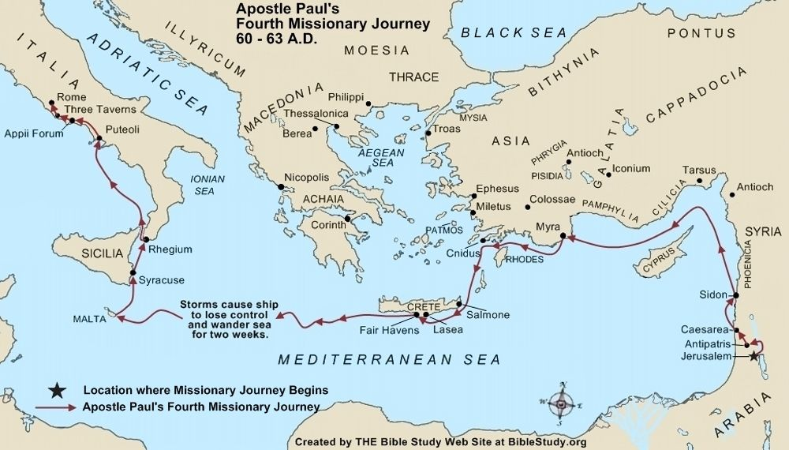
14 days

Slide 13
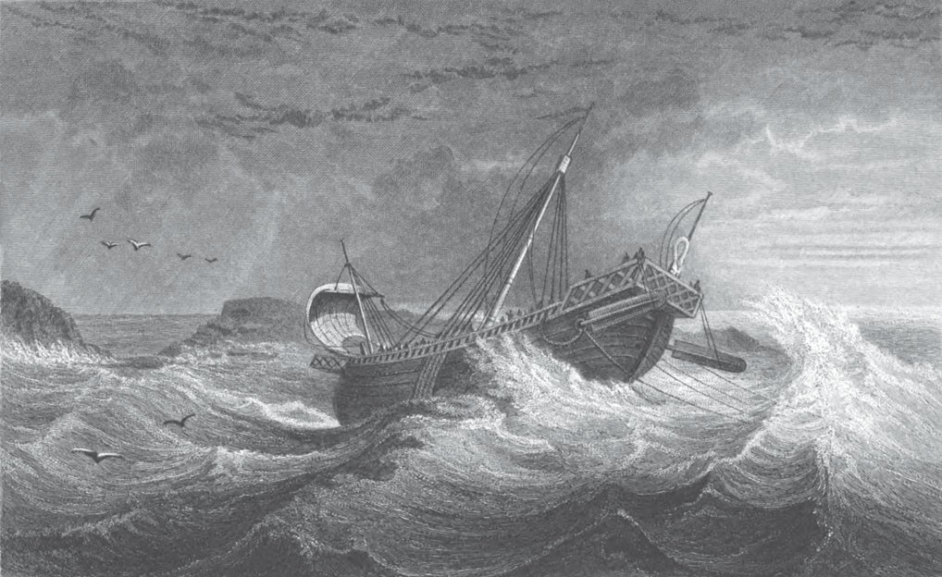
Now they’re going through a period of time were they’re more and more afraid that there is no hope. Ellen White says in this history that those people on board the ship or those other than the few Christians, they lost all hope of survival.
Will now read verse 21 to 24
27:21 But after long abstinence Paul stood forth in the midst of them, and said, Sirs, ye should have hearkened unto me, and not have loosed from Crete, and to have gained this harm and loss.
27:22 And now I exhort you to be of good cheer: for there shall be no loss of [any man's] life among you, but of the ship.
27:23 For there stood by me this night the angel of God, whose I am, and whom I serve,
27:24 Saying, Fear not, Paul; thou must be brought before Caesar: and, lo, God hath given thee all them that sail with thee.

Slide 14
After a time they neared the small island of Clauda, and while under its shelter they did all in their power to make ready for the worst. The boat would be their only means of escape, in case the ship should founder; but while in tow it was every moment likely to be dashed to pieces. The first work was to hoist it on board the ship. This was no easy task; for it was with the utmost difficulty that the seamen could perform the simplest duty. All possible precaution was taken to render the ship firm and secure, and then there was nothing left to do but to drift at the mercy of wind and wave. There was no place into which they could run for shelter, the wind was driving them, and even the poor protection afforded by the little island would not avail them long. Such was the disastrous ending of the day which had begun with soft breezes and high hopes. {LP 265.1}
All night the tempest raged, and the ship leaked. The next day, all on board--soldiers, sailors, passengers, and prisoners--united in throwing overboard everything that could be spared. Night came again, but the wind did not abate. The storm-beaten ship, with its shattered mast and rent sails, was tossed hither and thither by the fury of the gale. Every moment it seemed that the groaning timbers must give way as the vessel reeled and quivered under the tempest's shock. The leak rapidly increased, and passengers and crew worked constantly at the pumps. There was not a moment's rest for one on board. "The third day," says Luke, "we cast out with our own hands the tackling of the ship; and when neither sun nor stars in many days appeared, and no small tempest lay on us, all hope that we should be saved was then taken away." A gloomy apathy settled upon those three hundred souls, as for fourteen days they drifted, helpless and hopeless, under a sunless and starless heaven. They had no means of cooking; no fire could be lighted, the utensils had been washed overboard, and most of the provisions were water-soaked and spoiled. In fact while their good ship was wrestling with the tempest, and the waves talked with death, no one desired food. {LP 265.2}
In the midst of that terrible scene, the apostle retained his calmness and courage. Notwithstanding he was physically the greatest sufferer of them all, he had words of hope for the darkest hour, a helping hand in every emergency. In this time of trial, he grasped by faith the arm of infinite power, his heart was stayed upon God, and amid the surrounding gloom his courage and nobility of soul shone forth with the brightest luster. While all around were looking only for swift destruction, this man of God, in the serenity of a blameless conscience, was pouring forth his earnest supplications in their behalf. {LP 266.1}

Slide 15
Paul had no fears for himself; he felt assured that he would not be swallowed up by the hungry waters. God would preserve his life, that he might witness for the truth at Rome. But his human heart yearned with pity for the poor souls around him. Sinful and degraded as they were, they were unprepared to die, and he earnestly pleaded with God to spare their lives. It was revealed to him that his prayer was granted. When there was a lull in the tempest, so that his voice could be heard, he stood forth on the deck and said:-- {LP 266.2}
"Sirs, ye should have hearkened unto me, and not have loosed from Crete, and to have gained this harm and loss. And now I exhort you to be of good cheer; for there shall be no loss of any man's life among you, but of the ship. For there stood by me this night the angel of God, whose I am, and whom I serve, saying, Fear not, Paul; thou must be brought before Caesar; and, lo, God hath given thee all them that sail with thee. Wherefore, sirs, be of good cheer; for I believe God, that it shall be even as it was told me. Howbeit we must be cast upon a certain island." {LP 266.3}
At these words hope revived. Passengers and crew roused from their apathy, and put forth all possible exertion to save their lives. There was much yet to be done. Every effort within their power must be put forth to avert destruction; for God helps those only who help themselves. {LP 267.1}
It was the fourteenth night that they had been tossed up and down on the black, heaving billows, when, amid the sound of the storm, the sailors distinguished the roar of breakers, and reported that they were near some land. They "sounded, and found it twenty fathoms; and when they had gone a little further, they sounded again, and found it fifteen fathoms." They were now threatened by a new danger, of having their ship driven upon some rock-bound coast. They immediately cast out four anchors, which was the only thing that could be done. All through the remaining hours of that night they waited, knowing that any moment might be their last. The leak was constantly increasing, and the ship might sink at any time, even if the anchors held. {LP 267.2}
At last through rain and tempest the gray light fell upon their haggard and ghastly faces. The outlines of the stormy coast could be dimly seen, but not a single familiar landmark was visible. The selfish heathen sailors determined to abandon the ship and crew, and save themselves in the boat which they had with so much difficulty hoisted on board. Pretending that they could do something more to secure the safety of the ship, they unloosed the boat, and began to lower it into the sea. Had they succeeded, they would have been dashed in pieces upon the rocks, while all on board would have perished from their inability to handle the sinking vessel. {LP 267.3}
At this moment, Paul perceived the base design, and averted the danger. With his usual prompt energy and courage he said to the centurion and soldiers, "Except these abide in the ship, ye cannot be saved." The apostle's faith in God did not waver; he had no doubt concerning his own preservation, but the promise of safety to the crew had been conditional upon their performance of duty. The soldiers, on hearing Paul's words, immediately cut off the ropes of the boat, letting her fall off into the sea. {LP 268.1}

Slide 16
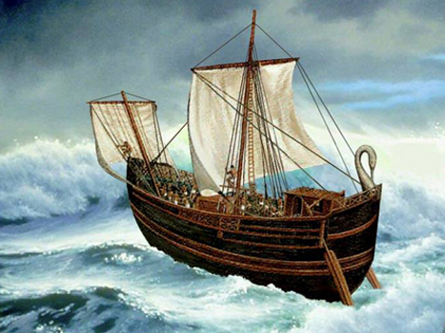
So you come to a point we're Paul is giving a message of hope and he's told that they're going to make land but they're going to be shipwrecked. They will see land, the ship is going to be lost, but those on board will survive. Ellen White says that that depended on their performance of duty. She’s saying there's no hope for this ship, it's going to be wrecked. But if those on board the ship put forward every possible effort they will survive and make it through that history. This is the message that Paul is giving
So he gives this message to those on board the ship and those that believe are filled with hope. What did they begin to do? They have people standing watch, like watchmen. What are they looking for? Land, they need to see it in a distance. Because they've been told this ship is going to be shipwrecked and shipwreck is their only hope of survival. That's what we read in verse 27.
Next we’ll read 25 to 27
27:25 Wherefore, sirs, be of good cheer: for I believe God, that it shall be even as it was told me.
27:26 Howbeit we must be cast upon a certain island.
27:27 But when the fourteenth night was come, as we were driven up and down in Adria, about midnight the shipmen deemed that they drew near to some country;

Slide 17
So their only hope is shipwreck. And then on this night, like every night before they're watching for land. Verse 27 is when they spot that land and what night is it? It's the 14th night. What's symbology is connected to the 14th night? If we went into Millerite history and we spoke of the 14th night, what waymark are we considering? The midnight cry. And it isn't any time on the 14th night, it says on the 14th night at midnight. When we mark the midnight cry we're talking about Exeter, and when was Exeter, what date? August 14th where the message was first given. Samuel Snow arrived on the 14thnight, and gave the M/C, and what did he say? He said right in front of you is a shut door, this is Oct 22, 1844 and it’s a warning message. What they are being warned about in this history is shipwreck.
When is comes to the ship in our first line, what is S/L? It's a shut door, its the end of their journey. When we bring that down to the second ship we find the same end at shipwreck S/L and a shut door, but prior to that the warning is given. And they’re told that this is right in front of you, and now you can see it, it’s visible. This is Acts 27:27 a doubling, and it is on the 14thnight at Midnight, when they are giving the M/C. It wouldn’t be stretching the story to say there would be a cry go up over the boat when they spotted land....
Adramyttium
“Abide in death”
TOE
“cut out”
2 FP
Bitterness
Extracting
bright white
harvest
Panium/
MC
Cypress
Myra
Lycia
SL
1A
Ceasarea
911
Sidon
Overturn
A nation made up of every tribe
Cilicia
Pamphylia
Argos
4th
Felix/Festus= USA
(Reagan/Bush)
Agrippa SDA
4th
4th
USA
UN
refreshing
Alexandria
“protector or
defender of the people”
126
East wind
9/11
Euroclydon
Myra
Lycia
TOE
1989
Lasea
27:27
MC
Oct 22
Shipwreck
1863
Cnides
Alexandria
‘61
‘65
‘91
S
Wheat
USA
Adventism
Bitterness
harvest
Crete
Salmone
wise
14th night
X

Slide 18
Acts 27:28
27:28 And sounded, and found [it] twenty fathoms: and when they had gone a little further, they sounded again, and found [it] fifteen fathoms.
They do these two sounding's, first 20 fathoms and then 15 fathoms. What are they measuring? Depth. But what are they really measuring? Time. They want to know how long it will take them, to be shipwrecked, so they need to know where to stop the ship because they can tell they are being driven into the coast too quickly and they need to throw down an anchor. So what they are measuring is the distance between those two locations. If we were to measure the depth and saw that it was 20 fathoms, and then wait a while and saw that it is 15 fathoms, that depth is giving us a time frame to how close we are. If we turn these measurements into something we’re more familiar with, we’ll go from Fathoms to Inches. 20 Fathoms is 1440 inches. 1 Fathom is 72 inches. 15 Fathoms is 1080 inches. And what does this add up too? 2520 inches, and they are measuring time, between these 2 way marks.
TOE
“cut out”
Adramyttium
“Abide in death”
2 FP
Bitterness
Extracting
bright white
harvest
Panium/
MC
Cypress
Myra
Lycia
SL
1A
Ceasarea
911
Sidon
Overturn
A nation made up of every tribe
Cilicia
Pamphylia
Argos
4th
Felix/Festus= USA
(Reagan/Bush)
Agrippa SDA
4th
4th
USA
UN
refreshing
Alexandria
“protector or
defender of the people”
126
East wind
9/11
Euroclydon
Myra
Lycia
TOE
1989
Lasea
27:27
MC
Oct 22
Shipwreck
1863
Cnides
Alexandria
‘61
‘65
‘91
S
Wheat
USA
Adventism
Bitterness
harvest
Crete
Salmone
wise
14th night
20 Fathoms = 1440 in+
15 Fathoms = 1080 in=
2520
X

Slide 19
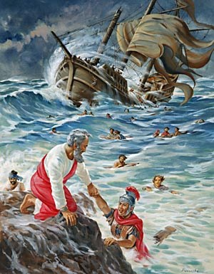
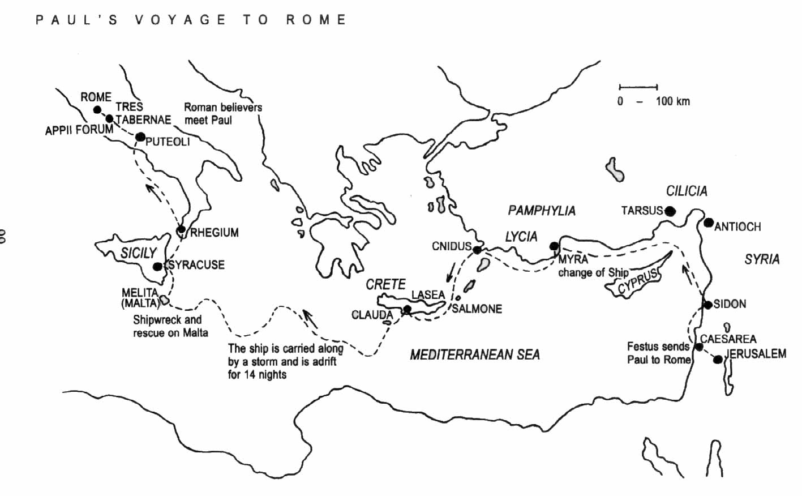
So we’ll go to Acts 27:39-41, 44. 27:39 And when it was day, they knew not the land: but they discovered a certain creek with a shore, into the which they were minded, if it were possible, to thrust in the ship.
27:40 And when they had taken up the anchors, they committed [themselves] unto the sea, and loosed the rudder bands, and hoisted up the mainsail to the wind, and made toward shore.
27:41 And falling into a place where two seas met, they ran the ship aground; and the forepart stuck fast, and remained unmoveable, but the hinder part was broken with the violence of the waves.
27:44 And the rest, some on boards, and some on [broken pieces] of the ship. And so it came to pass, that they escaped all safe to land.

Slide 20
Adramyttium
“Abide in death”
TOE
“cut out”
2 FP
Bitterness
Extracting
bright white
harvest
Panium/
MC
Cypress
Myra
Lycia
SL
So you have this story of shipwreck, if we were to consider this ship and we come into this history, we have how many groups of people?
We have Paul, who does he first give a message to? First of all when we come to this history, we will call it M/N; when Paul has a message he takes it to the ship. These people are not the Christian believers, because in verse 2 it lists for us the Christians believers on the ship.
27:2 And entering into a ship of Adramyttium, we launched, meaning to sail by the coasts of Asia; [one] Aristarchus, a Macedonian of Thessalonica, being with us.
1A
Ceasarea
911
Sidon
Overturn
A nation made up of every tribe
Cilicia
Pamphylia
Argos
4th
Felix/Festus= USA
(Reagan/Bush)
Agrippa SDA
4th
4th
USA
UN
refreshing
Alexandria
“protector or
defender of the people”
126
East wind
9/11
Euroclydon
Myra
Lycia
TOE
1989
Lasea
27:27
MC
Oct 22
Shipwreck
1863
Cnides
Alexandria
‘61
‘65
‘91
S
Wheat
USA
Adventism
Bitterness
harvest
Crete
Salmone
wise
14th night
Paul
Aristarchus
Luke
20 Fathoms = 1440 in+
15 Fathoms = 1080 in=
2520
X

Slide 21
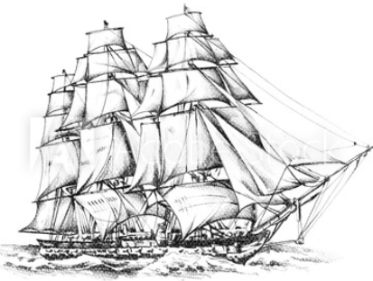
Adramyttium
“Abide in death”
TOE
“cut out”
2 FP
So who is on the ship, there’s Paul and Aristarchus, these are our Christians, there is another believer, Luke. You will notice in verse 2, he says Aristarchus is with us. So we know there is someone else, but Luke is silent about himself, his name isn't included, but he records this chapter, he doesn't speak of himself. But it is through his writings that we have the book of Acts, and that was Luke. So there are three Christians, and when they get on board this ship, they begin to give the gospel message, they give that in this story from 1989, when Paul begins to warn them of the danger they are in. They are not listening to him, who does he give that too? The remainder of the people on the ship, all those remaining.
We come to this way mark and it’s ship wreck or S/L. EGW speaks about this, when they are shipwrecked some join with Paul in praising God, so you have division. Paul is giving a message, they come to this way mark and they stand on the beach, split into 2 classes, some join with Paul in Praising God, they have accepted his message, but some don't. So you see 2 groups. And then what do they do?
Bitterness
Extracting
bright white
harvest
Panium/
MC
Cypress
Myra
Lycia
SL
1A
Ceasarea
911
Sidon
Overturn
A nation made up of every tribe
Cilicia
Pamphylia
Argos
4th
Felix/Festus= USA
(Reagan/Bush)
Agrippa SDA
4th
4th
USA
UN
refreshing
Alexandria
“protector or
defender of the people”
126
East wind
9/11
Euroclydon
Myra
Lycia
TOE
1989
Lasea
27:27
MC
Oct 22
Shipwreck
1863
Cnides
Alexandria
‘61
‘65
‘91
S
Wheat
USA
Adventism
Bitterness
harvest
Crete
Salmone
wise
14th night
20 Fathoms = 1440 in+
15 Fathoms = 1080 in=
2520
X
Paul
Aristarchus
Luke

Slide 22
Adramyttium
“Abide in death”
TOE
“cut out”
2 FP
Bitterness
Extracting
bright white
harvest
Acts 28:1 And when they were escaped, then they knew that the island was called Melita.
28:2 And the barbarous people showed us no little kindness: for they kindled a fire, and received us every one, because of the present rain, and because of the cold.
First Paul gives a message to the ship, we have our first group, our second group and then what do they unite in doing? They give the gospel message to a third group. And what group is that? This is the Island Melita. So you have 3 groups, first Paul united with 2 other supporters, he gives a message to the ship, those on board the ship are fully divided at Sunday law. Now those who have accepted Paul’s message unite with him. And you have a unified group of believers, a purified church, to give the message to the Island, and at S/L, on the first line, we marked harvest. That harvest is for third group or the world or the Island. First of all we see the church in two groups, and then the world. Priest, Levites, Nethanims. Paul, ship, Island.
Panium/
MC
Cypress
Myra
Lycia
SL
1A
Ceasarea
911
Sidon
Overturn
A nation made up of every tribe
Cilicia
Pamphylia
Argos
4th
Felix/Festus= USA
(Reagan/Bush)
Agrippa SDA
4th
4th
USA
UN
refreshing
USA
UN
USA
UN
Dictatorship
Alexandria
“protector or
defender of the people”
126
East wind
9/11
Euroclydon
Myra
Lycia
TOE
1989
Lasea
27:27
MC
Oct 22
Shipwreck
1863
Cnides
MN
Alexandria
‘61
‘65
‘91
S
Wheat
USA
Adventism
Bitterness
harvest
Crete
Salmone
wise
14th night
20 Fathoms = 1440 in+
15 Fathoms = 1080 in=
2520
X
1
2
3
Paul
Aristarchus
Luke
Melita

Slide 23
And this brings about another point for our first line, this overturning, and you see what is rising up, from Panium to S/L. The 6thhead, the US falls as the 7thhead of the UN rises. But what does this 7thhead look like? When it's the 6thhead, the USA, that enforces the S/L. So what does the 7thlook like? Because the US, has more power after S/L than it had before. What we are marking is a change, a transition or a different period or cycle in the USA. It rose up with certain institution, they have fallen by S/L.. But they are not necessarily gone, they changed in form. The USA is going down, the UN is coming up. The 6thhead is the USA, in what condition? It’s a Republic horn, but still a dominant force in the UN. We come to the 7thhead, how is it different from the 6th? The 6this USA, over the UN. The 7this the UN, and the USA is still the dominant force. And what we’re suggesting is that the institutions have ended at the S/L, because it's no longer the beast that rose up in in 1798. Now instead of Republicanism, you have a dictatorship, so when the USA tells one group to pass the S/L, it does what it’s told, the USA is now a dictatorship. So what we are marking in this history is a change of leadership, it looks different. Before and after S/L there’s a change in the leadership.
Adramyttium
“Abide in death”
TOE
“cut out”
2 FP
Bitterness
Extracting
bright white
harvest
Panium/
MC
Cypress
Myra
Lycia
SL
1A
Ceasarea
911
Sidon
Overturn
A nation made up of every tribe
Cilicia
Pamphylia
Argos
4th
Felix/Festus= USA
(Reagan/Bush)
Agrippa SDA
4th
4th
USA
UN
refreshing
USA
UN
USA
UN
Dictatorship
Alexandria
“protector or
defender of the people”
126
East wind
9/11
Euroclydon
Myra
Lycia
TOE
1989
Lasea
27:27
MC
Oct 22
Shipwreck
1863
Cnides
MN
Alexandria
‘61
‘65
‘91
S
Wheat
USA
Adventism
Bitterness
harvest
Crete
Salmone
wise
14th night
20 Fathoms = 1440 in+
15 Fathoms = 1080 in=
2520
X
1
2
3
Paul
Aristarchus
Luke
Melita

Slide 24
Adramyttium
“Abide in death”
TOE
“cut out”
2 FP
Bitterness
Extracting
bright white
harvest
So when we bring that into the internal, we want read a quote:
ML 334. 4, (Paraphrasing). We want to go the middle portion and to orientate us in this story, she is discussing something that is happening between the M/C and ship wreck. So if we went to our first line it’s in the history of Cilicia and Pamphylia.
We’re talking about that same history, and EGW says, that as Paul was on the ship, the storm beating around him and the ship is falling apart. Paul gives orders to the commander of the ship, and saves the lives of those on board. She says although he’s a prisoner he’s really the master of the ship. That’s the point we want to bring. Who is the leader between M/C and S/L? Paul. So while you see falling leadership internally as well as externally, you have a new leadership rising up. And that leadership is Paul even though he looks as a prisoner. So the leadership rising up here, much more visible than before, of that of Paul and who does Paul represent? Priests, or the first group. So when we come to Panium, the priests begin to do a work, they are calling out the Levites, but you now see them as leaders. As though a prisoner, they actually are the commander or the boss of that ship. It’s an external and an internal change in leadership.
Panium/
MC
Cypress
Myra
Lycia
SL
1A
Ceasarea
911
Sidon
Overturn
A nation made up of every tribe
Cilicia
Pamphylia
Argos
4th
Felix/Festus= USA
(Reagan/Bush)
Agrippa SDA
4th
4th
USA
UN
refreshing
USA
UN
USA
UN
Dictatorship
Alexandria
“protector or
defender of the people”
126
East wind
9/11
Euroclydon
Myra
Lycia
TOE
1989
Lasea
27:27
MC
Oct 22
Shipwreck
1863
Cnides
MN
Alexandria
‘61
‘65
‘91
S
Wheat
USA
Adventism
Bitterness
harvest
Crete
Salmone
wise
1
2
3
14th night
Paul
Aristarchus
Luke
Melita
20 Fathoms = 1440 in+
15 Fathoms = 1080 in=
2520
X
LP 265.2 EGW says they have no means of cooking, no fire could be lighted, the leaks were getting worse and worse, no one rested night nor day. All are working to keep the ship afloat. And no one desired food. But what she says, is that that good ship was wrestling with the storm. What does she say about the ship? What type of ship is it? Its a good ship.

Slide 25
Our top line is the story of a bad ship, as one perspective, it abode in death. But this ship of Alexandria is a good ship, all the way from 1798 to Sunday Law. No matter the condition, it’s still defending and protecting the people and fulfilling it’s job function. And the reason it’s still fulfilling it’s job function and hasn’t yet sunk is because on board is Paul, it’s undergirded with line upon line upon line of rope holding it together and its going to bring them to the exact destination they need to go, which is to the 3rdgroup of people. But it’s Paul that has kept that ship afloat, because while he's on board giving the gospel, which is what he is on this journey to do that ship no matter its condition is fulfilling its purpose. Even though the situation looks dire, it’s fulfilling its purpose according to plan. And its going to scrape through all the way to shipwreck at which points it’s no longer needed, the institutions are swept away.
Adramyttium
“Abide in death”
TOE
“cut out”
2 FP
Bitterness
Extracting
bright white
harvest
Panium/
MC
Cypress
Myra
Lycia
SL
1A
Ceasarea
911
Sidon
Overturn
A nation made up of every tribe
Cilicia
Pamphylia
Argos
4th
Felix/Festus= USA
(Reagan/Bush)
Agrippa SDA
4th
4th
USA
UN
refreshing
USA
UN
USA
UN
Dictatorship
Alexandria
“protector or
defender of the people”
126
East wind
9/11
Euroclydon
Myra
Lycia
TOE
1989
Lasea
Panium
27:27
MC
Oct 22
Shipwreck
1863
Cnides
Raphia
MN
Alexandria
‘61
‘65
‘91
S
Wheat
USA
Adventism
Bitterness
harvest
Crete
Salmone
wise
1
2
3
14th night
Paul
Aristarchus
Luke
Melita
20 Fathoms = 1440 in+
15 Fathoms = 1080 in=
2520
X

Slide 26
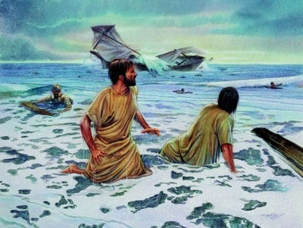
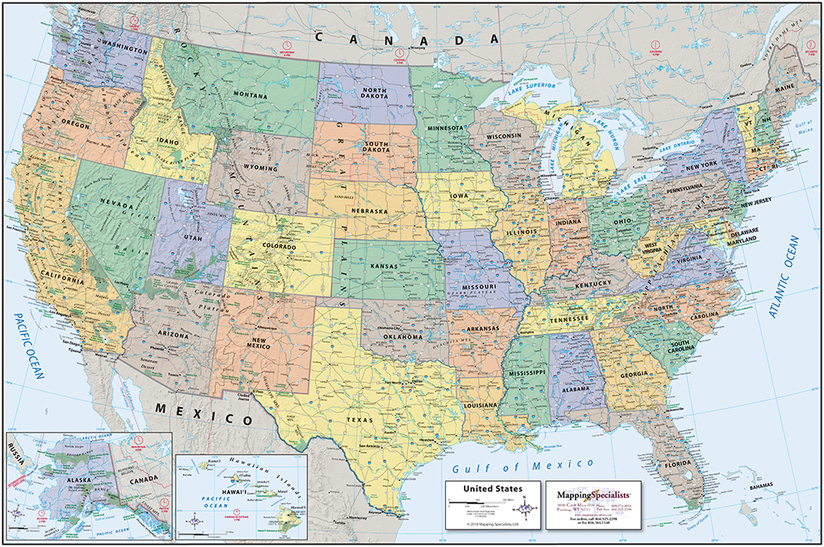
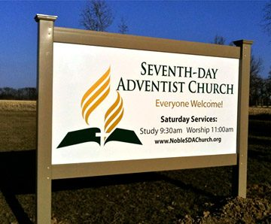
Acts 27 is the story of 2 ships, what is their theme? We can talk about Paul and the ship and the Island, but you won’t bring them back into 1863, because while we can see other layers and draw lessons, the story that is being told, is of the ship itself, the institutions of the USA and Adventism. Like the Ark, that is a separate theme than people, it’s separate from the story of the priests, and the levites, and the nethanims. It’s separate from the story of the 144K. Because like the ark, we’re talking about structures and not the people. So when we come to this history and we use this terminology, we say M/N, M/C, S/L, what we really mean is 2 battles. We are going to call them Raphia and Panium, S/L. And we might be more familiar saying it that way. And we refer to Raphia and Panium as M/N and the M/C. But who are these way marks for? It’s not for the 144K, Raphia and Panium are not M/N and the M/C for the 144K. They are not M/N, M/C for the priests. Raphia and Panium are not M/N, and M/C for the Levites, they are not M/N and M/C for the world. So none of our stories about people give us a structure where Raphia is M/N and Panium is the M/C. We only get this structure if we create another line, that isn't about the people, but about the institutions, the institutions raised up in 1798. Like the ark, it’s not about the people on board or not on board, but a separate structure, and that structure has its own warning message, or cry at midnight saying the door is about to be closed on the structure. And the at the S/L the door shuts for the institutions of the USA and Adventism.
MN
MC
10/22
7/21
8/14,15
MN
Raphia
MC
Panium
COP
S/L

Slide 27
And that close of probation or shut door, that we would place at S/L is prefigured, or warned in the history of M/N and M/C or Raphia or Panium. At Panium they are able to say we are just about to face a shut door. So when we talk about Midnight, Midnight Cry, Sunday Law, that language is not accurate. In no history do we have M/N, M/C, and S/L. In Millerite history it went from M/N to M/C, to Oct 22, 1844. And what was Oct 22, 1844? It’s a shut door. It’s a close of probation (COP).
July 21, Aug 14-15, Oct 22, 1844 - that’s where our language comes from. So when we say Raphia and Panium and Sunday Law, that’s accurate. But if we’re going to use the terminology of M/N and M/C, it’s bringing us to a shut door, (cop), Raphia, Panium - M/N, M/C COP. That is the story of the institutions, not any of our lines that show us people or the history of a group of people.
A couple of things we want to bring out of this study: The over turning that takes place at Panium and S/L and we want to see that we can say M/N, M/C, and COP. And we can say Raphia and Panium and S/L. This is one story, this is telling a story. Raphia, Panium S/L. When we say that Raphia and Panium S/L is a M/N and M/C it's telling the story of the ship that has existed from 1798, went through a difficult time in 1844, went off course in 1863 in the middle of a civil war, sails through a 126 yrs to the TOE in 1989. The message is warning is given. It's ignored, the east wind strikes, it’s held together by line upon line, its preserved because of the presence of Paul who is given a message. And at the M/C the 14th night they can see land before them, they measure the distance and time which came to a 2520. It’s given them some concept of how close they are to ship wreck. And we see this cry is to tell them about the shipwreck of the institutions of the USA and Adventism. This is a shut door, it’s the end of the story of those institutions. Because after Sunday Law the USA takes on very different characteristics. Built into this story we can still observe 3 things: Paul, the ship and the Island. The Priests, the Levites, the Nethanims.
MN
MC
10/22
7/21
8/14,15
MN
Raphia
MC
Panium
COP
S/L

