Slide 1
Camp Meeting Guadeloupe
Acts 27 5 of 15
Tess Lambert
April 2019

Slide 2
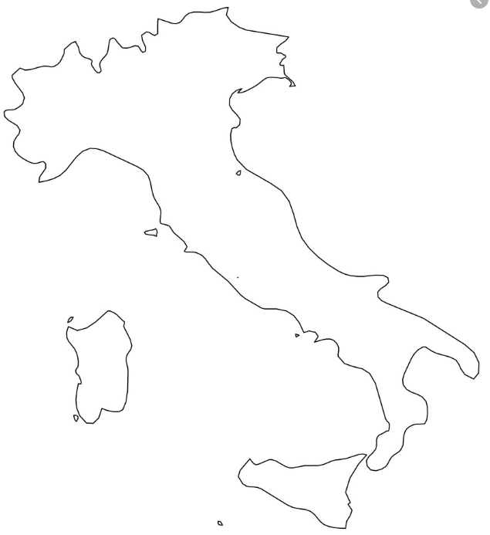
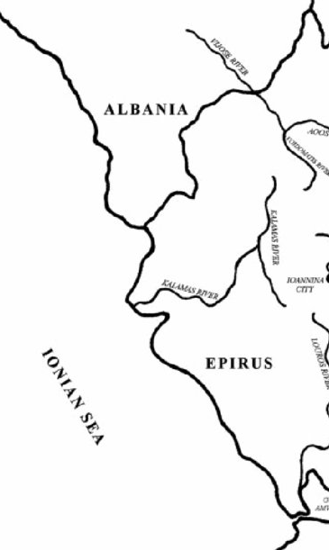
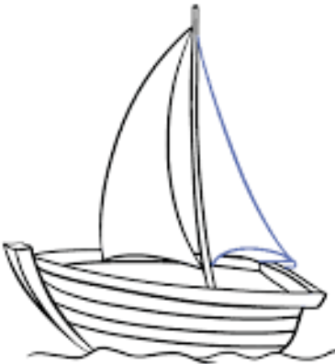
10
-307
-303
-301
Ipsus
291
289-288
287
285
282
280
280
Heraclea
279
Asculum
317
Macedonia divided
Cold war
winter
treaty
Cassander
Athens
Demetrius
Frees
Athens
Alliance
Demetrius
Pyrrhus
S, C, L 3 allies
Vs
Antigonu
Demetrius
→ Pyrrhus
Pyrrhus invades Thessaly
Demetrius invades Epirus
Demetrius
W. Py,
E. Lys.
Subterfuge
Sanctions
Thurri allies with Rome
Tar. Attacks Thurri
Pyrrhus
Arrives in
Tarentum
Rome ý
attacks Pyrrhus þ
Pyrrhus þattacks Rome ý
In our last study we talked about Acts 27 which linked us into the history of Pyrrhus. Partly because of the number 273, also because we are covering the history that relates to the King of the South. We identified that where Acts 27 brought us was to the life of a king called Pyrrhus. And as we’ve begun to identify, it takes place in 2 parts, Alpha and Omega. First there is the history of Macedonia, which we’ve already traced. (line starting at 317BC to 285 ) And now there is a second history. Pyrrhus was not successful when his campaigns were directed into the Greek world of Macedonia and these generals – Alexander’s Empire. So Pyrrhus is forced to find a new field. And where he chooses to go is into Italy and into war with Rome. And now it's war between the North and the South of Italy, between Rome and Pyrrhus allied to Tarentum.
In 285BC we find Thurri, another city state that was generally under the spear of influence of Tarentum, changes its allegiance to that of Rome. You can mark that twice in this history – 285 and 282BC. In 282BC Rome responds and breaks an agreement it had with Tarentum. Tarentum responds by attacking Thurri, and this leads to war with Rome. So there’s a war now between Rome and Tarentum. Tarentum is not strong enough to defeat Rome alone, so they ask King Pyrrhus to fight on their behalf. He sails over in 280BC, and he brings all these city states into an allegiance. He begins to prepare Tarentum itself for war with Rome. Rome descends on the South later that same year initiating the first battle, before Pyrrhus was ready. They meet at Heraclea, and Pyrrhus is victorious against Rome, because of this new weapon the war elephants, that Rome hadn't seen before. It's winter so both sides withdraw, and prepare to fight again in the spring.
KN
Rome
l
l
l
l
l
l
Tarentum
l
l
l
l
l
l
l
l
l
l
l
l
l
l
l
l
l
l
l
KS
l
Thurri
l
l
l
l
l
Pyrrhus
Rome

Slide 3
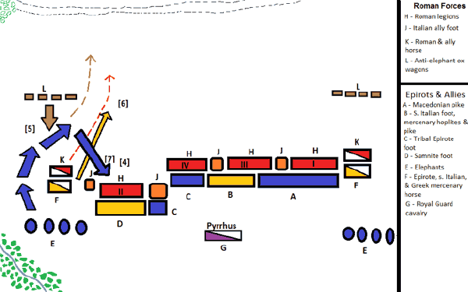
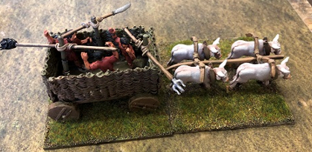
The following spring they meet at Asculum. Rome has spent the winter preparing for the elephants by building up these carts. But it was failure for Rome, the elephants just break them apart. And Pyrrhus wins again thanks to his elephants. We also see that Pyrrhus is loosing men, and he can't win many more times before his army is so weakened that it can’t fight. So he makes a temporary peace with Rome, and instead engages on this new plan to build up his strength more gradually, beginning with the Island of Sicily. Thinking that if he can take Sicily he can also take Carthage. Carthage is powerful, they have the resources and knowledge to build a powerful navy because of their costal location along the North of Africa. Pyrrhus was going to build an immense navy there and come around to Greece and Macedonia and fight with our familiar faces, particularly the generals Lysimachus and Seleucus, probably face Ptolemy in Egypt, come back around and become King of Macedonia, and sweep back to take Rome. Pyrrhus has this circular plan, he's still going to take Rome, but more gradually. So that’s where our story ended.

Slide 4
-289-288
-287
-285
-282
-280
-280
Heraclea
-279
Asculum
-275
Beneventum
Dictator
D. Temple
Sicily
Cold war
winter
treaty
Demetrius invades Epirus
Demetrius
W. Py,
E. Lys.
Subterfuge
Sanctions
Thurri allies with Rome
Tar. Attacks Thurri
Pyrrhus
Arrives in
Tarentum
Rome ý
attacks Pyrrhus þ
Pyrrhus þattacks Rome ý
Pyrrhus sailed down to Sicily, and he quickly freed the Island from the control of Carthage. This is where he really went wrong. He wanted to become King of everything, his plans were so big, that he needed to rule in a different way. The people of Sicily were not just going to build him an army and navy very willingly, they needed a little bit of force. They called Pyrrhus to their country to free them from dictatorship and they didn't expect him to be another dictator. But when he sailed down to Sicily and freed them, he took control of the island and he started to abuse his new power. Imprisoning the leadership of the Island, killing or imprisoning those who spoke against him and forcing the people to start building this navy for this plan he has. And as they start to resist he exercises more and more force. And very quickly they realize they have another dictatorship that’s worse than Carthage. What Carthage gave them was better than what Pyrrhus was doing. So the population was beginning to wish they had their old dictatorship back. Pyrrhus is also running out of money because he wants to build this massive navy and it takes money, so he is also having financial trouble. To become King of everything takes a lot of resources, finances and people, and he is struggling with that. So he takes some advice, and he goes to an ancient temple. There’s a godess in Sicily in this massive temple, and underneath is buried this treasure. All the gold and offerings that have been given to this deity. And facing financial trouble, Pyrrhus desecrates that temple. He raids it and takes all of its wealth and he puts it on to ships. Then he sails these ships back to Tarentum to fund his war effort. But these ships encounter a storm, they are destroyed and all the wealth that has been placed on them from this temple was spread over the coast line and this caused Pyrrhus to panic. And in his language after this time all the way to his death, was that everything that was failing after was the judgment of this goddess, for desecrating her temple.

Slide 5
Pyrrhic War
-289-288
-287
-285
-282
-280
-280
Heraclea
-279
Asculum
-275
Beneventum
Dictator
D. Temple
Sicily
Cold war
winter
treaty
Demetrius invades Epirus
Demetrius
W. Py,
E. Lys.
Subterfuge
Sanctions
Thurri allies with Rome
Tar. Attacks Thurri
Pyrrhus
Arrives in
Tarentum
Rome ý
attacks Pyrrhus þ
Pyrrhus þattacks Rome ý
Rome þattacks Pyrrhus ý
So in this history after the battle of Asculum takes place in Sicily he behaves as a dictator, and he desecrates the temple. The situation gets so bad in Sicily, that they write to Carthage and ask Carthage to come and free them from Pyrrhus. So first they asked Pyrrhus to come and free them from Carthage, then they realized they had a worse dictator under Pyrrhus, so they asked for Carthage back. At the same time Sicily is asking to return to Carthage, Pyrrhus receives a report that Rome has broken their treaty and is descending on Tarentum. He’d left his son in Tarentum to watch over the city, and he receives a report that Rome is marching on it. So he is facing a battle with Rome he can't avoid.
Seeing his control of Sicily weakened internally, he flees Sicily and returns to Tarentum just in time. Rome is descending, and Carthage is attacking. He heads back to Southern Italy and faces Rome at one final battle in 275BC, the battle of Beneventum.
KN
Rome
l
l
l
l
l
l
Tarentum
l
l
l
l
l
l
l
l
l
l
l
l
l
l
l
l
l
l
l
KS
l
Thurri
l
l
l
l
l
Pyrrhus

Slide 6
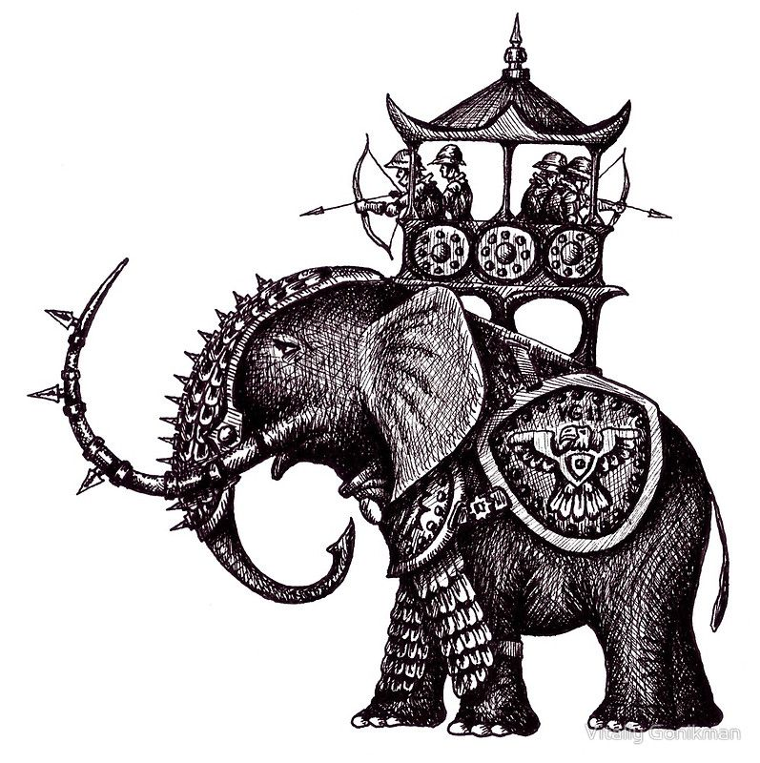
Pyrrhic War
-289-288
-287
-285
-282
-280
-280
Heraclea
-279
Asculum
-275
Beneventum
-273
Dictator
D. Temple
Sicily
Cold war
winter
treaty
Demetrius invades Epirus
Demetrius
W. Py,
E. Lys.
Subterfuge
Sanctions
Thurri allies with Rome
Tar. Attacks Thurri
Pyrrhus
Arrives in
Tarentum
Rome ý
attacks Pyrrhus þ
Pyrrhus þattacks Rome ý
Rome þattacks Pyrrhus ý
This is the last battle between Rome and Pyrrhus. It’s a 6 year war, with 3 battles between the North and South, Rome and Pyrrhus. It ends in 275BC with the last battle. Rome attacks the south (Pyrrhus), and this time it is victory for Rome, and Pyrrhus is defeated. Why is he defeated? Once again Pyrrhus faced Rome. Rome was on one side, Pyrrhus on the other side and then the elephants. Behind the elephants, about 20 of them is his army. The elephants charged at the Roman army. As the elephants charged, something caused them to change direction. And they turned around and charged back over Pyrrhus's own army, so the elephants of Pyrrhus defeated him.
It's elephants that still decide the victory of that battle, but instead of helping Pyrrhus defeat Rome, they turn and charge over his own troops and this looses the battle for Pyrrhus.
The only real story of how that happened, was that there was a younger elephant that was wounded, and that its mother was part of this group. When she heard the cries of her wounded baby, she became wild and distracted, and turned back to go to the baby elephant. When she turned, she leads all the elephants to turn and go towards Pyrrhus—they went back over Pyrrhus’s army
Rome
Pyrrhus

Slide 7
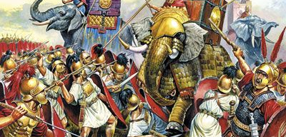
So again as with Heraclea and Asculum and now with Beneventum the victor is decided by the role of elephants. And with the battle at Beneventum, Pyrrhus leaves Italy. He flees immediately and go's back to Epirus, which takes us right back to where we began. 275 BC is the end of the Pyrrhic War.
273BC, There is a general or king who has been following the reports of these battles between Rome and Pyrrhus, because he is intimately connected to one of the players. This General is Ptolemy. He knows Pyrrhus very well. Pyrrhus has spent a lot of time in Egypt. He married Ptolemy's step daughter, they have very close and personal connections. And Ptolemy knows what a good general Pyrrhus is.
Ptolemy hasn’t been paying much attention to the rise of Rome, but over the 6 year battle with Pyrrhus he watches over Rome’s behavior. He saw how Rome swept down and took all of the South. He recognizes that there is an important global power developing, and he can no longer ignore it's rise.

Slide 8
Macedonia Italy
Pyrrhic War
-287
-285
-282
-280
-280
Heraclea
-279
Asculum
-275
Beneventum
-272
Dictator
D. Temple
Sicily
-273
Cold war
winter
treaty
Demetrius
W. Py,
E. Lys.
Subterfuge
Sanctions
Thurri allies with Rome
Tar. Attacks Thurri
Pyrrhus
Arrives in
Tarentum
Rome ý
attacks Pyrrhus þ
Pyrrhus þattacks Rome ý
Rome þattacks Pyrrhus ý
Egypt →
Rome
Rome→ Egypt
Maximum flood
Pyrrhus killed
Argos
Tarentum falls
In 273BC, Ptolemy or Egypt sends ambassadors to Rome, the first offer of a diplomatic relationship. AT Jones tells us that the following year, in 272BC, Rome returned that favor. And Rome sent ambassadors to Egypt, headed by Fabius Maxima Jerges. His name means the “Maximum Flood”.
Two other things happened this year, in 275BC Pyrrhus is defeated, but he is not killed. In 272BC, Pyrrhus is down in Greece and fighting a separate campaign in this city. He makes some very poor choices while he is fighting, his son is killed and he is emotional over it and he continues to make worse decisions. He ends up in the streets of this city fighting in tight ally ways with his whole army. Fighting in hand to hand combat with his enemy, he is disconnected. He’s made poor decisions by bringing his army and elephants into the middle of a city. It was an effort to take a Greek city that went completely wrong. As he is fighting hand to hand with this soldier, he’s fighting in this tight street. In a window above, the mother of the soldier who is fighting with Pyrrhus is watching. She leans out the window and takes roof tiles and hurls them at Pyrrhus, who is on a horse. One of the tiles hits him on the head, it stuns him and he falls off his horse. And he is killed by the soldier, by the fall and the soldier. 272BC Pyrrhus is killed.
We already discussed this in Acts 27, what city was he killed in? Argos. Argos is named after the Argolic plain where they grew all their grain. Its name, Argos is a reference to the color of the grain at harvest time, white.

Slide 9
Macedonia Italy
Pyrrhic War
-287
-285
-282
-280
-280
Heraclea
-279
Asculum
-275
Beneventum
-272
Dictator
D. Temple
Sicily
-273
Cold war
winter
treaty
Demetrius
W. Py,
E. Lys.
Subterfuge
Sanctions
Thurri allies with Rome
Tar. Attacks Thurri
Pyrrhus
Arrives in
Tarentum
Rome ý
attacks Pyrrhus þ
Pyrrhus þattacks Rome ý
Rome þattacks Pyrrhus ý
Egypt →
Rome
Rome→ Egypt
Maximum flood
Pyrrhus killed
Argos
Tarentum falls
There’s another story we can link to 272BC. In 275BC Pyrrhus is defeated in Italy. Rome has control over the South. But Tarentum did not surrender so easily, and they hold out under siege. From 275 to 272BC, Rome is besieging the city of Tarentum, the last city they have to take to have total control of the South. And in 272BC Tarentum surrenders, Tarentum falls and Rome takes the last city on the South.
We will come back to this concept, because Beneventum, we already drew conclusion that Beneventum is a reference to what we call Panium. And 272BC becomes a symbol of S/L. We call these way marks Panium and S/L. S/L being shipwreck in the story of Acts 27.
We are going to review this history again, from a different perspective in another study. But what we can begin to see, is that the defeat of the king of the South is a process. Everyone knows who won in 275BC, Egypt is already recognizing it, but it's still a process. It begins in 275BC and begins to fall, till it's completely destroyed in 272BC and we’ll discuss what that looks like. In the story of Pyrrhus we are going to bring in other witnesses to show this process. This is the story of Pyrrhus from 303BC, when he begins to be involved in world politics, to 272BC, where he dies.
So we have divided his life story into 2 parts, Macedonia and Italy. Macedonia ends a cold war, and it also begins a second phase, it’s changing in its location. So when we come to the Pyrrhic war history, we are already referencing the battles of Raphia and Panium.

Slide 10
4th Diadochi War
10
-307
-303
-301
Ipsus
291
289-288
287
285
282
280
280
Heraclea
279
Asculum
317
Macedonia divided
Cold war
winter
treaty
Cassander
Athens
Demetrius
Frees
Athens
Alliance
Demetrius
Pyrrhus
S, C, L 3 allies
Vs
Antigonu
Demetrius
→ Pyrrhus
Pyrrhus invades Thessaly
Demetrius invades Epirus
Demetrius
W. Py,
E. Lys.
Subterfuge
Sanctions
Thurri allies with Rome
Tar. Attacks Thurri
Pyrrhus
Arrives in
Tarentum
Rome ý
attacks Pyrrhus þ
Pyrrhus þattacks Rome ý
Macedonia Italy
Pyrrhic War
-287
-285
-282
-280
-280
Heraclea
-279
Asculum
-275
Beneventum
-272
Dictator
D. Temple
Sicily
-273
Cold war
winter
treaty
Demetrius
W. Py,
E. Lys.
Subterfuge
Sanctions
Thurri allies with Rome
Tar. Attacks Thurri
Pyrrhus
Arrives in
Tarentum
Rome ý
attacks Pyrrhus þ
Pyrrhus þattacks Rome ý
Rome þattacks Pyrrhus ý
Egypt →
Rome
Rome→ Egypt
Maximum flood
Pyrrhus killed
Argos
Tarentum falls

Slide 11
Macedonia Italy
Pyrrhic War
-287
-285
-282
-280
-280
Heraclea
-279
Asculum
-275
Beneventum
-272
Dictator
D. Temple
Sicily
-273
Cold war
winter
treaty
Demetrius
W. Py,
E. Lys.
Subterfuge
Sanctions
Thurri allies with Rome
Tar. Attacks Thurri
Pyrrhus
Arrives in
Tarentum
Rome ý
attacks Pyrrhus þ
Pyrrhus þattacks Rome ý
Rome þattacks Pyrrhus ý
Egypt →
Rome
Rome→ Egypt
Maximum flood
Pyrrhus killed
Argos
Tarentum falls
What we want to begin to consider, is what this teaches us in application. Pyrrhus comes in 2 histories, and that’s the King of the South. So when we come into our history and we talk about Panium, who is the king of the South? Russia, who do we bring to mind? There is a king and a kingdom. Russia is the kingdom, Putin is the King.
Daniel 2 gives us an important principal, a Bible rule. The rule is about a king and a kingdom. When Daniel tells Nebuchadnezzar the meaning of the statue, he points to the head of gold. And what does he say to Nebuchadnezzar? “That head of Gold is you”, it’s Nebuchadnezzar as an individual. It's not just a kingdom but it is also a person. We did the same thing with Greece. It's Greece, but who is it? It’s Alexander. When you come to the history of a kingdom you come to a history that’s connected to a prominent king and the symbology is connected.

Slide 12
So if this is the history of Putin and Russia, who is the first history speaking of when we come to its Alpha?
We are going to trace the kings of Epirus, Pyrrhus was the most prominent king and covers all our history. But the first king marked in that history is Admetus and Pyrrhus is the 10th.
1
10
Admetus
Pyrrhus
1
10

Slide 13
Pyrrhus became king, he faced some internal problems and he was removed from that leadership. Someone else became king. Neoptolemus II. Pyrrhus forced him to co-rule. So there was a time when you had 2 kings of Epirus, Pyrrhus and Neoptolemus II. Pyrrhus had Neoptolemus killed, and he returned as the sole king of the kingdom.
If we are going to talk about Pyrrhus and say that he is Vladimir Putin, Putin was president for 2 terms, 2000 to 2008, two four year terms. Under the Russian Constitution he can not run for a 3rdconsecutive year. So Putin pretends to step down and Medvedev becomes president. But was he ruling alone? Medvedev made Putin his prime minister, and they did not try to hide the fact that they were co -ruling. But Medvedev was only president for 1 full year term. And in 2011, he announced he would not be running for re- election, he dutifully stepped aside and Vladimir Putin could run for a 3rdterm, because it wasn't consecutive. So this is how Vladimir Putin retained hold of power, without breaking the Russian constitution which says you can only rule for 2 consecutive terms, the same as the laws in America. But he has managed to control that country by using some clever tactics since 1999, which is 20 years.
When we discuss Putin we are saying he is the 10th. Who is the first? Stalin.
1
10
Admetus
Aeacides
Neoptolemus
Aeacides
Alecetus
Pyrrhus
Neoptolemus II
Pyrrhus
Co-rule
1
10
Putin
Medvedev
Putin
Stalin
Co-rule

Slide 14
Looking at Pyrrhus again, we’ve already said that he became king at a young age. Why was he king so young? What we find in that history is that their nation had a set of peculiar problems. His father had been king, Aeacides, but he lost the support of his own people and he was removed in a political coup. And another king took the throne, a rival, Neoptolemus. This doesn't last long, Aeacides is returned to the throne, and Neoptolemus is removed. But because of this coup, Aeacides is so weakened that he is killed in this history by Cassander. Cassander does not like the leadership of Aeacides, so he invades Epirus and has him killed. When he is killed, his brother, Pyrrhus's uncle takes the throne, Alecetus II. He is the oldest brother of Aeacides. He should have had the throne in the beginning because he is the oldest brother. The reason he is overlooked is because he very is unpopular, and is known for his lack of self control, particularly his temper. The historians call it an “Ungovernable temper”.
1
10
Admetus
Aeacides
Neoptolemus
Aeacides
Alecetus
Pyrrhus
Neoptolemus II
Pyrrhus
coup
rival
weakened
No self control
Co-rule
1
10
Putin
Medvedev
Putin
Stalin
Co-rule

Slide 15
We brought that down into the history that lead us to Putin, who we should remind ourselves when he became president, was comparatively young, incredibly inexperienced, unlike any president they had before, until the leadership of Stalin. (?)
We find Gorbachev who was removed in a political coup that placed rival is Yanayav as leading in this stage what is the Soviet Union. Yanayav takes power, but not for long because Gorbachev was able to come back. He survives the coup and retakes power. But he has been so weakened by what has happened in this history, that he can not hold on to government. He steps down, and it is the end of the Soviet Union because he was so weakened.
Boris Yeltsin took power, what was Boris Yeltsin's problem? He had no self control. In particular with alcohol and the corruptions in his government. His lack of self control has a side effect with his health as it begins to fail. Because of these issues he loses the respect of the people and is forced to step down, making way for Putin. So we can see these histories are paralleling. When Gorbachev stepped down that was the end of the USSR.
When you go back to the history leading up to Stalin, when Czar Nicholas was removed, it was the end of the Monarchy. Instead of Czar Nicholas, Lenin takes power. Why didn't Lenin stay in power? He had health issues, he had a series of strokes.
1
10
Admetus
Aeacides
Neoptolemus
Aeacides
Alecetus
Pyrrhus
Neoptolemus II
Pyrrhus
coup
rival
weakened
No self control
Co-rule
1
10
Czar Nic.
Boris
Yeltsin
Putin
Medvedev
Putin
Lenin
Stalin
Gorbachev
Yanayav
Gorbachev
End of
Monarchy
Health
coup
rival
End of USSR
weakened
No self control
health
Co-rule

Slide 16
1
10
So we can parallel the rise of Putin, that placed him in power as young and inexperienced with the rise of Pyrrhus who came in young and inexperienced. We can create this structure, a straight reference from Pyrrhus to Putin.
We can also see it in the line from of rise of Stalin to the rise of Putin on our line. Gorbachev to Yeltsin. Czar Nicholas is the end of the Monarchy, Gorbachev is the end of the USSR. Lenin takes power, he has problems with his health, and he places Stalin in his position. Stalin is placed in the position of General Secretary, which he holds to his death by Lenin. Vladimir Putin is placed in his position, first as prime minister and then as president directly by Boris Yeltsin. Boris Yeltsin has a problem with his health due to lack of self control, particularly in relation to alcohol.
Admetus
Aeacides
Neoptolemus
Aeacides
Alecetus
Pyrrhus
Neoptolemus II
Pyrrhus
coup
rival
weakened
No self control
Co-rule
1
10
Czar Nic.
Boris
Yeltsin
Putin
Medvedev
Putin
Lenin
Stalin
Gorbachev
Yanayav
Gorbachev
End of
Monarchy
Health
coup
rival
End of USSR
weakened
No self control
health
Co-rule

Slide 17
1
10
We have created two structures and we can see that Pyrrhus is Putin, they are representative of each other. And that explains the history in our Italy line. We can also see that Putin is typified by Stalin. So Pyrrhus equals Putin, Putin equals Stalin. We can take the history of Pyrrhus as we see it in Italy and it represents Putin. But if Pyrrhus equals Putin and Putin equals Stalin, who is Pyrrhus also going to tell us of? Stalin. Because this is the Alpha and Omega, the 2 histories of the King of the South. The king of the South under Stalin, and the king of the South under Putin. So when we come to the beginning history, whose history are we to look into? Stalin and that takes us into the world wars, which Elder Parminder has been introducing and describing to us. So they should already be familiar terms. We should already be aware of how we are studying them and the conclusions we are coming to about them.
Admetus
Aeacides
Neoptolemus
Aeacides
Alecetus
Pyrrhus
Neoptolemus II
Pyrrhus
coup
rival
weakened
No self control
Co-rule
1
10
Czar Nic.
Boris
Yeltsin
Putin
Medvedev
Putin
Lenin
Stalin
Gorbachev
Yanayav
Gorbachev
End of
Monarchy
Health
coup
rival
End of USSR
weakened
No self control
health
Co-rule
Stalin and Putin both face war with KN
2 histories of Pyrrhus life = the 2 histories of life of KS an alpha and omega history
Pyrrhus = Putin A = B B = C
Putin = Stalin What is A? A = C

Slide 18
1929
April 1, 1939
Proxy
Great
depression
We are looking at the king of the South, the USSR. Not from its end history, we want to go back to the very beginning where the king of the South becomes involved in world affairs. 1917 was the Russian revolution where Russia turned into a communist power, first under Lenin, and then transitioning to under Stalin. It's engulfed in civil war until around 1922, 5 years later, and then it takes years from 1922 to 1929, for Stalin to take over the USSR as a dictatorship. He wasn't the only communist that was influential, you may have heard of Trotsky and other factions vying for power that were really Stalin’s first internal enemies. Even though the USSR has transitioned into this communist power, from 1917 to 1929, it's distracted by internal issues. First of all civil war, then Trotsky, and Stalin tries to take over the country. In 1929, it's Stalin’s 50thbirthday, he begins in a more clear fashion to build a cultive personality and he puts down his last government rivals. So from 1929, Stalin is in a stronger position to now start pushing his ideology world wide.
We also know 1929 for other events. This was the economic crash that began the great depression. And a side affect of that financial crash was that it enabled the rise of Hitler. When the market collapsed inside Germany, life became much more difficult, and people became much more desperate for alternatives. And the language of a populist leader like Adolf Hitler became much more appealing to them, and you can trace his election wins from 1929 and see how quickly that escalated.

Slide 19
Across Europe from 1917, particularly escalating from 1917 up to the WW2, much of Europe becomes divided into 2 sides, and countries are deciding which side they are going to stand with. The division that begins off quietly is between to modes of government, fascism and communism. The countries are deciding on which side they stand. So across Europe many of countries are choosing one of these forms of government they want to be. Under fascism you can mark Italy, under Mussolini, and you have Germany as it rises up under Hitler.
Under Communism you have the USSR under Stalin. And he is looking at these fascist governments as a threat. Because he sees these powerful countries are turning fascist coming into an alliance, he sees that alliance as a threat. He wants to stem that flow, by stopping more of Europe from turning fascist.
And the next country having an internal struggle of which form of what government it will take is Spain. And there is a Spanish civil war, beginning in the history after 1929 and ends in 1939. And this Spanish civil war is a struggle between fascism and communism. Particularly between the USSR and Germany. They call it a practice match, like you would have in sport, a practice match before you have the major match. They say that this Spanish civil war was the practice match before WW2. And it's a proxy war between Germany and the USSR, between Hitler and Stalin. And the men you would identify with Spain in this history, is General Franco. In 1939 General Franco wins, and Spain becomes fascist. So you can see in this history that there is a division between German and USSR already developed, they are natural enemies. And that is obvious from the Spanish civil war, which ends on April 1, 1939.
Fascists
Communism
Mussolini (Italy)
Hitler (Germany)
Send aid to Franco
Stalin (USSR)
Send aid to Spanish
government

Slide 20
1929
April 1, 1939
Aug. 23,
1939
Proxy
Great
depression
Spanish Civil War
Molotov Ribbentrop Pact
Non Aggression
Spheres of Influence
Trade—payment
Fascists
Communism
So the world is shocked and amazed when just a few months later, in 1939 Aug 23, these two natural enemies enter into an alliance. This is an alliance between these 2 powers who just fought each other in a proxy war. Natural greatest enemies. And they go into an alliance known as the Molotov Ribbentrop pact. Why would Hitler want an alliance with the USSR? In the history of the WW1, in which Hitler was a soldier, Germany faced a particular problem, that the other countries did not have. And it’s is one of the major reasons why Germany was unsuccessful in those histories and that issue relates to its location. When a country waged war, it makes sense to send your army to the front line, and the enemy sends their army to the front line, and then your two armies fight. But Germany has a particular problem and that is its location. When fighting its enemies in WW1, against England, France, USSR, its main enemies are on the opposite sides of the country. And it had to fight a war on two different fronts. And as that invasion was successful and his army is spread out, and its army got further and further divided until you had two fronts further and further apart. Which means you’re harming your man power and resources. For France to fight Germany, all it needed was one front. The USSR one front. But Germany is so vulnerable, because of its central location, And this is the history of WW1, where Germany was defeated, partly because of this vulnerable location where France and England fought against them.
Mussolini (Italy)
Hitler (Germany)
Send aid to Franco
Stalin (USSR)
Send aid to Spanish
government
Germany
W
E

Slide 21
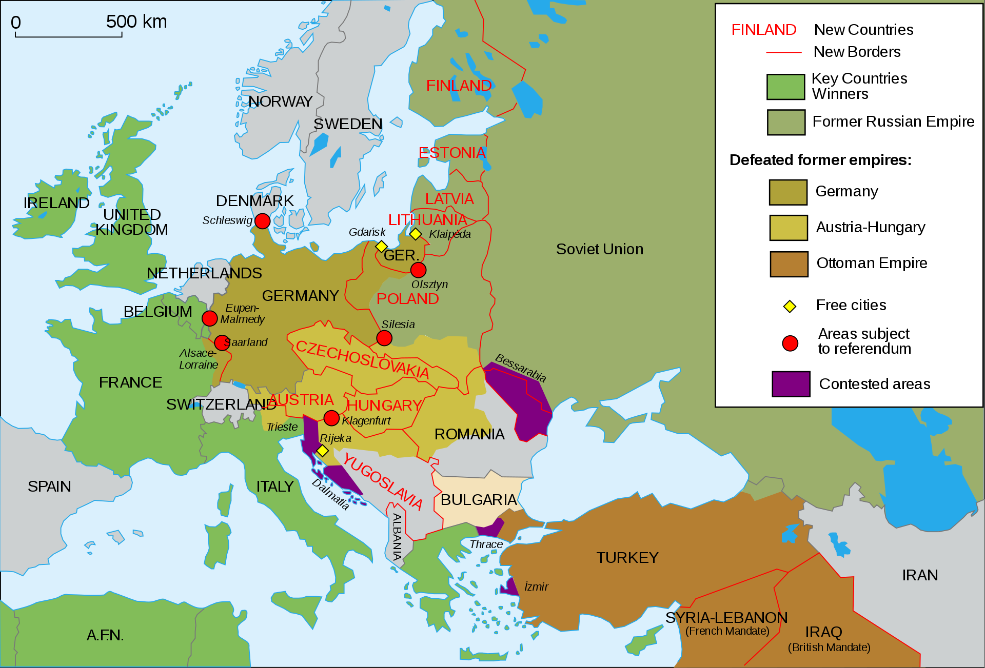
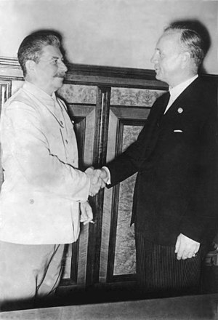
Hitler well knows he is entering into WW2, because what he wants is Poland. He wants to take Poland, and he has already been told that if you attack Poland, then your going to face war with Britain and with France. Both of them had assured Poland, Britain and France have both told Poland, that if Germany invades you, we will go to war with them. Hitler knows that and he wants Poland, so he knows he’s about to go to war with Britain and France. He's going to face war on the western front. And he’s just come out of the history of WW1 where he fraught, and he knows that if he is to start another war on two fronts, there's no hope of victory. He knows that his enemy in on the Eastern front just waiting for him to be weak and Stalin is going to attack him. So he can not fight war with the West and the East at the same time. So what he wants is an assurance from Stalin that when he goes to fight the West, that Stalin will not interfere and attack him at a vulnerable moment.
So for this reason Hitler goes into an alliance with Stalin in 1939. The Molotov Ribbentrop Pact. It has 3 parts to it.
Non aggression Stalin promises Hitler that he will not attack Germany while Hitler is at war with the West. They put a time frame on this.
Was a division of Eastern Europe between themselves, into spheres of influence. They said they would take Eastern Europe and divide it between them selves.
Trade payment. Hitler was so Isolated, he needed to be able to import from the USSR, to fund his war effort. If he was also going to bring in shipments from allies from the South or from Asia, he also needed to use the Soviet rail lines.
Germany didn't have the resources for WW2. So the Soviet Union ends up funding that war effort. And Germany is supposed to pay for those imports. This is the logic for why Hitler would want an alliance with his natural enemy, he knows he’s about to go to war with the west.

Slide 22
1929
April 1, 1939
Aug. 23,
1939
Sept 1
1939
Proxy
Great
depression
Spanish Civil War
Molotov Ribbentrop Pact
Non Aggression
Spheres of Influence
Trade—payment
Br., Fr., Pld
Vs
Germany
é
USSR
Why would Stalin want an alliance with Hitler, what did he have to gain from that? What Stalin was able to do, was sit back and watch his greatest enemies destroy each other. So without him having to engage in any effort, he watches Britain and France and Germany, begin to destroy and weaken each other. If you have 2 enemies and they’re fighting each other, that gives you the opportunity when they are in their weakest moments to step in and control both. So Stalin wants this war with Western Germany to go on as long as possible, and he is willing to help Hitler, if in an effort both Germany and the west are weakened. And out of that agreement there is also the division of spheres of influence. While Hitler is horrifying the world, Stalin can more easily sneak in and take control of Eastern European countries with out repercussion. So these natural enemies begin WW2 as allies, because of this pact. It was 8 days later, Sept 1st, when Hitler invaded Poland, and Hitler was taking on 3 allies. Taking on Poland, France, and England vs. Hitler, who has an important ally, the King of the South, USSR. This was the first invasion of WW2.

Slide 23
1929
April 1, 1939
Aug. 23,
1939
Sept 1
1939
Aug
1940
Europe divided
Proxy
Great
depression
Spanish Civil War
Molotov Ribbentrop Pact
Non Aggression
Spheres of Influence
Trade—payment
Br., Fr., Pld
Vs
Germany
é
USSR
From the Sept 1st, they begin to divide Eastern Europe into spheres of influence. It has caused some strain, some problems with there allegiance, because they began to argue over certain countries. It wasn't all done with their initial division, now they have some problems. Particularly in the Balkans, Bulgaria, some of those countries, they begin to argue. A break down over these two issues: spheres of influence and trade, which culminates in Aug 1940. For one month they ceased trade, and this is the work of Stalin. He refuses to send any more supplies to Germany, for two reasons - there's trouble over dividing Europe, neither side are happy with their share, and there’s issues over trade. Hitler isn't paying for his imports. For a whole month there is a stale mate until they meet in secret and sort out their differences. They redraw the map of Europe and come to an agreement over trade. And their alliance becomes strong again. But Hitler is afraid, he sees how quickly Stalin can cut off his supplies. And he decides that instead of waiting until the end of the war, he is going to do what he intended all the way along, and attack his ally. He is ready for a war on two fronts, so it was delayed but not prevented.

Slide 24
1929
April 1, 1939
Aug. 23,
1939
Sept 1
1939
Aug
1940
June 22
1941
1945
Europe divided
Proxy
Great
depression
Spanish Civil War
Molotov Ribbentrop Pact
Non Aggression
Spheres of Influence
Trade—payment
Br., Fr., Pld
Vs
Germany
é
USSR
Operation
Barbsrosa
USA→Germ← USSR
West East
June 22 1941, Hitler invaded the Soviet Union. This was Operation Barbarosa. It's the largest invasion known in history. Covering the furthest amount of territory, and with the most men. There's never been an invasion known of that has surpassed it. And Stalin was taken completely by surprise, so now Hitler has a war on two fronts.
This drives Stalin into an alliance, he changes sides, he goes from supporting Hitler into an alliance with the allies. The same people, the allies that Stalin had helped Hitler fight, he now joins to fight against Hitler. It's repeating the history of 301BC, with Demetrius and Pyrrhus, and the 3 allies, where Pyrrhus and Demetrius were fighting. Pyrrhus ends up joining to fight Demetrius, in 287BC.
In the history of 1945, by the time we get to the end of that war, you have Germany, Hitler facing an invasion from two sides. From the West you have a new player, but part of that same alliance. The USA, in an alliance with France and Britain, from the West. From the East, you have Stalin, USSR. You see Germany is divided into East to West, and Hitler was defeated. Was either side happy with just their portion? No.

Slide 25
This sparked a war, but not a conventional war, a cold war. From 1945 to 1989, it doesn't truly end till 1991. The Soviet Union does not end in 1989, but in 1991. Now you had a cold war. What did the USA use against the Soviet Union? subterfuge, and sanctions. By the end of the this cold war, the USSR lost power, what did they lose? What did Pyrrhus lose? Spheres of influence. He lost everything except the borders of his own country. And the Soviet Union lost everything except the borders of Russia itself. And that’s enough to call that a defeat, defeated in 1991, beginning in 1989.
1929
April 1, 1939
Aug. 23,
1939
Sept 1
1939
Aug
1940
June 22
1941
1945
1989-91
Europe divided
Cold war
Proxy
Great
depression
Spanish Civil War
Molotov Ribbentrop Pact
Non Aggression
Spheres of Influence
Trade—payment
Br., Fr., Pld
Vs
Germany
é
USSR
Operation
Barbsrosa
Germ
USA USSR
West East
Subterfuge
sanctions

Slide 26
If we parallel these histories, we can mark a period of 10, a proxy war. We recognize the end of the proxy war in Athens, and Spain. Then these natural enemies go into an alliance. Demetrius goes into an alliance with Pyrrhus, and we see the introduction of the king of the South. Germany is going into an alliance with the Soviet Union and Stalin, because they have a plan. There's a battle coming, there’s an invasion coming... Cassander, Lysimicus and Seleucus against Antigonus and Demetrius. Demetrius is supported by Pyrrhus. This is the history of the allies, against Hitler. Hitler was supported by the Soviet Union. There is a division of Macedonia, and a division of Europe. Then we see their relationship strained, Pyrrhus and Demetrius as a result of the division. Hitler and Stalin relationship strained. They fix their differences, but it is a temporary patch. And it is properly broken when Demetrius invades Epirus and when Hitler invades the Soviet Union. This drives the King of the South back into an alliance with the allies, who he had originally opposed. And the king of the North is defeated by the invasion on two fronts, which divides his country into East and West. There are two victors, they each take a portion of that territory. And you have a cold war, where they are using sanctions and spheres of influence, the King of the North using sanctions and subterfuge, and the King of the South loosing his spheres of influence, until he is defeated.
4th Diadochi War
Macedonia Italy
10
-307
-303
-301
Ipsus
291
289-288
287
285
282
317
Macedonia divided
Proxy
Cold war
Cassander
Athens
Demetrius
Frees
Athens
Alliance
Demetrius
Pyrrhus
S, C, L 3 allies
Vs
Antigonu
Demetrius
→ Pyrrhus
Pyrrhus invades Thessaly
Demetrius invades Epirus
Demetrius
W by Py,
E by Lys.
Subterfuge
Sanctions
Thurri allies with Rome
Tar. Attacks Thurri
1929
April 1, 1939
Aug. 23,
1939
Sept 1
1939
Aug
1940
June 22
1941
1945
1989-91
Europe divided
Cold war
Proxy
Great
depression
Spanish Civil War
Molotov Ribbentrop Pact
Non Aggression
Spheres of Influence
Trade—payment
Br., Fr., Pld
Vs
Germany
é
USSR
Operation
Barbsrosa
Germ
USA USSR
West East
Subterfuge
sanctions

Slide 27
4th Diadochi War
Macedonia Italy
10
-307
-303
-301
Ipsus
291
289-288
287
285
282
317
Macedonia divided
Cold war
Cassander
Athens
Demetrius
Frees
Athens
Alliance
Demetrius
Pyrrhus
S, C, L 3 allies
Vs
Antigonu
Demetrius
→ Pyrrhus
Pyrrhus invades Thessaly
Demetrius invades Epirus
Demetrius
W by Py,
E by Lys.
Subterfuge
Sanctions
Thurri allies with Rome
Tar. Attacks Thurri
1929
April 1, 1939
Aug. 23,
1939
Sept 1
1939
Aug
1940
June 22
1941
1945
1989-91
2014
Europe divided
Cold war
Proxy
Great
depression
Spanish Civil War
Molotov Ribbentrop Pact
Non Aggression
Spheres of Influence
Trade—payment
Br., Fr., Pld
Vs
Germany
é
USSR
Operation
Barbsrosa
Germ
USA USSR
West East
Subterfuge
sanctions
Russia, Putin attacks Ukraine
At that same point in time, we would have originally said a couple of years ago the story ends. Dan 11:40 ends and the King of the South is defeated, we would have originally thought that. Now we know there is a part B. That part B is Pyrrhus in Italy, because at this same point in time, something else is happening that shows. Who changes its influence here? There’s a sphere of influence that changed their allegiance from Tarentum to Rome, from the king of the South to the King of the North and this sparks a conflict. In 1989 building to 1991, the country of Ukraine changed its allegiance from the Soviet Union to the West. They do it first in 1989 to 91, But there is a later date, 2014, where they repeat that process. They reject Russia and choose an alliance with the west. And what was Russia’s response? Now it is a history with Vladimir Putin.

Slide 28
4th Diadochi War
Macedonia Italy
10
-307
-303
-301
Ipsus
291
289-288
287
285
282
280
317
Macedonia divided
Cold war
Cassander
Athens
Demetrius
Frees
Athens
Alliance
Demetrius
Pyrrhus
S, C, L 3 allies
Vs
Antigonu
Demetrius
→ Pyrrhus
Pyrrhus invades Thessaly
Demetrius invades Epirus
Demetrius
W by Py,
E by Lys.
Subterfuge
Sanctions
Thurri allies with Rome
Tar. Attacks Thurri
1929
April 1, 1939
Aug. 23,
1939
Sept 1
1939
Aug
1940
June 22
1941
1945
1989-91
2014
Europe divided
Cold war
Proxy
Great
depression
Spanish Civil War
Molotov Ribbentrop Pact
Non Aggression
Spheres of Influence
Trade—payment
Br., Fr., Pld
Vs
Germany
é
USSR
Operation
Barbsrosa
Germ
USA USSR
West East
Subterfuge
sanctions
Russia, Putin attacks Ukraine
2014 Russia, attacks the Ukraine, and if you go to the list of sanctions placed on Russia, many of them come from this incident, this conflict of Russia attacking the Ukraine. So there is an escalation again with the King of the South. Another history where the king of the North and the King of the South begin to quarrel. We can see that happening in Ukraine, first in 1989 – 91, right where our first history ends but then it gets repeated. We get to 2014, it begins to get repeated. The history of 280BC begins to come into our history, and we begin to make present day applications.

Slide 29
M
+
Ω
Miller
144
Ω
If we were to go into the History of Adventism, we would talk about Alphas and Omegas, Moses and Christ, Millilitres and 144K. And what is one of the conclusions we come to? We say Moses and Christ. And then we say Millerites and 144. How do you know what the end looks like? By the beginning, we don't just learn about our history from the history of Christ. We know about our history because the alpha tells us about the omega. The history of the Millilitres tells us about the history of the 144K. So if we are going to understand our history, where do we look? We look to Millerite history. So when we make our application we understand the King of the North and the King of the South in this history. We are not just going to take Pyrrhus in Italy, we are not just going to learn from the Omega, we have to take the Alpha. We have to take the history of Stalin and Hitler, and WW2, and over lay it.
In our next study we are going to take both histories of alpha and omega to teach us our own.

