Slide 1
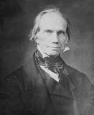
Henry Clay
Elder Tess Lambert
September 5, 2020
Islands of the Sea September Camp Meeting #2

Slide 2
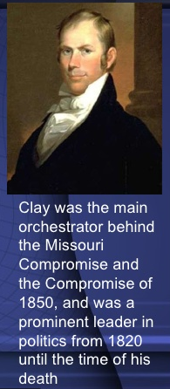
Missouri Compromise 1818-1820
In an effort to preserve the balance of power in Congress between slave and free states, the Missouri Compromise was passed in 1820 admitting Missouri as a slave state and Maine as a free state. Furthermore, with the exception of Missouri, this law prohibited slavery in the Louisiana Territory north of the 36° 30´ latitude line. In 1854, the Missouri Compromise was repealed by the Kansas-Nebraska Act. Three years later the Missouri Compromise was declared unconstitutional by the Supreme Court in the Dred Scott decision, which ruled that Congress did not have the authority to prohibit slavery in the territories.

Slide 3
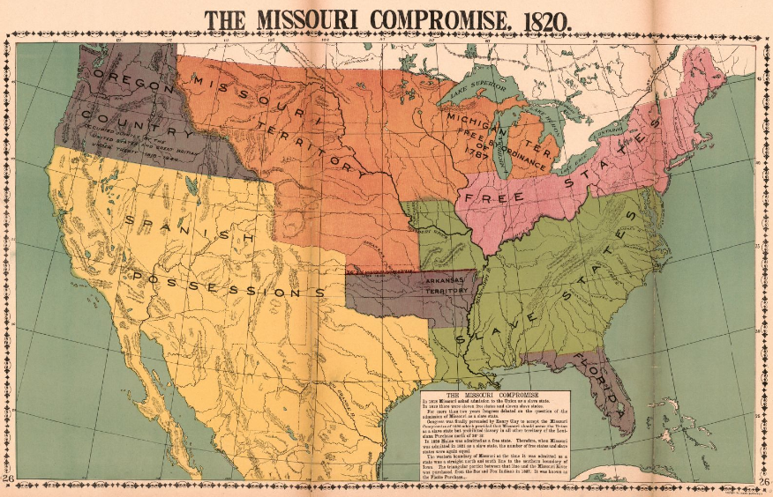

Slide 4
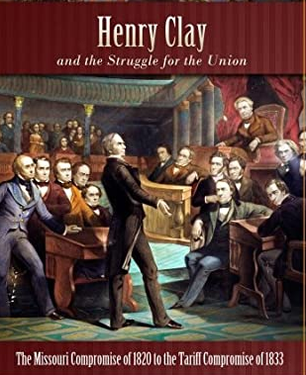
Compromise Tariff of 1833
Compromise Tariff of 1833 Definition and Summary: The Compromise Tariff of 1833 was proposed by Henry Clay with the cooperation of John C. Calhoun to defuse the gravity of the Nullification Crisis. The Compromise Tariff was passed by Congress in March 1833 and gradually lowered the tariff rates over the next 10 years until, in 1842, they would be as low as they were by the Tariff Act of 1816. The Compromise Tariff ended the Nullification Crisis.
After he lost both the fight over the bank and his second bid for the presidency, Clay addressed the South Carolina nullification crisis with his compromise tariff of 1833, which gradually lowered tariffs over the following 10 years. Although the controversy was ostensibly about South Carolina’s refusal to collect federal tariffs, many historians believe it was actually rooted in growing Southern fears over the North’s abolition movement. Clay was able to prevent a serious confrontation as defiant South Carolinians were taking up arms and Jackson was threatening force.

Slide 5
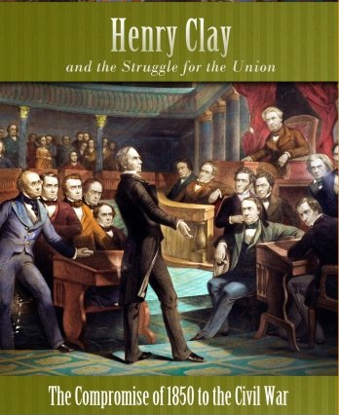
Compromise of 1850
The Compromise of 1850 was a package of five separate bills passed by the United States Congress in September 1850 that defused a political confrontation between slave and free states on the status of territories acquired in the Mexican–American War. It also set Texas's western and northern borders and included provisions addressing fugitive slaves and the slave trade. The compromise was brokered by Whig senator Henry Clay and Democratic senator Stephen Douglas with the support of President Millard Fillmore.
A debate over slavery in the territories had erupted during the Mexican–American War, as many Southerners sought to expand slavery to the newly-acquired lands and many Northerners opposed any such expansion. The debate was further complicated by Texas's claim to all former Mexican territory north and east of the Rio Grande, including areas it had never effectively controlled. These issues prevented the passage of organic acts to create organized territorial governments for the land acquired in the Mexican–American War. In early 1850, Clay proposed a package of bills that would settle most of the pressing issues before Congress. Clay's proposal was opposed by President Zachary Taylor, anti-slavery Whigs like William Seward, and pro-slavery Democrats like John C. Calhoun, and congressional debate over the territories continued.
After Taylor died and was succeeded by Fillmore, Douglas took the lead in passing Clay's compromise through Congress as five separate bills. Under the compromise, Texas surrendered its claims to present-day New Mexico and other states in return for federal assumption of Texas's public debt. California was admitted as a free state, while the remaining portions of the Mexican Cession were organized into New Mexico Territory and Utah Territory. Under the concept of popular sovereignty, the people of each territory would decide whether or not slavery would be permitted. The compromise also included a more stringent Fugitive Slave Law and banned the slave trade in Washington, D.C. The issue of slavery in the territories would be re-opened by the Kansas–Nebraska Act, but many historians argue that the Compromise of 1850 played a major role in postponing the American Civil War.
https://en.wikipedia.org/wiki/Compromise_of_1850

Slide 6
Compromise of 1850
Fugitive Slave Law
Main article: Fugitive Slave Act of 1850
One statute of the Compromise of 1850, enacted September 18, 1850, is informally known as the Fugitive Slave Law, or the Fugitive Slave Act. It bolstered the Fugitive Slave Act of 1793. The new version of the Fugitive Slave Law required federal judicial officials in all states and federal territories, including in those states and territories in which slavery was prohibited, to assist with the return of escaped slaves to their masters actively in the states and territories permitting slavery. Any federal marshal or other official who did not arrest an alleged runaway slave was liable to a fine of $1000. Law enforcement everywhere in the US had a duty to arrest anyone suspected of being a fugitive slave on no more evidence than a claimant's sworn testimony of ownership. Suspected slaves could neither ask for a jury trial nor testify on their own behalf. Also, any person aiding a runaway slave by providing food or shelter was to be subject to six months' imprisonment and a $1000 fine. Officers capturing a fugitive slave were entitled to a fee for their work.
In addition to federal officials, the ordinary citizens of free states could be summoned to join a posse and be required to assist in the capture, custody, and/or transportation of the alleged escaped slave.
The law was so rigorously pro-slavery as to prohibit the admission of the testimony of a person accused of being an escaped slave into evidence at the judicial hearing to determine the status of the accused escaped slave. Thus, if a freedman were claimed to be an escaped slave, they could not resist their return to slavery by truthfully telling their actual history.
The Fugitive Slave Act was essential to meet Southern demands. In terms of public opinion in the North, the critical provision was that ordinary citizens were required to aid slave catchers. Many northerners deeply resented that requirement to help slavery personally. Resentment towards the Act continued to heighten tensions between the North and South, which were inflamed further by abolitionists such as Harriet Beecher Stowe. Her book, Uncle Tom's Cabin, stressed the horrors of recapturing escaped slaves and outraged Southerners.^{[49]}
https://en.wikipedia.org/wiki/Compromise_of_1850

Slide 7
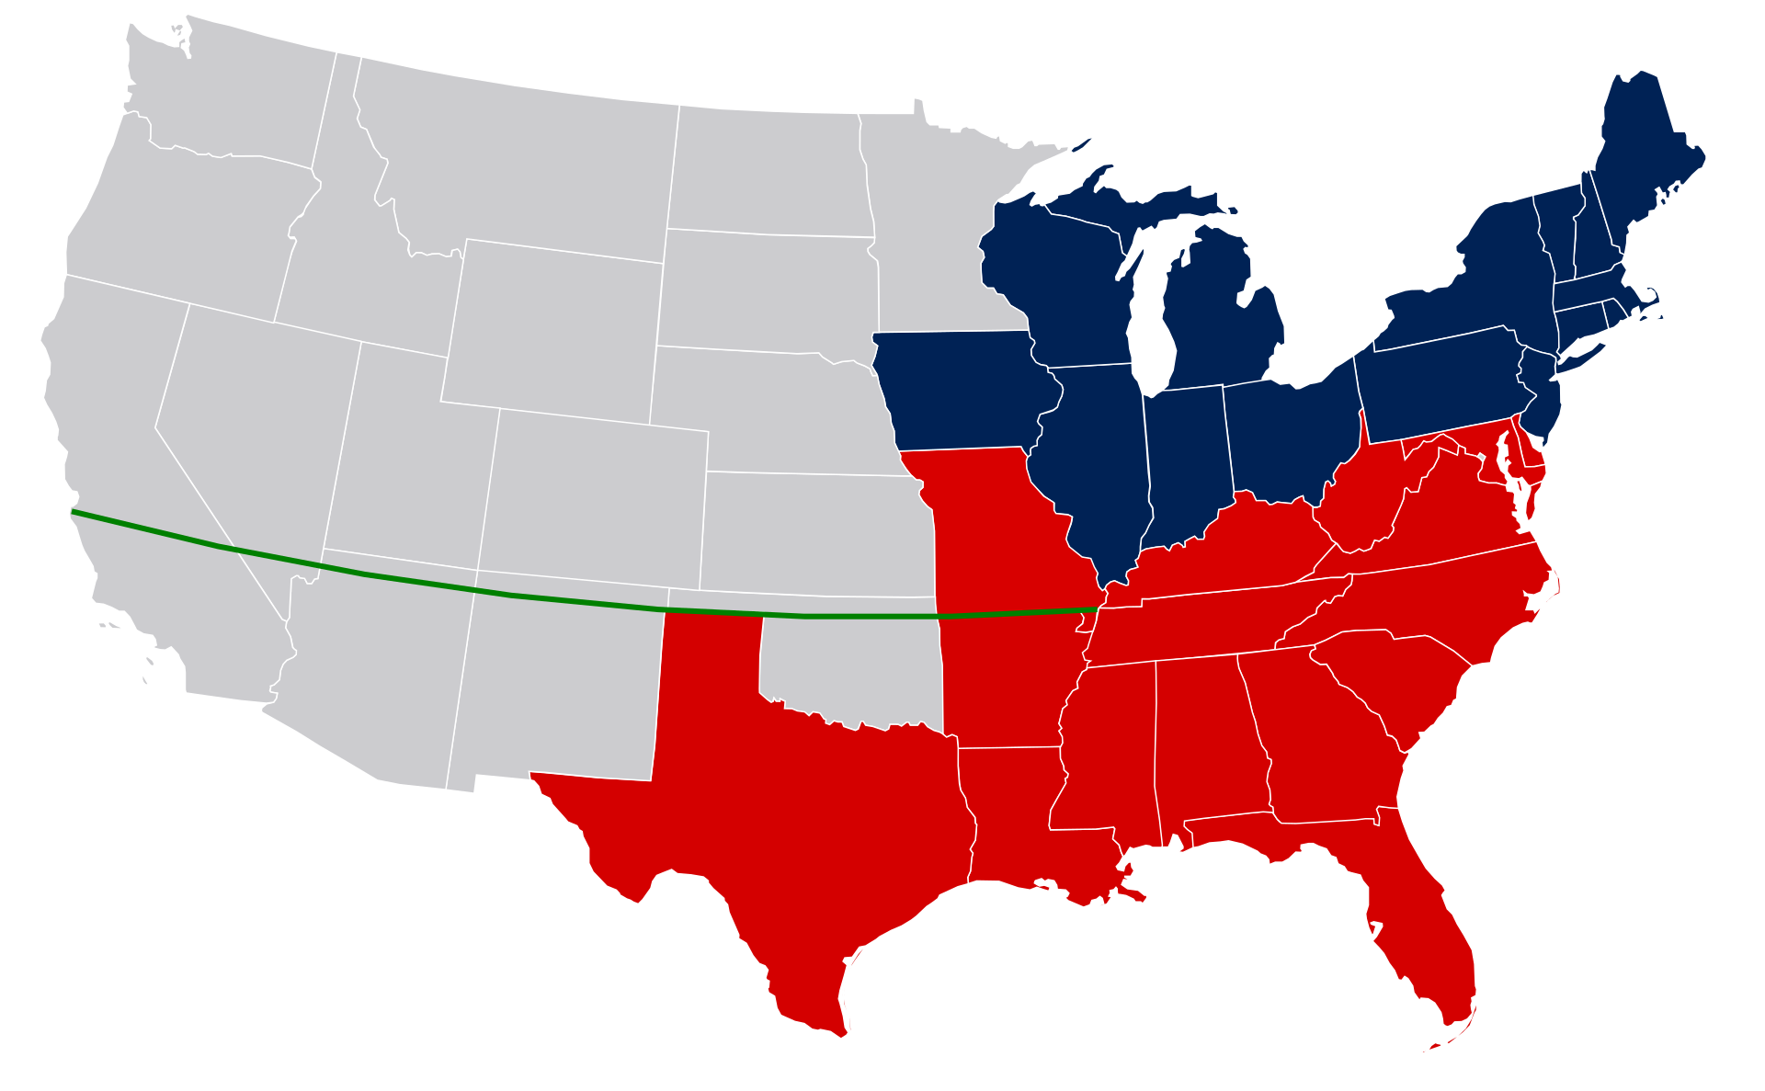
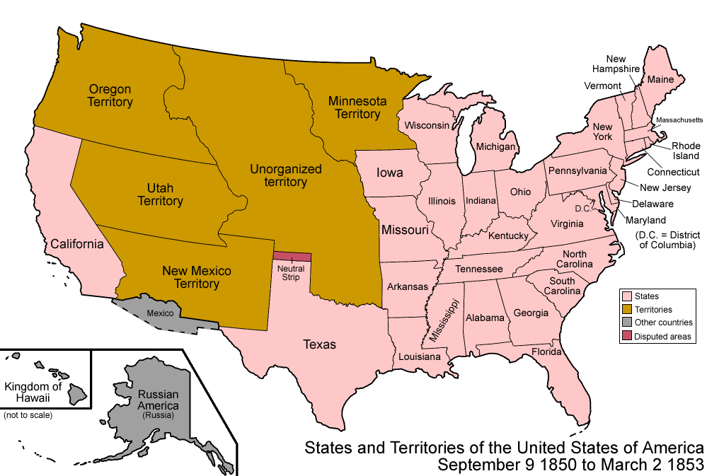
Compromise of 1850
Free states in early 1850
Slave states (without Texas's claims to New Mexico)
Territories (later state borders, Gadsden Purchase)
Missouri Compromise Line 36°30'

Slide 8
We're continuing on from our previous study and we'll first do a short review. We'll include a couple of thoughts that weren't mentioned in the previous study. They're not new thoughts, this is just a reminder.
There are set periods where they can see that there was a particular development in US politics in how political parties were structured and organized. We have the first party system, the second party system and the third-party system. They are the three that overlap with our reform line. We're focusing mostly on the second party system which was predominantly the Whig party versus the Democrat party. The Whig party fell apart in the 1850s and a branch of that became the Republican party.
Washington continues to advance his idea of the dangers of sectionalism and expands his warning to include the dangers of political parties to the country as a whole. These warnings are given in the context of the recent rise of two opposing parties within the government—the Democratic-Republican Party led by Jefferson, and Hamilton's Federalist Party. Washington had striven to remain neutral during a conflict between Britain and France brought about by the French Revolution, while the Democratic-Republicans had made efforts to align with France, and the Federalists had made efforts to ally with Great Britain.
Washington recognizes that it is natural for people to organize and operate within groups such as political parties, but he also argues that every government has recognized political parties as an enemy and has sought to repress them because of their tendency to seek more power than other groups and to take revenge on political opponents.^{[4]} He feels that disagreements between political parties weakened the government.
Moreover, he makes the case that "the alternate domination" of one party over another and coinciding efforts to exact revenge upon their opponents have led to horrible atrocities, and "is itself a frightful despotism. But this leads at length to a more formal and permanent despotism." From Washington's perspective and judgment, political parties eventually and "gradually incline the minds of men to seek security… in the absolute power of an individual",^{[1]} leading to despotism. He acknowledges the fact that parties are sometimes beneficial in promoting liberty in monarchies, but he argues that political parties must be restrained in a popularly elected government because of their tendency to distract the government from their duties, create unfounded jealousies among groups and regions, raise false alarms among the people, promote riots and insurrection, and provide foreign nations and interests access to the government where they can impose their will upon the country.
1st Party system 1792-1824
2nd Party system 1828-1854
3rd Party system 1854-1890’s

Slide 9
Then after about 1855 you had Democrats versus Republicans, but the predecessor of the Republicans was the Whig party.
The parties switched platforms between the Civil War and the Civil Rights era. So, in the Millerite history the Democrats were more on southern interests and the Whigs and Republicans on northern interests. Particularly early on there was significant grey areas but those parties became more and more polarized, just like today.
α Modern
1798
1840
1850
COP
1861
1863
TT
1798
1840
July 21,
1844
Oct. 22,
1844
1850
TT
✓
18
33
✓
✓
✓
✓
✓
1850
1861
⬆
2nd Adv
TT
✓
So, if you're William Miller, or Samuel Snow you're expecting the second Advent to be in 1844. As we cover this history you see polarization rising in the 10-15 years prior to this history. Slavery is becoming more and more divisive and the future of the United States hinges on the 1844 US election.

Slide 10
α Modern
This is a book by John Bicknell titled America 1844:
First quote
“Miller was confident that election day would never take place. While among the politicians in Washington he wrote that he planned to "show them an important revolution will take place before long which will supersede the necessity of choosing a president by ballot. For the King of Kings will soon be inaugurated into the chair of State.”
1798
1840
1850
COP
1861
1863
TT
1798
1840
July 21,
1844
Oct. 22,
1844
1850
TT
✓
18
33
✓
✓
✓
✓
✓
1850
1861
⬆
2nd Adv
TT
✓
So is William Miller particularly focused on the external political events?
No

Slide 11
α Modern
1798
1840
1850
COP
1861
1863
Oct. 22, 1844 lines up with November 9th, 2019. Would we care about the external events of 2019 if Christ was coming in a matter of months? In a history of success, they should have corrected that mistake in time. What we are seeing now is largely what they should have seen if Samuel snow had corrected the mistake. (theirs was a line of failure, the 2nd angel, Samuel Snow did not correct the mistake).
TT
1798
1840
July 21,
1844
Oct. 22,
1844
1850
Failure
TT
✓
18
33
✓
✓
✓
✓
✓
1850
1861
⬆
2nd Adv
TT
Nov.9,2019
✓

Slide 12
α Modern
1798
1840
1850
COP
1861
1863
TT
Then on top of that of necessity they must have a woman prophet who is also impeded by her own sexism that says these external events are outside a woman's sphere of influence.
1798
1840
July 21,
1844
Oct. 22,
1844
1850
Failure
TT
✓
18
33
✓
✓
✓
✓
✓
1850
1861
⬆
2nd Adv
TT
Nov.9,2019
✓

Slide 13
α Modern
1798
1840
1850
COP
1861
1863
So, to review, we started back from the beginning and we looked at the Constitution, we saw that it was a compromised document in three particular parts. One of those was a fugitive slave clause, though they wrote it in an ambiguous way to disguise the ugly word. But if they didn't mean slavery, they wouldn't have amended that after the Civil War. So, the principle of the fugitive Slave Act was in the Constitution, reinforced by other laws, finally and particularly with the 1850 Compromise.
TT
1798
1840
July 21,
1844
Oct. 22,
1844
1850
Failure
TT
✓
18
33
✓
✓
✓
✓
✓
1850
1861
⬆
2nd Adv
TT
Nov.9,2019
✓
Passed on September 18, 1850 by Congress, The Fugitive Slave Act of 1850 was part of the Compromise of 1850. The act required that slaves be returned to their owners, even if they were in a free state. The act also made the federal government responsible for finding, returning, and trying escaped slaves.

Slide 14
α Modern
1798
1840
1850
COP
1861
1863
In 1861 the South makes the following argument: the law and a plain reading of the Constitution is on our side. And if you want to do a plain reading their arguments are better than that of the North.
So, 1798 you have a compromised Constitution because the main priority is to hold that Union together. Then 1798 Henry Clay does his first political speech.
TT
1798
1840
July 21,
1844
Oct. 22,
1844
1850
Failure
TT
✓
18
33
✓
✓
✓
✓
✓
1850
1861
Henry Clay first political speech
⬆
2nd Adv
TT
Nov.9,2019
✓

Slide 15
α Modern
1798
1840
1850
COP
1861
1863
We looked at the 1818 Missouri Compromise. Missouri wanted to enter in as a slave state. This wasn't accepted in the North so Henry Clay linked the request of two states. Missouri can enter as a slave state if Maine can enter as a free state.
John Quincy Adams said the following:
"I take it for granted that the present question is a mere preamble. It's like the title page of a book. The title page of a great tragic volume"
TT
1798
1840
July 21,
1844
Oct. 22,
1844
1850
Failure
TT
✓
18
33
✓
✓
✓
✓
✓
1850
1861
Henry Clay first political speech
⬆
2nd Adv
TT
Nov.9,2019
✓
In an effort to preserve the balance of power in Congress between slave and free states, the Missouri Compromise was passed in 1820 admitting Missouri as a slave state and Maine as a free state. ... In 1854, the Missouri Compromise was repealed by the Kansas-Nebraska Act.

Slide 16
α Modern
John Quincy Adams is the eldest son of his father John Adams Sr. John Adams Sr. was president in 1798. But his son also becomes president and as John Quincy Adams ages he becomes more and more against slavery. He says this Missouri Compromise is just the title page or just the introduction. The president thinks that the compromise will take all of this away, but he doesn't believe that.
This question, this issue is now destined to last the extent of their individual and political lives.
1798
1840
1850
COP
1861
1863
TT
1798
1840
July 21,
1844
Oct. 22,
1844
1850
Failure
TT
✓
18
33
✓
✓
✓
✓
✓
1850
1861
Henry Clay first political speech
⬆
2nd Adv
TT
Nov.9,2019
✓

Slide 17
α Modern
We need to be clear in this history, and we're hoping we all see more and more clearly, this was not a fight between slave holders and abolitionists. To be an abolitionist was considered to be a radical extremist. What the North was involved in, what Henry Clay was involved in, was a type of abolition. But what they wanted to do was to end slavery slowly, they just hoped it would gradually end of itself in the South without their effort. People could be abolitionists for different reasons.
1798
1840
1850
COP
1861
1863
TT
1798
1840
July 21,
1844
Oct. 22,
1844
1850
Failure
TT
✓
18
33
✓
✓
✓
✓
✓
1850
1861
Henry Clay first political speech
⬆
2nd Adv
TT
Nov.9,2019
✓
The majority of people were in the center. And their position with slavery could be one of the following things:

Slide 18
α Modern
Slavery should end because the black population is having more and more children.
Inevitably some of them are freed.
The races somehow mixed to whatever degree and that's a bad thing.
Freed black people might take white people's jobs.
It's better for white people if slavery ended.
And then the popular idea at the time, they put them all back on ships and send them back to Africa.
You could be against slavery for racist reasons.
1798
1840
1850
COP
1861
1863
TT
1798
1840
July 21,
1844
Oct. 22,
1844
1850
Failure
TT
✓
18
33
✓
✓
✓
✓
✓
1850
1861
Henry Clay first political speech
⬆
2nd Adv
TT
Nov.9,2019
✓
This is part of the problem that the Black Lives Matter protesters are raising because the people that in today's warped history treats as heroes, if you investigate their positions, were no heroes. But there's been a cult of personality, an invention of history wrapped around them. John Quincy Adams was one of the better ones of that history. But if you're an abolitionist in the radical sense of the word you didn't get far in politics.

Slide 19
α Modern
1798
1840
1850
COP
1861
1863
So, this was not anti-racist versus racists for the most part. This was mostly just various extremes of racism in both political parties. But the Whig then Republican party leaned towards abolition and the Democrat party leaned towards slavery. just as you have centrists today and then a spectrum of left and right. Abolition being an absolute extreme position.
TT
1798
1840
July 21,
1844
Oct. 22,
1844
1850
Failure
TT
✓
18
33
✓
✓
✓
✓
✓
1850
1861
Henry Clay first political speech
⬆
2nd Adv
TT
Nov.9,2019
✓

Slide 20
α Modern
We discussed 1798. 1818 to 1820 was the Missouri Compromise. Now we'll discuss 1833. We mentioned a pro slavery extremist in our previous study, John C. Calhoun. He was from South Carolina; he was a strong defender of slavery and minority states rights. In the late 1820s his views changed more and more radically. The issue of slavery was very closely connected to the issues over the economy. The economy of the North was more dependent upon manufacturing. And the South with slavery on agriculture.
1798
1840
1850
COP
1861
1863
TT
1798
1840
July 21,
1844
Oct. 22,
1844
1850
Failure
TT
✓
18
20
33
✓
✓
✓
✓
1850
1861
✓
⬆
2nd Adv
Henry Clay first political speech
TT
Missouri
Compromise
Nov.9,2019
✓
John C. Calhoun
North---manufacturing (tariff)
South---slavery, agriculture

Slide 21
α Modern
The economy of the North was suffering because of cheap imported goods. If you can buy cheap manufacturing from Britain it drives down prices of their own manufacturing. So, they placed a tariff on imported manufacturing, so you pay extra to import manufactured goods. But in the South, they don't have much manufacturing so they're importing quite a lot. And as the tariff drives up prices it hurts their economy.
COP
1861
1798
1840
1850
1863
TT
1798
1840
July 21,
1844
Oct. 22,
1844
1850
Failure
TT
✓
18
20
33
✓
✓
✓
✓
1850
1861
✓
⬆
2nd Adv
Henry Clay first political speech
TT
Missouri
Compromise
Nov.9,2019
✓
John C. Calhoun
North---manufacturing (tariff)
South---slavery, agriculture
The South takes this personally. John C. Calhoun starts spreading the ideas through the South that there should be conditions on the southern states staying in the Union. If the government doesn't follow through with the requests of the South they will secede from the Union. This becomes a genuine risk in that history.

Slide 22
α Modern
September 11, 1830 John C. Calhoun wrote a letter. He says that the tariff is the effect not the cause of this issue. He says the truth can't be hidden any longer. It's the slavery in the South and the choices she has made in respect to industry that has placed them in this difficult position where their interests are being violated. Interest sacrificed, domestic institutions subordinated, themselves and children reduced to wretchedness. So, the North and the South play politics in Congress. They all try to pretend that slavery doesn't exist, that that not a root cause of their issues.
1798
1840
1850
COP
1861
1863
TT
1798
1840
July 21,
1844
Oct. 22,
1844
1850
Failure
TT
✓
18
20
33
✓
✓
✓
✓
1850
1861
✓
⬆
2nd Adv
Henry Clay first political speech
TT
Missouri
Compromise
Nov.9,2019
✓
John C. Calhoun
North---manufacturing (tariff)
South---slavery, agriculture

Slide 23
α Modern
1798
1840
1850
COP
1861
1863
John C. Calhoun is quite helpful to us because he had a way of cutting through the political speech and making the issues directly about slavery. He does the same thing in 1844. Whigs and Democrats are arguing about whether or not to annex Texas. Both are diplomatically pretending that this issue has nothing to do with the expansion of slavery. And Calhoun upsets the South when he goes public and says it's all about slavery.
TT
1798
1840
July 21,
1844
Oct. 22,
1844
1850
Failure
TT
✓
18
20
33
✓
✓
✓
✓
1850
1861
✓
⬆
2nd Adv
Henry Clay first political speech
TT
Missouri
Compromise
Nov.9,2019
✓
John C. Calhoun
North---manufacturing (tariff)
South---slavery, agriculture

Slide 24
α Modern
1798
1840
1850
COP
1861
1863
It hurt their cause because the South had less of a chance of getting that passed if the North knew it was all about slavery. But Calhoun wanted to push that to the forefront because he wanted slavery to gain the ascendancy and spread. So, a compromise tariff was constructed in 1833, proposed by in union, John C. Calhoun and Henry Clay, it was considered to save the Union.
TT
1798
1840
July 21,
1844
Oct. 22,
1844
1850
Failure
TT
✓
18
20
33
✓
✓
✓
✓
1850
1861
✓
⬆
2nd Adv
Henry Clay first political speech
Compromise
tariff
TT
Missouri
Compromise
Nov.9,2019
✓
John C. Calhoun
North---manufacturing (tariff)
South---slavery, agriculture

Slide 25
α Modern
1798
1840
1850
COP
1861
1863
Also, in late 1833 Henry Clay began to have dinners with certain opposition leaders to try and come up with a candidate to oppose Martin Van Buren in the next election. This is considered to be the birth of the Whig party.
In the 1836 election the Whigs didn't run one candidate, they ran multiple candidates to try to prevent the Democrat party from gaining a majority.
TT
1798
1840
July 21,
1844
Oct. 22,
1844
1850
Failure
TT
✓
18
20
33
✓
✓
✓
✓
1850
1861
✓
⬆
2nd Adv
Henry Clay first political speech
Compromise
Tariff, Whig party formed
TT
Missouri
Compromise
Nov.9,2019
✓
John C. Calhoun
North---manufacturing (tariff)
South---slavery, agriculture

Slide 26
α Modern
This is from that same book America 1844:
There was another rule introduced into Congress that same year led by pro-slavery Democrats. It was called the gag rule, gag as in you can't speak. What this rule made happen, what they said all these irritating abolitionists are sending petitions to Congress and this subject of abolition prevents us from getting our work done. So they decided that they would not accept any petitions that talked about freeing the slaves and every time there was a new Congress John Quincy Adams tried to have that rule removed.
1798
1840
1850
COP
1861
1863
TT
1798
1840
July 21,
1844
Oct. 22,
1844
1850
Failure
TT
✓
18
20
33
✓
✓
✓
✓
1850
1861
✓
⬆
2nd Adv
Henry Clay first political speech
Compromise
Tariff, Whig party formed
TT
Missouri
Compromise
Nov.9,2019
✓
John C. Calhoun
North---manufacturing (tariff)
South---slavery, agriculture

Slide 27
α Modern
It was not successfully removed until 1844. So, from 1836 to 1844 you couldn't even approach Congress on the subject of abolition. A Tennessee slaveholder led in the application of that rule, James K. Polk. He was Clay's opponent and victor in the 1844 election. He became the president that annexed Texas to California and Oregon, but the Democrats weren't able to pass that rule alone, Whigs were involved.
That's the issue of 1833 between North and South.
1840
COP
1861
1798
1850
1863
TT
1798
1840
July 21,
1844
Oct. 22,
1844
1850
Failure
TT
✓
18
20
33
✓
✓
✓
✓
1850
1861
✓
⬆
2nd Adv
Henry Clay first political speech
Compromise
Tariff, Whig party formed
TT
Missouri
Compromise
Nov.9,2019
✓
John C. Calhoun
North---manufacturing (tariff)
South---slavery, agriculture

Slide 28
compromises
1818 to 1821
1833
1850
There’s a number of US elections
1840.
1844.
1848
1860
To try and make it clearer what we're doing, we're discussing three compromises, 1818-1821, 1833, 1850
There’s a number of US elections
1840, 1844, 1848, 1860
We've discussed 1818 to 1821 and then 1833. In the 1840 election the Whig party is finally ready to settle on one candidate. The Whig party leans against slavery and the Democrat party for slavery. So, they are looking for a candidate, and one of those candidates was General Winfield Scott. He was no great hero for equality, but he had written a letter expressing sympathy for abolitionists.
α Modern
1798
1840
1850
COP
1861
1863
TT
1798
1840
July 21,
1844
Oct. 22,
1844
1850
Failure
TT
✓
18
20
33
✓
✓
✓
✓
1850
1861
✓
⬆
2nd Adv
Henry Clay first political speech
Compromise
Tariff, Whig party formed
TT
Missouri
Compromise
Nov.9,2019
✓

Slide 29
compromises
1818 to 1821
1833
1850
There’s a number of US elections
1840. P. William Henry Harrison/V. John Tyler
1844.
1848
1860
Someone leaked that letter to the Virginia delegation of the Whig party. The position you might think of as reasonable. If you want to win the election you don't want an extremist. So, he is not given that candidacy.
For the position of President, they choose William Henry Harrison, a nice centrist so they can win the election. Back then the vice president didn't do very much, it was a powerless position. So, to win votes in the South they pick a vice president who's a southern slave owner, John Tyler. Many Whigs were excited with Harrison because they said there would never be another slave holding president again.
α Modern
1798
1840
1850
COP
1861
1863
TT
1798
1840
July 21,
1844
Oct. 22,
1844
1850
Failure
TT
✓
18
20
33
✓
✓
✓
✓
1850
1861
✓
⬆
2nd Adv
Henry Clay first political speech
Compromise
Tariff, Whig party formed
TT
Missouri
Compromise
Nov.9,2019
✓

Slide 30
compromises
1818 to 1821
1833
1850
There’s a number of US elections
1840. P. William Henry Harrison (dies)/V. John Tyler
1844.
1848
1860
They felt they had won against slavery with Harrison. They made the right compromises to win the election, but the boat was headed in the right direction. After one month in office Harrison dies so their victories turn to mourning by their own compromise.
John Tyler was a slave owning southerner, barely a Whig. He quickly becomes president and throws out all the Whig agenda items. This angers the party so much that they throw him out of the Whig party while he's president. But all that he does between 1840 and 1844 is the result of their own compromise to win more votes in the south. He's the one that brings the annexation of Texas into the public view.
α Modern
1798
1840
1850
COP
1861
1863
TT
1798
1840
July 21,
1844
Oct. 22,
1844
1850
Failure
TT
✓
18
20
33
✓
✓
✓
✓
1850
1861
✓
⬆
2nd Adv
Henry Clay first political speech
Compromise
Tariff, Whig party formed
TT
Missouri
Compromise
Nov.9,2019
✓

Slide 31
compromises
1818 to 1821
1833
1850
There’s a number of US elections
1840. P. William Henry Harrison (dies)/V. John Tyler
1844 P. Henry Clay
1848
1860
1844 election, the Whig party is finally going to nominate their own leader, Henry Clay against the Democrat’s Polk. By 1844 the issue of annexing Texas is a major political question. The Democrats demand it, and the Whigs are against it. So, Henry Clay stands against the annexation of Texas, but he wants to win southern votes. So, he writes a letter to the southern newspapers and he says he's not that opposed to annexing Texas just if the conditions were right. He had some strict conditions, but he showed himself as favorable to the idea. The problem is that the letter he wrote to the southern newspapers is also read by the northern newspapers.
α Modern
1798
1840
1850
COP
1861
1863
TT
1798
1840
July 21,
1844
Oct. 22,
1844
1850
Failure
TT
✓
18
20
33
✓
✓
✓
✓
1850
1861
✓
⬆
2nd Adv
Henry Clay first political speech
Compromise
Tariff, Whig party formed
TT
Missouri
Compromise
Nov.9,2019
✓

Slide 32
compromises
1818 to 1821
1833
1850
There’s a number of US elections
1840. P. William Henry Harrison (dies)/V. John Tyler
1844 P. Henry Clay
1848
1860
The northern Whigs that did not want to annex Texas, did not want to see the expansion of slavery, they can easily visibly see that he's compromised and they're angry. He told the North one thing and the South another thing and he loses support in his own party because of that.
The other attack on him is that he wasn't very religious, he wasn't very moral. The same kind of attack you'd get against a Democrat. They chose a very religious vice president to balance that ticket, but he loses the election. There are a number of reasons he lost the election, but we'll look at two.
α Modern
1798
1840
1850
COP
1861
1863
TT
1798
1840
July 21,
1844
Oct. 22,
1844
1850
Failure
TT
✓
18
20
33
✓
✓
✓
✓
1850
1861
✓
⬆
2nd Adv
Henry Clay first political speech
Compromise
Tariff, Whig party formed
TT
Missouri
Compromise
Nov.9,2019
✓

Slide 33
compromises
1818 to 1821
1833
1850
There’s a number of US elections
1840. P. William Henry Harrison (dies)/V. John Tyler
1844 P. Henry Clay
1848
1860
He visibly compromised in the letter that he sent to the South on Texas
The fact that they had not taken a stronger position on slavery splits the vote
And staunch abolitionists vote for a third party, the liberty party.
α Modern
1798
1840
1850
COP
1861
1863
TT
1798
1840
July 21,
1844
Oct. 22,
1844
1850
Failure
TT
✓
18
20
33
✓
✓
✓
✓
1850
1861
✓
⬆
2nd Adv
Henry Clay first political speech
Compromise
Tariff, Whig party formed
TT
Missouri
Compromise
Nov.9,2019
✓

Slide 34
compromises
1818 to 1821
1833
1850
There’s a number of US elections
1840. P. William Henry Harrison (dies)/V. John Tyler
1844 P. Henry Clay
1848
1860
Quoting now from a short biography portion on Henry Clay and it's going to be speaking about Polk, the winner:
"Polk proved to be an extraordinarily successful president. Perhaps the most underrated in history. He secured Oregon, California, Texas and the Southwest in between. It's hard to imagine what the United States may have been without him. But the Mexican War, fought over Texas and Polk's expansionist policies were the views that ignited the events that led directly to the Civil War."
α Modern
1798
1840
1850
COP
1861
1863
TT
1798
1840
July 21,
1844
Oct. 22,
1844
1850
Failure
TT
✓
18
20
33
✓
✓
✓
✓
1850
1861
✓
⬆
2nd Adv
Henry Clay first political speech
Compromise
Tariff, Whig party formed
TT
Missouri
Compromise
Nov.9,2019
✓

Slide 35
compromises
1818 to 1821
1833
1850
There’s a number of US elections
1840. P. William Henry Harrison (dies)/V. John Tyler
1844 P. Henry Clay
1848
1860
α Modern
On our reform line, July 1844 would be 2014 and October 1844 would be 2019. 1850 would be Sunday law. What happened in that 1844 election led directly to 1850, led directly to 1861.
SL
1798
1840
1850
COP
1861
1863
2014
2019
TT
1798
1840
July 21,
1844
Oct. 22,
1844
1850
Failure
TT
✓
18
20
33
✓
✓
✓
✓
1850
1861
✓
⬆
2nd Adv
Henry Clay first political speech
Compromise
Tariff, Whig party formed
TT
Missouri
Compromise
Nov.9,2019
✓

Slide 36
compromises
1818 to 1821
1833
1850
There’s a number of US elections
1840. P. William Henry Harrison (dies)/V. John Tyler
1844 P. Henry Clay
1848
1860
Going back to the quote, "the main result of the war and is huge increase in territory was to set off in Congress a sectional struggle over the expansion of slavery that shattered the political parties and eventually the Union. Some commentators later claimed that had Henry Clay been elected in 1844 there may never have been a Civil War."
We can't lose sight of the fact that Clay is not the bad guy in all of this. He is not the Trump, the Bannon, the McConnell. We're not making him specifically anyone, but what he symbolizes today.
α Modern
SL
1798
1840
1850
COP
1861
1863
2014
2019
TT
1798
1840
July 21,
1844
Oct. 22,
1844
1850
Failure
TT
✓
18
20
33
✓
✓
✓
✓
1850
1861
✓
⬆
2nd Adv
Henry Clay first political speech
Compromise
Tariff, Whig party formed
TT
Missouri
Compromise
Nov.9,2019
✓

Slide 37
compromises
1818 to 1821
1833
1850
There’s a number of US elections
✓1840. P. William Henry Harrison (dies)/V. John Tyler
☒1844 P. Henry Clay/V. Theodore F
✓1848 P.
1860
Just a note Abraham Lincoln is involved in all of this. This 1840 election was radically different than any election held before. It ran on emotional, populist campaigns.
They won 1840 election, lost 1844 and won 1848.
Harrison won by this cult of personality that made him a man of the people. The false idea that he lived in a log cabin was a major part of that cult of personality. Lincoln campaigned for Harrison in 1840 and if you have a picture in your mind of Lincoln in a log cabin it's because he just stole all of that and reused it in 1860.
α Modern
SL
1798
1840
1850
COP
1861
1863
2014
2019
TT
1798
1840
July 21,
1844
Oct. 22,
1844
1850
Failure
TT
✓
18
20
33
✓
✓
✓
✓
1850
1861
✓
⬆
2nd Adv
Henry Clay first political speech
Compromise
Tariff, Whig party formed
TT
Missouri
Compromise
Nov.9,2019
✓

Slide 38
compromises
1818 to 1821
1833
1850
There’s a number of US elections
✓1840. P. William Henry Harrison (dies)/V. John Tyler
☒1844 P. Henry Clay/V. Theodore F
✓1848 P. Zachary Taylor/V.
1860
Now to the 1848 election, the Whigs win this election. They again choose someone who they think will win over southern votes, Zachary Taylor. But he was tired of those southern threats where they say if you don't do what we like we're going to secede from the Union. Zachary Taylor's position is you try that, I'll just go to war with you, and you won't win. He was quite threatening.
α Modern
SL
1798
1840
1850
COP
1861
1863
2014
2019
TT
1798
1840
July 21,
1844
Oct. 22,
1844
1850
Failure
TT
✓
18
20
33
✓
✓
✓
✓
1850
1861
✓
⬆
2nd Adv
Henry Clay first political speech
Compromise
Tariff, Whig party formed
TT
Missouri
Compromise
Nov.9,2019
✓

Slide 39
compromises
1818 to 1821
1833
1850
There’s a number of US elections
✓1840. P. William Henry Harrison (dies)/V. John Tyler
☒1844 P. Henry Clay/V. Theodore F
✓1848 P. Zachary Taylor/V.
1860
Taylor hoped this tactic would avoid a lengthy debate in Congress and maintain the integrity of the nation. He tired of threats from southern politicians claiming they would leave the Union if slavery were outlawed in the new western territories.
By October of 1849, California settlers drafted a state constitution outlawing slavery and applied for statehood. The delicate ratio of slave to free states in the government was upset by this development, pushing calmer politicians to search for a compromise.
Esteemed politician Henry Clay, known as the Great Compromiser from his previous work in times of crisis, recognized the debate was spiraling out of control and began searching for a resolution. Taylor opposed Clay's proposal and continued claiming he would use military force rather than compromise. https://study.com/academy/lesson/why-did-zachary-taylor-oppose-the-compromise-of-1850.html
α Modern
SL
1798
1840
1850
COP
1861
1863
2014
2019
TT
1798
1840
July 21,
1844
Oct. 22,
1844
1850
Failure
TT
✓
18
20
33
✓
✓
✓
✓
1850
1861
✓
⬆
2nd Adv
Henry Clay first political speech
Compromise
Tariff, Whig party formed
TT
Missouri
Compromise
Nov.9,2019
✓

Slide 40
compromises
1818 to 1821
1833
1850
There’s a number of US elections
✓1840. P. William Henry Harrison (dies)/V. John Tyler
☒1844 P. Henry Clay/V. Theodore F
✓1848 P. Zachary Taylor/V.
1860
In 1844 they decide to annex Texas. In 1845 they go to war with Mexico over Texas. By 1846 they're looking at all three, Texas, California, Oregon. California doesn't want to be a territory, the Gold Rush is occurring, California is a vast area, and their population is booming, and they want to become a state. You have the same issue in the history of 1848 to 1850 that you had in 1818, Missouri and Maine, what do you do with these new states? So, California doesn't want slavery, what do you do now when you make it a state?
α Modern
SL
1798
1840
1850
COP
1861
1863
2014
2019
TT
1798
1840
July 21,
1844
Oct. 22,
1844
1850
Failure
TT
✓
18
20
33
✓
✓
✓
✓
1850
1861
✓
⬆
2nd Adv
Henry Clay first political speech
Compromise
Tariff, Whig party formed
TT
Missouri
Compromise
Nov.9,2019
✓

Slide 41
compromises
1818 to 1821
1833
1850
There’s a number of US elections
✓1840. P. William Henry Harrison (dies)/V. John Tyler
☒1844 P. Henry Clay/V. Theodore F
✓1848 P. Zachary Taylor (dies)/V.
1860
The South says that if slavery is outlawed in these new Western States they will secede from the Union. So, the 1844 choice to rapidly expand the United States sets off this sectional crisis. And this is what the 1850 Compromise is all about. The North says we want California as a free state, it upsets the free state slave state balance. In steps Henry Clay and what they need is a compromise. He's deathly ill but he throws his energy into this compromise. Zachary Taylor doesn't want this compromise; he won't sign it. Zachary Taylor dies after 18 months in office.
α Modern
1798
1840
1850
COP
1861
1863
TT
2014
July 21,
1844
2019
Oct. 22,
1844
SL
1850
1798
1840
Failure
TT
✓
18
20
33
✓
✓
✓
✓
1850
1861
✓
⬆
2nd Adv
Henry Clay first political speech
Compromise
Tariff, Whig party formed
TT
Missouri
Compromise
Nov.9,2019
✓

Slide 42
compromises
1818 to 1821
1833
1850
There’s a number of US elections
✓1840. P. William Henry Harrison (dies)/V. John Tyler
☒1844 P. Henry Clay/V. Theodore F
✓1848 P. Zachary Taylor (dies)/V. Millard Fillmore
1860
In steps vice president Millard Fillmore. He's a pro-business northerner. People thought he would balance this southern Taylor. But whereas Taylor wouldn't sign the compromise, he dies in 1850 and Millard Fillmore signs it. Millard Fillmore was personally opposed to slavery as was Henry Clay, but their argument was the priority is the safety of the Union and upholding a plain reading of the Constitution.
So, in 1850, to preserve the Union, a Whig northern president signs a Whig written compromise.
α Modern
1798
1840
1850
COP
1861
1863
TT
2014
July 21,
1844
2019
Oct. 22,
1844
SL
1850
1798
1840
Failure
TT
✓
18
20
33
✓
✓
✓
✓
1850
1861
✓
⬆
2nd Adv
Henry Clay first political speech
Compromise
Tariff, Whig party formed
TT
Missouri
Compromise
Nov.9,2019
✓

Slide 43
compromises
1818 to 1821
1833
1850
There’s a number of US elections
✓1840. P. William Henry Harrison (dies)/V. John Tyler
☒1844 P. Henry Clay/V. Theodore F
✓1848 P. Zachary Taylor (dies)/V. Millard Fillmore
1860
We're going to summarize and then in our next study we'll go into Abraham Lincoln. Henry Clay died in 1852 and Abraham Lincoln gave his eulogy 8 years before he was nominated for president. So, we have the political life of Henry Clay from 1798 to 1852, the great compromiser. His three main compromises
1818 to 1821 Missouri to preserve the Union
1833 the tariff compromise to preserve the Union
1850 to preserve the Union
α Modern
1798
1840
1850
COP
1861
1863
TT
2014
July 21,
1844
2019
Oct. 22,
1844
SL
1850
1798
1840
Failure
TT
✓
18
20
33
✓
✓
✓
✓
1850
1861
✓
⬆
2nd Adv
Henry Clay first political speech
Compromise
Tariff, Whig party formed
TT
Missouri
Compromise
Nov.9,2019
✓

Slide 44
compromises
1818 to 1821
1833
1850
There’s a number of US elections
✓1840. P. William Henry Harrison (dies)/V. John Tyler
☒1844 P. Henry Clay/V. Theodore F
✓1848 P. Zachary Taylor (dies)/V. Millard Fillmore
1860
He based his foundation on a plain reading of the Constitution over his personal convictions and he prided himself on being a centrist, not a radical extremist abolitionist. He founded the Whig party that later became the Republican party under Lincoln. They won two elections but had four presidents in office because both of their presidents died. In 1840 they compromised and that turned the course of the United states. In 1844 they lost because of compromise. In 1848 again they're trying to balance their election ticket and the vice president signs the 1850 Compromise. We've looked at those three compromises and three elections.
α Modern
1798
1840
1850
COP
1861
1863
TT
2014
July 21,
1844
2019
Oct. 22,
1844
SL
1850
1798
1840
Failure
TT
✓
18
20
33
✓
✓
✓
✓
1850
1861
✓
⬆
2nd Adv
Henry Clay first political speech
Compromise
Tariff, Whig party formed
TT
Missouri
Compromise
Nov.9,2019
✓

Slide 45
compromises
1818 to 1821
1833
1850
There’s a number of US elections
✓1840. P. William Henry Harrison (dies)/V. John Tyler
☒1844 P. Henry Clay/V. Theodore F
✓1848 P. Zachary Taylor (dies)/V. Millard Fillmore
1860
We need to think about how much more reasonable their position is. If you want to turn the course of America, you have to win the election. And if you want a high chance of winning that election you want a candidate that can get enough votes. Someone that can appeal to both sides, someone who's a centrist, not a radical abolitionist. That way they can gradually end slavery and preserve the Union.
α Modern
1798
1840
1850
COP
1861
1863
TT
2014
July 21,
1844
2019
Oct. 22,
1844
SL
1850
1798
1840
Failure
TT
✓
18
20
33
✓
✓
✓
✓
1850
1861
✓
⬆
2nd Adv
Henry Clay first political speech
Compromise
Tariff, Whig party formed
TT
Missouri
Compromise
Nov.9,2019
✓

Slide 46
compromises
1818 to 1821
1833
1850
There’s a number of US elections
✓1840. P. William Henry Harrison (dies)/V. John Tyler
☒1844 P. Henry Clay/V. Theodore F
✓1848 P. Zachary Taylor (dies)/V. Millard Fillmore
1860
Isn't there a place for compromise? Whatever we feel, don't the states have the freedom to choose for themselves? Shouldn't we respect their individual decisions for how to run their own states? The right to do that is written into the Constitution. So, whatever they believed about slavery, doesn't their position seem reasonable? That's why Henry Clay today is revered as a hero of his time. Someone who wasn't so stubborn he couldn't work with both sides. Someone who upheld the Constitution and the Union. You would think he was on the right side of history, but Ellen White says differently.
α Modern
1798
1840
1850
COP
1861
1863
TT
2014
July 21,
1844
2019
Oct. 22,
1844
SL
1850
1798
1840
Failure
TT
✓
18
20
33
✓
✓
✓
✓
1850
1861
✓
⬆
2nd Adv
Henry Clay first political speech
Compromise
Tariff, Whig party formed
TT
Missouri
Compromise
Nov.9,2019
✓

Slide 47
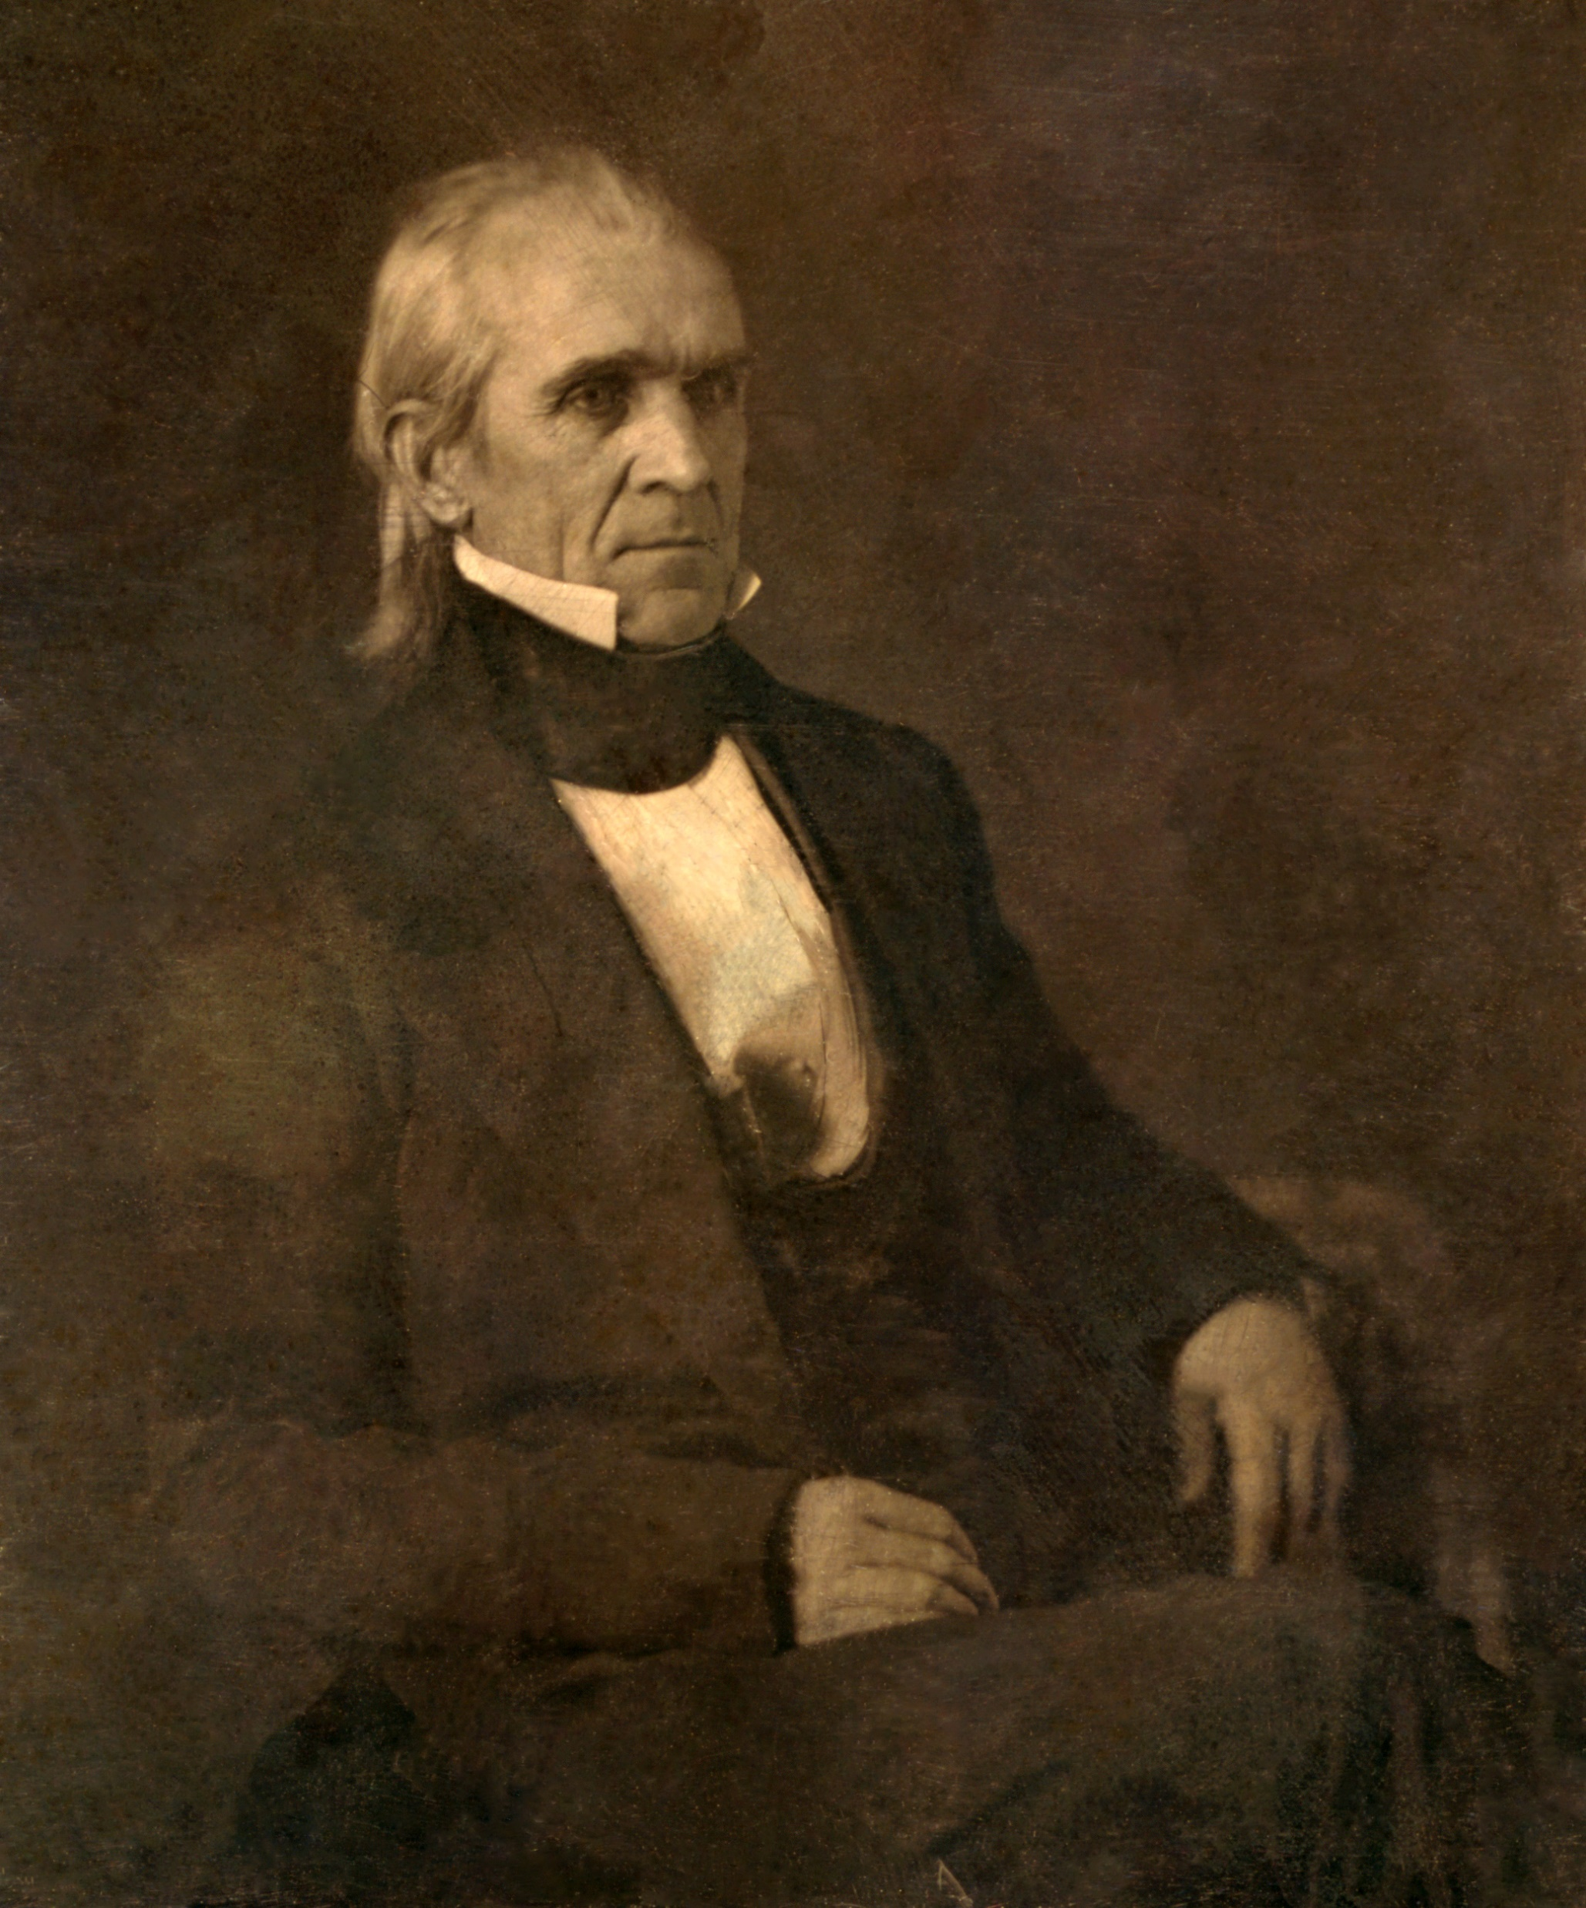
Often referred to as the first “dark horse,” James K. Polk was the 11th President of the United States from 1845 to 1849, the last strong President until the Civil War.
Often referred to as the first “dark horse” President, James K. Polk was the last of the Jacksonians to sit in the White House, and the last strong President until the Civil War.
He was born in Mecklenburg County, North Carolina, in 1795. Studious and industrious, Polk was graduated with honors in 1818 from the University of North Carolina. As a young lawyer he entered politics, served in the Tennessee legislature, and became a friend of Andrew Jackson.
In the House of Representatives, Polk was a chief lieutenant of Jackson in his Bank war. He served as Speaker between 1835 and 1839, leaving to become Governor of Tennessee.
Until circumstances raised Polk’s ambitions, he was a leading contender for the Democratic nomination for Vice President in 1844. Both Martin Van Buren, who had been expected to win the Democratic nomination for President, and Henry Clay, who was to be the Whig nominee, tried to take the expansionist issue out of the campaign by declaring themselves opposed to the annexation of Texas. Polk, however, publicly asserted that Texas should be “re-annexed” and all of Oregon “re-occupied.”
The aged Jackson, correctly sensing that the people favored expansion, urged the choice of a candidate committed to the Nation’s “Manifest Destiny.” This view prevailed at the Democratic Convention, where Polk was nominated on the ninth ballot.

Slide 48
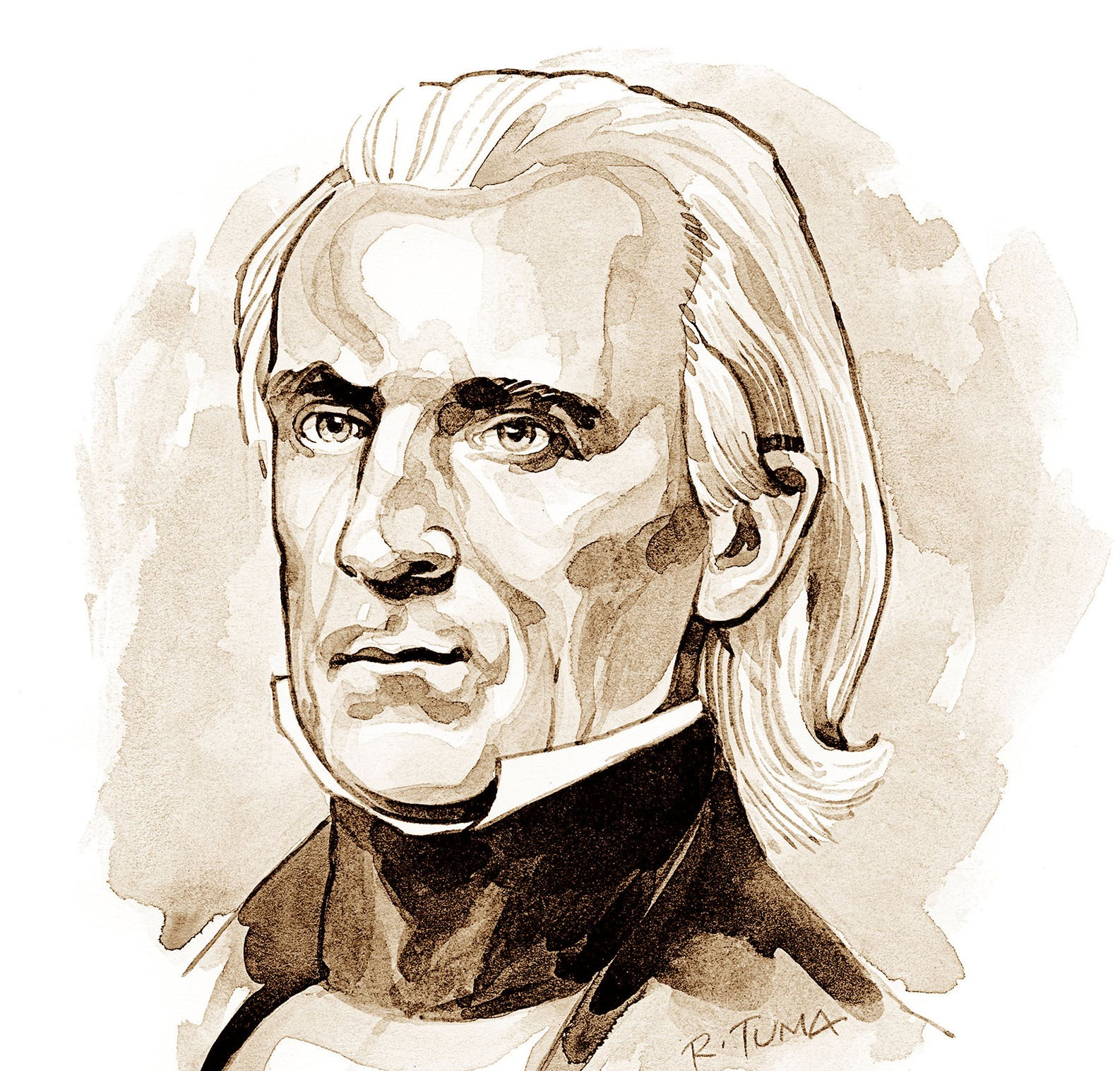
“Who is James K. Polk?” Whigs jeered. Democrats replied Polk was the candidate who stood for expansion. He linked the Texas issue, popular in the South, with the Oregon question, attractive to the North. Polk also favored acquiring California.
Even before he could take office, Congress passed a joint resolution offering annexation to Texas. In so doing they bequeathed Polk the possibility of war with Mexico, which soon severed diplomatic relations.
In his stand on Oregon, the President seemed to be risking war with Great Britain also. The 1844 Democratic platform claimed the entire Oregon area, from the California boundary northward to a latitude of 54’40’, the southern boundary of Russian Alaska. Extremists proclaimed, “Fifty-four forty or fight,” but Polk, aware of diplomatic realities, knew that no course short of war was likely to get all of Oregon. Happily, neither he nor the British wanted a war.
He offered to settle by extending the Canadian boundary, along the 49th parallel, from the Rockies to the Pacific. When the British minister declined, Polk reasserted the American claim to the entire area. Finally, the British settled for the 49th parallel, except for the southern tip of Vancouver Island. The treaty was signed in 1846.
Acquisition of California proved far more difficult. Polk sent an envoy to offer Mexico up to $20,000,000, plus settlement of damage claims owed to Americans, in return for California and the New Mexico country. Since no Mexican leader could cede half his country and still stay in power, Polk’s envoy was not received. To bring pressure, Polk sent Gen. Zachary Taylor to the disputed area on the Rio Grande.
To Mexican troops this was aggression, and they attacked Taylor’s forces.
Congress declared war and, despite much Northern opposition, supported the military operations. American forces won repeated victories and occupied Mexico City. Finally, in 1848, Mexico ceded New Mexico and California in return for $15,000,000 and American assumption of the damage claims.
President Polk added a vast area to the United States, but its acquisition precipitated a bitter quarrel between the North and the South over expansion of slavery.
Polk, leaving office with his health undermined from hard work, died in June 1849.
The Presidential biographies on WhiteHouse.gov are from “The Presidents of the United States of America,” by Frank Freidel and Hugh Sidey. Copyright 2006 by the White House Historical Association.

