Slide 1
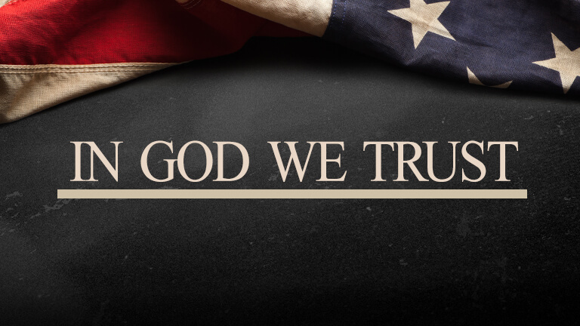
“Hold the Rope” Camp Meeting
Germany December 2020 – January 2021
"In God We Trust" - Tess Lambert 30.12.2020
FIN1844

Slide 2
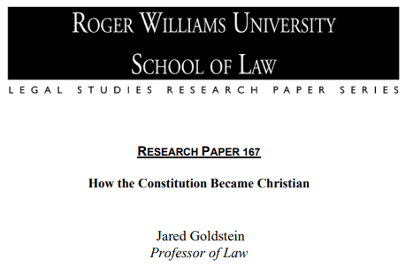
About a week ago two documents were shared on the ‘Media Broadcast.’ The first one was How the Constitution Became Christian; the second is called Church and State in The Early Republic. It's the first document that's the focus of our attention. The second document will help to give some context to the first. So, what we're going to do is work through that first document and supplement that history with other documents so we can build a broader picture of particularly Evangelical history.
I say this at the beginning of every presentation, what we are teaching in these classes, in this class, is built directly upon what we have been studying since May, through other camp meetings and particularly the last presentation, it's all one continuing theme.
If we aren't familiar with those presentations, this one will be much harder to follow, we are building up on these studies.

Slide 3
144,000
1989
9/11
F
SL
COP
2AD
IoK
144K
LC
2019
Priests
1989
9/11
2014
2021
F
IoK
May-Sept
“Apis Bull”
I always try to begin by trying to show where we are on our reform line, so a little revision, 1989, 2001, ‘Sunday law,’ ‘Close of Probation,’ and ‘Second Advent.’ That's the line of the 144,000 and we know where we are. But we're also on another line of the priesthood. First fractal, and we discussed fractals a few weeks ago on a Sabbath series. We understand ourselves on this fractal to be in the ‘Time of Trouble,’ (‘TT’) that's easy to imagine, between the ‘Increase of Knowledge’ (‘IoK’) and the ‘Formalization.’ But we're between the ‘IoK’ and the ‘Formalization’ on two different reform lines at the same time. If you trace the presentations you can see them weaving between these two thoughts, that we are bracing ourselves for two different distinct ‘formalizations.’ We stand here, heading towards the formalization of the priests for the Second Advent, and very soon after that we reach the ‘formalization’ that's designed to prepare us for the ‘Sunday law.’ This ‘IoK’ was particularly May to September this year and it is the Apis Bull study, as that developed in Oceania between May and September. But it continues to grow to swell.

Slide 4
144,000
1989
9/11
F
SL
COP
2AD
IoK
144K
LC
2019
Priests
1989
9/11
2014
2021
F
IoK
α
ῼ
May-Sept
“Apis Bull”
Sabbath
Marriage
At the French camp meeting, the point was made that we have two institutions established in Eden, two institutions God has had to reestablish before the next Eden, the Sabbath and marriage.
There are two histories for ‘Modern Israel,’ ‘Alpha’ and ‘Omega’ and what is happening is there is a re-establishment of the Sabbath in our ‘Alpha’ history, and a re-establishment of marriage in our ’Omega’ history. So, if the Millerites had done their job properly we would have understood the Sabbath, gone to Heaven, sorted marriage out in a thousand years. But that didn't work so we do it on Earth, the Sabbath and marriage, twin institutions.

Slide 5
144,000
1989
9/11
F
SL
COP
2AD
IoK
144K
LC
2019
Priests
1989
9/11
2014
2021
F
IoK
α
ῼ
May-Sept
“Apis Bull”
Sabbath
Marriage
So, all of Adventism looking at the Sabbath, in 2015 they decided not to ordain women and at the same time they opposed gay marriage, you can see they have an issue with marriage and they're not doing well with the second institution. The same as ‘Ancient Israel,’ they grabbed hold of the Sabbath, that's their focus of attention when Christ comes back. In fact, they know this so well they make sure that they kill Him before the Sabbath starts, because you wouldn't want to break the Sabbath by killing God on it. So, you're going to kill Him on Friday, get all your work done before the sun sets. So, you have this acceptance of Sabbath issue with marriage.

Slide 6
144,000
1989
9/11
F
SL
COP
2AD
IoK
144K
LC
2019
Priests
1989
9/11
2014
2021
F
IoK
α
ῼ
May-Sept
“Apis Bull”
Sabbath
Marriage
Someone in the chat is talking about the thousand years, if someone doesn't think it's going to take a thousand years to sort out this problem, I would suggest inequality runs that deep. I'm at the point of thinking this is going to take a thousand years; I didn't think we'd be at this stage in two years. I thought many more people would get it so I wouldn't be surprised by a thousand years. I hope that we're excited at the thought of how much we still have to learn, entire subjects that perhaps God doesn't think we're ready for yet.

Slide 7
144,000
1989
9/11
F
SL
COP
2AD
IoK
144K
LC
2019
Priests
1989
9/11
2014
2021
F
IoK
α
ῼ
May-Sept
“Apis Bull”
Sabbath
Marriage
I said that to make one point, this ‘IoK’, this ‘formalization’ is the training of the first group to go to work and we're teaching people about marriage. So this subject of marriage is the key concept of the message in each history from the ‘formalization’ of the ‘Midnight Cry,’ to our ‘IoK’ and ‘formalization,’ and it will continue to be as we approach the Sunday law. This ‘IoK’ from May to September, it's also important to be watching the studies in Wales. It was neither planned nor a coincidence that the theme of the studies in Wales have been on marriage from the beginning, addressing some practical issues connected with this message.

Slide 8
1798
144,000
1989
9/11
F
SL
COP
2AD
IoK
144K
LC
2019
Priests
1989
9/11
2014
2021
F
IoK
α
ῼ
Sabbath
Marriage
May-Sept
“Apis Bull”
Whether it's that series in Wales on marriage or the Apis Bull, we've been preparing for that thousand years. What the Apis bull series started with in May, it was meant to be a study that brought us to Millerite history, and it has done that, but I kept getting sidetracked. Because as we began in 1798 there were other themes that we were tracing. What began to happen was instead of focusing just on Millerite history, we could see that there was a thread of Protestantism connecting 1798 to the present day. I'll describe it this way, when was the ‘Time of the End?’ 1798, so Ellen White is able to say, even when she's outside of a reform line that she's in the ‘Time of the End.’

Slide 9
1798
144,000
1989
9/11
F
SL
COP
2AD
IoK
144K
LC
2019
Priests
1989
9/11
2014
2021
F
IoK
α
ῼ
Sabbath
Marriage
May-Sept
“Apis Bull”
Elder Parminder has taught all of this, when you look at the ‘Time of the End’ (‘ToE’) you can see it structurally as 1798 or 1989, dates that begin a reform line, but the way you'll find Ellen White use that phrase is that the ‘ToE’ began in 1798 and extends all the way to the Second Advent. So humanity has been in the ‘ToE’ since 1798. You can use it two different ways. Ellen White doesn't have visibility of Daniel 11:40 part B as being 1989. She has no visibility of World War II let alone 1989. She's going to use that phrase as 1798 extending all the way to the Second Advent.

Slide 10
1798
144,000
1989
9/11
F
SL
COP
2AD
IoK
144K
LC
2019
Priests
1989
9/11
2014
2021
F
IoK
α
ῼ
Sabbath
Marriage
May-Sept
“Apis Bull”
So, we can see it structurally, but this progressive thought also makes sense. The ‘ToE’ does not start and then it ceases to be the ‘ToE.’ If 1798 is the ToE’ and this is the Second Advent, then how can all this not be the ‘ToE’? Because otherwise what end is it talking about? I'm going to use the second concept that we've been in the ‘ToE’ since 1798. This is a history that is prophetically loaded; the Second Great Awakening, Millerite history, the Civil War, all the history leading up to World War I, World War II, and the Cold War. There is so much happening, the formation of the modern European countries, the fall of monarchy, the introduction of communism, all these events occurred in the ‘ToE.’

Slide 11
1798
144,000
1989
9/11
F
SL
COP
2AD
IoK
144K
LC
2019
Priests
1989
9/11
2014
2021
F
IoK
α
ῼ
Sabbath
Marriage
May-Sept
“Apis Bull”
And before God gave us prophetic glasses, we would not have seen World War I or World War II as having anything to do with a ‘Great Controversy’ which makes no sense. And as we understand this ‘ToE’ prophetically, we see that all of this has everything to do with the ‘Great Controversy’ as both sides prepare for the end.

Slide 12
1798
1888
2nd Adv.
144,000
1989
9/11
F
SL
COP
2AD
IoK
144K
LC
2019
Priests
1989
9/11
2014
2021
F
IoK
May-Sept
“Apis Bull”
To break down this history, this fight, God has given us different parabolic structures, different models to break down this history and help us make sense of it, different structures with different themes to make different points. I want to give three brief examples, we can look at this history of the ‘ToE’ and how we usually go to that history would be to say ‘Alpha’ history, the 1888 history, and ‘Omega’ history. That's all quite neat; failure, failure, success. Egypt, Babylon Rome, it's rock solid. And you see the interaction in these histories between Adventism and Protestantism dealing with the issues of inequality in both the ‘Alpha’ and ‘Omega.’

Slide 13
1798
1888
1989
2nd Adv.
WW
2001
144,000
1989
9/11
F
SL
COP
2AD
IoK
144K
LC
2019
Priests
1989
9/11
2014
2021
F
IoK
May-Sept
“Apis Bull”
But it's not the only structure that God gives us to break down the ‘ToE’; we have the lines of the counterfeit. So over this we can see that Satan counterfeited the ‘Alpha’ history, attempting to, it took him until the 1888 history with the world wars, then 1888 -1989, and then our history from 2001, this is the counterfeit. So it's going to break down the “ToE’ even more. God is giving us more models to try and help us see the ‘Great Controversy’ in the “ToE’, in the history since 1798.

Slide 14
1798
1888
1989
2nd Adv.
WW
2001
144,000
1989
9/11
F
SL
COP
2AD
IoK
144K
LC
2019
Priests
1989
9/11
2014
2021
F
IoK
May-Sept
“Apis Bull”
We won't be using either of those models in this camp meeting. The model that we will use was introduced last year and it was developed from our understanding of 2014 as ‘midnight,’ ‘midway’ or a ‘midpoint.’ The title for those studies was called “In God We Trust.” And through two methods a study was developed that highlighted the 1860s to 1900s time period, the 1940s and 1950s and 1979 to present.

Slide 15
Brazil SOTP 2019
Here we have the lines drawn out from “In God We trust” that was taught, showing us the beginning of the National Reform Movement, we know what that led to, next the 1940s and 50s and then 1979 to present. We were taken to those three histories from using 2014 as ‘Midway’ and prophetic time spans. From 2014 the ‘151’ takes us to the beginning of the National Reform Movement. And the ’63’ takes us to the epicenter of the 1950s crisis.
151
63
Cnidus
11/9/
2019
*151
9/11
2001
2014
1863
1861
1865
1952
1954
1956
tarry
2017
.
Recognize
God on coins
In God We Trust
National Reform Movement
Engraved on coins
Eisenhower
Pledge of allegiance
‘under God’
Official motto
USA
In God We Trust
Public Schools
Mississippi
AR
Act 911
*151
6 months
N ª Union
Republicans
S ª Confederate
Democrats
Apr 19
July 21
Oct 22
3
3
.
The third model, I'm sure there are more, the third I've mentioned today is this model that highlighted three time periods where there was an Evangelical movement to change the United States, to mobilize political power, and whatever came with that. We may tend to think of that it's just being a ‘Sunday law.’

Slide 17
1798
1888
1989
2nd Adv.
WW
2001
144,000
1989
9/11
F
SL
COP
2AD
IoK
144K
LC
2019
Priests
1989
9/11
2014
2021
F
IoK
May-Sept
“Apis Bull”
So coming back to our line, the ‘Increase of Knowledge’ of the ‘Sunday law’ is 2019. We've already said these waymarks are time periods, May to September for us. When did the ‘Increase of Knowledge’ on the 144,000 line begin in 2019? When did the ‘Increase of Knowledge’ of the Sunday law begin? I would suggest it started in February.

Slide 18
1798
1888
1989
2nd Adv.
WW
2001
144,000
1989
9/11
F
SL
COP
2AD
Feb-Aug
IoK
144K
LC
2019
Priests
1989
9/11
2014
2021
F
IoK
May-Sept
“Apis Bull”
What did we see in February? February was the Brazilian camp meeting and that's when I would mark the beginning of the ‘Increase of Knowledge’ for the ‘Sunday law.’ I would say February to August, you could say September. In August what we're teaching is equality, it's reached that point and we know there's no ‘Sunday law.’ But I would suggest our understanding in February began to transform our idea of the ‘Sunday law.’ Because what were we teaching at that camp meeting?

Slide 19
1798
1888
1989
2nd Adv.
WW
2001
144,000
1989
9/11
F
SL
COP
2AD
Feb-Aug
IoK
144K
LC
2019
Priests
1989
9/11
2014
2021
F
IoK
May-Sept
“Apis Bull”
What I find so fascinating is it didn't begin by taking us to slavery to change our idea of the ‘Sunday law’, that was August. In February where did it take us? It took us to 1888 and it told us that Adventism which is us, does not understand 1888 history. Most of that camp meeting I was reading quotes of AT Jones showing that we did not correctly understand what he fought for. If Adventism, us, understood 1888 how would we have stood on gay marriage in 2015? That was all said in February. So, this ‘Increase of Knowledge’ is going to radically change our understanding of the ‘Sunday law,’ not in the Adventist understanding that there is this structure, but what it looks like.

Slide 20
1798
1888
1989
2nd Adv.
"Mr. Corliss.-I reside in this city, sir, with my family. I speak in behalf of the Seventh-day Adventist church in Washington, of which I am, at present, the pastor; as a citizen of the United States; and as a resident of this District. I appear, not as has been affirmed before you, to speak in behalf of a Saturday Sabbath. Far from it, Gentlemen of the Committee. If this bill, No. 3854, were to have incorporated into it, instead of 'Sunday, or the first day of the week,' the words, 'Saturday, or the seventh day of the week,' there is no one who would oppose it stronger than I. (1892 ATJ, DPL 63.8)
144,000
WW
2001
1989
9/11
F
SL
COP
2AD
Feb-Aug
IoK
144K
LC
Priests
2019
1989
9/11
2014
2021
F
IoK
May-Sept
“Apis Bull”
God is going to begin that work by taking us to 1888 history not to Millerite history. Making the point in quote after quote that Adventism does not understand the external of 1888. We read the quote of AT Jones who stood in Congress and said, if you were trying to propose a bill that defended the Saturday Sabbath, we would oppose it just as strongly as we oppose the Sunday law. (paraphrase) And that is not the approach that Adventism takes to government today.

Slide 21
1798
1888
1989
2nd Adv.
144,000
WW
2001
1989
9/11
F
SL
COP
2AD
Feb-Aug
IoK
144K
LC
Priests
2019
1989
9/11
2014
2021
F
IoK
May-Sept
“Apis Bull”
So our ‘Increase of Knowledge’ of the ‘SL’ takes us to 1888. It was this ‘Increase of Knowledge,’ it was not saying we understand 1888 but we’ve forgotten Millerite history, it was saying we don't understand 1888 and we forgotten slavery. We didn't even know the Civil War was part of the ‘Great Controversy.’ So we're having to go through this, what is really quite a steep ‘Increase of Knowledge.’

Slide 22
1798

SL
2nd Adv.
Jedediah
Morse
Priests
2019
1989
9/11
2014
2021
F
IoK
May-Sept
“Apis Bull”
As we go into the study of this camp meeting, we're not going back to discuss Millerite history, slavery. We were trying to do that in May to September, but we kept getting redirected when we began looking at Jedediah Morse and the split within Protestantism. I want to give one example of how we misunderstand. As we get closer to the ‘SL’ it stands out in more and more detail. Back here it's okay to say that Protestantism will do something. As we get closer, and the message refines that is far too broad of a statement.

Slide 23
1798
SL
2nd Adv.
Jedediah
Morse
Priests
2019
1989
9/11
2014
2021
F
IoK
May-Sept
“Apis Bull”
An example: What is your perspective of the World Council of Churches? What I understood is that this World Council of Churches, a sign of the end times as Protestants came together with this deep state agenda to introduce a ‘SL’ into the United States. We ignore the split within Protestantism and the fact that many of these Protestants who would call themselves fundamentalists, oppose the World Council of Churches, calling it too liberal. That this World Council of Churches is as evil to them as the UN, so they formed the International Council of Churches.

Slide 24
1798
SL
2nd Adv.
Jedediah
Morse
Conservative
Liberal
Adventism
Priests
2019
1989
9/11
2014
2021
F
IoK
May-Sept
“Apis Bull”
So Adventism sees these liberal Protestants, they think we're going to oppose these liberal Protestants, we see the UN, we see the World Council of Churches (‘WCC’) so we'll stand apart from that and we'll reject the UN and will reject the ‘WCC’. Instead of standing apart all we did was align ourselves with conservative Protestantism, who sees the great threat is globalism, the UN and the ‘WCC’. We have not stood separate to Protestantism; all we did was align ourselves with one stream of Protestantism. And like conservative Protestantism we stand here looking at the liberals for the threat who we think will institute the ‘SL’. This warped worldview, it's just repeating the mistake of ancient Israel.

Slide 25
1798
SL
2nd Adv.
Jedediah
Morse
Conservative
Liberal
So we need to understand 1888 history and trace Protestantism back from the ‘Time of the End.’ We're going to do that particularly with that first document. We'll supplement this document with three other sources. The first source is The Church and State in The Early Republic. The Second source we will supplement with will be some references to AT Jones. The third source is a book called The Evangelicals: The Struggle to Shape America by Francis Fitzgerald. I have this as an audio book, I don't have time to read but as an audio book it's almost 26 hours and I have not finished. But it's a very in-depth look at Protestantism, particularly beginning in detail from the Second Great Awakening. It's titled The Evangelicals: The Struggle to Shape America. It's difficult to reference an audio book of that size so you may find me just making statements of fact such as Billy Graham was a fundamentalist where I won't necessarily prove it because the laid-out evidence is in a 26-hour audio book. It's published in April of 2017. So, it's particularly these three other reference materials we will use.

Slide 26
1798
SL
2nd Adv.
Jedediah
Morse
Conservative
Liberal
There's also much more information in articles and YouTube videos. Just as a disclaimer, we will have to simplify and whenever you simplify people can get a little frustrated, that they don't think you're going far enough to see the real picture. But I would suggest we always need to cut away the mud. However, much we need to simplify, there's quite a simple and consistent thread that we are tracing.
144,000
1989
9/11
F
SL
COP
2AD
Feb-Aug
IoK
144K
LC
Priests
2019
1989
9/11
2014
2021
F
IoK
May-Sept
“Apis Bull”

Slide 27
I'm going to summarize. We have been in the ‘Time of the End’ since 1798, it is a loaded history and we have not realized how much of that history is the final struggles of the ‘Great Controversy,’ the prophetic nature of those events, from the Civil War to World War II, to Reagan who we can see more clearly.
144,000
1989
9/11
SL
COP
2AD
Feb-Aug
IoK
F
144K
LC
Priests
2019
1989
9/11
2014
2021
F
IoK
May-Sept
“Apis Bull”
α
ῼ
Sabbath
Marriage
We are in the final events of the final events, God has brought ‘Modern Israel’ to the same point as ‘Ancient Israel,’ Adventism is failing in their ‘Omega’ history. He has the people he's training; we stand heading towards two formalizations, we have been through the ‘Increase of Knowledge,’ we have the formalization of the priests to come and the formalization of the ‘SL.’ As we approach the ‘SL’ it's standing out with more and more clarity, as God gives us different models to break down past history leading to future history.

Slide 28
We looked at just three different models, Millerite, 1888, 144,000, the study of the counterfeit. But then it's this third model “In God We Trust,” showing us regardless of what Adventism is doing, three Protestant movements from the 1860s, 1950s and present.
144,000
1989
9/11
SL
COP
2AD
Feb-Aug
IoK
F
144K
LC
Priests
2019
1989
9/11
2014
2021
F
IoK
α
ῼ
May-Sept
“Apis Bull”
Sabbath
Marriage
That's all an introduction to the first document because this first document, the introduction, first page, third paragraph "this article illustrates the dynamics that transform conflicts over national identity into constitutional conflicts by examining three movements in the long-standing debate over whether the United States should be understood as a Christian Nation. The 19th century Christian Amendment Movement, mid 20th century Judeo-Christian nationalism, and the new Christian right that began in the 1970s and '80s."

Slide 30
So, it's going to take us back to 1888 history then the 1950s and then the present day. An external source, perfectly validating our message. I want us to look into the author just for a moment. The author is Jared A. Goldstein. Professor Goldstein was one of the first civilian lawyers allowed into Guantanamo Bay.
144,000
1989
9/11
SL
COP
2AD
Feb-Aug
IoK
F
144K
LC
Priests
2019
1989
9/11
2014
2021
F
IoK
α
ῼ
May-Sept
“Apis Bull”
Sabbath
Marriage
He represented several Kuwaiti detainees in Guantanamo Bay. His involvement with those Guantanamo cases, his defense of them led all the way to the Supreme Court. He's a national expert on Habeas Corpus. So, he's a lawyer, a professor, he's particularly known through his fight against Guantanamo Bay, for the constitutional rights of several of the inmates, he's authored numerous briefs for the Supreme Court, he’s nationally recognized, he regularly publishes in the highest law journals and he is a teacher of constitutional law. That's the status of the man who wrote How The Constitution became Christian. This is not a law student writing for an exam.

Slide 31
You go through the other articles he's written, in 2018 The Ku Klux Klan's Constitution. In 2018 another article, Unfit for the Constitution, Nativism and the Constitution From the Founding Fathers to Donald Trump. In that article he's tracing nationalism from the beginning of the United States to Donald Trump, this article is from 2017.
144,000
1989
9/11
SL
COP
2AD
Feb-Aug
IoK
F
144K
LC
Priests
2019
1989
9/11
2014
2021
F
IoK
May-Sept
“Apis Bull”
In 2014 The American Liberty League and the Rise of Constitutional Nationalism. In 2011 he's writing about The Constitution and the Tea Party Movement. We've discussed how the tea party led to Donald Trump. So, he's written, that's just a few of them, some fascinating articles and he's not someone unrecognized or untrained. He's defended constitutional rights through Guantanamo Bay all up to the Supreme Court.

Slide 32
144,000
So we're going through his 2017 document, How the Constitution Became Christian. That's just our introduction to this document. Last year we were given a model that looked at three Evangelical movements. This document does the same, it looks at the same three movements but it's going to expand our understanding of that history. It's not enough to know there will be a ‘SL.’
1989
9/11
SL
COP
2AD
Feb-Aug
IoK
F
144K
LC
Priests
2019
1989
9/11
2014
2021
F
IoK
May-Sept
“Apis Bull”
Adventism stands on the train tracks looking for the World Council of Churches and the UN to do something and not realizing that conservative evangelicalism has had a 41-year head start while we were putting our boots on. If we want to understand this modern history, putting aside the 1950s, Adventists know to lift up 1888, so we should understand it. We'll come back to this document in our next study. We'll go through certain portions and address each one of these three movements and add in some surrounding context.

Slide 33
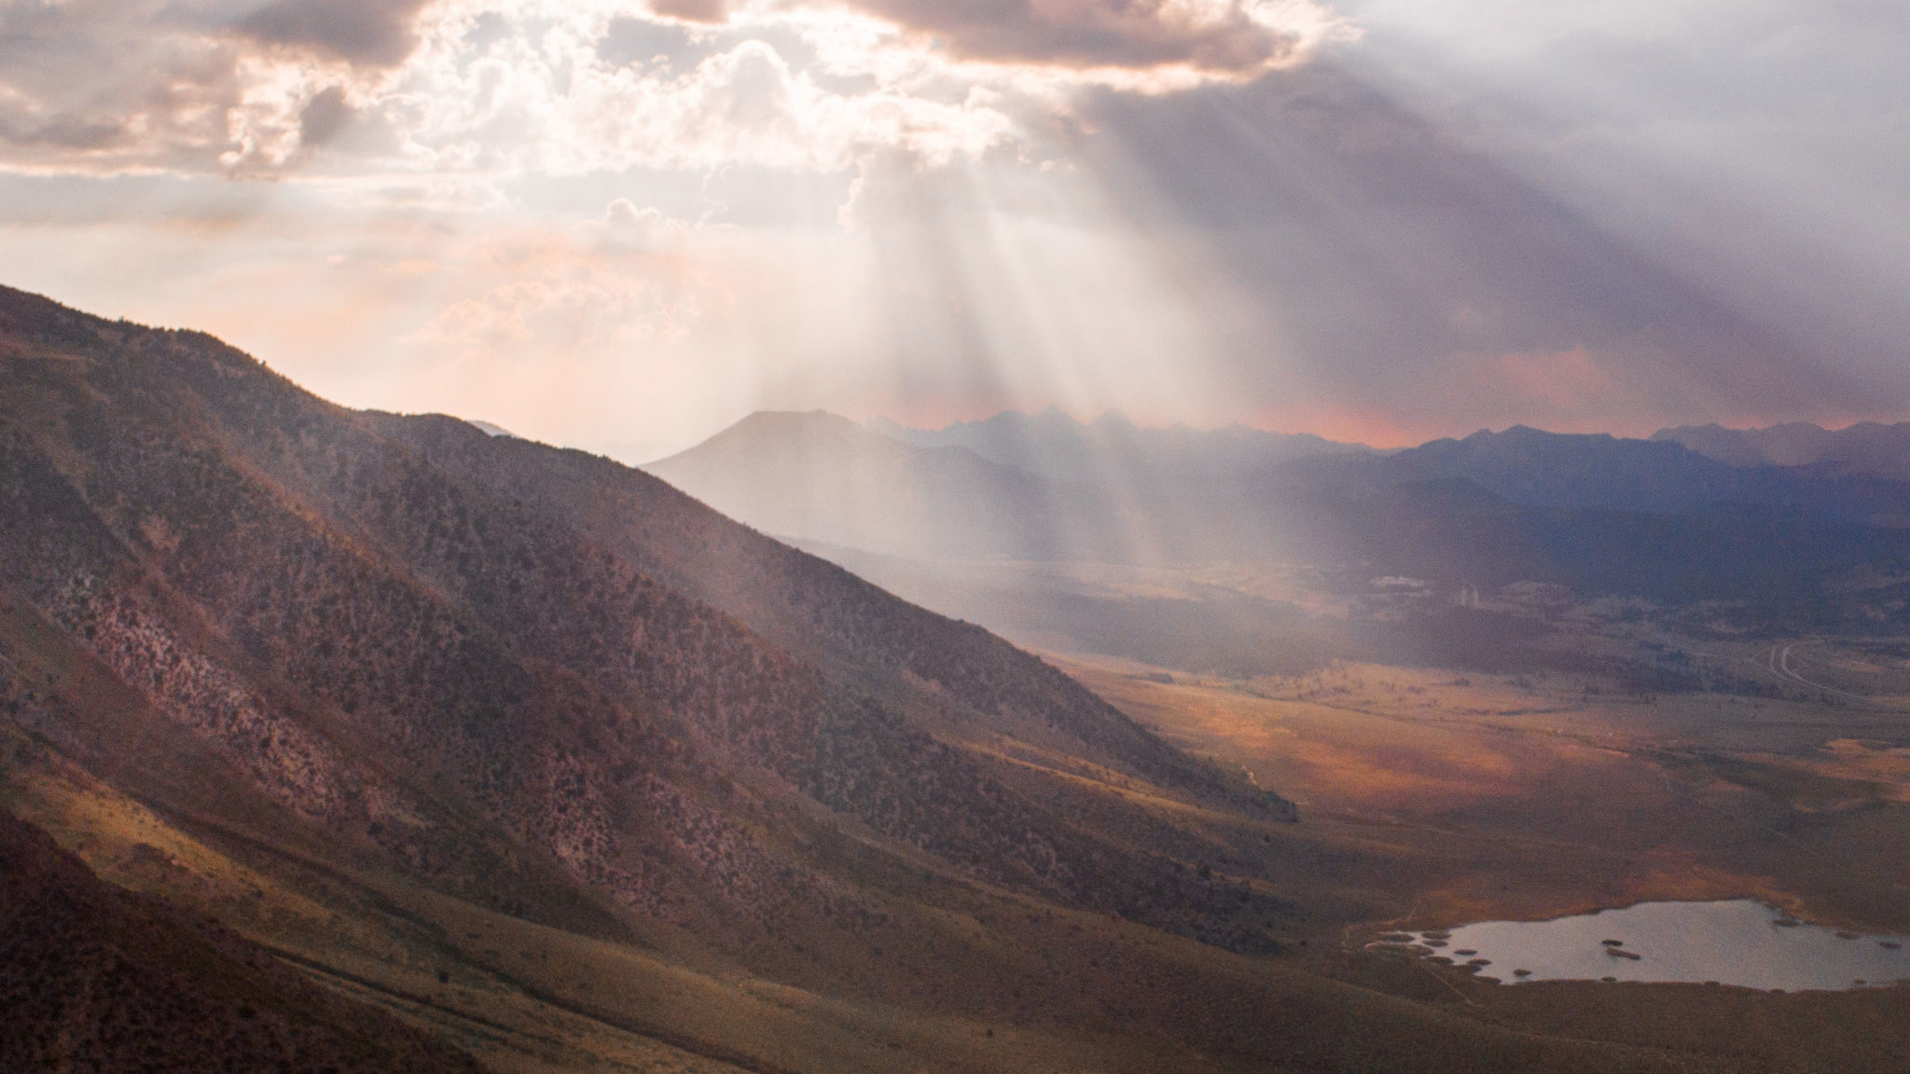
If you’ll kneel with me, we’ll close in prayer.
Dear Lord, thank you for how you have been opening our eyes, we see more clearly the curtain withdrawn in this great struggle. I pray Lord that we will see it more clearly, not just in the details, the facts of the matter. May we not lose sight of the point of this war, the fight over a human soul and the value of that soul. May that cause each one of us to live and act correctly. I pray this in Jesus' name, Amen

