Slide 1
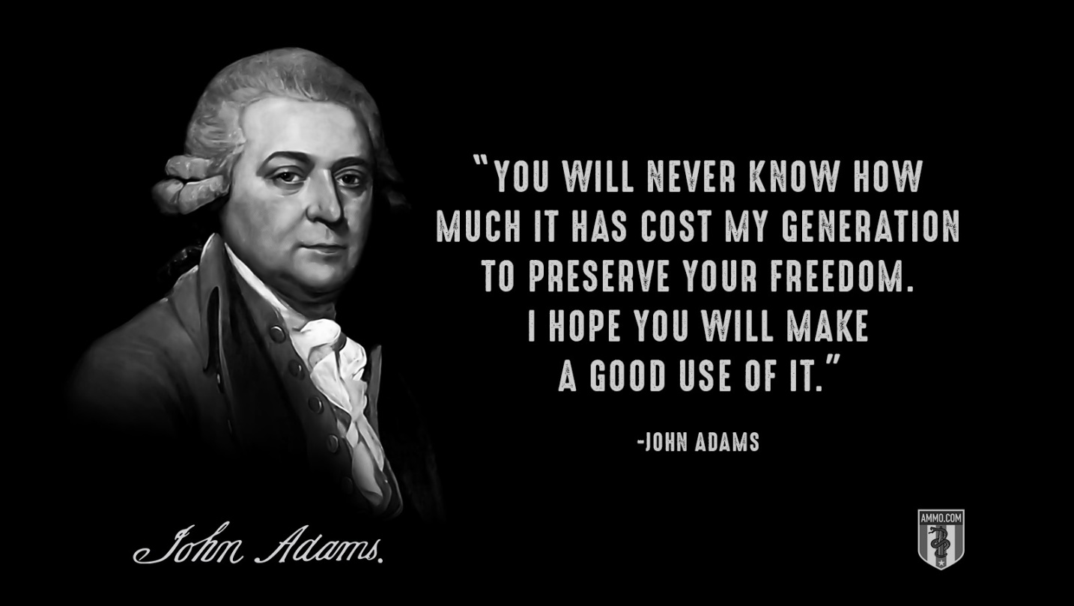
Freedom In America
Introduction to Documents of Freedom Part 1: Unit Overview
08/20/2019
https://www.docsoffreedom.org/units/documents-of-freedom-introduction
Side Note:
The Battle of Yorktown: It is considered the last major land battle of the American Revolutionary War. [The battle ended on October 19, 1781.] The Continental Army, led by General George Washington [and French army troops led by the Comte de Rochambeau], won a decisive victory against the British Army, led by General Lord Charles Cornwallis. ... The battle took place in Yorktown, Virginia, near the York River. Reference from Wikipedia

