Slide 1
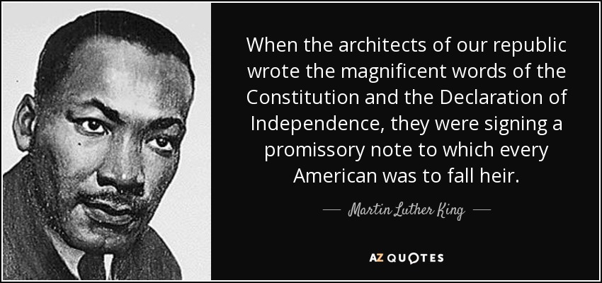
Freedom In America
Introduction to Documents of Freedom Part 2: Civic Virtue and Our Constitutional Republic
08/27/2019
https://www.docsoffreedom.org/student/readings/civic-virtue-and-our-constitutional-republic
Civic virtue is the cultivation of habits important for the success of the community. Closely linked to the concept of citizenship, civic virtue is often conceived as the dedication of citizens to the common welfare of their community even at the cost of their individual interests. The identification of the character traits that constitute civic virtue has been a major concern of political philosophy. The term civility refers to behavior between persons and groups that conforms to a social mode (that is, in accordance with the civil society), as itself being a foundation of society and law.
Reference from Wikipedia

