Slide 1
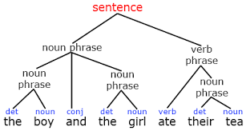
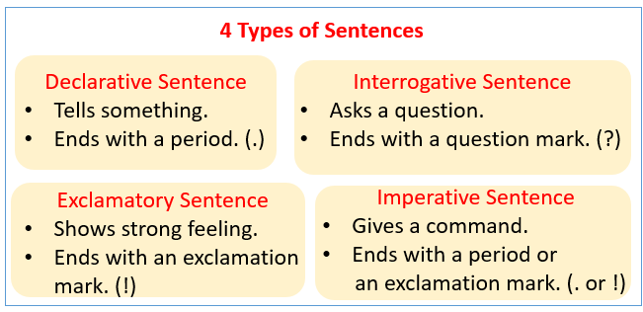
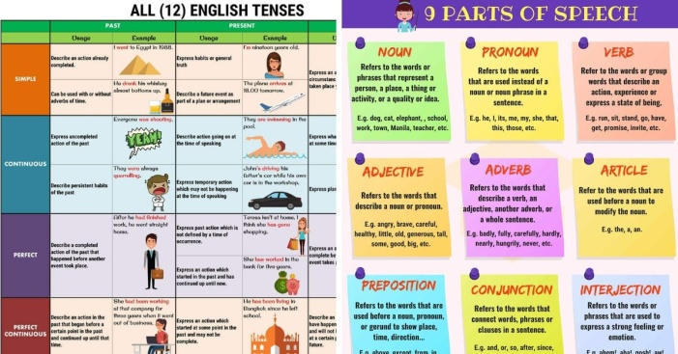
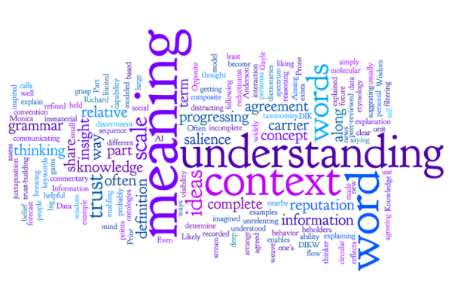
90% Written Word
Written word: Language expressed in writing… Formal writing as a way of expressing ideas, emotions, etc. opposed to speaking.
Semantics: The meaning of word, phrase, sentence, or text.
Grammar: The set of structural rules governing the composition of clauses, phrases, and words in a natural language
Punctuation: is a set of marks that regulates and clarifies the meaning of different text.
Context: The circumstances that form the setting of an event , statement, or idea, and in terms of which can be fully understood and assessed.
Subject and Theme: The Subject of the story is always about what the story is about. Theme of the story is how the meaning of the story is defined.
EX. Subject is love
Theme is love can overcome all obstacles

Slide 2
90% Written Word CONT’
Theme
The main idea or an underlying meaning or message
It’s important not to confuse a theme of literary work with its subject. Subject is a topic that acts as a foundation for a literary work, while a theme is an opinion or fact expressed on the subject.
For example, a writer may choose a subject of war for his story, and the theme may be his personal opinion that war is a curse for humanity.
A writer has to figure out how to express a theme in a way that the reader can understand or figure out. There are four main ways to express a theme in a story:
1. Thoughts and conversations of characters
2. The feelings of characters in a story.
3. The lesson the character(s) learn at the end of the story
4. The actions going on in the story.
Theme is an element of a story that binds together various essential elements of a narrative. It is often a truth that exhibits universality and stands true for people of all cultures. It gives readers a better understanding of the main character’s conflicts, experiences, discoveries, and emotions as they are derived from them. Through themes a writer has to give his readers an insight into how the world works, or how he or she views human life.
Themes are presented in thoughts and conversations of characters because each word is written by the author with good reason. Thoughts that are repeated throughout a story can contribute to feelings of the character, or character…
An author knows that how a character acts or thinks can translate into a message for the audience.

Slide 3
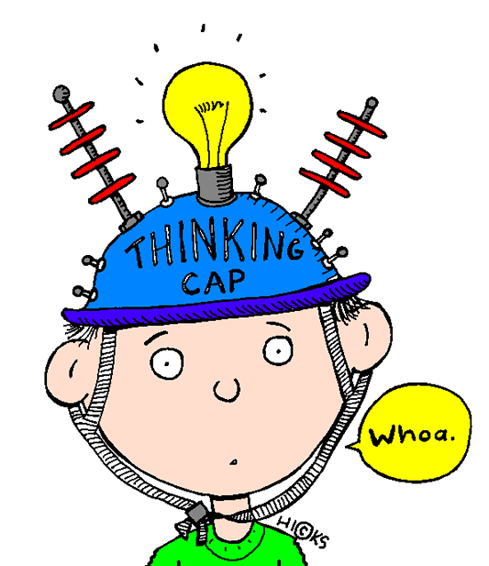
Question ?
1. In understanding the essence of a theme, why do you think God chose the main characters He has in every generation/dispensation to fulfill His specific purposes?
God chooses men and women to express His messages (which includes His thoughts and feelings) about a particular subject or event to others around them.
That particular person is chosen because their life experience, emotions, persona/character—all that has shaped them into the person they are—would best deliver that very message in a way others can understand Him and His ways in His story.
Romans 8:29-30
²⁹ For whom he did foreknow, he also did predestinate to be conformed to the image of his Son, that he might be the firstborn among many brethren.
³⁰ Moreover whom he did predestinate, them he also called: and whom he called, them he also justified: and whom he justified, them he also glorified.
No other person would have the same outcome He desires to express His exact point.
2. What do you call a person who bears a message based on the hope God has given them through victory over trials and affliction?
Psalm 139:13-14
¹³ For thou hast possessed my reins: thou hast covered me in my mother's womb.
¹⁴ I will praise thee; for I am fearfully and wonderfully made: marvellous are thy works; and that my soul knoweth right well.
A Living Parable
Psalm 71:6
⁶ By thee have I been holden up from the womb: thou art he that took me out of my mother's bowels: my praise shall be continually of thee.

Slide 4
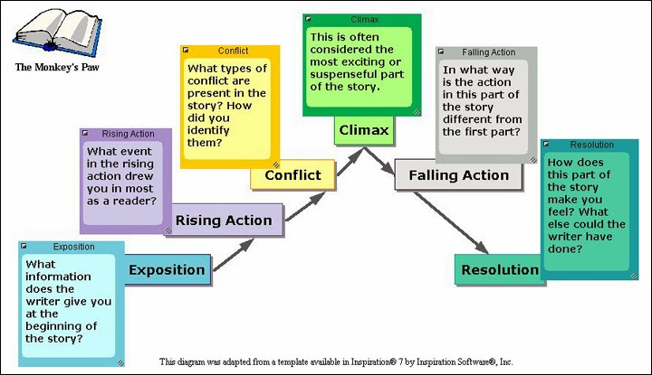
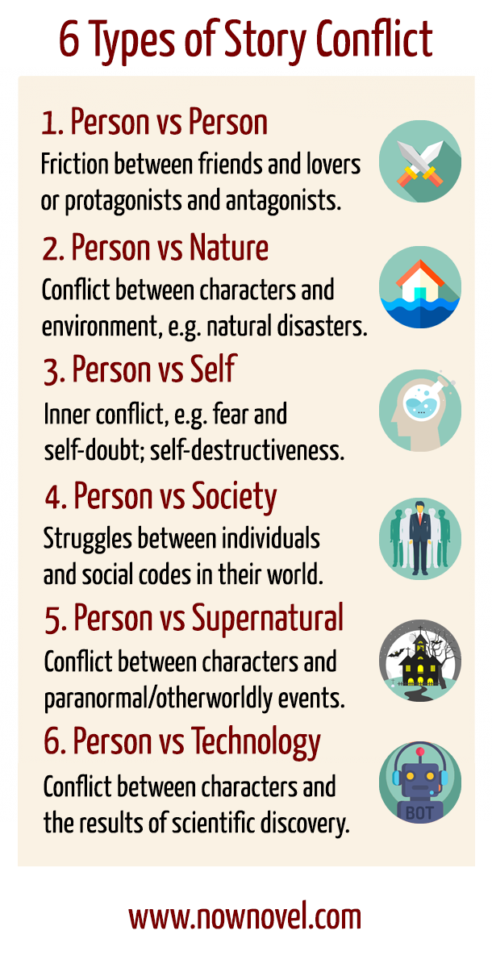
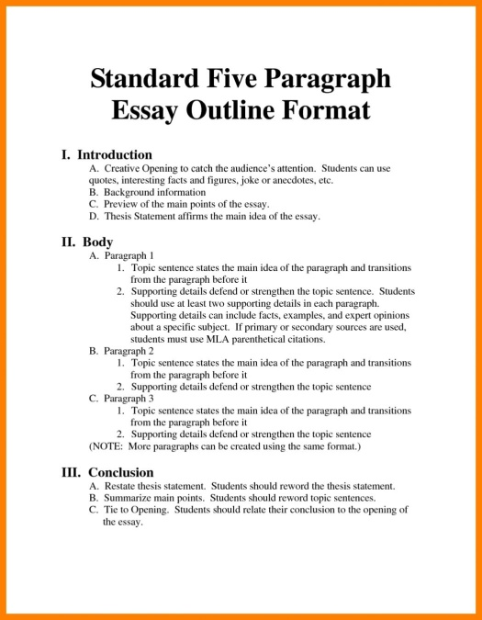
10% Structure and pattern
Format: Basic beginning, middle, and end; Introduction, body, conclusion; Topic, explanation, summary/repeat.
Narrative Structure: The content of the story and the form used to tell the story—The overall design or layout of a story.
Plot: the series of events that make up a story. These events relates to each other in a pattern or a sequence.
Setting: is what establishes the time, place, and setting.
Character: any person, animal, or figure represented in a literary work.
Conflict: involves a struggle between two opposing forces, usually a protagonist and an antagonist.
Climax: Turning point-- Point in the narrative at which the conflict or tension hits the highest peak.
Resolution: The ending—part of the story’s plot where the main problem is resolved or worked out.
Symbolism: Helps to layer meaning within a narrative. Symbols are what readers hold onto long after the story is over.
Pattern Recognition: Allows readers to see the relationships between characters, actions, and ideas within the book and also allows readers to connect a particular literary work to works or ideas outside the story.
Parable: Gives us extra information that we cannot see with just the word itself.

Slide 5
SUMMARY
To understand the mind/thought/idea/view of the author expressed in literature determines that we have read and comprehended the message correctly.
In order for us to obtain the correct understanding, we need to be open to what the author is conveying and laying out before us to see and know.
Properly using the tools—written word and parables—will help us obtain the correct interpretation of the particular literature
Parables gives us extra information that we cannot see with just the written word itself. They help us to understand the in-depth thought/idea behind what is stated.

