Slide 1
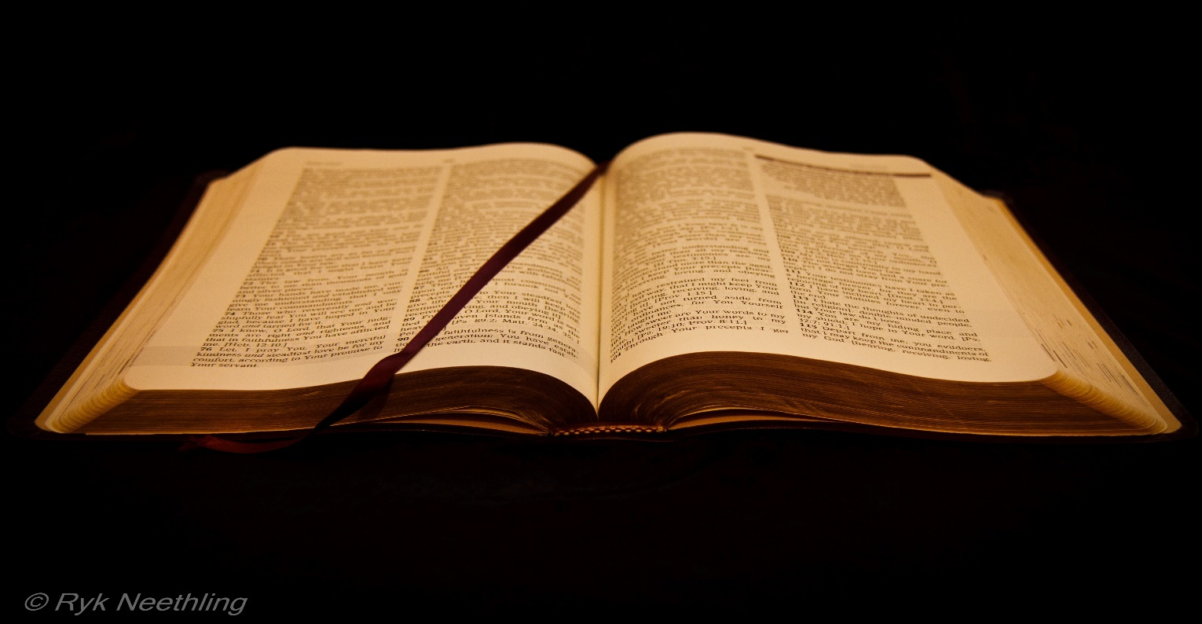
Introduction to Parables
The Thought Behind the Word Understanding the Mind of the Author
https://youtu.be/H-cvgJITTrA

Slide 2
Before one speaks, what do most do?
Think. We usually think before we speak. Before any word is expressed is a thought.
When you pick up a book to read it, what are you preparing yourself to do?
To understand the mind of the author... Behind every literature is an author expressing his/her thoughts and views for the reader to understand him/her and come away with a new idea or thinking on a subject.
God wants us to understand His mind—the way He thinks—and overall Himself. Through His word we have an entrance into the mind of God—His view of every detail revolving around us in relation to Himself and others.
What do we need to do in order to understand the mind or written word of an author?
We need to be open to viewing the author’s thought as he/she views it. Based on that understanding, we choose to agree or disagree with that idea or view
Philippians 2:5 Let this mind be in you, which was also in Christ Jesus
We cannot come to the Word of God and seek to understand it with our own understanding and carnal thinking. Spiritual things are spiritually discerned.
1 Corinthians 2:14 But the natural man receiveth not the things of the Spirit of God: for they are foolishness unto him: neither can he know them, because they are spiritually discerned.

Slide 3
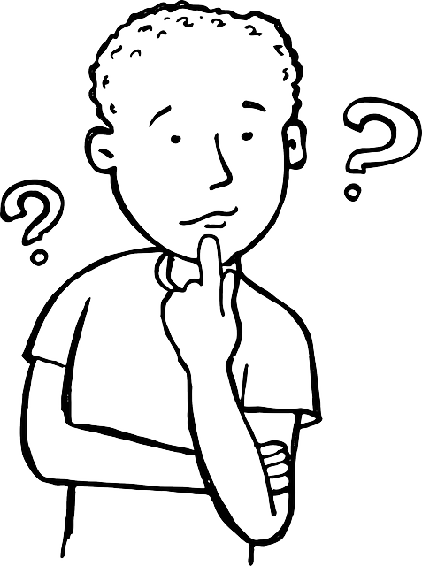
What are the tools used to understand literature? What do we use to understand the author’s mind/thought/idea?
The written word, narrative structure, and pattern recognition.
100%
90%
10%
Written word
Semantics
Grammar
Punctuation
Context
Theme
Subject
Structure
Format
Plot
Setting
Conflict
Resolution
Pattern
Symbolism
Pattern Recognition
The bulk of information needed to understand the point of thought.
Parables helps us to understand the in-depth thought/idea behind what is stated.
PARABLES:
Provides extra information that we cannot see with just the word itself.

