Slide 1
Iranian Revolution
7 January 1978 – 11 February 1979

Slide 2
The Iranian Revolution (Persian: انقلاب ایران‎, romanized: Enqelâbe Irân, pronounced [ʔeɴɢeˌlɒːbe ʔiːɾɒːn]; also known as the Islamic Revolution or the 1979 Revolution)^{[1]} was a series of events that culminated in the overthrow of the Pahlavi dynasty under Shah Mohammad Reza Pahlavi—who was supported by the United States^{[2]}—and the replacement of his government with an Islamic republic under the Grand Ayatollah Ruhollah Khomeini, a leader of one of the factions in the revolt.^{[3]} The revolution was supported by various Islamist and leftist organizations^{[4]} and student movements.
Demonstrations against the Shah commenced in October 1977, developing into a campaign of civil resistance that included both secular and religious elements.^{[5][6][7]} The protests rapidly intensified in 1978 as a result of the burning of Rex Cinema which was seen as the main cause of the Revolution,^{[8][9]} and between August and December that year, strikes and demonstrations paralyzed the country. The Shah left Iran in exile on 16 January 1979, as the last Persian monarch, leaving his duties to a regency council and Shapour Bakhtiar, who was an opposition-based prime minister. Ayatollah Khomeini was invited back to Iran by the government,^{[10][11]} and returned to Tehran to a greeting by several million Iranians.^{[12]} The royal reign collapsed shortly after, on 11 February, when guerrillas and rebel troops overwhelmed troops loyal to the Shah in armed street fighting, bringing Khomeini to official power.^{[13][14]} Iran voted by national referendum to become an Islamic republic on 1 April 1979^{[15]} and to formulate and approve a new theocratic-republican constitution^{[5][6][16][17]} whereby Khomeini became supreme leader of the country in December 1979.

Slide 3
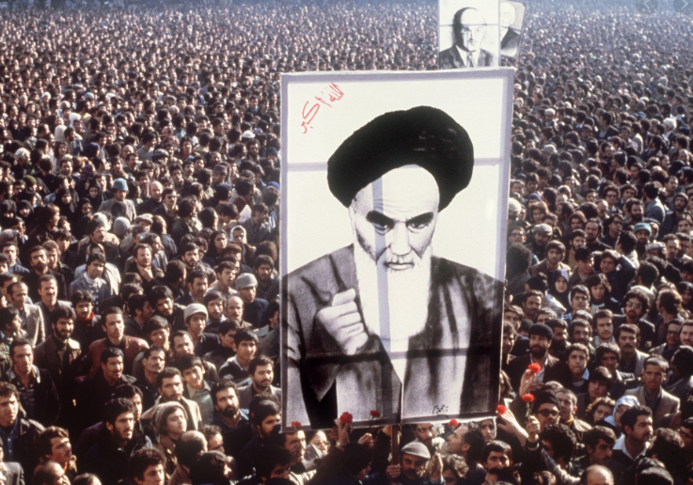
The revolution was unusual for the surprise it created throughout the world.^{[18]} It lacked many of the customary causes of revolution (defeat in war, a financial crisis, peasant rebellion, or disgruntled military);^{[19]} occurred in a nation that was experiencing relative prosperity;^{[10][17]} produced profound change at great speed;^{[20]} was massively popular; resulted in the exile of many Iranians;^{[21]} and replaced a pro-Western authoritarian monarchy^{[10]} with an anti-Western theocracy^{[10][16][17][22]} based on the concept of velayat-e faqih (or Guardianship of the Islamic Jurists). It was a relatively nonviolent revolution, and it helped to redefine the meaning and practice of modern revolutions (although there was violence in its aftermath).^{[23]}

Slide 4
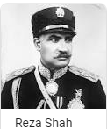
Background (1906–1977)
Shi'a clergy (or Ulama) have historically had a significant influence in Iran. The clergy first showed themselves to be a powerful political force in opposition to Iran's monarch with the 1891 Tobacco Protest boycott that effectively destroyed an unpopular concession granted by the shah giving a British company a monopoly over buying and selling Tobacco in Iran. To some the incident demonstrated that the Shia ulama were "Iran's first line of defense" against colonialism.^{[3]}
Reza Shah
The dynasty that the revolution overthrew – the Pahlavi dynasty – was known for its autocracy, its focus on modernization and Westernization as well as its disregard for religious^{[4]} and democratic measures in Iran's constitution.
The founder of the dynasty, army general Reza Shah Pahlavi, replaced Islamic laws with western ones, and forbade traditional Islamic clothing, separation of the sexes and veiling of women (hijab).^{[5]} Women who resisted his ban on public hijab had their chadors forcibly removed and torn. In 1935 a rebellion by pious Shi'a at the shrine of Imam Reza in Mashhad was crushed on his orders with dozens killed and hundreds injured,^{[6]} rupturing relations between the Shah and pious Shia in Iran.^{[7][8]}

Slide 5
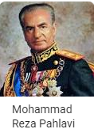
The last Shah of Iran comes to power
Reza Shah was deposed in 1941 by an invasion of allied British and Soviet troops^{[9]} who believed him to be sympathetic with the allies' enemy Nazi Germany. His son, Mohammad Reza Pahlavi was installed by the allies as monarch. Prince Pahlavi (later crowned shah) reigned until the 1979 revolution with one brief interruption. In 1953 he fled the country after a power-struggle with his Prime Minister Mohammad Mossadegh. Mossadegh is remembered in Iran for having been voted into power through a democratic election, nationalizing Iran's British-owned oil fields, and being deposed in a military coup d'état organized by an American CIA operative and aided by the British MI6. Thus foreign powers were involved in both the installation and restoration of Shah Mohammad Reza Pahlavi.
The shah maintained a close relationship with the United States, both regimes sharing a fear of the southward expansion of the Soviet state, Iran's powerful northern neighbor. Leftist and Islamist groups attacked his government (often from outside Iran as they were suppressed within) for violating the Iranian constitution, political corruption, and the political oppression by the SAVAK (secret police).

Slide 6
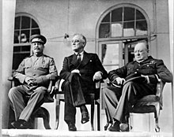
World War II
Iran claimed to be a neutral country during the opening years of World War II. In April, 1941, the war reached Iran's borders when Rashid Ali, with assistance from Germany and Italy, launched the 1941 Iraqi coup d'état, sparking the Anglo-Iraqi War of May, 1941. Germany and Italy quickly sent the pro-Axis forces in Iraq military aid from Syria but during the period from May to July the British and their allies defeated the pro-Axis forces in Iraq and later Syria and Lebanon.
In June, 1941, Nazi Germany broke the Molotov–Ribbentrop Pact and invaded the Soviet Union, Iran's northern neighbor. The Soviets quickly allied themselves with the Allied countries and in July and August, 1941 the British demanded that the Iranian government expel all Germans from Iran. Reza Shah refused to expel the Germans and on 25 August, 1941, the British and Soviets launched a surprise invasion and Reza Shah's government quickly surrendered after less than a week of fighting.^{[14]} The invasion's strategic purpose was to secure a supply line to the USSR (later named the Persian Corridor), secure the oil fields and Abadan Refinery (of the UK-owned Anglo-Iranian Oil Company), and limit German influence in Iran. Following the invasion, on 16 September, 1941 Reza Shah abdicated and was replaced by Mohammad Reza Pahlavi, his 21 year old son.^{[15][16][17]}

Slide 7
1953 Iranian coup d'état
The 1953 Iranian coup d'état, known in Iran as the 28 Mordad coup d'état (Persian: کودتای ۲۸ مرداد‎), was the overthrow of the democratically elected Prime Minister Mohammad Mosaddegh in favour of strengthening the monarchical rule of the Shah, Mohammad Reza Pahlavi on 19 August 1953,^{[5]} orchestrated by the United States (under the name TPAJAX Project^{[6]} or "Operation Ajax") and the United Kingdom (under the name "Operation Boot"), and carried out by the Iranian military.^{[7][8][9][10]}
Mosaddegh had sought to audit the documents of the Anglo-Iranian Oil Company (AIOC), a British corporation (now part of BP) and to limit the company's control over Iranian oil reserves.^{[11]} Upon the refusal of the AIOC to co-operate with the Iranian government, the parliament (Majlis) voted to nationalize Iran's oil industry and to expel foreign corporate representatives from the country.^{[12][13][14]} After this vote, Britain instigated a worldwide boycott of Iranian oil to pressure Iran economically.^{[15]} Initially, Britain mobilized its military to seize control of the British-built Abadan oil refinery, then the world's largest, but Prime Minister Clement Attlee opted instead to tighten the economic boycott^{[16]} while using Iranian agents to undermine Mosaddegh's government.^{[17]:3} Judging Mosaddegh to be unreliable and fearing a Communist takeover in Iran, UK prime minister Winston Churchill and the Eisenhower administration decided to overthrow Iran's government, though the preceding Truman administration had opposed a coup, fearing the precedent that Central Intelligence Agency (CIA) involvement would set.^{[17]:3} British intelligence officials' conclusions and the UK government's solicitations were instrumental in initiating and planning the coup, despite the fact that the U.S. government in 1952 had been considering unilateral action (without UK support) to assist the Mosaddegh government.^{[18][19][20]}

Slide 8
1953 Iranian coup d'état
Following the coup in 1953, a government under General Fazlollah Zahedi was formed which allowed Mohammad Reza Pahlavi, the last Shah of Iran (Persian for an Iranian king),^{[21]} to rule more firmly as monarch. He relied heavily on United States support to hold on to power.^{[12][13][14][22]} According to the CIA's declassified documents and records, some of the most feared mobsters in Tehran were hired by the CIA to stage pro-Shah riots on 19 August.^{[5]} Other men paid by the CIA were brought into Tehran in buses and trucks, and took over the streets of the city.^{[23]} Between 200^{[3]} and 300^{[4]} people were killed because of the conflict. Mosaddegh was arrested, tried and convicted of treason by the Shah's military court. On 21 December 1953, he was sentenced to three years in jail, then placed under house arrest for the remainder of his life.^{[24]:280[25][26]} Other Mosaddegh supporters were imprisoned, and several received the death penalty.^{[14]} After the coup, the Shah continued his rule as monarch for the next 26 years^{[13][14]} until he was overthrown in the Iranian Revolution in 1979.^{[13][14][17]}
In August 2013, sixty years afterward, the U.S. government formally acknowledged the U.S. role in the coup by releasing a bulk of previously classified government documents that show it was in charge of both the planning and the execution of the coup, including the bribing of Iranian politicians, security and army high-ranking officials, as well as pro-coup propaganda.^{[27][28]} The CIA is quoted acknowledging the coup was carried out "under CIA direction" and "as an act of U.S. foreign policy, conceived and approved at the highest levels of government".^{[29]}

Slide 9
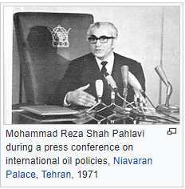
White Revolution (1963–78)
The White Revolution was a far-reaching series of reforms in Iran launched in 1963 by Shah Mohammad Reza Pahlavi and lasted
until 1978. Mohammad Reza Shah's reform program was built especially to weaken those classes that supported the traditional system.
It consisted of several elements including land reform; sales of some state-owned factories to finance the land reform; the
enfranchisement of women; nationalization of forests and pastures; formation of a literacy corps; and institution of profit-sharing
schemes for workers in industry.^{[54]}
The Shah advertised the White Revolution as a step towards westernization,^{[55]} and it was a way for him to legitimize the Pahlavi dynasty.
Part of the reason for launching the White Revolution was that the Shah hoped to get rid of the influence of landlords and to create a
new base of support among the peasants and working class.^{[56][57]} Thus, the White Revolution in Iran was an attempt to introduce
reform from above and preserve traditional power patterns. Through land reform, the essence of the White Revolution, the Shah hoped
to ally himself with the peasantry in the countryside, and hoped to sever their ties with the aristocracy in the city.
What the Shah did not expect, however, was that the White Revolution led to new social tensions that helped create many of the problems the Shah had been trying to avoid. The Shah's reforms more than quadrupled the combined size of the two classes that had posed the most challenges to his monarchy in the past—the intelligentsia and the urban working class. Their resentment towards the Shah also grew as they were now stripped of organizations that had represented them in the past, such as political parties, professional associations, trade unions, and independent newspapers. The land reform, instead of allying the peasants with the government, produced large numbers of independent farmers and landless laborers who became loose political cannons, with no feeling of loyalty to the Shah. Many of the masses felt resentment towards the increasingly corrupt government; their loyalty to the clergy, who were seen as more concerned with the fate of the populace, remained consistent or increased. As Ervand Abrahamian pointed out: "The White Revolution had been designed to preempt a Red Revolution. Instead, it paved the way for an Islamic Revolution."^{[58]} The White Revolution's economic "trickle-down" strategy also did not work as intended. In theory, oil money funneled to the elite was supposed to be used to create jobs and factories, eventually distributing the money, but instead the wealth tended to get stuck at the top and concentrated in the hands of the very few.^{[59]}

Slide 10
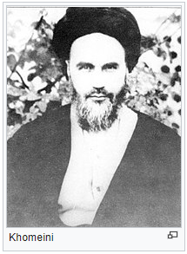
Rise and exile of Ayatollah Khomeini (1963–)
The post-revolutionary leader—Shia cleric Ayatollah Ruhollah Khomeini—first came to political prominence in 1963 when he led opposition to the Shah and his White Revolution which aimed to break up landholdings owned by some Shi’a clergy, allow women to vote and religious minorities to hold office, and finally grant women legal equality in marital issues.
Khomeini was arrested in 1963 after declaring the Shah a "wretched miserable man" who had "embarked on the [path toward] destruction of Islam in Iran."^{[60]} Three days of major riots throughout Iran followed, with 15,000 dead from police fire as reported by opposition sources.^{[61]} However, anti-revolutionary sources conjectured that just 32 were killed.^{[62]}
Khomeini was released after eight months of house arrest and continued his agitation, condemning Iran's close cooperation with Israel and its capitulations, or extension of diplomatic immunity, to American government personnel in Iran. In November 1964, Khomeini was re-arrested and sent into exile where he remained for 15 years (mostly in Najaf, Iraq), until the revolution.

Slide 11
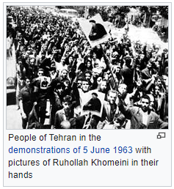
Ideology of the Iranian Revolution
In this interim period of "disaffected calm,"^{[63]} the budding Iranian revival began to undermine the idea of
Westernization as progress that was the basis of the Shah's secular reign, and to form the ideology of
the 1979 revolution: Jalal Al-e-Ahmad's idea of Gharbzadegi—that Western culture was a plague or an
intoxication to be eliminated;^{[64]} Ali Shariati's vision of Islam as the one true liberator of the Third World from oppressive colonialism, neo-colonialism, and capitalism;^{[65]} and Morteza Motahhari's popularized retellings
of the Shia faith all spread and gained listeners, readers and supporters.^{[64]}
Most importantly, Khomeini preached revolt, and especially martyrdom, against injustice and tyranny was part of Shia Islam,^{[66]} and that Muslims should reject the influence of both liberal capitalism and communism, ideas that inspired the revolutionary slogan "Neither East, nor West – Islamic Republic!“
Away from public view, Khomeini developed the ideology of velayat-e faqih (guardianship of the jurist) as government, that Muslims—in fact everyone—required "guardianship," in the form of rule or supervision by the leading Islamic jurist or jurists.^{[67]} Such rule was ultimately "more necessary even than prayer and fasting" in Islam,^{[Note 2]} as it would protect Islam from deviation from traditional sharia law and in so doing eliminate poverty, injustice, and the "plundering" of Muslim land by foreign non-believers.^{[68]}
This idea of rule by Islamic jurists was spread through his book Islamic Government, mosque sermons, and smuggled cassette speeches by Khomeini^{[69]} among his opposition network of students (talabeh), ex-students (able clerics such as Morteza Motahhari, Mohammad Beheshti, Mohammad-Javad Bahonar, Akbar Hashemi Rafsanjani, and Mohammad Mofatteh), and traditional businessmen (bazaari) inside Iran.^{[69]}

Slide 12
Opposition groups and organizations
Other opposition groups included constitutionalist liberals—the democratic, reformist Islamic Freedom Movement of Iran, headed by Mehdi Bazargan, and the more secular National Front. They were based in the urban middle class, and wanted the Shah to adhere to the Iranian Constitution of 1906 rather than to replace him with a theocracy,^{[70]} but lacked the cohesion and organization of Khomeini's forces.^{[71]}
Marxist groups—primarily the communist Tudeh Party of Iran and the Fedaian guerrillas^{[Note 3]}—had been weakened considerably by government repression. Despite this the guerrillas did help play an important part in the final February 1979 overthrow^{[73]} delivering "the regime its coup de grace."^{[74]} The most powerful guerrilla group—the People's Mujahedin—was leftist Islamist and opposed the influence of the clergy as reactionary.
Some important clergy did not follow Khomeini's lead. Popular ayatollah Mahmoud Taleghani supported the left, while perhaps the most senior and influential ayatollah in Iran—Mohammad Kazem Shariatmadari—first remained aloof from politics and then came out in support of a democratic revolution.^{[75]}
Khomeini worked to unite this opposition behind him (except for the unwanted 'atheistic Marxists'),^{[76][77]} focusing on the socio-economic problems of the Shah's government (corruption and unequal income and development),^{[76][78]} while avoiding specifics among the public that might divide the factions^{[79]}—particularly his plan for clerical rule, which he believed most Iranians had become prejudiced against as a result of propaganda campaign by Western imperialists.^{[Note 4][80]}
In the post-Shah era, some revolutionaries who clashed with his theocracy and were suppressed by his movement complained of deception,^{[81]} but in the meantime anti-Shah unity was maintained.^{[82]}

Slide 13
Several events in the 1970s set the stage for the 1979 revolution.
The 1971 2,500-year celebration of the Persian Empire at Persepolis, organized by
the government, was attacked for its extravagance. "As the foreigners reveled on drink
forbidden by Islam, Iranians were not only excluded from the festivities, some were starving."^{[83]}
Five years later, the Shah angered pious Iranian Muslims by changing the first year of the
Iranian solar calendar from the Islamic hijri to the ascension to the throne by Cyrus the Great.
"Iran jumped overnight from the Muslim year 1355 to the royalist year 2535."^{[84]}
The oil boom of the 1970s produced an "alarming" increase in inflation, waste and an
"accelerating gap" between the rich and poor, the city and the country,^{[85]} along with the
presence of tens of thousands of unpopular skilled foreign workers. Many Iranians were also
angered by the fact that the Shah's family was the foremost beneficiary of the income generated by oil, and the line between state earnings and family earnings blurred. By 1976, the Shah had accumulated upward of $1 billion from oil revenue; his family – including 63 princes and princesses had accumulated between $5 and $20 billion; and the family foundation controlled approximately $3 billion.^{[86]} By mid-1977 economic austerity measures to fight inflation disproportionately affected the thousands of poor and unskilled male migrants settling in the cities working in the construction industry. Culturally and religiously conservative,^{[87]} many went on to form the core of the revolution's demonstrators and "martyrs".^{[88]}
All Iranians were required to join and pay dues to a new political party, the Ḥezb-e Rastakhiz party—all other parties were banned.^{[89]} That party's attempt to fight inflation with populist "anti-profiteering" campaigns—fining and jailing merchants for high prices – angered and politicized merchants while fueling black markets.^{[90]}
The Shah of Iran (left) meeting with members of the U.S. government: Alfred Atherton, William Sullivan, Cyrus Vance, Jimmy Carter, and Zbigniew Brzezinski, 1977

Slide 14
In 1977 the Shah responded to the "polite reminder" of the importance of political rights by the new American president, Jimmy Carter, by granting amnesty to some prisoners and allowing the Red Cross to visit prisons. Through 1977 liberal opposition formed organizations and issued open letters denouncing the government.^{[91]} Against this background a first crucial manifestation of public expression of social discontent and political protest against the regime took place in October 1977, when the German-Iranian Cultural Association in Teheran hosted a series of literature reading sessions, organized by the newly revived Iranian Writers Association and the German Goethe-Institute. In these "Ten Nights" (Dah Shab) 57 of Iran's most prominent poets and writers read their works to thousands of listeners. They demanded the end of censorship and claimed the freedom of expression.^{[92]}
Also in 1977, the popular and influential modernist Islamist theorist Ali Shariati died under mysterious circumstances. This both angered his followers, who considered him a martyr at the hands of SAVAK, and removed a potential revolutionary rival to Khomeini. Finally, in October Khomeini's son Mostafa died of an alleged heart attack, and his death was also blamed on SAVAK. A subsequent memorial service for Mostafa in Tehran put Khomeini back in the spotlight.^{[93][94]}

Slide 15
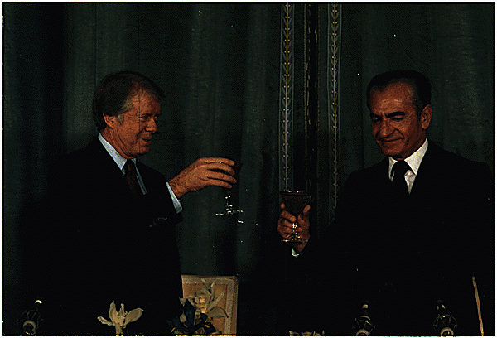
THE IRANIAN REVOLUTION—A TIMELINE OF EVENTS
STORM CLOUDS GATHER
1977
January – July
Journalists, intellectuals, lawyers, and political activists publish a series of open letters criticizing the accumulation of power at the hands of the Shah.
October
A 10-night poetry festival organized by the Iranian writers’ association at the Goethe Institute in Tehran attracts thousands of participants for lectures criticizing the government.
October 23
Mostafa Khomeini, the eldest son of exiled cleric Ayatollah Ruhollah Khomeini, dies of unknown causes at age 47 in Najaf, Iraq. The elder Khomeini has lived in exile since 1963, when he was arrested for leading protests against the Shah’s modernization program.
November 15-16
During a visit to Washington, the Shah’s welcome at the White House is disrupted by protests by Iranian students (as well as the tear gas used by police to quash the protests.)
December 31
On a brief visit to Iran, President Jimmy Carter toasts the Shah, describing Iran as “an island of stability in one of the most troubled areas of the world.”

Slide 16
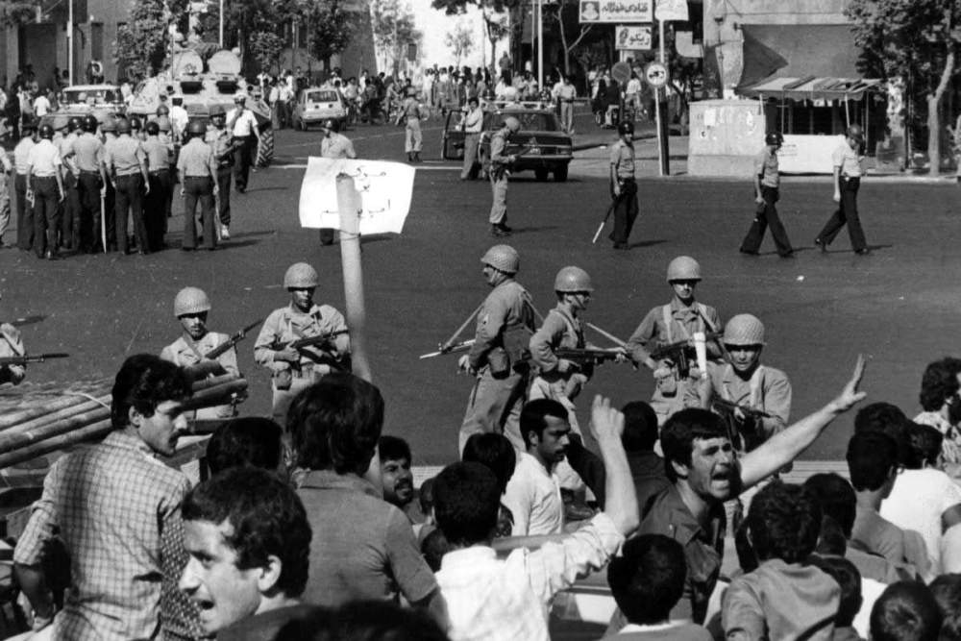
THE IRANIAN REVOLUTION—A TIMELINE OF EVENTS
A SPARK IGNITES
1978
January 6
Iranian newspaper Ettela’at publishes a front-page editorial disparaging Ayatollah Ruhollah Khomeini, reportedly written by the royal court at the directive of the Shah.
January 9
The main bazaar in Qom, where Iran’s largest seminaries are based, closes to protest the defamation of Khomeini. Several thousand protestors attacks symbols of the monarchy; security forces kill at least five people.
February 18
Consistent with Shia tradition, mourning ceremonies are held in cities across Iran on the fortieth day following the death of the Qom protestors. A student protestor is killed in Tabriz, provoking riots and further violence.
March – May
The cycle of protests, repression, violence, and mourning continues in three dozen Iranian cities.
June 7
The Shah replaces General Nematollah Nassiri, the head of SAVAK; one of his successor’s first moves was to order the release of 300 detained clerics.
July 20
Protests erupt in Mashhad after the death of a cleric in a road accident; a number of people were killed in the upheaval there and elsewhere.
August 9-10
The arrest of a cleric provokes riots in Isfahan, which quickly spread to Shiraz, Qazvin, Tabriz, Abadan, and Ahwaz. The Shiraz Art Festival is cancelled and an estimated 100 are killed. Martial law is declared in Isfahan.

Slide 17
THE IRANIAN REVOLUTION—A TIMELINE OF EVENTS
A REVOLUTION ERUPTS
August 19
477 Iranians die in a deliberately set fire at Cinema Rex in Abadan. The opposition blames SAVAK; after the revolution, an Islamist confessed and was prosecuted for the arson.
August 27
Prime Minister Jamshid Amouzegar resigns; his successor, Jafar Sharif-Emami, undertakes reforms intended to assuage.
September 8
On the morning after the Shah declared martial law, security forces fire on a large protest in Tehran’s Jaleh Square. At least 100 were killed and the event became known as “Black Friday.”
October 3
At the Shah’s behest, the Iraqi government deports Khomeini. After he is denied entry to Kuwait, Khomeini travels to France and settles in Neuphle-le-Chateau, a Parisian suburb, where he benefits from far greater media access and attention.
November 6
Days after protests swell in Tehran on a religious holiday, efforts to broker a national unity government with the opposition collapse, thanks to Khomeini’s defiance. Prime Minister Sharif-Emami resigns, succeeded by Gen. Gholamreza Azhari. The Shah broadcast on national television a promise not to repeat past mistakes and to make amends saying, “I heard the voice of your revolution…As Shah of Iran as well as an Iranian citizen, I cannot but approve your revolution.”
December 6
Only a week after he publicly reaffirmed U.S. support for and “confidence in” the Shah, President Jimmy Carter publicly hedges in press statements, noting that “We personally prefer that the Shah maintain a major role, but that is a decision for the Iranian people to make.”
December 10-11
Millions of Iranians protest all over the country demanding the removal of the Shah and return of Ayatollah Ruhollah Khomeini.
December 29
The Shah appoints Shapour Bakhtiar as prime minister. A long-time nationalist politician and vocal critic of the Shah, he is confirmed by the parliament two weeks later.
January 12
In Paris, Ayatollah Khomeini forms the Revolutionary Council to coordinate the transition.

Slide 18
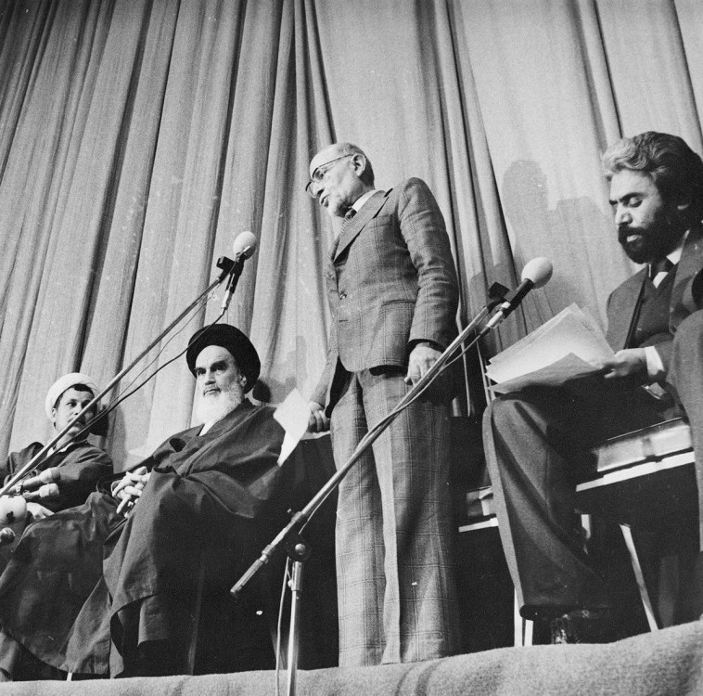
THE IRANIAN REVOLUTION—A TIMELINE OF EVENTS
THE INTERREGNUM
1979
January 16
Shah and his family leave Iran for Egypt, ostensibly for “vacation.” As he departs, the Shah tells Prime Minister Bakhtiar “I give Iran into your care, yours and God’s.”
February 1
Khomeini returns to Iran and is greeted by millions of people in the streets of Tehran.
February 4
Khomeini appoints Mehdi Bazargan as the prime minister of an interim government. Bakhtiar insists that he remains the head of the only legitimate Iranian government.
February 10
Bakhtiar announces country-wide curfew and martial law. Khomeini orders his followers to ignore the curfew and rise up in national revolution.
February 11
The armed forces declare neutrality, and any remnants of the Shah’s government collapse. Bakhtiar quickly fled Iran for France, where he was assassinated in 1991 by Iranian agents.

Slide 19
THE IRANIAN REVOLUTION—A TIMELINE OF EVENTS
THE PROVISIONAL GOVERNMENT
1979
February 14
The U.S. Embassy in Tehran is attacked by crowds; embassy staff initially surrender, but the protestors were ousted on the order of Iran’s acting Foreign Minister Ibrahim Yazdi.
March 8
Tens of thousands of Iranian women protest in Tehran on International Women’s Day to oppose mandatory veiling. (See also: https://designyoutrust.com/2018/10/rare-photographs-document-iranian-women-protest-against-the-hijab-law-in-march-1979/)
March 30-31
Iranians participate in a national referendum on whether Iran should become an “Islamic Republic;” the motion (which offered no alternatives) received near-unanimous support.
May 5
Islamic Revolutionary Guard Corps is established by a decree issued by Khomeini.
August 3
Iranians vote in nation-wide elections for the Assembly of Experts, a clerical-dominated body empowered to finalize the draft constitution. Due to boycotts by leftist, nationalist, and some Islamist factions, voter turnout falls far below the March referendum.
October 14
Assembly of Experts approves draft new constitution, enshrining Khomeini’s innovative doctrine of velayat-e faqih, which accords ultimate authority to a religious leader.
October 22
Shah Mohammed Reza Pahlavi is allowed to enter the U.S. for medical treatment. Khomeini condemns the U.S. for allowing the deposed Shah entry into the country.

Slide 20
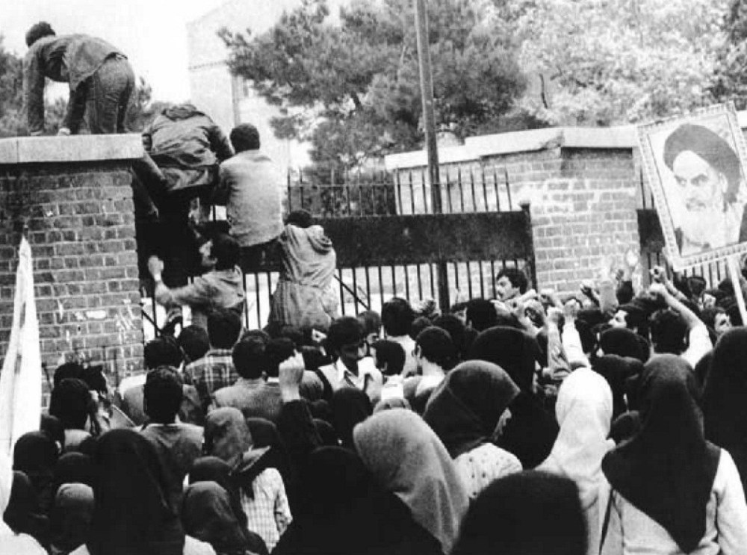
THE IRANIAN REVOLUTION—A TIMELINE OF EVENTS
THE HOSTAGE CRISIS
1979
November 4
Student protestors overrun the U.S. Embassy in Tehran, seizing its personnel as hostages.
November 6
The leaders of Iran’s provisional government resign in protest, ceding uncontested authority of the new state to Khomeini and the Revolutionary Council.
November 7
U.S. President Jimmy Carter sends emissaries with a personal note to Iran to negotiate the release of the hostages, but they are refused entry.
November 14
U.S. freezes all the property and interests of the government of Iran and the Central Bank of Iran.
November 19-20
13 female and African-American hostages are released in a unilateral Iranian gesture.
December 2-3
Iran’s new constitution overwhelmingly approved in a popular referendum that drew participation from 75% of the electorate.
December 4
The United Nations Security Council passes a resolution calling for Iran to release the hostages.
December 15
The Shah leaves the United States for Panama.

Slide 21
THE IRANIAN REVOLUTION—A TIMELINE OF EVENTS
THE HOSTAGE CRISIS
1979
January 25
Abolhassan Bani Sadr is elected as the Islamic Republic’s first president; within 18 months, he would be impeached and flee the country.
March 14
Iranians vote in parliamentary elections, with a second round held in May.
April 7
U.S. formally severs diplomatic relations with Iran.
April 25
Operation Eagle Claw: Embassy hostage rescue mission fails, after sandstorms cause the crash of one of the helicopters and the death of eight U.S. soldiers.
April 28
Secretary of State Cyrus Vance announces his resignation, submitted to President Carter four days before the rescue operation was launched.
July 9
Iranian authorities discover a coup plot and launch a new purge of the military.
July 27
Shah Mohammed Reza Pahlavi dies in Cairo, Egypt.
September 12
In a speech, Ayatollah Khomeini outlines the preconditions for an agreement.
September 22
Iraq invades Iran, setting off an eight-year conflict that resulted in hundreds of thousands of casualties on both sides.

Slide 22
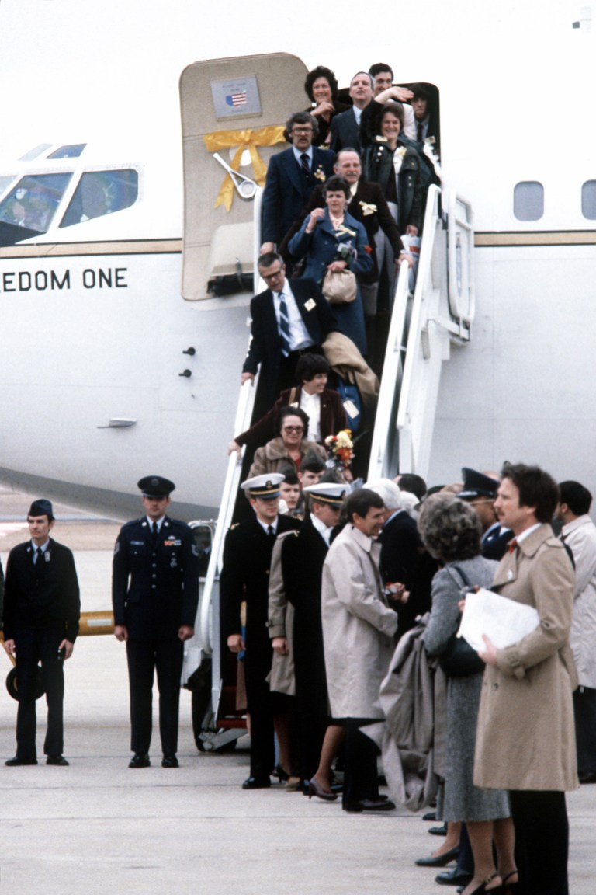
THE IRANIAN REVOLUTION—A TIMELINE OF EVENTS
January 20, 1980
All remaining U.S. hostages are released after 444 days, after Tehran and Washington conclude the Algiers Accords. The agreement unfreezes Iranian assets, lifts other U.S. sanctions on Iran, and establishes a tribunal to adjudicate billions of dollars of financial claims between the two countries.

Slide 23
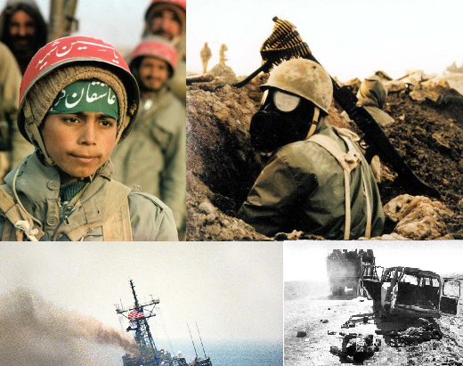
Iran Iraq War
22 September 1980 –
20 August 1988

Slide 24
The Iran–Iraq War (Persian: جنگ ایران و عراق‎; Arabic: حرب الخليج الأولى‎ “First Gulf War”)^{[66]}, referred to as the Imposed War^{[67][68]} and Holy Defense or Sacred Defense (Persian: دفاع مقدس)^{[69][70][71]} in Iran, began on 22 September 1980 when Iraq invaded Iran, and it ended on 20 August 1988, when Iran accepted the UN-brokered ceasefire. Iraq wanted to replace Iran as the dominant Persian Gulf state, and was worried the 1979 Iranian Revolution would lead Iraq's Shia majority to rebel against the Ba'athist government. The war also followed a long history of border disputes, and Iraq planned to annex the oil-rich Khuzestan Province and the east bank of the Shatt al-Arab (Arvand Rud).
Although Iraq hoped to take advantage of Iran's post-revolutionary chaos, it made limited progress and was quickly repelled; Iran regained virtually all lost territory by June 1982. For the next five years, Iran was on the offensive^{[72]} until Iraq took back the initiative in 1988, and whose major offensives led to the final conclusion of the war.^{[73][61]} There were a number of proxy forces—most notably the People's Mujahedin of Iran siding with Iraq and the Iraqi Kurdish militias of the KDP and PUK siding with Iran. The United States, Britain, the Soviet Union, France, and most Arab countries provided political and logistic support for Iraq, while Iran was largely isolated.

Slide 25
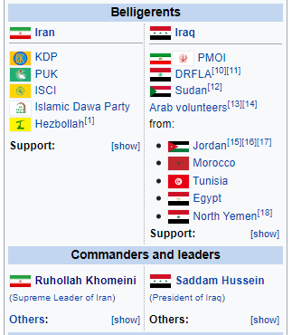
After eight years of war, war-exhaustion, economic devastation, decreased morale, military stalemate, lack of international sympathy against the use of weapons of mass destruction against civilians by Iraqi forces, and increased U.S.–Iran military tension all led to a ceasefire brokered by the United Nations.
The conflict has been compared to World War I in terms of the tactics used, including large-scale trench warfare with barbed wire stretched across fortified defensive lines, manned machine gun posts, bayonet charges, Iranian human wave attacks, extensive use of chemical weapons by Iraq, and, later, deliberate attacks on civilian targets. A special feature of the war can be seen in the Iranian cult of the martyr which had been developed in the years before the revolution. The discourses on martyrdom formulated in the Iranian Shia context led to the tactics of "human wave attacks" and thus had a lasting impact on the dynamics of the war.^{[74]}
An estimated 500,000 Iraqi and Iranian soldiers died, in addition to a smaller number of civilians. The end of the war resulted in neither reparations nor border changes.

Slide 26
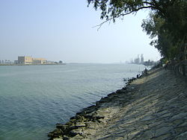
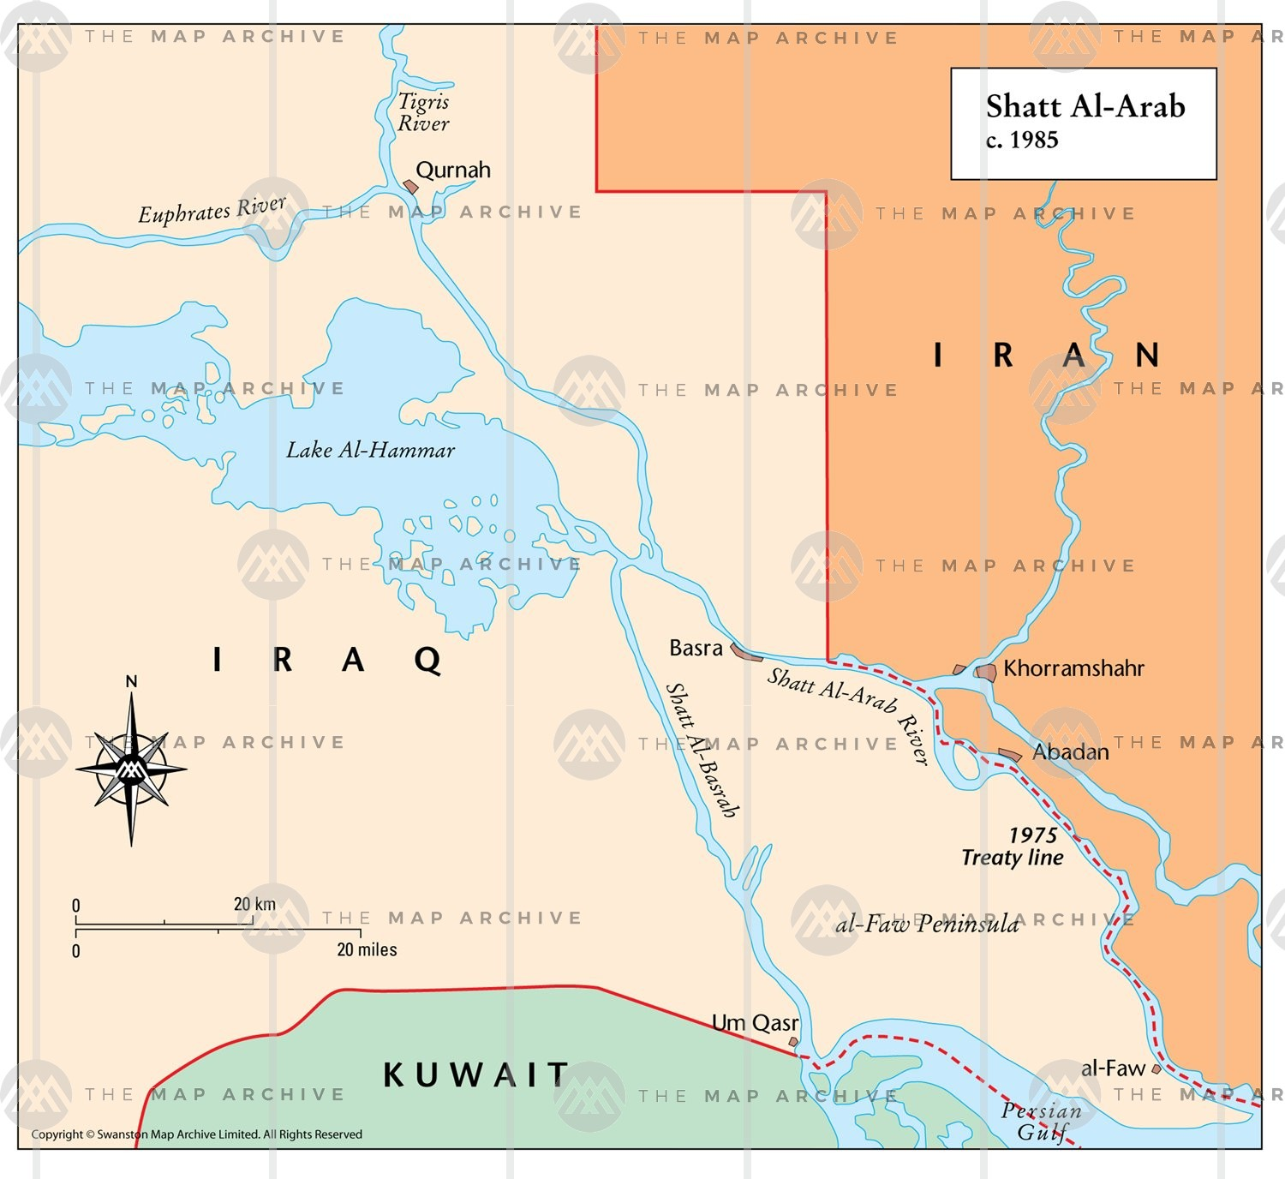
Shatt al-Arab river is made by the confluence of the Tigris and Euphrates river at Al-Qurnah and continues to end up at the Persian gulf south of the city of Al-Faw. …The river may have formed 2000–1600 years prior to the 21st century.^{[6]}
History:
The background of the issue stretches mainly back to the Ottoman-Safavid era, prior to the establishment of an independent Iraq, which happened in the 20th century. In the early 16th century, the Iranian Safavids gained most of what is present-day Iraq, but lost it later by the Peace of Amasya (1555) to the expanding Ottomans.^{[7]} In the early 17th century, the Safavids under king (shah) Abbas I (r. 1588–1629) regained it, only to lose it permanently (along, temporarily, with control over the waterway), to the Ottomans by the Treaty of Zuhab (1639).^{[8]} This treaty, which roughly re-established the common borders of the Ottoman and Safavid Empires the way they had been in 1555, never demarcated a precise and fixed boundary regarding the frontier in the south. Nader Shah (r. 1736–1747) restored Iranian control over the waterway, but the Treaty of Kerden (1746) restored the Zuhab boundaries, and ceded it back to the Turks.^{[9][10]} The First Treaty of Erzurum (1823) concluded between Ottoman Turkey and Qajar Iran, resulted in the same.^{[11][12]}
The Second Treaty of Erzurum was signed by Ottoman Turkey and Qajar Iran in 1847 after protracted negotiations, which included British and Russian delegates. Even afterwards, backtracking and disagreements continued, until British Foreign Secretary, Lord Palmerston, was moved to comment in 1851 that "the boundary line between Turkey and Persia can never be finally settled except by an arbitrary decision on the part of Great Britain and Russia". A protocol between the Ottomans and the Persians was signed in Istanbul in 1913, which declared that the Ottoman-Persian frontier run along the thalweg, but World War I canceled all plans.

Slide 27
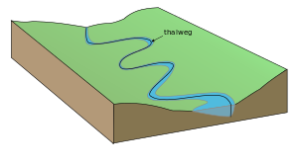
In geography and fluvial geomorphology, a thalweg or talweg (/ˈtɑːlvɛɡ/) is the line of lowest elevation within a valley or watercourse.^{[1]}
Under international law, a thalweg is the middle of the primary navigable channel of a waterway that defines the boundary line between states.^{[2][3]} Also under international law, thalwegs can acquire special significance because disputed river borders are often deemed to run along the river's thalweg.
The word thalweg is of 19th-century German origin. The German word Thalweg (modern spelling Talweg) is a compound noun that is built from the German elements Thal (since Duden's orthography reform of 1901 written Tal) meaning valley (cognate with dale in English), and Weg, meaning way. It literally means "valley way" and is used, with its modern spelling Talweg, in daily German to describe a path or road that follows the bottom of a valley, or in geography with the more technical meaning also adopted by English.

Slide 28
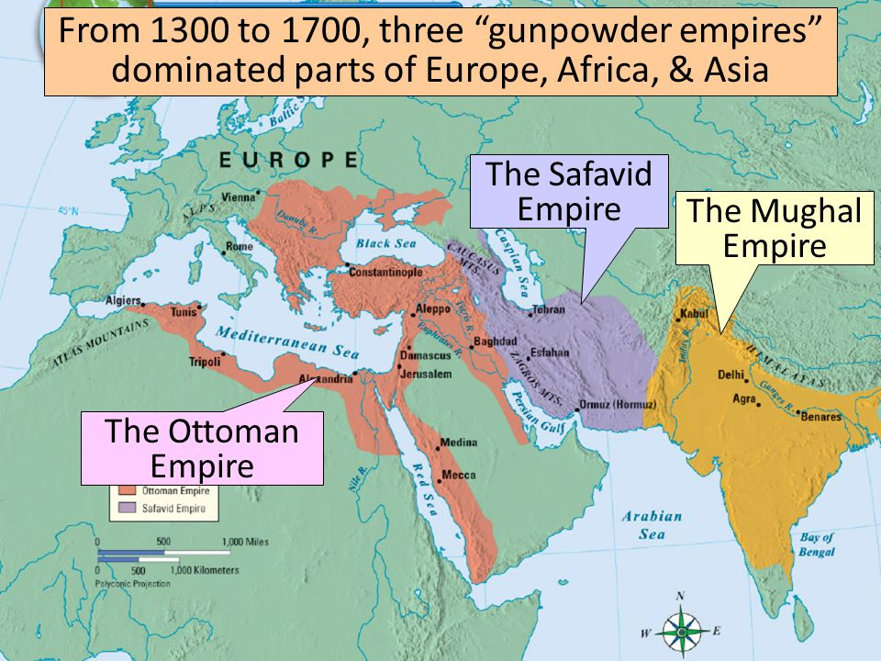

Slide 29
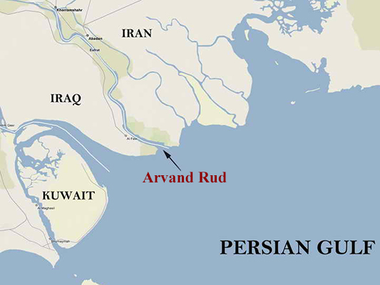
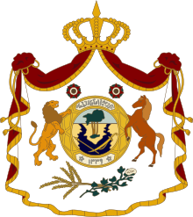
During the Mandate of Iraq (1920–32), the British advisors in Iraq were able to keep the waterway binational under the thalweg principle that worked in Europe: the dividing line was a line drawn between the deepest points along the stream bed. In 1937, Iran and Iraq signed a treaty that settled the dispute over control of the Shatt al-Arab.^{[13]} The 1937 treaty recognized the Iranian-Iraqi border as along the low-water mark on the eastern side of the Shatt al-Arab except at Abadan and Khorramshahr where the frontier ran along the thalweg (the deep water line) which gave Iraq control of almost the entire waterway; provided that all ships using the Shatt al-Arab fly the Iraqi flag and have an Iraqi pilot, and required Iran to pay tolls to Iraq whenever its ships used the Shatt al-Arab.^{[14]} The treaty of 1937 marked a familiar pattern by British empire of Divide and rule that was routinely employed in the Indian subcontinent and other British colonial or influenced regions: it ensured long term if not permanent tension between Iran and Iraq. As opposed to using the thalweg principle as advised during 1920–1932 period, which would have calmed down or ended the river border tensions between the two nations.
The Shatt al-Arab and the forest were depicted in the middle of the coat of arms of the Kingdom of Iraq, from 1932–1959.

Slide 30
Under Shah Mohammad Reza Pahlavi in the late 60s, Iran developed a strong military and took a more assertive stance in the Near East.^{[13]} In April 1969, Iran abrogated the 1937 treaty over the Shatt al-Arab and Iranian ships stopped paying tolls to Iraq when they used the Shatt al-Arab.^{[15]} The Shah argued that the 1937 treaty was unfair to Iran because almost all river borders around the world ran along the thalweg, and because most of the ships that used the Shatt al-Arab were Iranian.^{[16]} Iraq threatened war over the Iranian move, but on 24 April 1969, an Iranian tanker escorted by Iranian warships (Joint Operation Arvand) sailed down the Shatt al-Arab, and Iraq—being the militarily weaker state—did nothing.^{[14]} The Iranian abrogation of the 1937 treaty marked the beginning of a period of acute Iraqi-Iranian tension that was to last until the Algiers Accords of 1975.^{[14]}
All United Nations attempts to intervene and mediate the dispute were rebuffed. Under Saddam Hussein, Baathist Iraq claimed the entire waterway up to the Iranian shore as its territory. In response, Iran in the early 1970s became the main patron of Iraqi Kurdish groups fighting for independence from Iraq. In March 1975, Iraq signed the Algiers Accord in which it recognized a series of straight lines closely approximating the thalweg (deepest channel) of the waterway, as the official border, in exchange for which Iran ended its support of the Iraqi Kurds.^{[17]}
In 1980, Hussein released a statement claiming to abrogate the 1975 treaty and Iraq invaded Iran. International law, however, holds that in all cases no bilateral or multilateral treaty can be abrogated by one party only. The main thrust of the military movement on the ground was across the waterway which was the stage for most of the military battles between the two armies. The waterway was Iraq's only outlet to the Persian Gulf, and thus, its shipping lanes were greatly affected by continuous Iranian attacks.^{[17]}
When the Al-Faw peninsula was captured by the Iranians in 1986, Iraq's shipping activities virtually came to a halt and had to be diverted to other Arab ports, such as Kuwait and even Aqaba, Jordan. At the end of the Iran–Iraq War, both sides agreed to once again treat the Algiers Accord as binding.

Slide 32
September 1980
Sept. 22, 1980
Nov. 7
1980
Jan 18, 1981
Feb. 9,
1981
Feb. 22,
1981
Mar. 27,
1981
Saddam Hussein invades Iran
Iraqi military launches two attacks on Iran
Iran attacks Iraqi oil export terminals
Saddam tells Iran USA is giving Iraq arms
Islamic leaders seek to bring peaceful end
Iran says no cease fire with Iraq troops in Iran
Islamic peace movement attempted again
The major events of the Iran-Iraq War
1980
September 1980: Saddam Hussein, leader of Iraq, invaded Iran. He believed Ayatollah Khomeini wanted to overthrow him because he wanted all of Iraq to be Shi'ite and Saddam Hussein, along with some of his colleagues, were Sunni. Saddam Hussein knew that Khomeini inspired a lot of people with the Islamic revolution, so he saw him as a threat. Thus, he invaded Iran.
September 22, 1980: The Iraqi military launched two attacks on Iran.
November 7, 1980: Iranian commando units attack Iraqi oil export terminals at Mina al-Bakr and al-Faw
1981
January 18, 1981: Saddam Hussein tells Iran that America has been giving Iraq arms.
February 9, 1981: Both Iran and Iraq agree to a visit by Islamic leaders looking to bring a peaceful end to the Iran-Iraq war.
February 22, 1981: Iranian leaders insist that there will be no cease-fire while Iraqi troops are on Iranian soil.
March 27, 1981: The Islamic peace movement tries again for a peaceful resolution.

Slide 33
September 1980
Sept. 22, 1980
Nov. 7
1980
Jan 18, 1981
Feb. 9,
1981
Feb. 22,
1981
Mar. 27,
1981
Jan. 16,
1982
April 30,
1982
Oct., 2, 1982
Sept. 20, 1983
Feb. 12,
1984
May 20-21,
1984
June 15, 1984
Saddam Hussein invades Iran
Iraqi military launches two attacks on Iran
Iran attacks Iraqi oil export terminals
Saddam tells Iran USA is giving Iraq arms
Islamic leaders seek to bring peaceful end
Iran says no cease fire with Iraq troops in Iran
Islamic peace movement attempted again
WaPo reports Iran winning against Iraq
Iran new offensive, aims to drive Iraq out
Iran attack inside Iraq, claim to recapture 90 sq km
Khomeini threat: to cut off oil to West if West steps up aid to Iraq
1st time both sides are intentionally striking civilians
1st commercial carrier sunk in Gulf after Iraqi air attack. US blames Iran
UN brokers agreement: both agree to halt civilian attacks
1982
January 16, 1982: The Washington Post reports that the Iranian military is turning the tide of the war and winning the battle against Iraq.
April 30, 1982: Iran launches a new offensive against Iraq aimed at finally driving the Iraqis out of Iranian territory.
October 2, 1982: Iranian forces attack Iraqi units inside Iraq and claim to have recaptured 90 square kilometers of territory.
1983
September 20, 1983: Ayatollah Khomeini threatens to cut off oil supplies to the West by closing the Persian Gulf if Western countries step up military aid to Iraq.
1984
February 12, 1984: Marks the first time in the conflict that both sides are intentionally striking at civilian targets.
May 20-21, 1984: A ship registered in Panama becomes the first commercial carrier sunk in the Persian Gulf after an Iraqi air attack. // Officials from the State Department blame Iran for the continuation of the war.
June 15, 1984: United Nations Secretary brokers an agreement between Iran and Iraq which both sides agree to halt attacks on civilian targets.
November 26, 1984: The United States and Iraq re-establish full diplomatic relations.

Slide 34
September 1980
Nov. 7
1980
Jan 18, 1981
Feb. 9,
1981
Feb. 22,
1981
Mar. 27,
1981
April 30,
1982
Oct., 2, 1982
Sept. 20, 1983
Feb. 12,
1984
May 20-21,
1984
June 15, 1984
Mar. 7,
1985
July 8,
1986
June 21,
1987
Mar. 11
1988
Saddam Hussein invades Iran
Iran attacks Iraqi oil export terminals
Saddam tells Iran USA is giving Iraq arms
Islamic leaders seek to bring peaceful end
Iran says no cease fire with Iraq troops in Iran
Islamic peace movement attempted again
Iran new offensive, aims to drive Iraq out
Iran attack inside Iraq, claim to recapture 90 sq km
Khomeini threat: to cut off oil to West if West steps up aid to Iraq
1st time both sides are intentionally striking civilians
1st commercial carrier sunk in Gulf after Iraqi air attack. US blames Iran
UN brokers agreement: both agree to halt civilian attacks
Both repeal treaty that banned civilian attacks
Iran again tries to cross into Iraq
UN agrees to resolution calling for immediate cease fire
Truce signed in Ankara
1985
March 7, 1985: Both Iran and Iraq abrogate the June 1984 treaty that banned military attacks on civilians.
1986
February 24, 1986: The U.N. Security Council passes a resolution calling for an immediate cease-fire in the Iran-Iraq war.
July 8, 1986: Iran again attempts to cross the border into Iraq. Iran claimed to kill over 2,000 Iraqi soldiers. However, Iraq claims they "annihilated" the invading Iranian force.
1987
June 21, 1987: The U.N. Security Council agrees to a resolution calling for an immediate cease-fire in the Iran-Iraq War.
1988
March 11, 1988: In a truce signed in Ankara, Iran and Iraq agree to halt attacks on each other's cities.

Slide 35
1978-79
September 1980
Nov. 7
1980
Jan 18, 1981
Feb. 9,
1981
Feb. 22,
1981
Mar. 27,
1981
April 30,
1982
Oct., 2, 1982
Sept. 20, 1983
Feb. 12,
1984
May 20-21,
1984
June 15, 1984
Mar. 7,
1985
July 8,
1986
June 21,
1987
Mar. 11
1988
Iranian
Revolution
Saddam Hussein invades Iran
Iran attacks Iraqi oil export terminals
Saddam tells Iran USA is giving Iraq arms
Islamic leaders seek to bring peaceful end
Iran says no cease fire with Iraq troops in Iran
Islamic peace movement attempted again
Iran new offensive, aims to drive Iraq out
Iran attack inside Iraq, claim to recapture 90 sq km
Khomeini threat: to cut off oil to West if West steps up aid to Iraq
1st time both sides are intentionally striking civilians
1st commercial carrier sunk in Gulf after Iraqi air attack. US blames Iran
UN brokers agreement: both agree to halt civilian attacks
Both repeal treaty that banned civilian attacks
Iran again tries to cross into Iraq
UN agrees to resolution calling for immediate cease fire
Truce signed in Ankara
Late 2012-2013
Jan
2011
March
2011
June
2011
Summer
2011
Sept
2011
Oct
2011
Apr
2012
June
2012
Nov
2012
Aug 21 2013
April
2013
Aug 8
2013
Sept 14
2013
Sept
2015
Sept
2016
Onset of anti-regime protests
1st major protests
Refugees flee to Turkey from Jisr al-Shugur
Regional neighbors and global powers begin to take sides
Rebel militias
Engage with Syrian government
Russia & China cast first UN veto
Short Partial cease fire
Geneva
Communique
National Coalition for Syrian Rev. and Opp forces
International support more and more public
Hezbollah sends fighters
Syria uses Chemical weapons, kill hundreds
Al-Baghdadi to combine forces Iraq and Syria
ISIL
ISIS
US strikes in Iraq
Russia, Syria, US agree to place chem. Weapons under international control
Russia launches 1st air strikes against rebels
Russian/
Syrian bomb Aleppo, killing civilians
2016
Apr
2017
June
2017
Nov
2017
June 2018
Oct
2019
Syrian War
ISIL
Begins to
collapse
US bombs Shayrat air base after chemical weapons attack
Kurdish SDF
Launch assault on
Al-Raqqah
Assad’s forces push ISIL our of Dayr al-Zawr
Syrian campaign to recapture rebel-held territories
Trump orders withdrawal of US troops from N. Syria

Slide 36
https://thediplomat.com/2016/11/iran-the-us-and-the-persian-gulf/
The experience of Iran-Iraq war (1980-1988) has also encouraged Iran to focus its attention on securing the shipping routes in the Persian Gulf. During the so called “Tanker War,” Iranian and international tankers that carried petroleum to the energy markets were constantly attacked, resulting in fuel rations and economic hardships in Iran. The conflict in effect forced the United States, Soviet Union, and other major powers to intervene to ensure the free flow of oil through the Strait of Hormuz.
Ever since the establishment of the Islamic Republic in 1979, U.S.-Iranian relations have been locked in a geopolitical competition over power and influence in the Persian Gulf, effectively creating a zero-sum atmosphere. While some in both Tehran and Washington insist that a conflict between the United States and Iran is inevitable, I believe a tolerable coexistence, which guarantees the interests of both sides in the Persian Gulf is not out of reach. Iran and the United States are both interested in upholding the Persian Gulf’s maritime security, combating extremist groups, and ensuring the free flow of oil and energy; these areas of mutual interest can be the groundwork for coexistence. Iran strongly believes that the Persian Gulf is its own backyard, and that it should be given freedom of action to play its “natural” role as the hegemon. While this is not currently acceptable to any U.S. administration, Iran’s legitimate security concerns should not be dismissed. Iran too, should recognize the U.S. commitment to protect its interests and those of its allies, and refrain from actions that could antagonize the United States.

