Slide 1
WELCOME!
to the
Youth Prophecy Group
We will promptly start at 10:00am PST.
Contact us at:
youthprophecygroup@gmail.com
if you want notifications, notes, or recordings.

Slide 2
October 13, 2019
Meeting one
We’re glad you’re here to share and discuss the Midnight Cry message.

Slide 3
Christ and November 9th
Lesson One

Slide 4
November 9, 1989

Slide 5
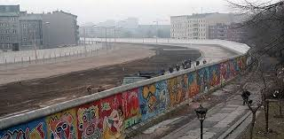
The
Berlin Wall

Slide 6
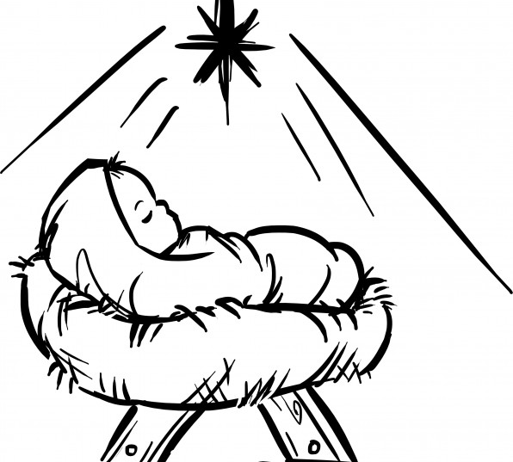
The birth of
Christ

Slide 7
TOE
4BC
Christ
TOE
11/9/1989
Priests

Slide 8
September 11, 2001

Slide 9
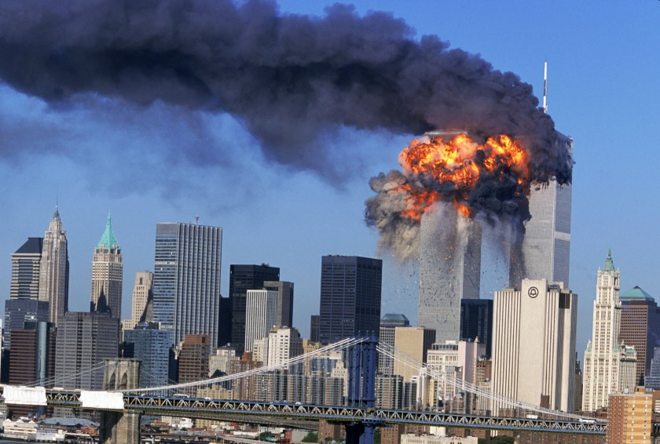
The
Twin Towers

Slide 10
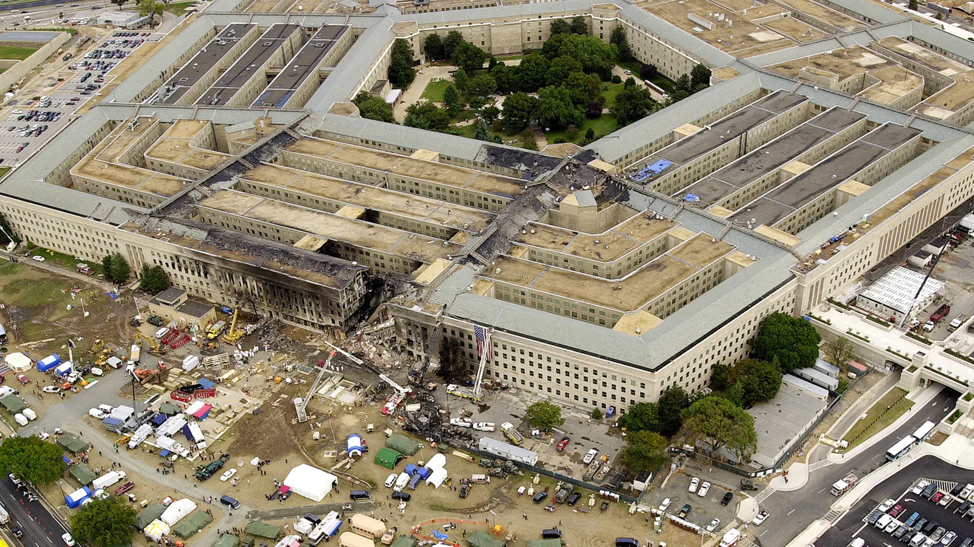
The
Pentagon

Slide 11
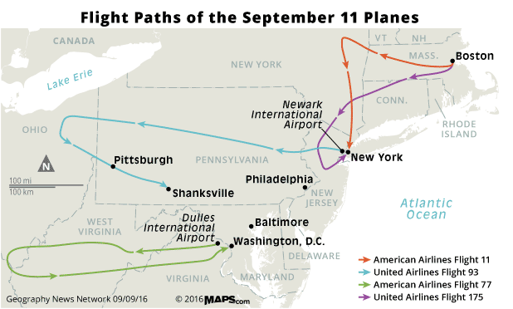
Hijacked planes map

Slide 12
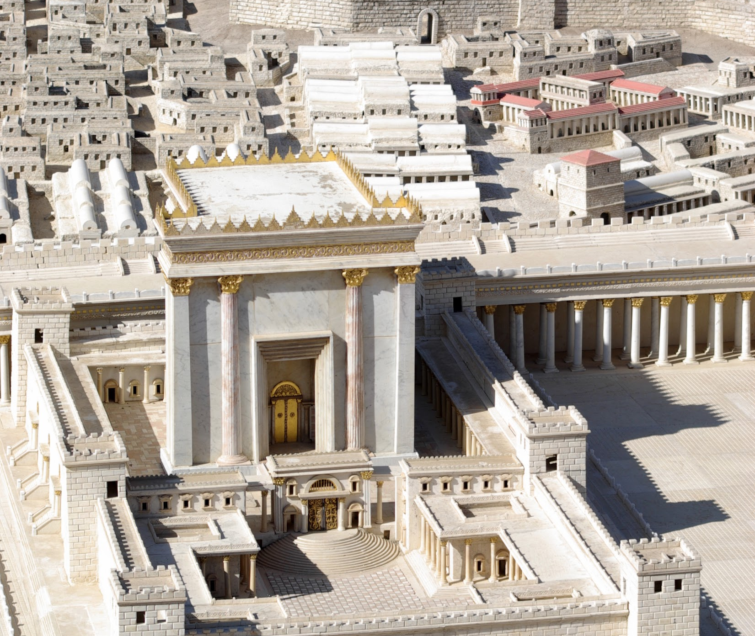
The temple in Christ’s day

Slide 13
TOE
4BC
Christ is 12
Christ
TOE
11/9/1989
9/11/2001
Priests

Slide 14
November 9, 2019

Slide 15
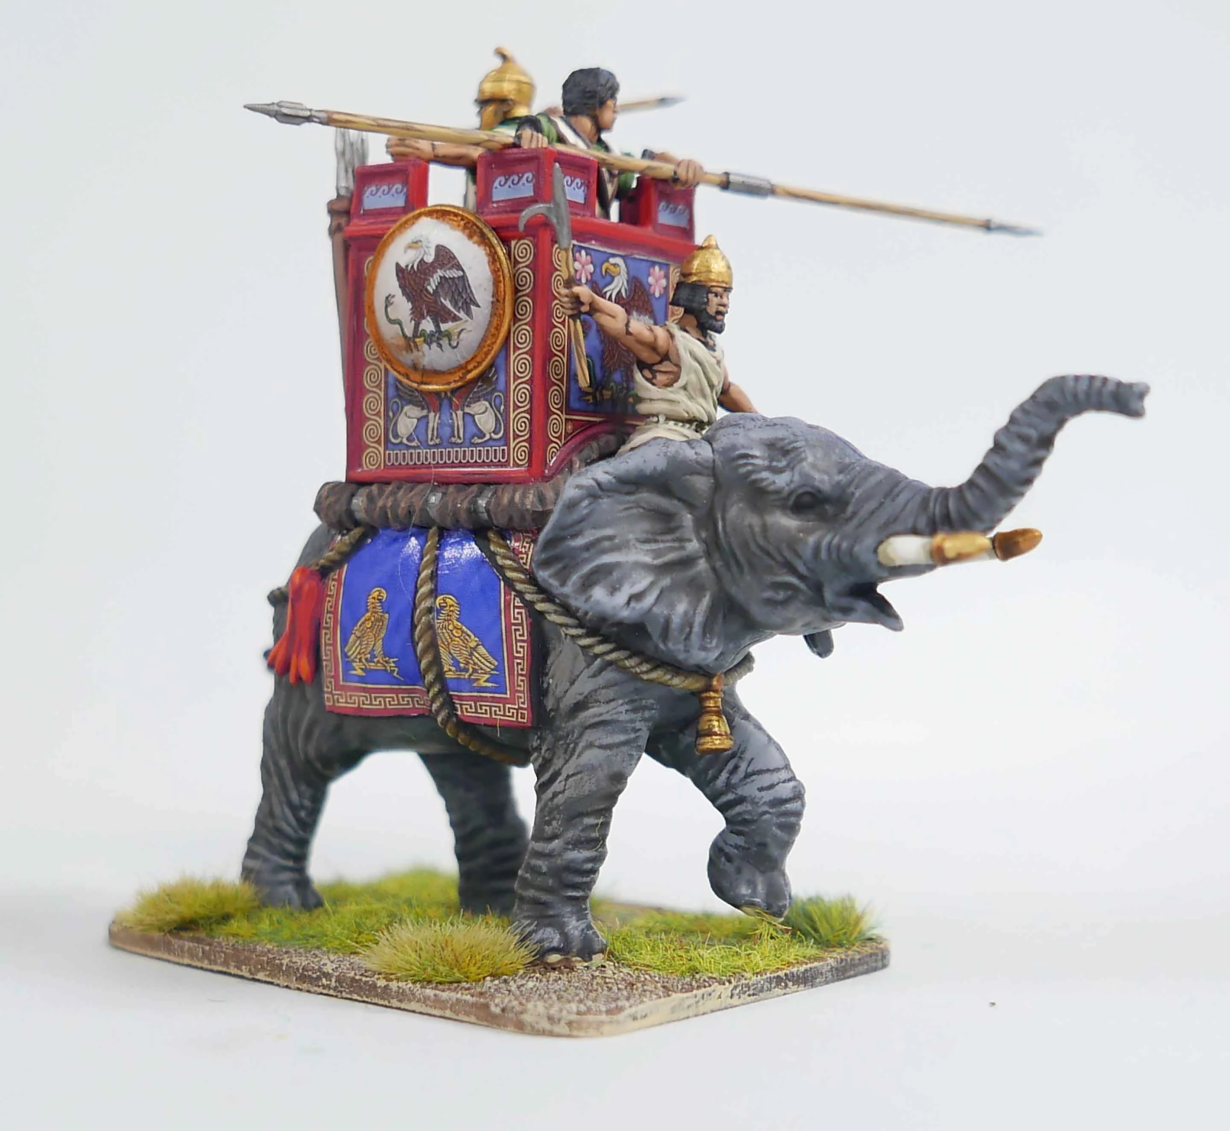
The battle of Raphia

Slide 16
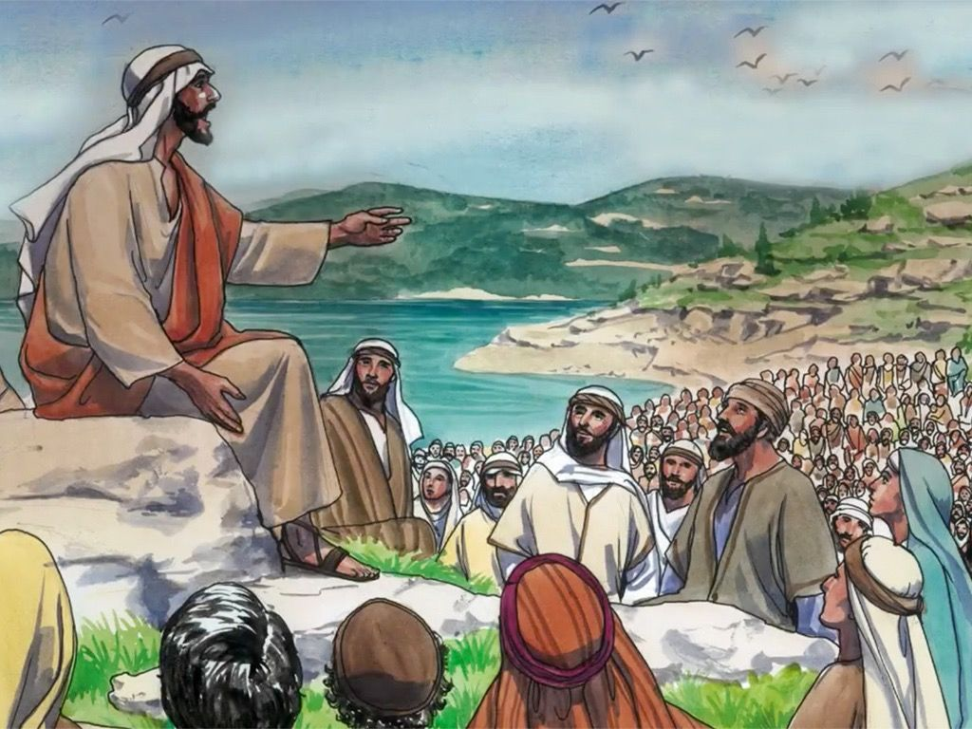
Jesus begins his public ministry

Slide 17
TOE
4BC
Christ is 12
Christ is 30
Christ
TOE
30 years
11/9/1989
9/11/2001
11/9/2019
Priests

Slide 19
Thank you for coming!
Contact us at:
youthprophecygroup@gmail.com
if you want notifications, notes, or recordings.

