Slide 1
WELCOME!
Youth Prophecy Group
10:00am PST
#3
Contact:
youthprophecygroup@gmail.com
For notes, questions, updates, and recordings

Slide 2
October 27, 2019
Meeting Three
We’re glad you’re here to share and discuss the Midnight Cry message.

Slide 3
Two Streams
Lesson Three

Slide 4
1989-2001

Slide 5
Internal
No new movement
No new leadership
Daniel 11:40-45
Line upon line
New leadership
New movement

Slide 6
External
USSR collapsed
USSR organized a fake collapse

Slide 7
1989
2001
2014
2019
2021
Daniel 11:40-45
Line upon line
New movement
Leadership

Slide 8
2001-2014

Slide 9
Internal
No 2520
No Time
No new messenger
2520
126
Time
New messenger

Slide 10
External
9/11 attack by Al Qaeda
President Barack Obama
9/11 planned by Bush and the CIA
Missile hit the Pentagon

Slide 11
1989
2001
2014
2019
2021
Time setting
Leadership

Slide 12
2014-2019

Slide 13
Internal
Future for America
No new leadership
“Thus Saith the Lord”
Midnight Cry message
New Leadership
The movement

Slide 14
External
President Trump
Republicans
Conservatives
Fox News
Conspiracy theories
Hillary Clinton
Democrats
Liberals
CNN

Slide 15
1989
2001
2014
2019
2021
Racism
Gender inequality
Conspiracy theories
Leadership

Slide 16
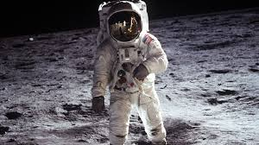
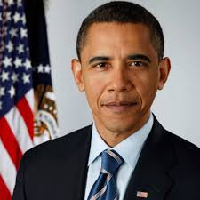
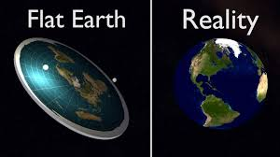
CONSPIRACY THEORIES

Slide 17
CNN was founded on June 1, 1980
CNN was the first TV channel to provide 24-hour news coverage
CNN was the first ALL news channel in the USA
The Persian Gulf war in 1991 was what pushed CNN past the “Big Three” (the major traditional commercial broadcast television networks in the USA- ABC, CBS, and NBC) because CNN was the only news outlet with the ability to communicate from inside Iraq during the initial hours of the Coalition bombing campaign.
CNN was the first cable news channel to break the news about the September 11th attacks.
2016 was CNN’s most watched year due to live coverage of the presidential election
To accommodate its worldwide audience, CNN banned words and phrases like “foreign” and “here at home”
Time Warner brought CNN in 1996
Fox News was founded on October 7, 1996
Fox News is conservative
The creator of Fox News hired a Republican Party media consultant as the CEO, the position he held until 2016.
Fox News is the dominant subscription news network in the USA
“Fox News has been described as practicing biased reporting in favor of the Republican Party, George W. Bush and Donald Trump administrations, and conservative causes while slandering the Democratic Party and spreading harmful propaganda intended to negatively affect its members' electoral performances.”

Slide 19
Thank you for coming!
Contact us at:
youthprophecygroup@gmail.com
if you want notes, questions,updates or recordings.

