Slide 1
WELCOME!
Youth Prophecy Group
10:00am PST
#4
Contact:
youthprophecygroup@gmail.com
For notes, questions, updates, and recordings

Slide 2
November 3, 2019
Meeting Four
We’re glad you’re here to share and discuss the Midnight Cry message.

Slide 3
Conspiracy Theories
Gender equality
three
tests
Racial equality

Slide 4
Revolutions
Lesson Four

Slide 5
The French Revolution
May 5, 1789 - November 9, 1799

Slide 6
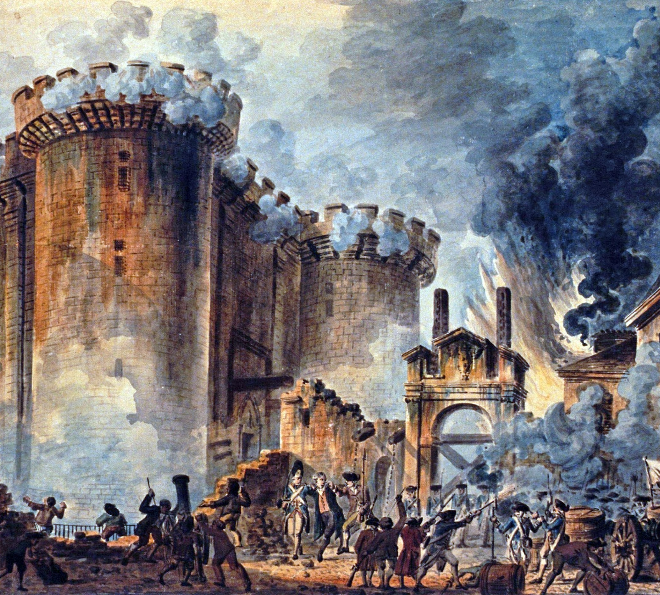
The French Revolution

Slide 7
French Revolution
11/9
1799
1789
Robespierre and others
overthrow the monarchy
Robespierre overthrown; Napoleon becomes a dictator on Ninth of Thermidor

Slide 8
The German Revolution
October 30, 1918 - November 9, 1918

Slide 9
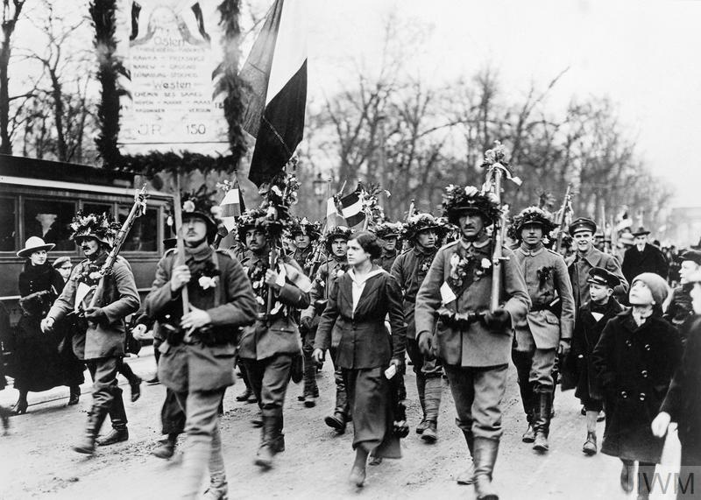
The German Revolution

Slide 10
German Revolution
10/30
1918
11/9
1918
Mutiny of German sailors
The Kaiser abdicates; end of the German monarchy

Slide 11
The Russian Revolution
March 8, 1917 - November 9, 1917

Slide 12
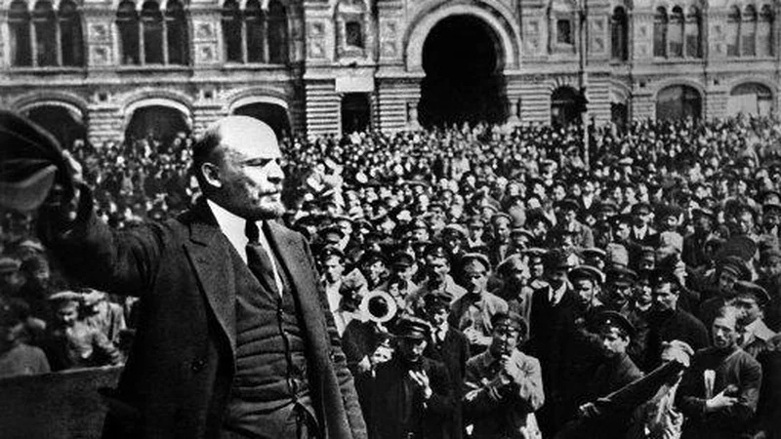
The Russian Revolution

Slide 13
Russian Revolution
3/8
1917
11/9
1917
11/7,8
1917
Strikes and protest begin
Bolsheviks storm the winter palace
October 27, 1917 on the Julian calendar; Lenin censors the press

Slide 14
The American Civil War
April 12, 1861 - April 9, 1865

Slide 15
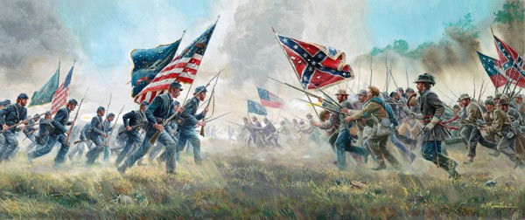
The American Civil War

Slide 16
American Civil War
4/12
1861
4/9
1865
Confederates
Attack
Union soldiers at Fort Sumter
Robert E. Lee surrenders
to Ulysses S. Grant

Slide 17
Our Revolution
September 11, 2001-November 9, 2019

Slide 18
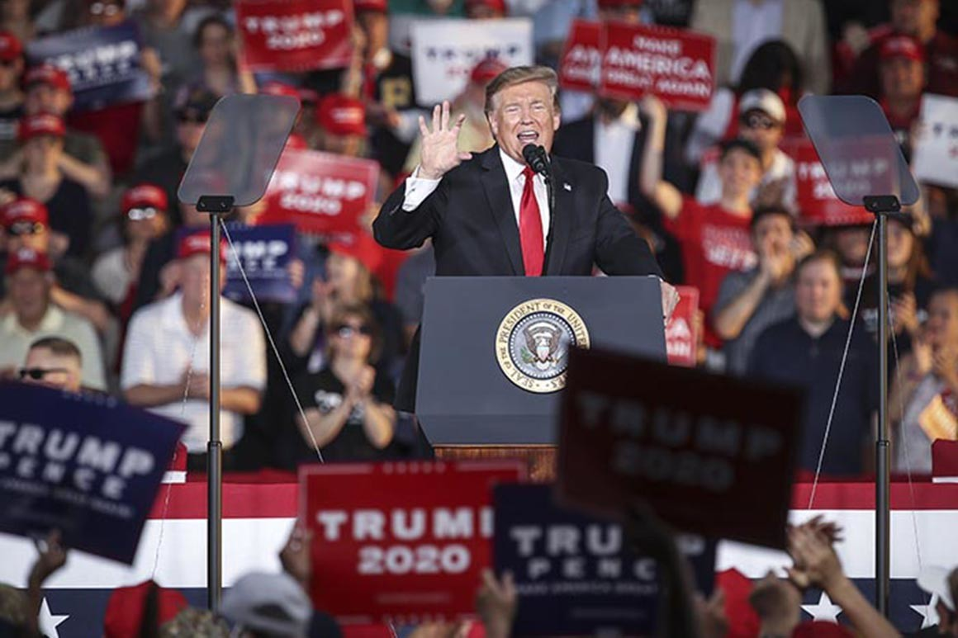
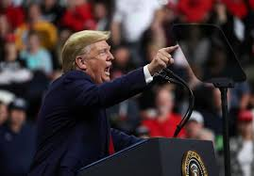
Our Revolution

Slide 19
Our Revolution
9/11
2001
11/9
2019
Revolution
Begins
Trump:
a less
Restrained
Dictator
End of
the Revolution

Slide 20
5/5/1789
11/9/1799
French Revolution
10/30/1918
11/9/1918
German Revolution
3/8/1917
11/9/1917
Russian Revolution
4/12/1861
4/9/1865
American Civil War
9/11/2001
11/9/2019
Our Revolution

Slide 22
Thank you for coming!
Contact us at:
youthprophecygroup@gmail.com
if you want notes, questions, updates or recordings.

