Slide 1
WELCOME!
Youth Prophecy Group
10:00am PST
#6
Contact:
youthprophecygroup@gmail.com
For notes, questions, updates, and recordings

Slide 2
November 17,2019
Meeting Six
We’re glad you’re here to share and discuss the Midnight Cry message.

Slide 3
The New World Order
Lesson Six

Slide 4
The World Power Systems
Multilateralism/ Globalism | Bilateralism | Unilateralism
When every country has an equal share of power on the world stage. | When only two countries have ALL the power. | When one country has ALL the power.

Slide 5
“A New World Order”
-Mikhail S. Gorbachev

Slide 6
Further world progress is now possible only through the search for a consensus of all mankind, in movement toward a new world order. We have arrived at a frontier at which controlled spontaneity leads to a dead end. The world community must learn to shape and direct the process in such a way as to preserve civilization, to make it safe for all and more pleasant for normal life. It is a question of cooperation that could be more accurately called "co-creation" and "co-development." The formula of development "at another's expense" is becoming outdated. In light of present realities, genuine progress by infringing upon the rights and liberties of man and peoples, or at the expense of nature, is impossible.

Slide 7
What did Gorbachev mean by “a new world order”?

Slide 8
MULTILATERALISM

Slide 9
“A New World Order”
-George H. W. Bush

Slide 10
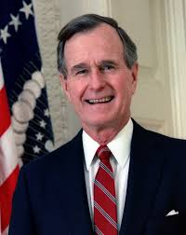
We stand today at a unique and extraordinary moment. The crisis in the Persian Gulf, as grave as it is, also offers a rare opportunity to move toward an historic period of cooperation. Out of these troubled times, our fifth objective — a new world order — can emerge: a new era — freer from the threat of terror, stronger in the pursuit of justice, and more secure in the quest for peace. An era in which the nations of the world, East and West, North and South, can prosper and live in harmony.

Slide 11
What did Bush mean by “a new world order”?

Slide 12
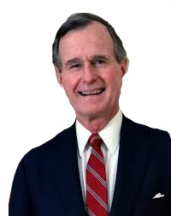
UNILATERALISM

Slide 13
1989
1991
Bilateralism
Unilateralism
USSR
1988
USA

Slide 14
November 9,
1989
January 17,
1991
George H.W. Bush’s
Unilateralism
Fall of the Berlin Wall
KOS deadly wound
Invasion of Iraq

Slide 15
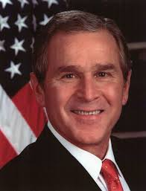
George W. Bush

Slide 16
What did Bush mean by “a new world order”?

Slide 17
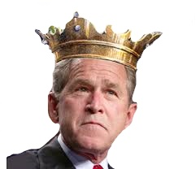
UNILATERALISM

Slide 18
2001
2003
George W. Bush’s
Unilateralism
Attack of Islam
Invasion of Iraq

Slide 19
A New World Order
-Donald J. Trump

Slide 20
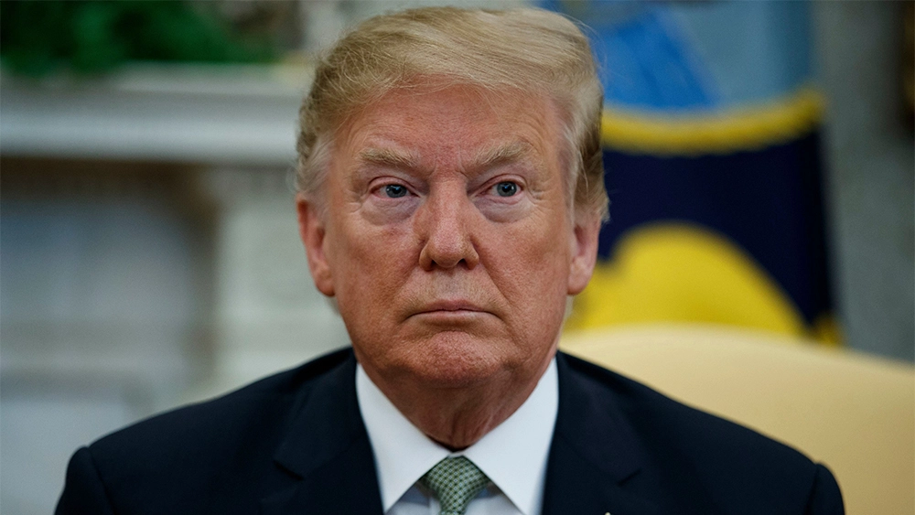
MAKE AMERICA GREAT AGAIN!!!

Slide 21
What does Trump’s New World Order look like?

Slide 22
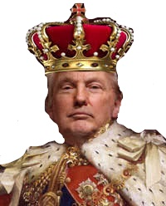
UNILATERALISM

Slide 23
2021
S/L
Bilateralism
Unilateralism
Russia
USA

Slide 24
What type of lateral world are we living in today, as in November 17, 2019?

Slide 25
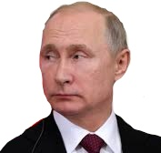
BILATERALISM

Slide 27
Thank you for coming!
Contact us at:
youthprophecygroup@gmail.com
if you want notifications, notes, or recordings.

