Slide 1
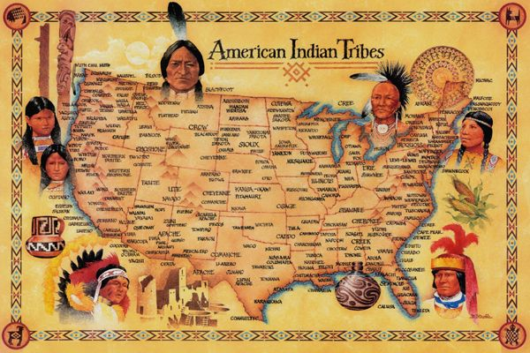
Freedom In America Part 5
Liberty and Equality
Part 3: Native Americans
https://www.docsoffreedom.org/readings/native-americans
Side Notes:
land grab
/ˈlan(d) ˌgrab/
noun
plural noun: land-grabs
an act of seizing land in an opportunistic or unlawful manner.
Land grabbing is a serious issue that affects the environment, economy, social welfare and human rights.

