Slide 1
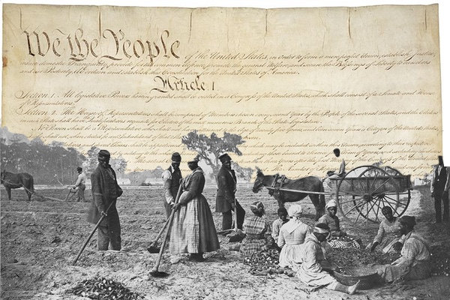
Freedom In America Part 5
Liberty and Equality
Part 4: Slavery and the Constitution
https://www.docsoffreedom.org/readings/slavery-and-the-constitution
Side Notes:

