Slide 1
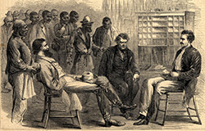
Freedom In America Part 5
Liberty and Equality
Part 5: Civil War and Reconstruction
https://www.docsoffreedom.org/readings/civil-war-and-reconstruction
Side Notes:

