Slide 1
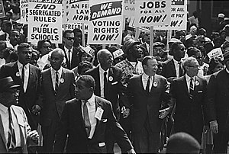
Freedom In America Part 5
Liberty and Equality
Part 6: The Civil Right Movement
https://www.docsoffreedom.org/readings/the-civil-rights-movement
Side Notes:

