Slide 1
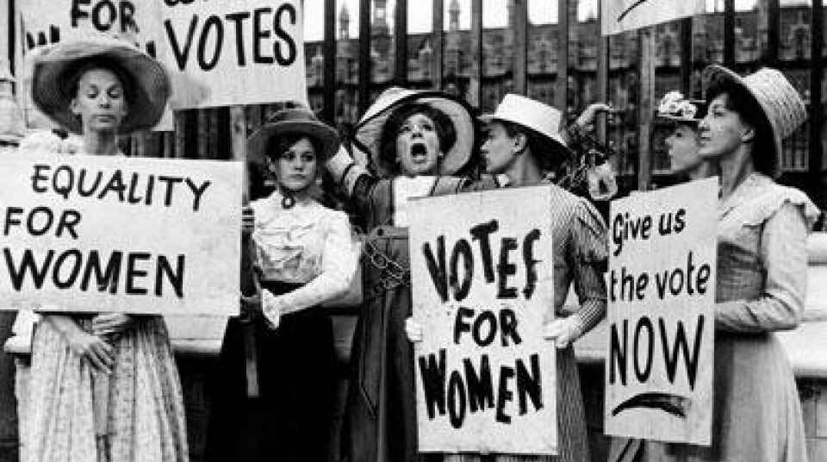
Freedom In America Part 5
Liberty and Equality
Part 7: Votes for Women
https://www.docsoffreedom.org/readings/votes-for-women
Side Notes:
“I long to hear that you have declared independence—and by the way in the new code of laws which I suppose it will be necessary for you to make I desire you would remember the ladies, and be more generous and favorable to them than your ancestors. Do not put such unlimited power into the hands of the husbands. Remember all men would be tyrants if they could. If particular care and attention is not paid to the ladies we are determined to foment a rebellion, and will not hold ourselves bound by any laws in which we have no voice, or representation” (Abigail Adams to John Adams, March 31, 1776)

