Slide 1
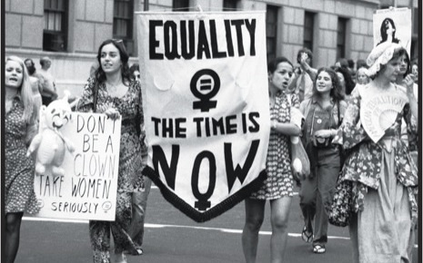
Freedom In America Part 5
Liberty and Equality
Part 8: Women’s Rights in the Late 20th Century
https://www.docsoffreedom.org/readings/women-s-rights-in-the-late-20th-century
Side Notes:
Notes:
8

