Slide 1
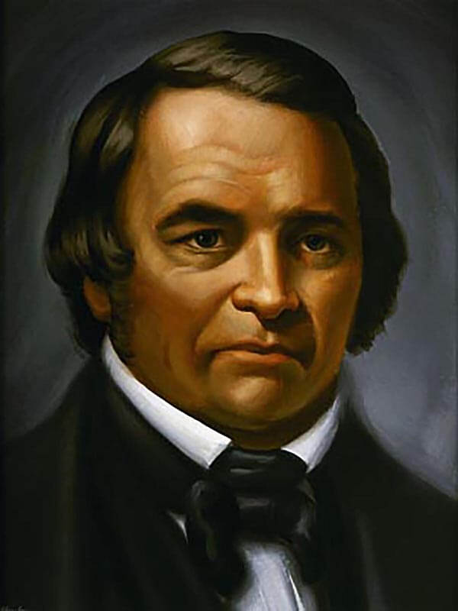
Miller’s 14 Rules for Bible Interpretation
William Miller, as a young man, was a deist. He believed that the Bible was a collection of mystical fables and contradictions. However during his service in the war of 1812, he realized that God intervened and saved his life and he was converted in 1816. He then became a serious Bible student.
William Miller, the Christian, wrote: “I was constrained to admit that the Scriptures must be a revelation from God. They became my delight; and in Jesus I found a friend. The Saviour became to me the chiefest among ten thousand; and the Scriptures, which before were dark and contradictory, now became the lamp to my feet and light to my path. My mind became settled and satisfied. I found the Lord God to be a Rock in the midst of the ocean of life. The Bible now became my chief study, and I can truly say, I searched it with great delight. I found the half was never told me.”
When challenged by his deist friends to prove that the Bible was the Word of God, Miller decided on two criteria:
1. If the Bible was the Word of God, it must be understandable from the obvious meaning of the language used.
2. If the Bible were the Word of God, it had to be consistent within itself. For two years Miller studied to satisfy himself concerning these two points.
THOSE WHO ARE ENGAGED IN PROCLAIMING THE THIRD ANGEL’S MESSAGE ARE SEARCHING THE SCRIPTURES UPON THE SAME PLAN THAT FATHER MILLER ADOPTED. {RH, 11-25-1884}
Notes:
https://www.aplib.org/periodical/william-miller-vol-1-number-2/

Slide 2
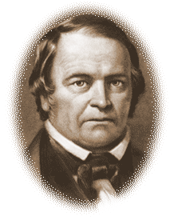
Miller’s 14 Rules for Bible Interpretation
After those two years of intensive Bible study, with no aids but his Cruden’s concordance, comparing Scripture with Scripture, he was perfectly satisfied that he could understand Scripture, that the Bible said what it meant, and meant what it said, and that the Bible was consistent with itself. In this process Miller became convinced from the study of the prophecies that Jesus would come to earth at the close of the 2300 days of Daniel 8:14 sometime in 1843 or 1844.
From 1816 – 1831 Miller farmed to support his family and continued studying. At age 49 he felt wholly unqualified for public speaking. He had a great struggle responding to God’s direct call to preach. Had it not been for the urging of the Holy Spirit,and his brethren, and the indications of unmistakable providences, he would never have entered a pulpit. But at last William Miller became a revivalist Adventist preacher.
From the first, his words were blessed in a remarkable manner to the salvation of souls. His first message was followed by a religious awakening. It was recognized that Miller could reach a class of minds not influenced by other men. In nearly every town in which he preached, scores, and in some, hundreds, were converted. Protestant churches of nearly all denominations were thrown open to him. The invitation to speak usually came from the ministers of the congregations. Miller had determined not to speak except by invitation. Before long, there were so many invitations, that he could not fill half of them.
THOSE WHO ARE ENGAGED IN PROCLAIMING THE THIRD ANGEL’S MESSAGE ARE SEARCHING THE SCRIPTURES UPON THE SAME PLAN THAT FATHER MILLER ADOPTED. {RH, 11-25-1884}
Notes:
https://www.aplib.org/periodical/william-miller-vol-1-number-2/

Slide 3
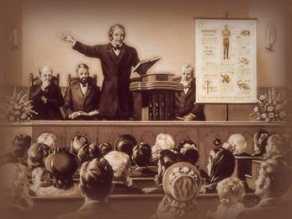
Miller’s 14 Rules for Bible Interpretation
In 1833, Miller was licensed to preach by his local Baptist church. Miller travelled and preached extensively in the New England and middle states. Initially he financed his ministry from his own purse. Later, he received some financial help, but it was never enough to meet travel expenses. Miller, his farm and his family, suffered financially during this period of his life.
In 1840, a group of ministers headed by William Miller signed their names to a call for a general conference on the second coming of the Lord Jesus Christ to be held October 13th at Boston.
Typhoid fever prevented Miller from attending. Among those who did attend were Joshua V. Himes (the church pastor where the conference was held), Henry Dana Ward, Henry Jones, Josiah Litch, and Joseph Bates.
THOSE WHO ARE ENGAGED IN PROCLAIMING THE THIRD ANGEL’S MESSAGE ARE SEARCHING THE SCRIPTURES UPON THE SAME PLAN THAT FATHER MILLER ADOPTED. {RH, 11-25-1884}
Notes:
https://www.aplib.org/periodical/william-miller-vol-1-number-2/

Slide 4
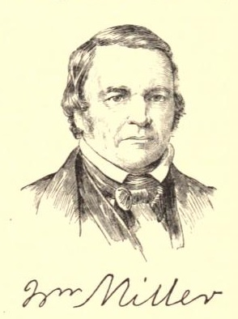
Miller’s 14 Rules for Bible Interpretation
Miller expected the Lord’s appearing sometime in the Jewish year of 1843, between March 21, 1843 and March 21, 1844. Interest and expectation of the Lord’s return continued up until the day of March 21st, 1844. But that day came and went with no visible return of Jesus. On May 2nd, six weeks after the fateful March 21st, Miller felt that the time had come to make a frank statement that there was an error in his preaching. He addressed a communication “To Second Advent Believers,” in which he said:“Were I to live my life over again, with the same evidence that I then had, to be honest with God and man I should have to do as I have done. … I confess my error, and acknowledge my disappointment; yet I still believe that the day of the Lord is near, even at the door; and I exhort you, my brethren, to be watchful, and not let the day come upon you unawares.”
Miller’s diary closes in 1844 with these words: “Now I have given, since 1832, three thousand two hundred lectures.” While laboring in Philadelphia in 1844, a friend gave the following description of Miller’s personal appearance: “There is a kindness of soul, simplicity, and power, peculiarly original, combined in his manner; and he is affable and attentive to all, without any affectation of superiority. He is of about medium stature, a little corpulent, and, in temperament, a mixture of sanguine and nervous. His intellectual developments are unusually full, and we see in his head great benevolence and firmness, united with a lack of self-esteem.”
THOSE WHO ARE ENGAGED IN PROCLAIMING THE THIRD ANGEL’S MESSAGE ARE SEARCHING THE SCRIPTURES UPON THE SAME PLAN THAT FATHER MILLER ADOPTED. {RH, 11-25-1884}
Notes:
https://www.aplib.org/periodical/william-miller-vol-1-number-2/

Slide 5
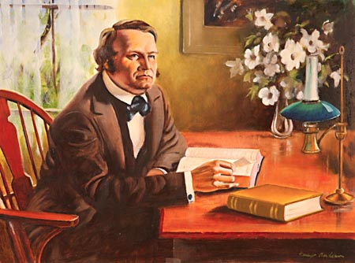
Miller’s 14 Rules for Bible Interpretation
Miller accepted the “seventh-month” date of October 22, 1844 only two or three weeks prior to the date, being persuaded by the evidence of the working of God’s Spirit in that movement. Though disappointed that day too, nevertheless he continued to hold fast his faith in the eminent second coming until his death.
The last five years of Miller’s life were spent preaching and writing of the expected Advent. Travel and speaking became more difficult due to illness. The last six months of life he was confined to bed; yet he died with hope undaunted. Miller did not accept the sanctuary truth. God in His great mercy and perfect knowledge saw that Miller’s rejection of this advanced light was not rebellion. Miller died in the hope of the Advent.
THOSE WHO ARE ENGAGED IN PROCLAIMING THE THIRD ANGEL’S MESSAGE ARE SEARCHING THE SCRIPTURES UPON THE SAME PLAN THAT FATHER MILLER ADOPTED. {RH, 11-25-1884}

Slide 6
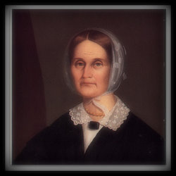
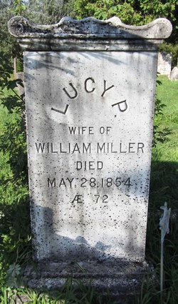
Miller’s 14 Rules for Bible Interpretation
Lucy Smith and her family lived in Poultney, Vermont, about 6 miles from the Miller home in Low Hampton, New York. There is little found in William Miller’s diary with regards to Lucy and her influence in his life, but on January 2, 1803, at age 20, he wrote, “Be it remembered that on this day, it being a Sunday in the afternoon of the aforesaid day, I did bind myself and was bound to be, the partner of Miss Lucy Smith, of Poultney.
And by these presents do agree to be hers and only hers till death shall part us (provided she is of the same mind). Whereunto I here set my hand and seal.” Evidently being “of the same mind”, they were married on Wednesday, June 29, 1803, and continued together until his death in 1849. They had 10 children, 8 of whom lived to adulthood.
Sylvester Bliss, in his memoirs of Miller, stated, “As Mrs. Lucy Miller is now living, all that might be said to her praise may not be said here. It is sufficient to state, that she was remarkably endowed, by nature and by her industrial and economical habits, to make domestic life highly agreeable, and to favor Mr. Miller’s promotion and success…”.
THOSE WHO ARE ENGAGED IN PROCLAIMING THE THIRD ANGEL’S MESSAGE ARE SEARCHING THE SCRIPTURES UPON THE SAME PLAN THAT FATHER MILLER ADOPTED. {RH, 11-25-1884}
Notes:
https://www.aplib.org/periodical/william-miller-vol-1-number-2/

Slide 7
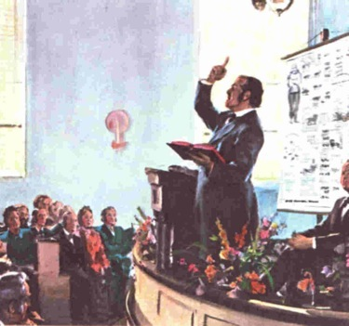
Miller’s 14 Rules for Bible Interpretation
Those who are engaged in proclaiming the third angel’s message are searching the Scriptures upon the same plan that Father Miller adopted. In the little book entitled “Views of the Prophecies and Prophetic Chronology,” Father Miller gives the following simple but intelligent and important rules for Bible study and interpretation: {RH November 25, 1884, par. 23}
“1. Every word must have its proper bearing on the subject presented in the Bible; 2. All Scripture is necessary, and may be understood by diligent application and study; 3. Nothing revealed in Scripture can or will be hid from those who ask in faith, not wavering; 4. To understand doctrine, bring all the scriptures together on the subject you wish to know, then let every word have its proper influence; and if you can form your theory without a contradiction, you cannot be in error; 5. Scripture must be its own expositor, since it is a rule of itself. If I depend on a teacher to expound to me, and he should guess at its meaning, or desire to have it so on account of his sectarian creed, or to be thought wise, then his guessing, desire, creed, or wisdom is my rule, and not the Bible.” {RH November 25, 1884, par. 24}
The above is a portion of these rules; and in our study of the Bible we shall all do well to heed the principles set forth. {RH November 25, 1884, par. 25}
THOSE WHO ARE ENGAGED IN PROCLAIMING THE THIRD ANGEL’S MESSAGE ARE SEARCHING THE SCRIPTURES UPON THE SAME PLAN THAT FATHER MILLER ADOPTED. {RH, 11-25-1884}
Notes:
These are some of the most important rules which I find the word of God warrants me to adopt and follow, in order for system and regularity. And if I am not greatly deceived, in so doing, I have found the Bible, as a whole, one of the most simple, plain, and intelligible books ever written, containing proof in itself of its Divine origin, and full of all knowledge that our hearts could wish to know or enjoy. I have found it a treasure which the world cannot purchase. It gives a calm peace in believing, and a firm hope in the future. It sustains the mind in adversity, and teaches us to be humble in prosperity. It prepares us to love and do good to others, and to realize the value of the soul. It makes us bold and valiant for the truth, and nerves the arm to oppose error. It gives us a powerful weapon to break down infidelity, and makes known the only antidote for sin. It instructs us how death will be conquered, and how the bonds of the tomb must be broken. It tells us of future events, and shows the preparation necessary to meet them. It gives us an opportunity to hold conversation with the King of kings, and reveals the best code of laws ever enacted.
This is but a faint view of its value; yet how many perishing souls treat it with neglect, or, what is equally as bad, treat it as a hidden mystery which cannot be known. Oh, my dear reader, make it your chief study. Try it well, and you will find it to be all I have said. Yes, like the Queen of Sheba, you will say the half was not told you.
The divinity taught in our schools is always founded on some sectarian creed. It may do to take a blank mind and impress it with this kind, but it will always end in bigotry. A free mind will never be satisfied with the views of others. Were I a teacher of youth in divinity, I would first learn their capacity and mind. If these were good, I would make them study the Bible for themselves, and send them out free to do the world good. But if they had no mind, I would stamp them with another’s mind, write bigot on their forehead, and send them out as slaves!

