Slide 1
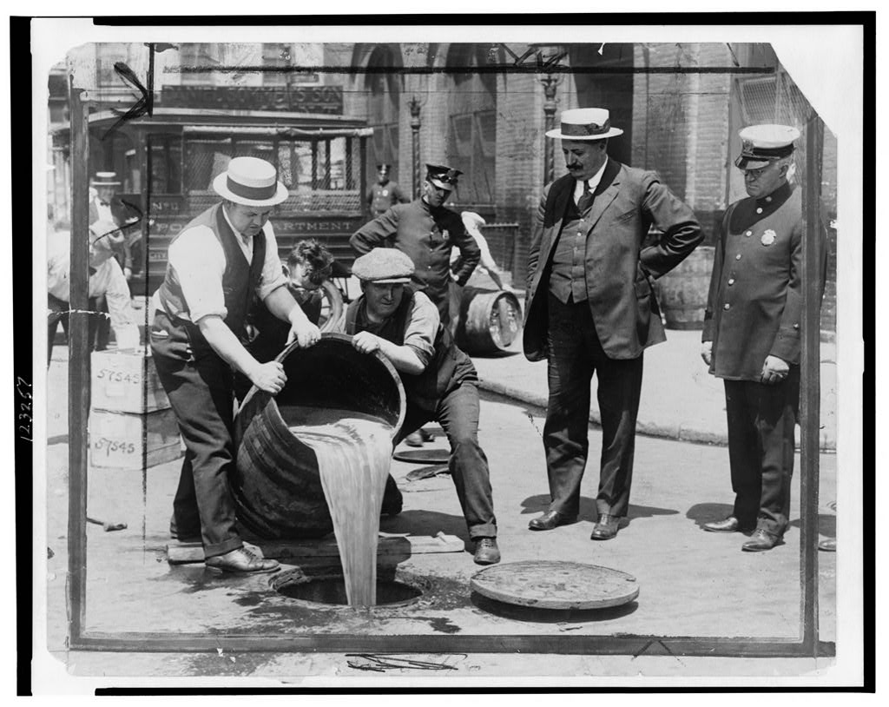
Freedom In America Part 8
Our Commercial Republic
Part 1: Unit Overview
https://www.docsoffreedom.org/units/our-commercial-republic
Side Notes:

