Slide 1
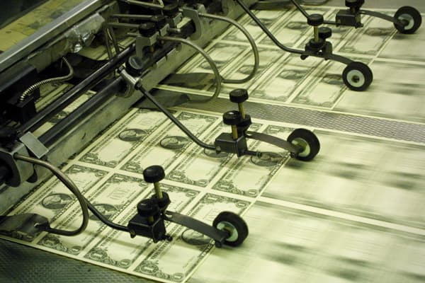
Freedom In America Part 8
Our Commercial Republic
Part 2: The Origins of Commercial Republic
https://www.docsoffreedom.org/readings/origins-of-our-commercial-republic
Side Notes:

