Slide 1
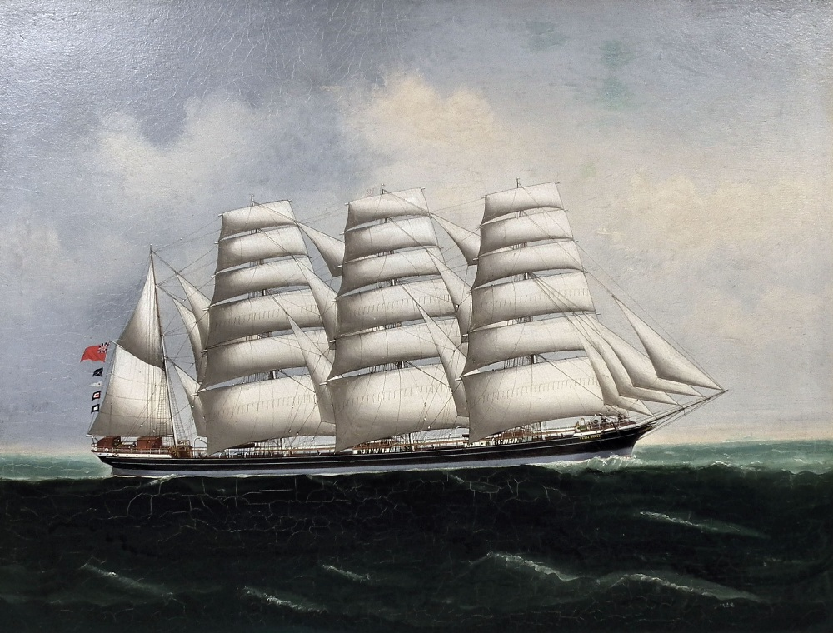
Freedom In America Part 8
Our Commercial Republic
Part 3: The Early Commercial Republic, 1789-1815
https://www.docsoffreedom.org/readings/the-early-commercial-republic
Side Notes:

