Slide 1
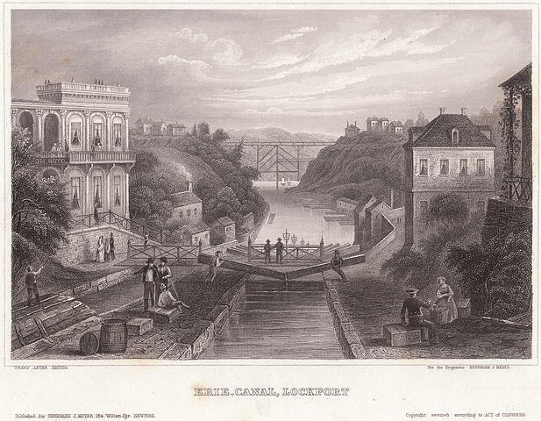
Freedom In America Part 8
Our Commercial Republic
Part 4: The Commercial Republic Before the Civil War, 1815-1860
https://www.docsoffreedom.org/readings/the-commercial-republic-before-the-civil-war
Side Notes:

