Slide 1
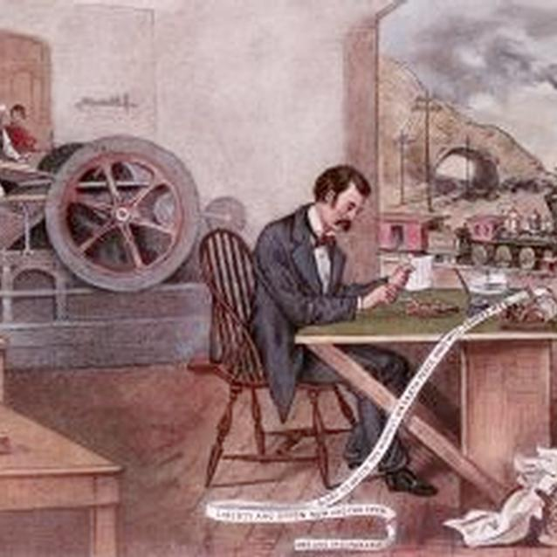
Freedom In America Part 8
Our Commercial Republic
Part 5: The Civil War and the Industrial Revolution
https://www.docsoffreedom.org/readings/the-civil-war-and-the-industrial-revolution
Side Notes:

